Slide 1
Neighbourhood-based metaheuristics for the Set Covering Problem
THE TASK
Design simulated annealing and tabu search for the SCP and show how their parameters and building blocks change quality and effort.
CH3 + RE → SA | TS
vs. the local search of Assignment 2
Assignment 3 · Heuristic Optimization
Group 11:
Artur Santoalha
Kirill Savin
1.0 %
TS deviation from the best
known (SA 1.3 %, local
search 2.7–2.9 %)
9,548
runs in 7 experiments,
tuned on 14 instances,
final test on all 42
2
metaheuristics on one
neighbourhood, RE after
every move

Slide 2
Design: two metaheuristics, one neighbourhood
Same start, same move, same budget – only the way of escaping local optima differs.
Common to both
Start: CH3 + RE (same seed → identical start)
Move: drop one selected set, repair it greedily, then RE after every move
Cost: incremental update, tried moves are undone from a log
Budget: 3000 evaluated neighbours (about 0.25 s)
Result: best cover found
SA
Simulated annealing
parameters: p₀, α, L
Random neighbour, accepted with exp(−Δ/T) if worse
T₀ calibrated: an average worsening move is accepted with probability p₀
Geometric cooling T ← αT every L evaluations
TS
Tabu search
parameters: tenure, k, aspiration, λ
Sample k neighbours, take the best admissible one – even if worse
Tabu: removed sets may not return, added sets may not be dropped for a tenure
Aspiration; frequency-based long-term memory
Building blocks under test RE after every move · randomised repair (GRASP-like restricted candidate list) · initial solution · aspiration · tabu attribute · dynamic tenure · long-term memory · computation budget.

Slide 3
Experimental design
Full factorial grids for the parameters, one factor at a time for the building blocks, a confirmation step and a final test.
Study | Factors and levels | Instances · seeds | Runs
A SA parameters | p₀ (6) × cooling α (3) × epoch L (4): 72 configurations | 14 tuning · 3 seeds | 3,024
B TS parameters | tenure (6) × sub-neighbourhood k (5): 30 configurations | 14 tuning · 3 seeds | 1,260
C Building blocks | RE per move, repair randomisation, start, aspiration, tabu attribute, dynamic tenure, memory λ (+ RE at equal CPU) | 14 tuning · 5 seeds | 2,240
F Confirmation | promising changes of study C, tested on the held-out instances | 28 held-out · 5 new seeds | 840
D Budget | 1000 – 30000 evaluations (SA with fixed and with scaled cooling, TS) | 14 tuning · 3 seeds | 504
E Final comparison | TS, SA, FI, BI – sequential, clean CPU times | all 42 · 10 new seeds | 1,680
Measures
Effectiveness: % deviation from the best known solution. Efficiency: evaluated neighbours (budget), CPU time, anytime behaviour.
Statistics
ANOVA with the instance as block (partial η²), Friedman test, Wilcoxon signed-rank with Holm correction on instance means; paired by the common start.
Raw data
All 9,548 runs in raw_data_NN3.xlsx and raw_data_NN3.txt (+ instance-level matrix of the final tests).

Slide 4
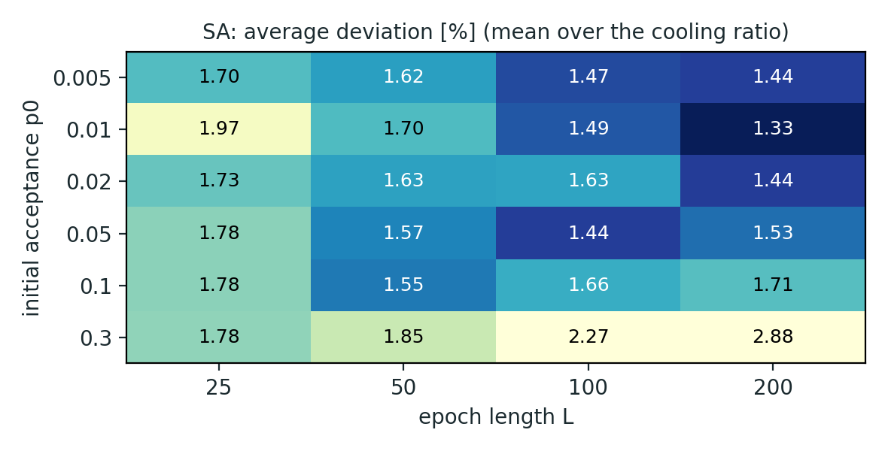
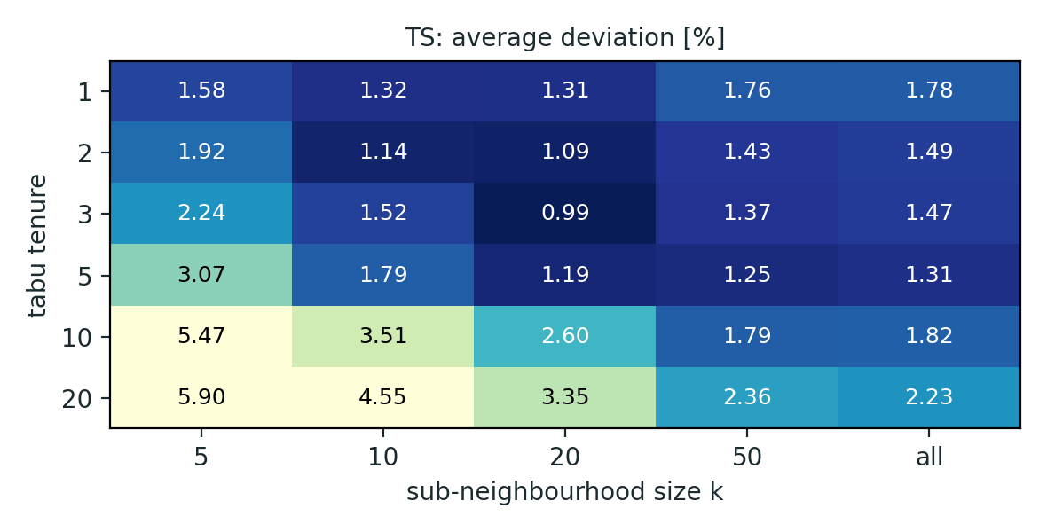
What matters: the parameters
Average deviation [%] on the tuning instances (3 seeds per cell); darker = better.
SA: start cold, the rest is a plateau
p₀ has the largest effect (η²ₚ = 0.049); α alone is not significant (0.0005)
a hot start with slow cooling never cools down: p₀ = 0.3, α = 0.98, L = 200 gives 3.7 % vs. 1.27 % for the best (p₀ = 0.01, α = 0.95, L = 200)
the six best configurations are statistically tied; best acceptance rate 10–15 %
TS: short tenure, k ≈ 20
tenure (η²ₚ = 0.33), k (0.22) and their interaction (0.18) all matter
tenure ≥ 10 freezes the cover: 3.4 % vs. 1.6 % for tenure ≤ 5
best: tenure 3, k = 20 (0.99 %); the whole neighbourhood allows 2.6× fewer iterations and is worse at this tenure

Slide 5
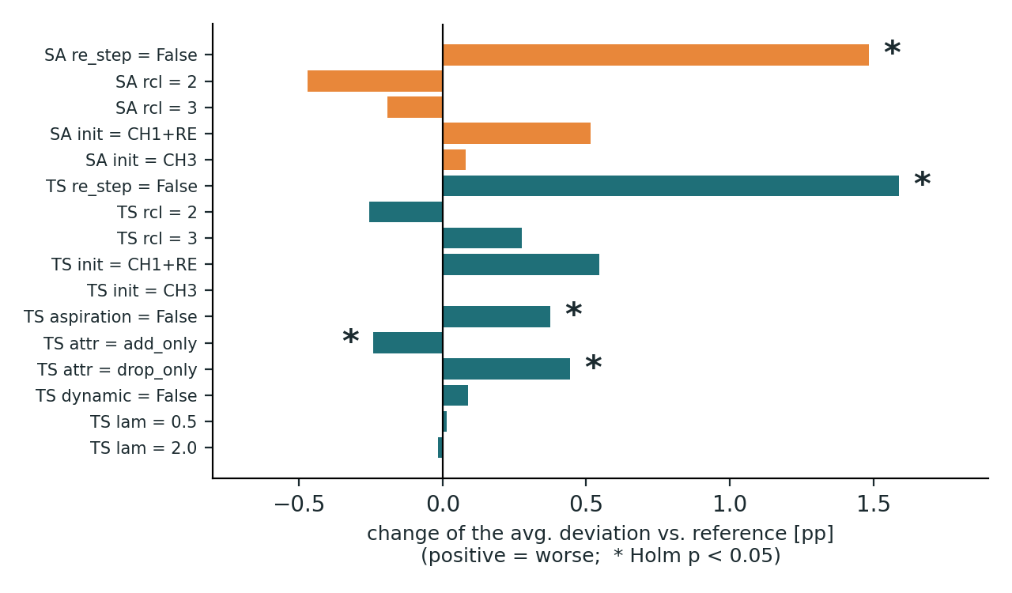
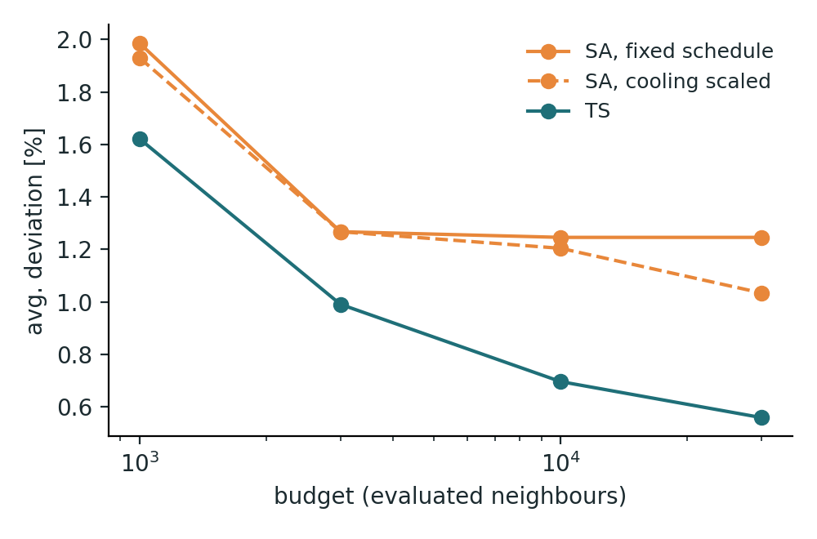
Building blocks and budget
One factor at a time around the best configuration (tuning instances, 5 seeds); confirmation on the 28 held-out instances.
RE after every move pays off
Without it +1.5 / +1.6 pp (SA / TS) although a move is ~40 % cheaper. At equal CPU time still +1.3 / +1.4 pp (Holm p < 0.005).
Winner’s curse
add_only tabu attribute and rcl = 2 looked better on the tuning set, but not on the held-out instances (Holm p ≥ 0.35). Nothing adopted: final = grid winners.
TS scales with the budget
TS 1.62 → 0.56 % from 1k to 30k evaluations; SA with a fixed schedule saturates at 1.25 %, with scaled cooling it reaches 1.03 %.

Slide 6
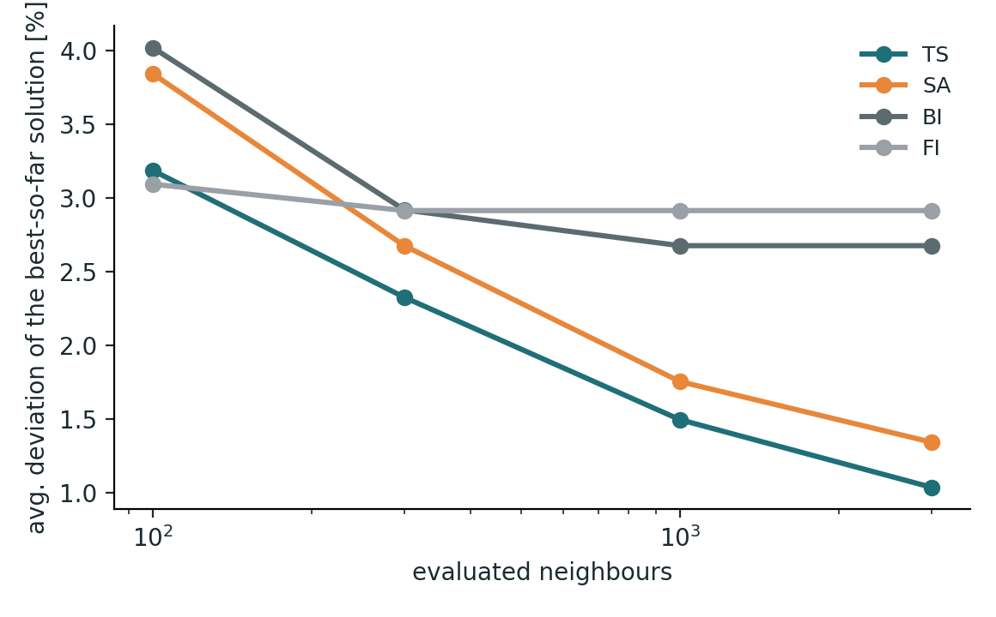
TS vs. SA vs. local search
Final comparison: all 42 instances, 10 seeds, same CH3 + RE start for every algorithm; budget 3000 evaluations for TS and SA.
Algorithm | Dev. (42) | Held-out (28) | Best of 10 | Best known reached | CPU / run
TS | 1.04 % | 0.96 % | 0.41 % | 25 / 42 | 0.228 s
SA | 1.34 % | 1.26 % | 0.69 % | 19 / 42 | 0.222 s
BI | 2.67 % | 2.54 % | 1.23 % | 8 / 42 | 0.016 s
FI | 2.91 % | 2.73 % | 1.41 % | 7 / 42 | 0.008 s
Friedman p = 2e-19; mean ranks TS 1.35, SA 1.89, BI 3.08, FI 3.68. TS beats SA on 28 instances, loses on 7; every pair is significant after Holm correction.
Equal effort
After 100 evaluations FI is still ahead; after 300 both TS (2.3 %) and SA (2.7 %) have reached the final quality of FI and BI (2.7–2.9 %).
Why TS > SA
A random drop-and-repair neighbour is mostly bad (10–15 % accepted). TS takes the best of 20 sampled neighbours in every iteration, and its tabu list prevents cycling.
Price and gain
14–29× the CPU time of FI / BI, but the error is halved and the spread over seeds is less than half.

Slide 7
Conclusions
What the experiments show, and what we would do next.
1.0 / 1.3 %
SA: start cold
TS: tenure 3, k = 20
TS and SA halve the error of the local search (2.7–2.9 %); TS is significantly better than SA.
Low p₀ (0.01–0.05), acceptance 10–15 %; cooling ratio and epoch form a flat plateau.
Short tabu list and a sampled neighbourhood; long tenures and tiny samples are bad.
RE every move
Confirm, don’t assume
Budget
−1.5 to −1.6 pp, also at equal CPU time – the most important building block.
Tuning-set gains of repair randomisation and tabu attribute vanished on held-out instances.
TS keeps improving with more evaluations; SA needs a cooling schedule that scales with the budget.
Recommendation Use tabu search (tenure 3, k = 20, RE after every move): 1.04 % on average, 25 of 42 best known values reached, 0.23 s per run. Next: richer neighbourhoods (several dropped sets, VNS-style shaking), restarts, parameters per instance class. Data and code: raw_data_NN3.xlsx / .txt and NN3.ipynb.

