Slide 1
Neighbourhood-based metaheuristics for the Set Covering Problem
THE TASK
Design simulated annealing and tabu search for the SCP and show how their parameters and building blocks change quality and effort.
CH3 + RE → SA | TS
vs. the local search of Assignment 2
Assignment 3 · Heuristic Optimization
Group 11:
Artur Santoalha
Kirill Savin
1.04 %
TS deviation from the best
known (SA 1.34 %, local
search 2.7–2.9 %)
9,548
runs in 7 experiments,
tuned on 14 instances,
final test on all 42
2
metaheuristics on one
neighbourhood, RE after
every move

Slide 2
Design: two metaheuristics, one neighbourhood
Same start, same move, same budget – only the way of escaping local optima differs.
Common to both
Start: CH3 (Look at every candidate set that still covers something new → Add the one with the lowest cost ÷ newly covered elements) + RE (same seed → identical start)
Move: drop one selected set, repair it greedily, then RE after every move
Cost: incremental update, tried moves are undone from a log
Budget: 3000 evaluated neighbours (about 0.25 s)
Result: best cover found
Simulated annealing
SA
p_0 - Initial probability of accepting an average worsening move in SA.
alpha - Cooling multiplier in SA.
L - Number of evaluations between cooling steps.
Explores one randomly selected neighbor at a time and may accept a worse solution with a probability that decreases as the temperature falls.
  Random neighbour, accepted with exp(−Δ/T) if worse
  T₀ calibrated: an average worsening move is accepted with probability p₀
  Geometric cooling T ← αT every L evaluations
Tabu search
TS
tenure - How long a tabu restriction remains active.
k - Number of candidate neighbors sampled in each TS iteration.
lambda - Strength of the long-term frequency penalty in TS.
Samples k neighbors, chooses the best admissible one, and can move to a worse solution to escape a local optimum. Its tabu memory discourages cycling back to recent moves
  Sample k neighbours, take the best admissible one – even if worse
  Tabu: removed sets may not return, added sets may not be dropped for a tenure
  Aspiration; frequency-based long-term memory
Building blocks under test RE after every move · randomised repair (GRASP-like restricted candidate list) · initial solution · aspiration · tabu attribute · dynamic tenure · long-term memory · computation budget.

Slide 3
Experimental design
Full factorial grids for the parameters (tune the algorithms), one factor at a time for the building blocks (investigate their components), examination of computational effort, a confirmation step for promising changes and a final comparison of the methods.
Study | Factors and levels | Instances · seeds | Runs
A SA parameters | p₀ (6) × cooling α (3) × epoch L (4): 72 configurations | 14 tuning · 3 seeds | 3,024
B TS parameters | tenure (6) × sub-neighbourhood k (5): 30 configurations | 14 tuning · 3 seeds | 1,260
C Building blocks | RE per move, repair randomisation, start, aspiration, tabu attribute, dynamic tenure, memory λ (+ RE at equal CPU) | 14 tuning · 5 seeds | 2,240
D Budget | 1000 – 30000 evaluations (SA with fixed and with scaled cooling, TS) | 14 tuning · 3 seeds | 504
E Confirmation | promising changes of study C, tested on the held-out instances | 28 held-out · 5 new seeds | 840
F Final comparison | TS, SA, FI, BI – sequential, clean CPU times | all 42 · 10 new seeds | 1,680
Measures
Effectiveness: % deviation from the best known solution. Efficiency: evaluated neighbours (budget), CPU time, anytime behaviour.
Statistics
ANOVA with the instance as block (partial η²), Friedman test, Wilcoxon signed-rank with Holm correction on instance means; paired by the common start.
Raw data
All 9,548 runs in the raw data (+ instance-level matrix of the final tests).

Slide 4
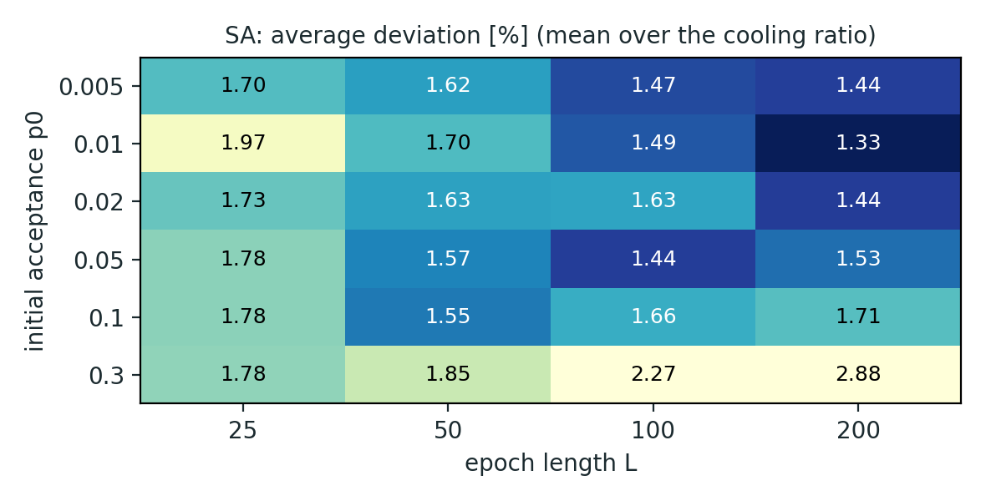
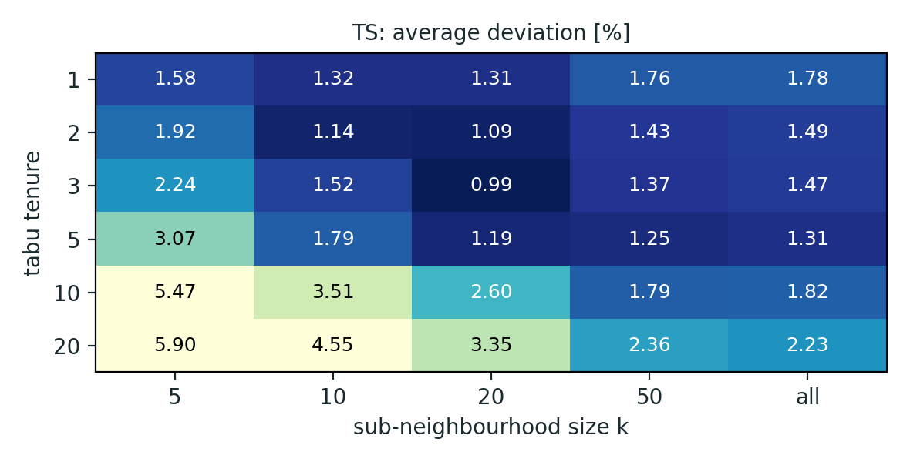
What matters: the parameters
Average deviation [%] on the tuning instances (3 seeds per cell); darker = better.
SA: The initial acceptance setting has the greatest impact; starting cold performs best, while the remaining settings yield broadly similar results
p₀ has the largest effect (η²ₚ = 0.049); α alone is not significant (0.0005)
a hot start with slow cooling never cools down: p₀ = 0.3, α = 0.98, L = 200 gives 3.7 % vs. 1.27 % for the best (p₀ = 0.01, α = 0.95, L = 200)
the six best configurations are statistically tied; best acceptance rate 10–15 %
TS: Both tenure and neighborhood sample size matter; a short tenure and k ≈ 20 appear to offer the best performance
tenure (η²ₚ = 0.33), k (0.22) and their interaction (0.18) all matter
tenure ≥ 10 freezes the cover: 3.4 % vs. 1.6 % for tenure ≤ 5
best: tenure 3, k = 20 (0.99 %); the whole neighbourhood allows 2.6× fewer iterations and is worse at this tenure

Slide 5
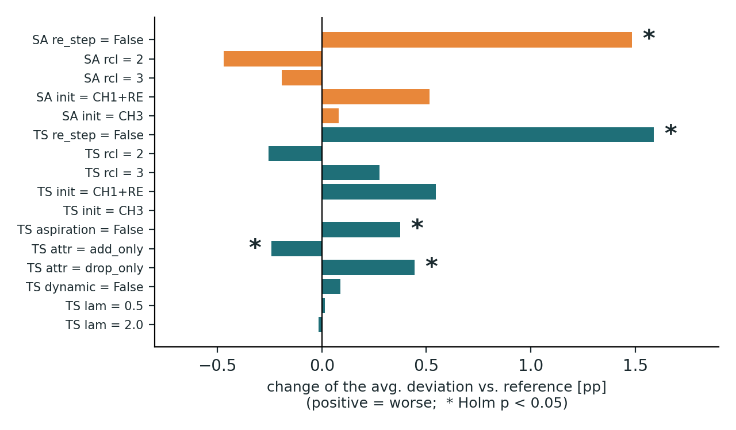
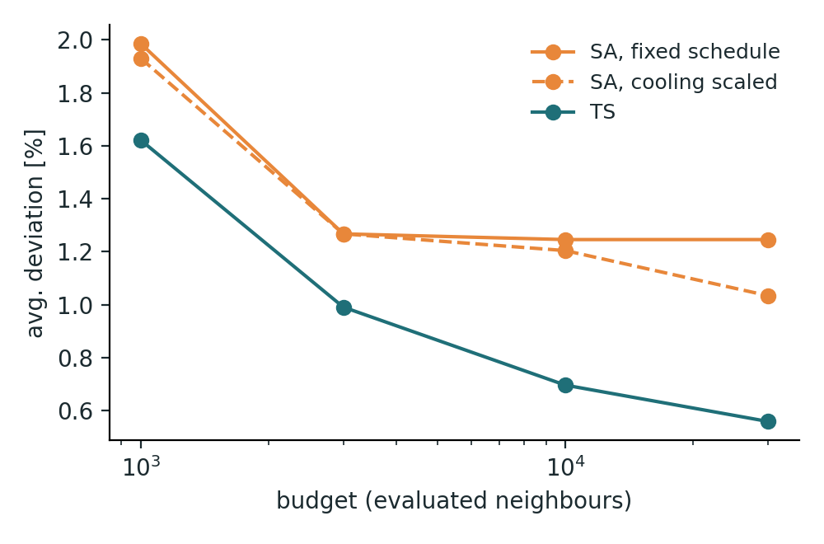
Building blocks and budget
One factor at a time around the best configuration (tuning instances, 5 seeds); confirmation on the 28 held-out instances.
RE after every move pays off
Without RE, deviation increases by +1.5 / +1.6 pp (SA / TS), despite moves being ~40 % cheaper. At equal CPU time, the increase reamains +1.3 / +1.4 pp (Holm p < 0.005).
Winner’s curse
The add_only tabu attribute and rcl = 2 looked better on the tuning set, but not on the held-out instances (Holm p ≥ 0.35). Neither was adopted; the final configuration uses the grid-search winners.
TS scales with the budget
TS deviation falls from 1.62% to 0.56% as the budget increases from 1k to 30k evaluations. SA with a fixed schedule saturates at 1.25%, while scaled cooling reaches 1.03%.

Slide 6
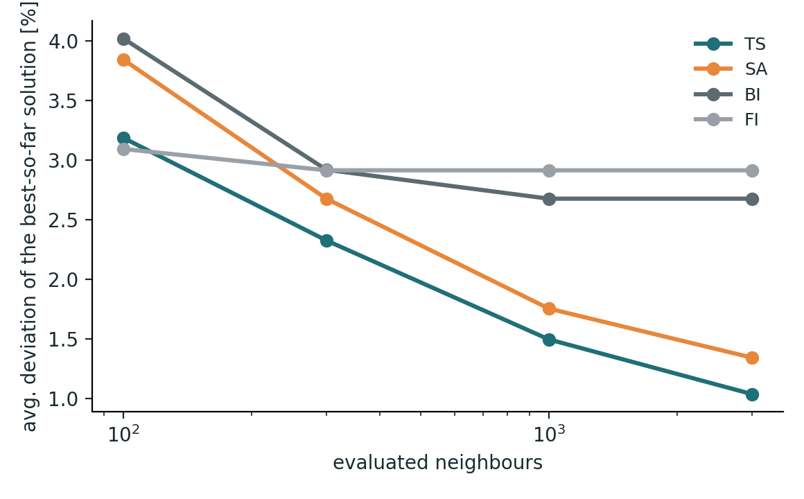
TS vs. SA vs. local search
Final comparison: all 42 instances, 10 seeds, same CH3 + RE start for every algorithm; budget 3000 evaluations for TS and SA.
Algorithm | Dev. (42) | Held-out (28) | Best of 10 | Best known reached | CPU / run
TS | 1.04 % | 0.96 % | 0.41 % | 25 / 42 | 0.228 s
SA | 1.34 % | 1.26 % | 0.69 % | 19 / 42 | 0.222 s
BI | 2.67 % | 2.54 % | 1.23 % | 8 / 42 | 0.016 s
FI | 2.91 % | 2.73 % | 1.41 % | 7 / 42 | 0.008 s
Friedman p = 2e-19 → indicates at least one algorithm differs statistically from the others; mean ranks TS 1.35, SA 1.89, BI 3.08, FI 3.68. TS beats SA on 28 instances, loses on 7; every pair is significant after Holm correction (useful to investigate which pairs differ).
Equal effort
After 100 evaluations FI is still ahead; after 300 both TS (2.3 %) and SA (2.7 %) have reached the final quality of FI and BI (2.7–2.9 %).
Why TS > SA
A random drop-and-repair neighbour is mostly bad (10–15 % accepted). TS takes the best of 20 sampled neighbours in every iteration, and its tabu list prevents cycling.
Price and gain
14–29× the CPU time of FI / BI, but the error is halved and the spread over seeds is less than half.

Slide 7
Conclusions
What the experiments show, and what we would do next.
1.04 / 1.34 %
SA: start cold
TS: tenure 3, k = 20
TS and SA halve the error of the local search (2.7–2.9 %); TS is significantly better than SA.
Low p₀ (0.01–0.05), acceptance 10–15 %; cooling ratio and epoch form a flat plateau.
Short tabu list and a sampled neighbourhood; long tenures and tiny samples are bad.
RE every move
Confirm, don’t assume
Budget
−1.5 to −1.6 pp, also at equal CPU time – the most important building block.
Tuning-set gains of repair randomisation and tabu attribute vanished on held-out instances.
TS keeps improving with more evaluations; SA needs a cooling schedule that scales with the budget.
Recommendation Use tabu search (tenure 3, k = 20, RE after every move): 1.04 % on average, 25 of 42 best known values reached, 0.23 s per run. Next: richer neighbourhoods (several dropped sets, VNS-style shaking), restarts, parameters per instance class.

