Slide 1
Constructive heuristics for the Set Covering Problem
THE PROBLEM
Choose sets of minimum total cost so that every element is covered.
minimise Σ wⱼ xⱼ
every element in at least one selected set, xⱼ ∈ {0, 1}
Assignment 1 · Heuristic Optimization
Group 11:
Artur Santoalha
Kirill Savin
42
OR-Library benchmark
instances (sets 4, 5, 6, A–D)
3
dynamic constructive
heuristics, each with and
without RE
+1
neighbourhood search
started from the
constructed covers

Slide 2
Three dynamic constructive heuristics
The purpose is to create three different constructive strategies with increasing use of information
In each CH, every step adds one set; scores are recomputed from the current partial solution
CH1
CH2
CH3
Random element, random set
Random element, best set
Best set overall
Look at every candidate set that still covers something new
Add the one with the lowest cost per new additional element added (cost ÷ newly covered elements)
In comparison to CH2, the difference is where the choice starts -> CH3 is more globally greedy
Pick a random uncovered element
Add a random set that covers it
Repeat until all elements are covered
Does not use optimization of the cost/coverage ratio to select
Pick a random uncovered element (CH1)
Add the covering set with the lowest cost per new additional element added (cost ÷ newly covered elements)
It keeps randomness (choice of uncovered element) BUT it adds an Element-driven greedy criterion for the set selection
The baseline – Deliberate Randomness
Chvátal’s greedy rule element
Dynamic bookkeeping Adding a set updates the uncovered list and the “still uncovered” count of every affected set – only what changed is touched. A set with nothing new to cover is not considered for the candidate list, so no fully redundant set is ever added.

Slide 3
From a feasible solution to a better feasible solution
Three stages, all built on the same incrementally updated state.
1
Construct
2
Redundancy elimination (RE)
3
Neighbourhood search
CH1, CH2 or CH3 builds a complete feasible solution (that ensures every element is covered).
Scan the chosen sets, most expensive first, and drop any set whose elements are all covered by others. One pass is enough.
Move: drop one set, repair greedily without it (if dropping one set creates uncovered elements), then RE. Take improving moves (first or best improvement) until none is left.
Incremental evaluation
Each add or remove updates coverage counts, the uncovered list and per-set scores for the touched elements only. Tried moves are undone from a log – the state is never copied.
Checked, not assumed
After every run the cover, its cost and (after RE) its minimality are recomputed from scratch and compared with the incremental values.

Slide 4
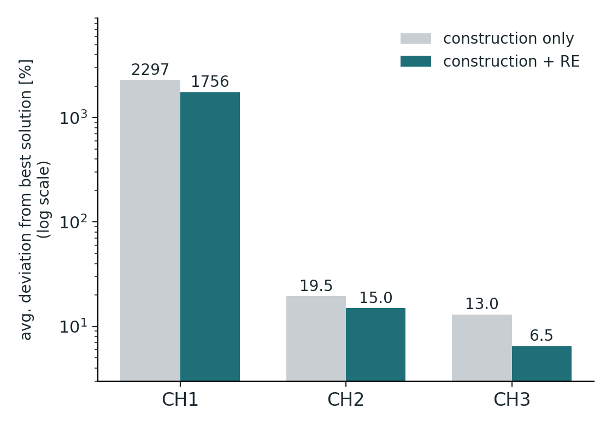
Results: construction, with and without RE
42 instances, one run per instance and method, same seed. Deviation from the best solution.
Method | Dev. no RE | Dev. with RE | Helped by RE
CH1 | 2297 % | 1756 % | 42 / 42
CH2 | 19.5 % | 15.0 % | 40 / 42
CH3 | 13.0 % | 6.5 % | 42 / 42
124 of 126
runs improved by RE; it never made a solution worse
13.0 % → 6.5 %
CH3 gains most from RE among the informed heuristics
CH1 is blind
ignoring cost and coverage costs orders of magnitude

Slide 5
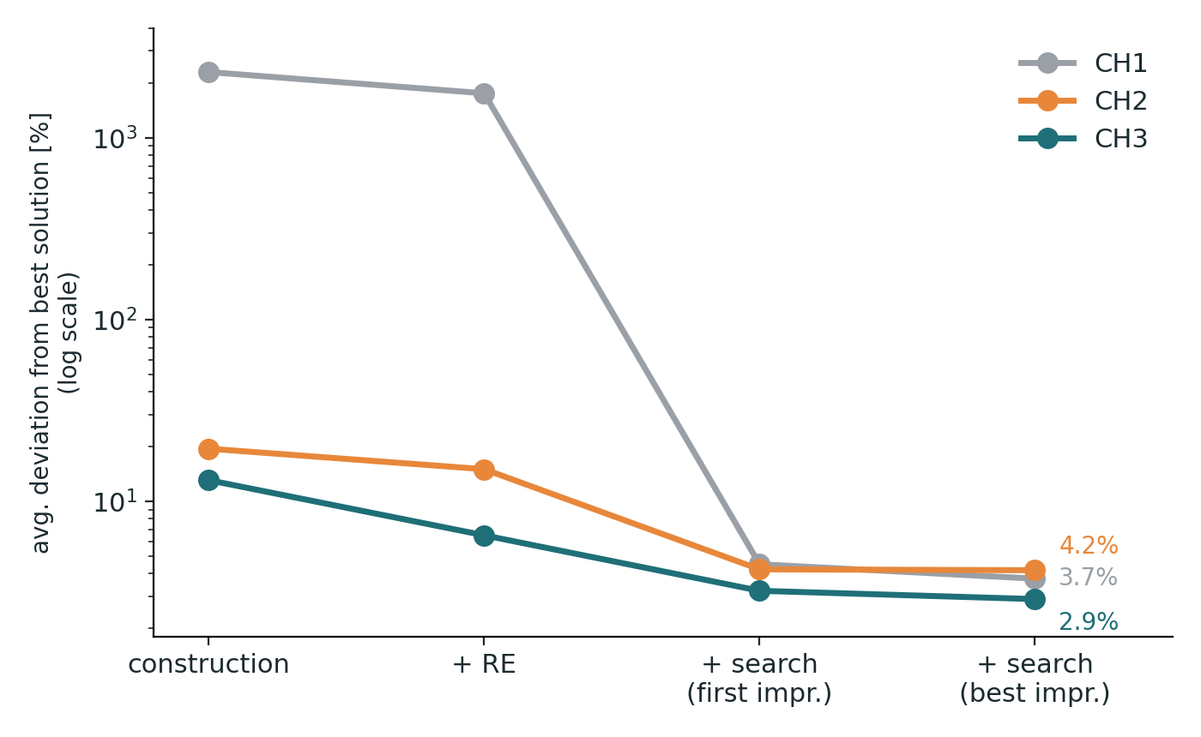
Neighbourhood search closes most of the gap
Compound heuristic: construction, then RE, then drop-and-repair search. Deviation from the best solution.
2.9 %
CH3 + RE + best-improvement search: the best average result
1756 % → 3.7 %
even the blind CH1 start is rescued by the same search
3 vs 32 moves
CH3 needs far fewer improving moves than CH1 – better start, less search
Takeaway The best cost is reached on only a few of the 42 instances (at most 3 per stage), and no heuristic beat the best solution. What is left, a few percent, is what constructive heuristics plus a simple local search cannot close – the case for stronger metaheuristics.

