Slide 1
Constructive heuristics for the Set Covering Problem
THE PROBLEM
Choose sets of minimum total cost so that every element is covered.
minimise Σ wⱼ xⱼ
every element in at least one selected set, xⱼ ∈ {0, 1}
Assignment 1 · Heuristic Optimization
42
OR-Library benchmark
instances (sets 4, 5, 6, A–D)
3
dynamic constructive
heuristics, each with and
without RE
+1
neighbourhood search
started from the
constructed covers

Slide 2
Three dynamic constructive heuristics
Every step adds one set; scores are recomputed from the current partial solution.
CH1
CH2
CH3
Random element, random set
Random element, best set
Best set overall
Pick a random uncovered element
Add a random set that covers it
Uses no cost or coverage information
Pick a random uncovered element
Add the covering set with the lowest cost ÷ newly covered elements
Look at every set that still covers something new
Add the one with the lowest cost ÷ newly covered elements
The baseline
Element-driven greedy
Chvátal’s greedy rule
Dynamic bookkeeping Adding a set updates the uncovered list and the “still uncovered” count of every affected set – only what changed is touched. A set with nothing new to cover leaves the candidate list, so no redundant set is ever added.

Slide 3
From a cover to a better cover
Three stages, all built on the same incrementally updated state.
1
Construct
2
Redundancy elimination (RE)
3
Neighbourhood search
CH1, CH2 or CH3 builds a complete cover.
Scan the chosen sets, most expensive first, and drop any set whose elements are all covered by others. One pass is enough.
Move: drop one set, repair greedily without it, then RE. Take improving moves (first or best improvement) until none is left.
Incremental evaluation
Each add or remove updates coverage counts, the uncovered list and per-set scores for the touched elements only. Tried moves are undone from a log – the state is never copied.
Checked, not assumed
After every run the cover, its cost and (after RE) its minimality are recomputed from scratch and compared with the incremental values.

Slide 4
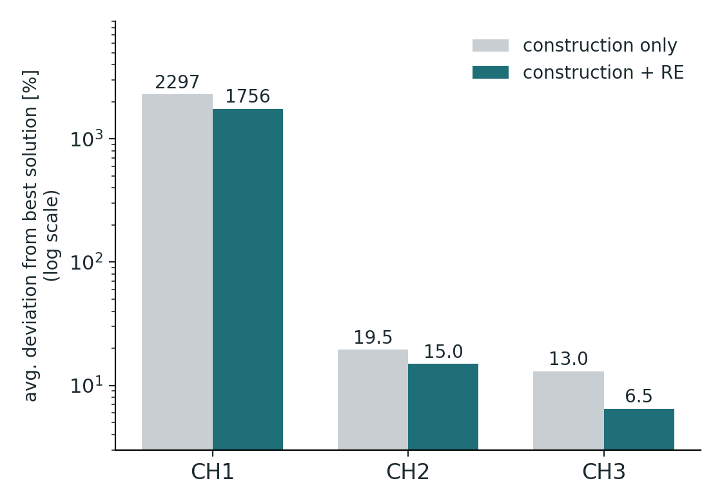
Results: construction, with and without RE
42 instances, one run per instance and method, same seed. Deviation from the best solution.
Method | Dev. no RE | Dev. with RE | Helped by RE
CH1 | 2297 % | 1756 % | 42 / 42
CH2 | 19.5 % | 15.0 % | 40 / 42
CH3 | 13.0 % | 6.5 % | 42 / 42
124 of 126
runs improved by RE; it never made a cover worse
13.0 % → 6.5 %
CH3 gains most from RE among the informed heuristics
CH1 is blind
ignoring cost and coverage costs orders of magnitude

Slide 5
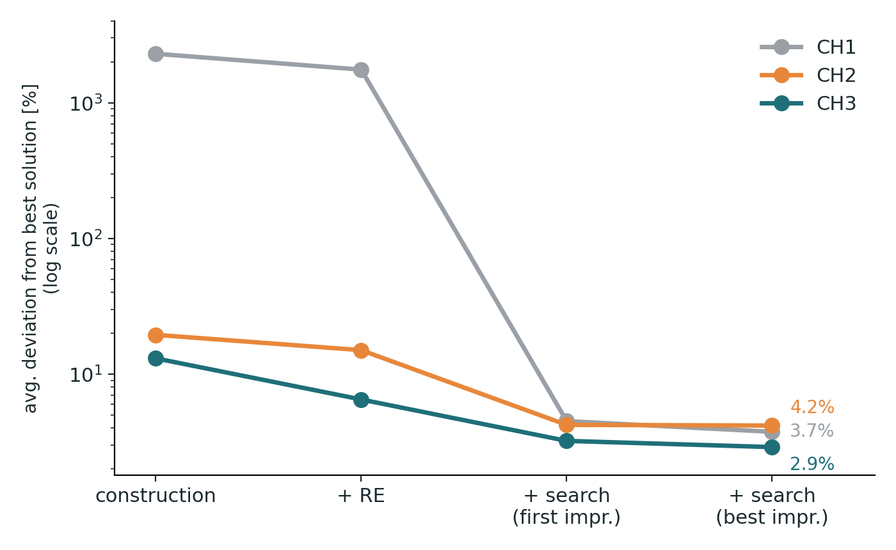
Neighbourhood search closes most of the gap
Compound heuristic: construction, then RE, then drop-and-repair search. Deviation from the best solution.
2.9 %
CH3 + RE + best-improvement search: the best average result
1756 % → 3.7 %
even the blind CH1 start is rescued by the same search
3 vs 32 moves
CH3 needs far fewer improving moves than CH1 – better start, less search
Takeaway The best cost is reached on only a few of the 42 instances (at most 3 per stage), and no heuristic beat the best solution. What is left, a few percent, is what constructive heuristics plus a simple local search cannot close – the case for stronger metaheuristics.

