Slide 1
Scene Management With Octrees
Shaun McThomas
Matt Yefima

Slide 2
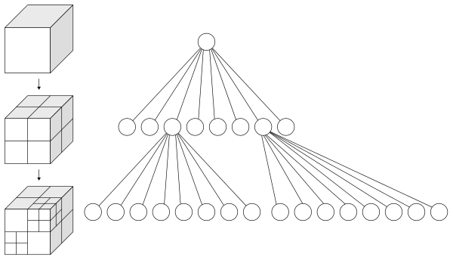
What is an Octree?
Tree data structure where every node has 8 children
Commonly used to partition regions in 3D space

Slide 3
Why use Octrees?
Efficiency in interactive 3D applications
Commonly used for collision detection and view frustum culling

Slide 4
Project Goals
Implement our own collision detection for simple shapes
Implement a brute force method of collision detection for all objects
Implement an Octree
Compare performance of each implementation

Slide 5
Current Progress
Researched Octree implementations
Began creating our test scene in Unity
Wrote collision detection for Axis Aligned Bounding Boxes and Spheres

