Slide 1

RL Lecture 2: PPO algorithm
Michael Melnik
mihail.melnik.ifmo@gmail.com

Slide 2
For today:
1. Proximal Policy Optimization (PPO) algorithm
- on-policy methods
- implementation from scratch
- experiments with classic toy problems
- analyse performance and training results
- neural network structure
2. RL frameworks
StableBaselines3
examples
RLLib (next lecture)

Slide 3
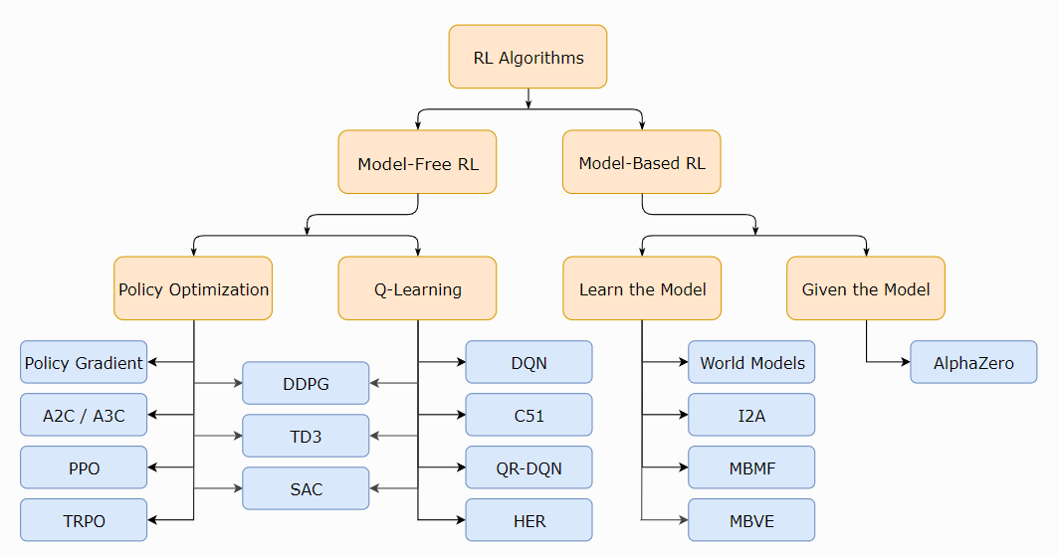
Deep Reinforcement Learning
Taxonomy
https://spinningup.openai.com/en/latest/spinningup/rl_intro.html
https://spinningup.openai.com/en/latest/spinningup/rl_intro2.html

Slide 4
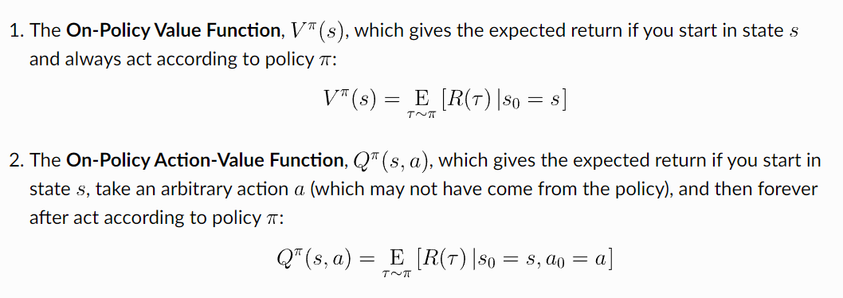

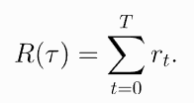
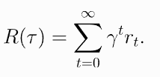
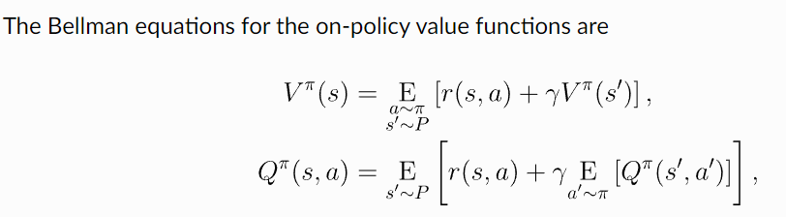


Review of terminology
S - set of all valid states
A - set of all valid actions
- reward function
finite-horizon undiscounted return
infinite-horizon discounted return
Trajectory
Policy
Bellman Equations:
https://spinningup.openai.com/en/latest/algorithms/ppo.html
https://spinningup.openai.com/en/latest/spinningup/rl_intro3.html
https://arxiv.org/pdf/1912.06680

Slide 5
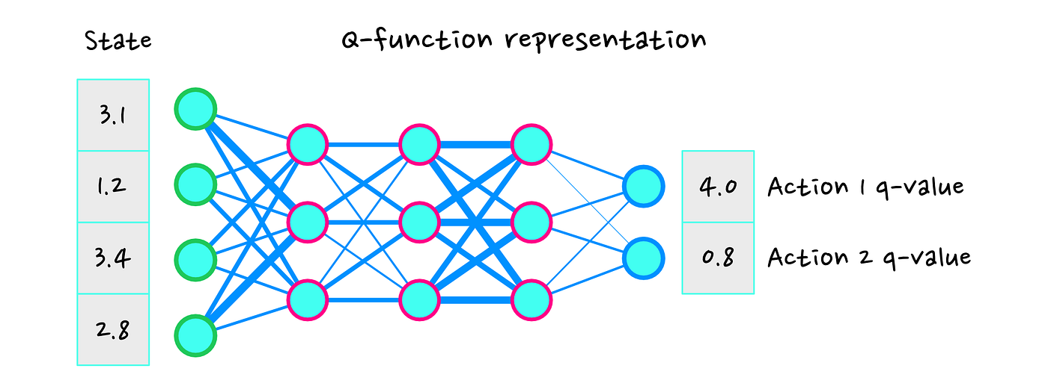

DQN review
Approximate Q function
Select optimal actions corresponding to bigger Q value

Slide 6
Off- On- policy
On-Policy: Learns using the policy currently being optimized; more stable but less sample-efficient.
Definition: In on-policy learning, the agent learns from data generated by the current policy it is trying to improve. In other words, it updates its policy using actions it took based on its existing policy.
Policy Evaluation: The agent improves the same policy that was used to collect the data.
Examples:
Proximal Policy Optimization (PPO)
Trust Region Policy Optimization (TRPO)
SARSA
Characteristics:
The policy used for taking actions (behavior policy) is the same as the one being updated (target policy).
More stable learning, but can be less sample-efficient because the data used must be aligned with the current policy.
Off-Policy: Learns using data from a different policy or past experiences; more sample-efficient but can be harder to stabilize.
Definition: In off-policy learning, the agent can learn from data collected from a different policy (behavior policy), rather than the one it is currently optimizing (target policy). This allows more flexibility in using data generated from other policies or even human demonstrations.
Policy Evaluation: The agent can learn the target policy using data generated by a different policy.
Examples:
Q-Learning
Deep Q-Network (DQN)
Deep Deterministic Policy Gradient (DDPG)
Soft Actor-Critic (SAC)
Characteristics:
More sample-efficient, as the agent can reuse old experiences to learn.
May be harder to stabilize due to potential discrepancies between the behavior and target policies.
Sample efficiency - how effective we can reuse obtained data

Slide 7




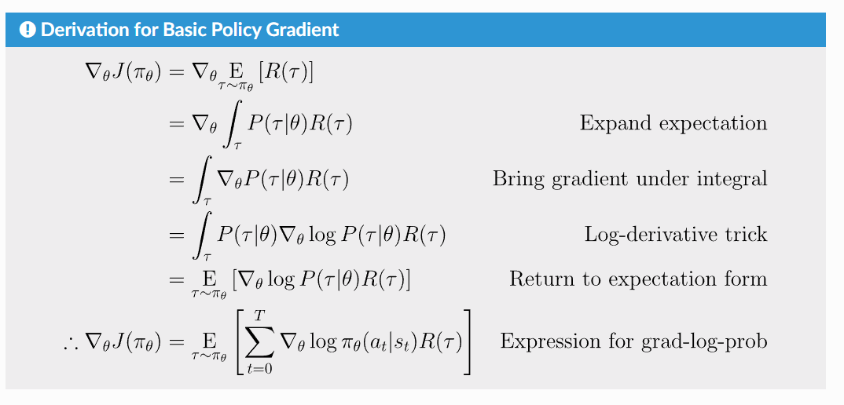
On-Policy base
We want to optimize reward
For that, we want to learn optimal policy
-Neural network parameters
Probability of trajectory
https://spinningup.openai.com/en/latest/spinningup/rl_intro3.html

Slide 8
Proximal Policy Optimization
Proximal Policy Optimization (PPO) is a popular algorithm in reinforcement learning (RL), introduced by OpenAI. It strikes a balance between simplicity and performance, making it one of the most widely used methods for training RL agents.
Key Features:
Clipped Objective Function: PPO avoids making large updates to the policy by clipping the probability ratio between the new and old policies. This helps maintain stability during training.
Trust Region Approximation: Instead of computing the exact trust region, PPO uses simpler and more computationally efficient methods to constrain policy updates, ensuring gradual improvement.
Ease of Implementation: PPO is relatively easy to implement compared to other algorithms like Trust Region Policy Optimization (TRPO), while providing comparable or better performance.
Pros:
Stability and robustness in training.
Simple and computationally efficient.
Works well across various RL environments.
Cons:
May require fine-tuning of hyperparameters.
Although robust, it can sometimes be less sample-efficient than more complex algorithms.
In summary, PPO is an accessible yet powerful tool in RL, offering a good balance between complexity and performance.
https://spinningup.openai.com/en/latest/algorithms/ppo.html
https://arxiv.org/pdf/1912.06680

Slide 9
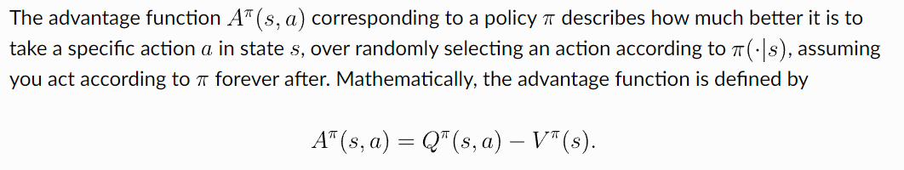
Advantage
V(s) - Value function
Q(s,a) - Action-Value function
The same as:
Q(s, a) = V(s) + A(s, a)
V(s) = Q(s, a) - A(s, a)

Slide 10
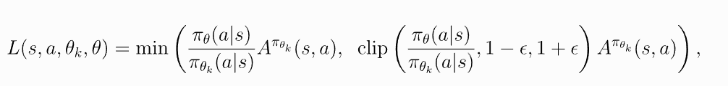
PPO algorithm
Loss:

Slide 11
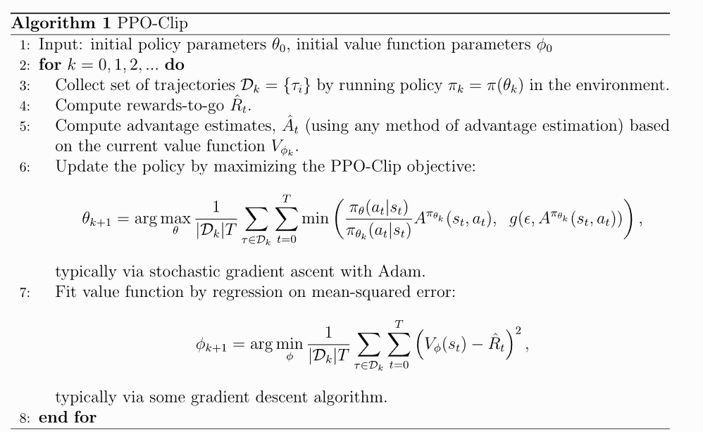
PPO algorithm

Slide 12
StableBaselines3
pip install stable-baselines3
pip install stable-baselines3[extra] # for tensorboard, atari, etc. …
https://stable-baselines3.readthedocs.io/en/master/guide/install.html
Many examples
Easy to launch
Easy to customize
Results tracking, tensorboard

Slide 13
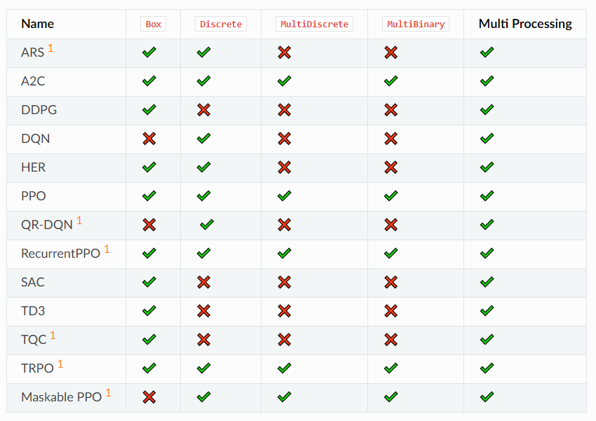
StableBaselines3 algorithms

Slide 14
Gym Spaces
Fundamental spaces
Box - Supports continuous (and discrete) vectors or matrices, used for vector observations, images, etc
Discrete - Supports a single discrete number of values with an optional start for the values
MultiBinary - Supports single or matrices of binary values, used for holding down a button or if an agent has an object
MultiDiscrete - Supports multiple discrete values with multiple axes, used for controller actions
Text - Supports strings, used for passing agent messages, mission details, etc
Composite Spaces
Often environment spaces require joining fundamental spaces together for vectorised environments, separate agents or readability of the space.
Dict - Supports a dictionary of keys and subspaces, used for a fixed number of unordered spaces
Tuple - Supports a tuple of subspaces, used for multiple for a fixed number of ordered spaces
Sequence - Supports a variable number of instances of a single subspace, used for entities spaces or selecting a variable number of actions
Graph - Supports graph based actions or observations with discrete or continuous nodes and edge values.

Slide 15
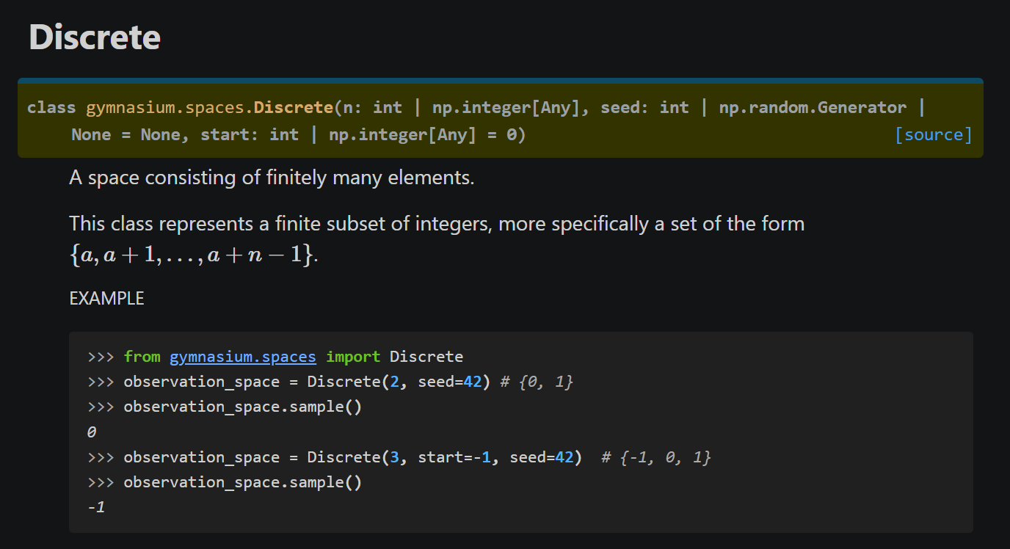
Gym Spaces Discrete

Slide 16
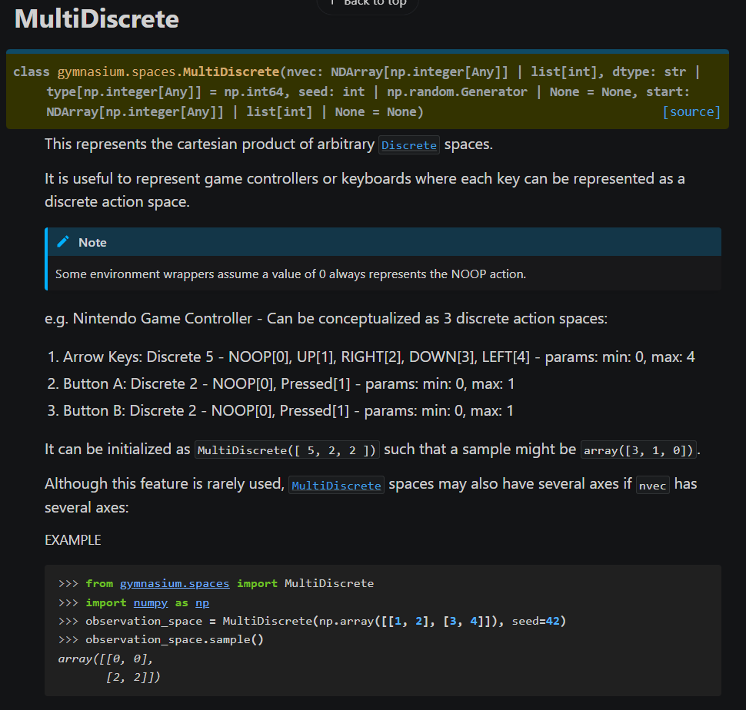
Gym Spaces MultiDiscrete

Slide 17
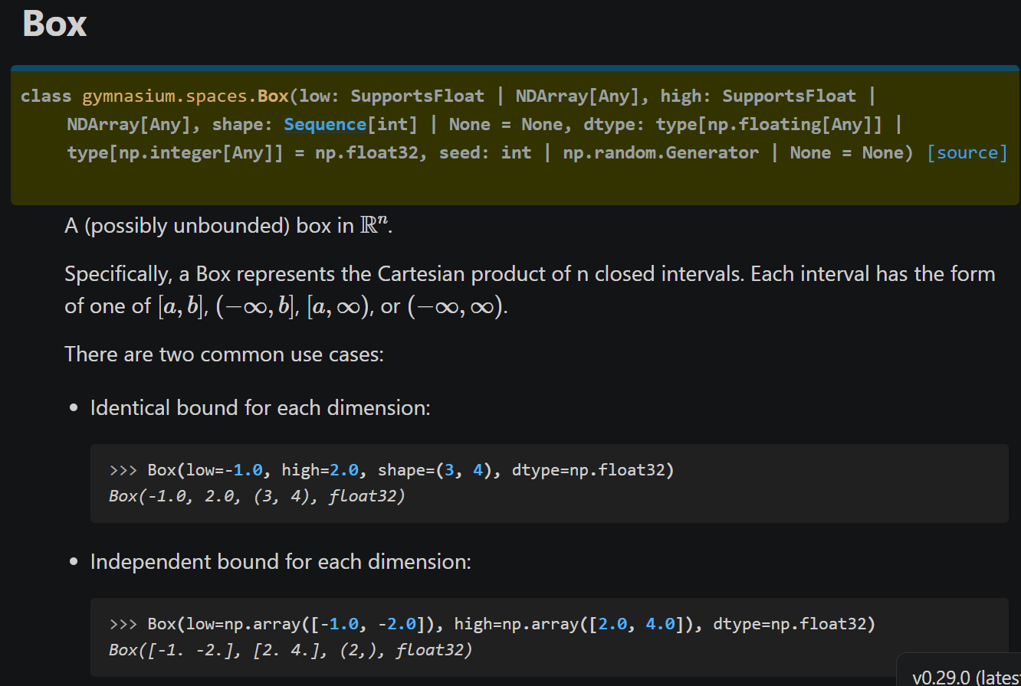
Gym Spaces Box

Slide 18
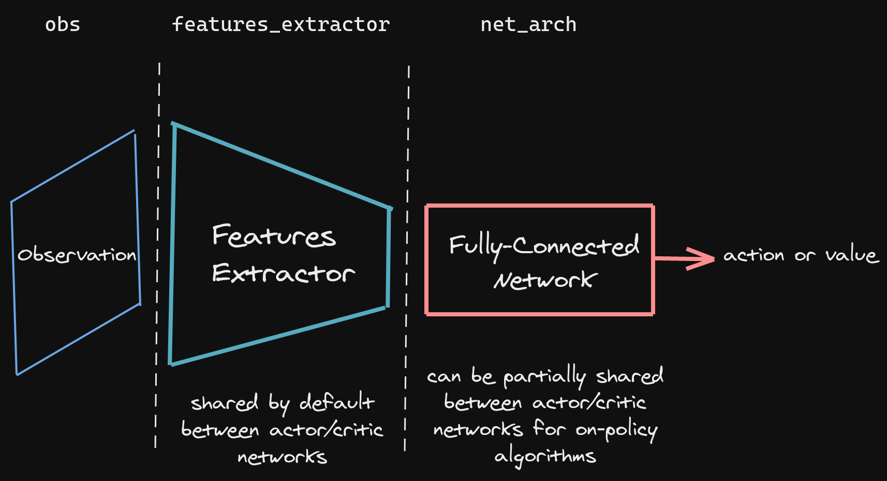
Neural Network structure
Consists of:
Obs (input)
Feature extractor
(if CNN)
FC Network
Output:
Action distribution
Value

Slide 19
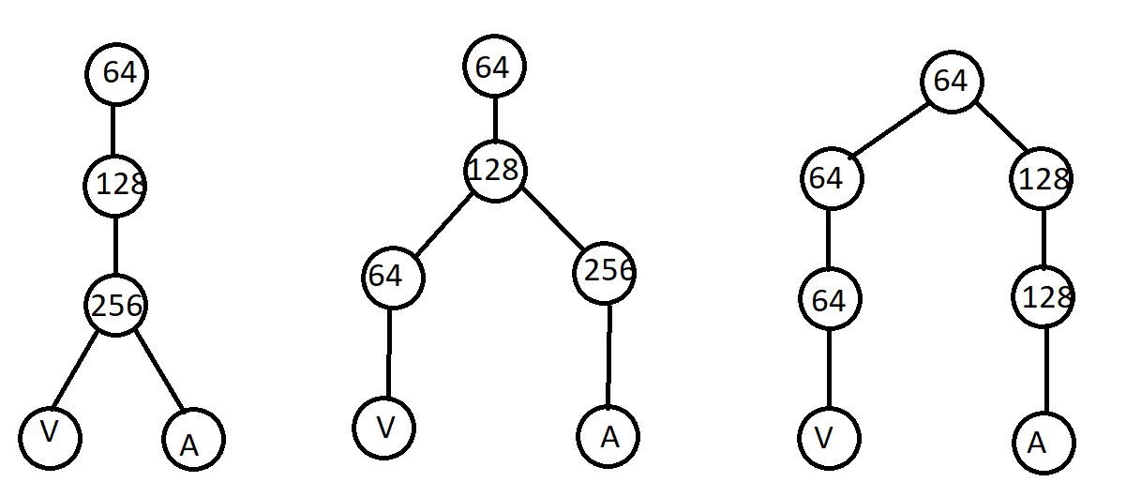
PPO branches
PPO uses Action (A) distribution and Value (V) as output.
Branches for A and V can be built together or separately.
Combined
Partially
Separated
In StableBaselines3 you can set it via parameter:
net_arch=dict(pi=[128, 128], vf=[128, 128]) # separate
net_arch=[128, 128] # Combined

Slide 20

Thank you for your attention!
www.ifmo.ru

