Slide 1
AADHAR AS SSN
Presentation by:
Anshul
Jaskaran Singh
Parminder Singh
3CE1
3CE2
3CE2
11501040
11501050
11501055

Slide 2
Our USPs
Unique way of Linking
A project with online and offline collaboration
Highly secure project

Slide 3
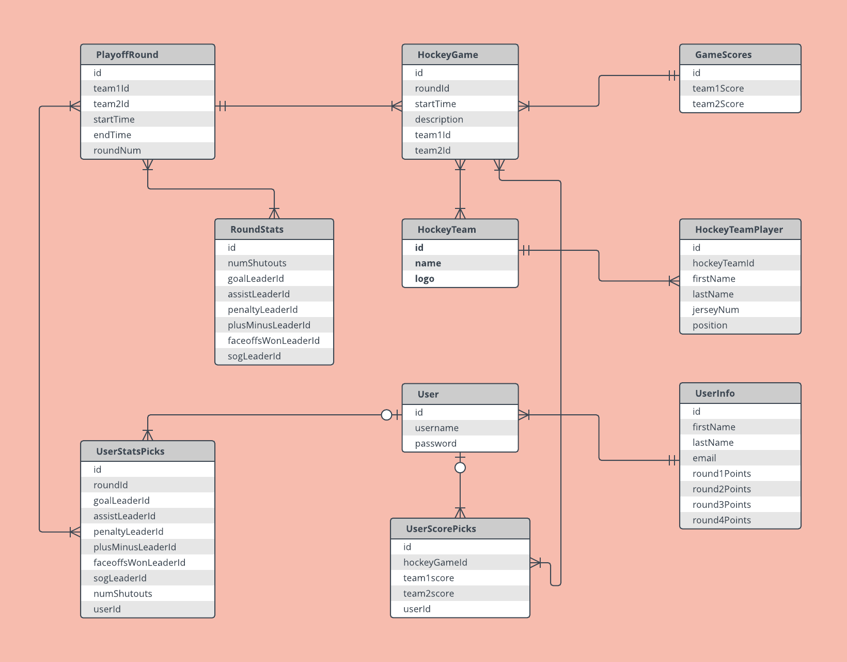
Unique way of Linking

Slide 4
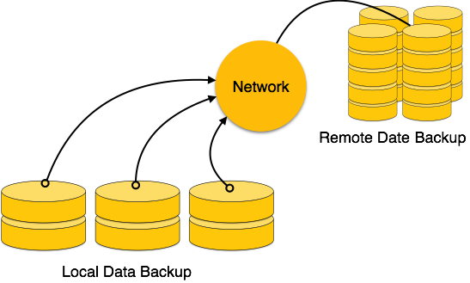
Unique way of Linking

Slide 5
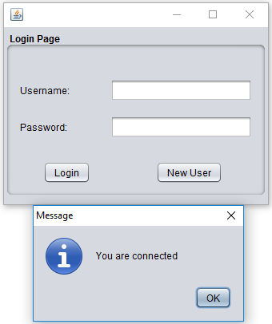
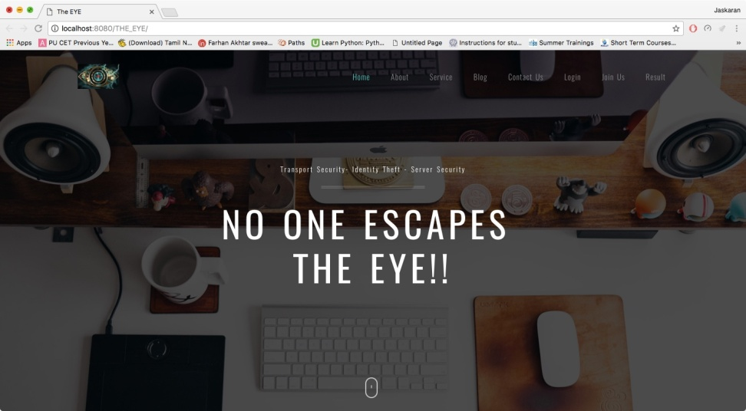
Offline and Online Collaboration

Slide 6
Our Project includes:
Module1: Local citizen Entries
Module2: Status checking
Module3: Online Website

Slide 7
Login Page

Slide 8
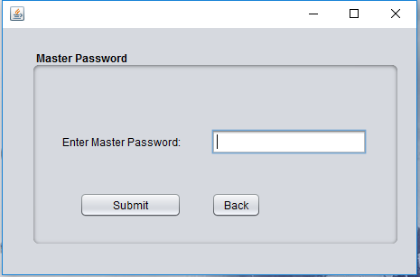
Master Password

Slide 9
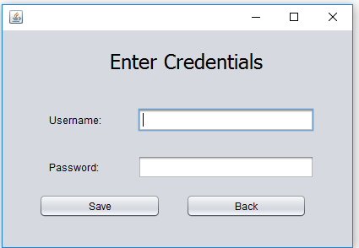
Enter Credentials

Slide 10
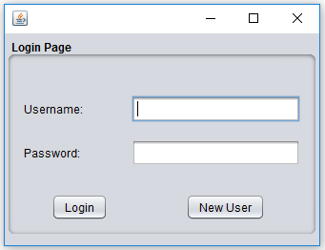
Login Page

Slide 11
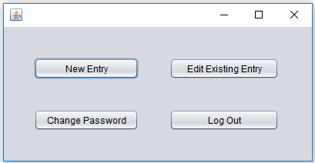
Login Successful

Slide 12
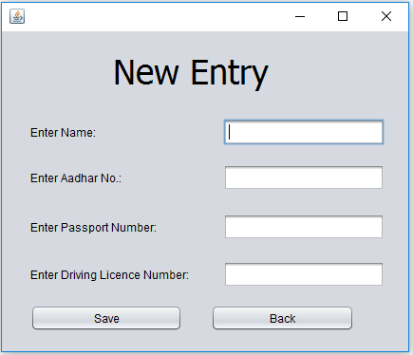
New Entry

Slide 13
Login Successful

Slide 14
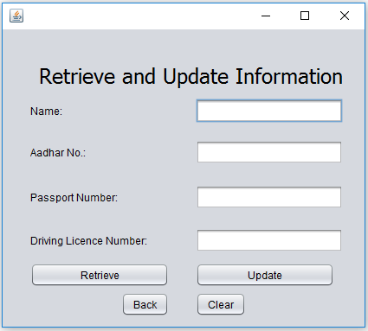
Edit Existing Entry

Slide 15
Login Successful

Slide 16
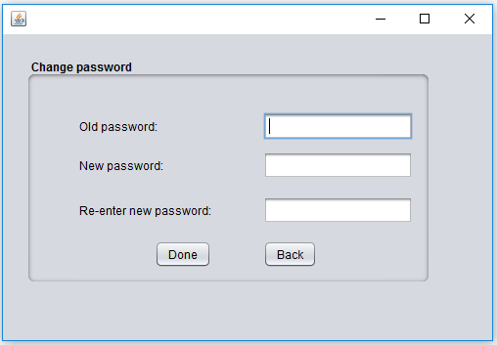
Change Password

Slide 17
Logout

Slide 18
Login Page

Slide 19
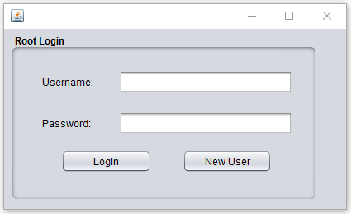
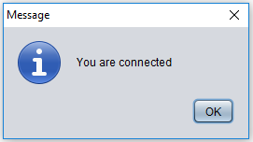
Login Page

Slide 20
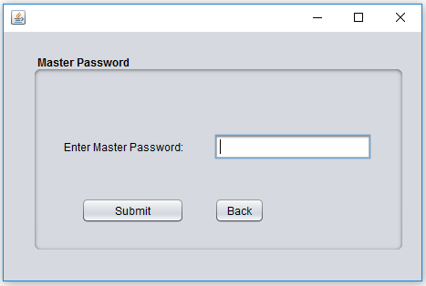
Master Password

Slide 21
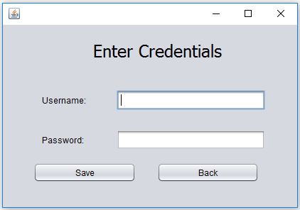
Enter Credentials

Slide 22
Login Page

Slide 23
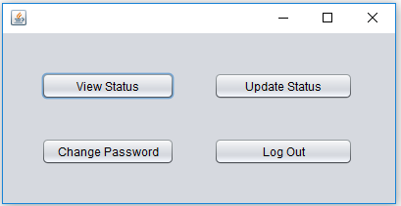
Login Successful

Slide 24
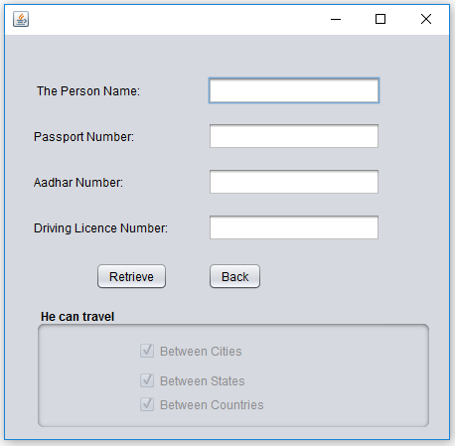
View Status

Slide 25
Login Successful

Slide 26
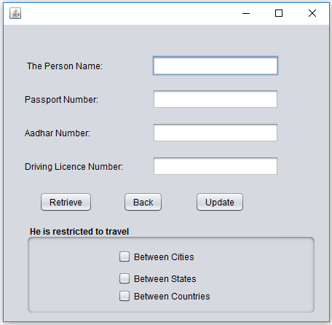
Update Status

Slide 27
Login Successful

Slide 28

Change Password

Slide 29
Logout

Slide 30

Homepage

Slide 31
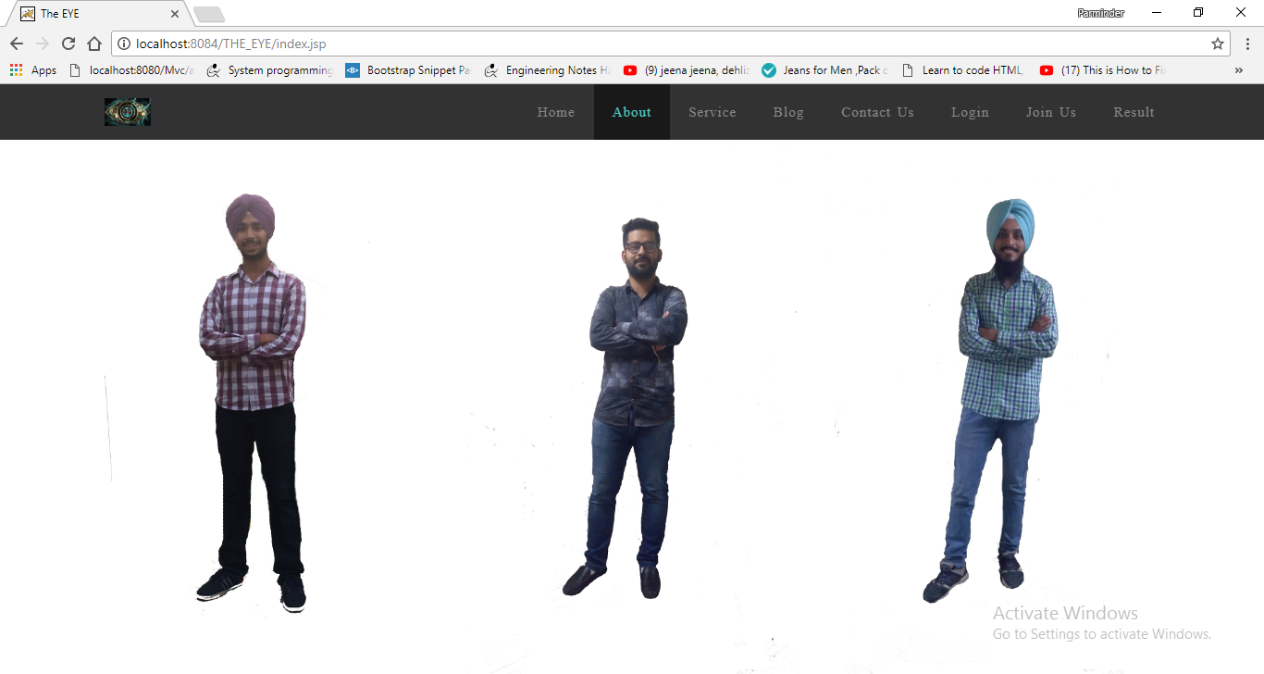
About

Slide 32
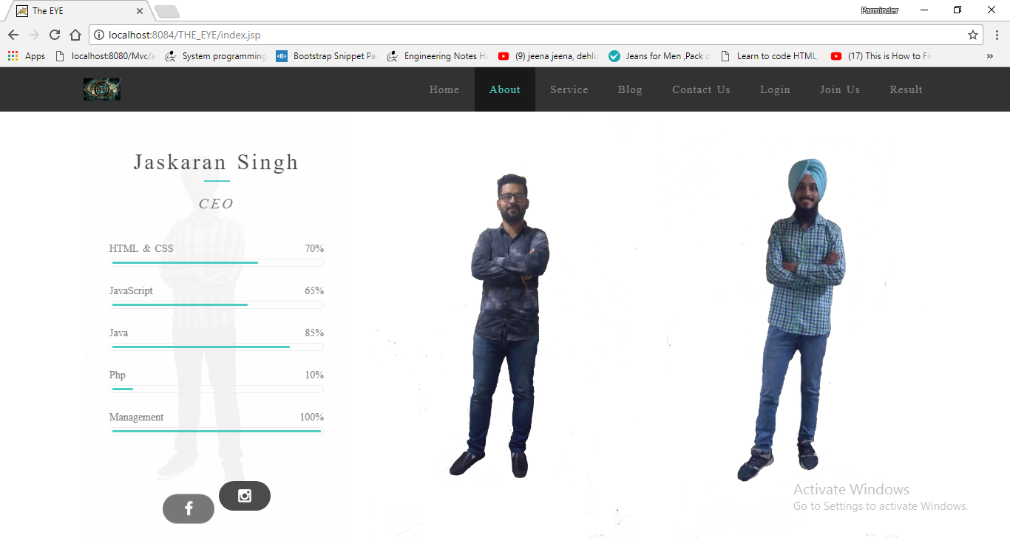
About

Slide 33
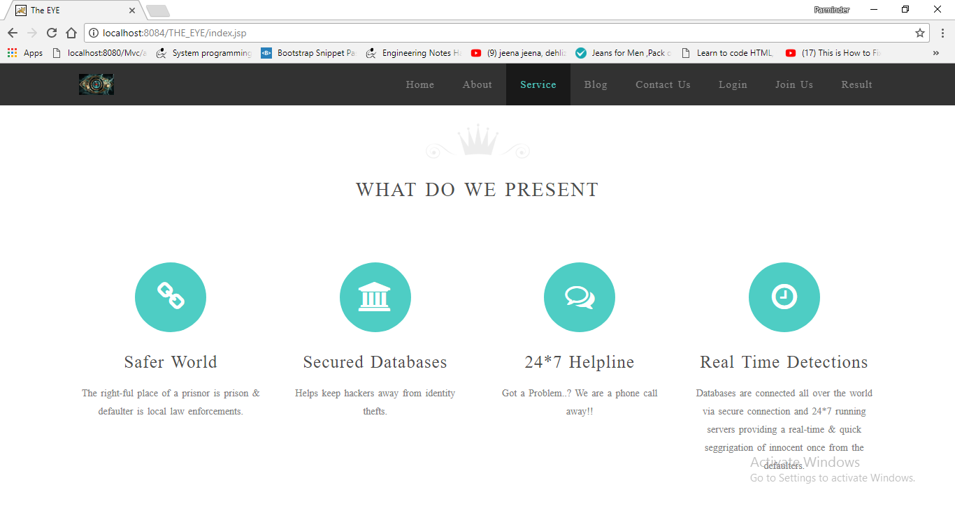
Services

Slide 34
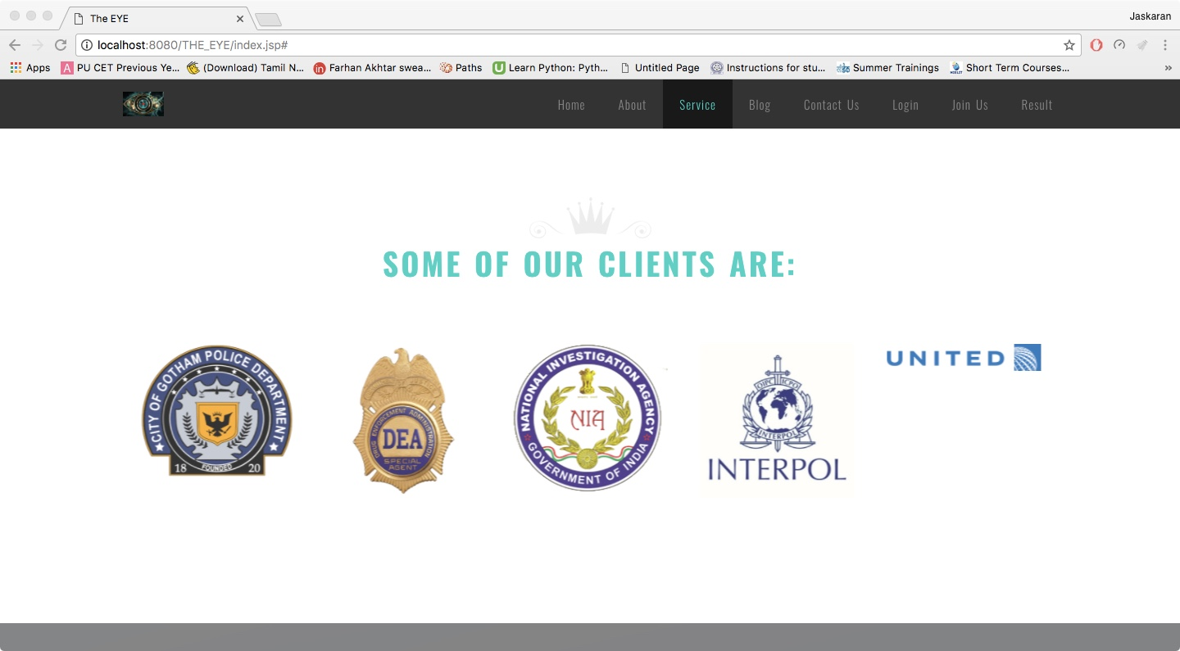
Client

Slide 35
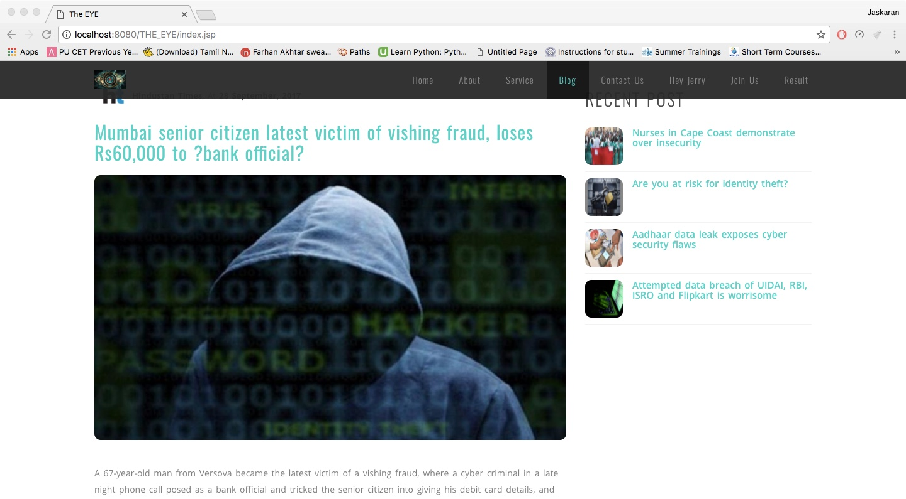
Blog

Slide 36
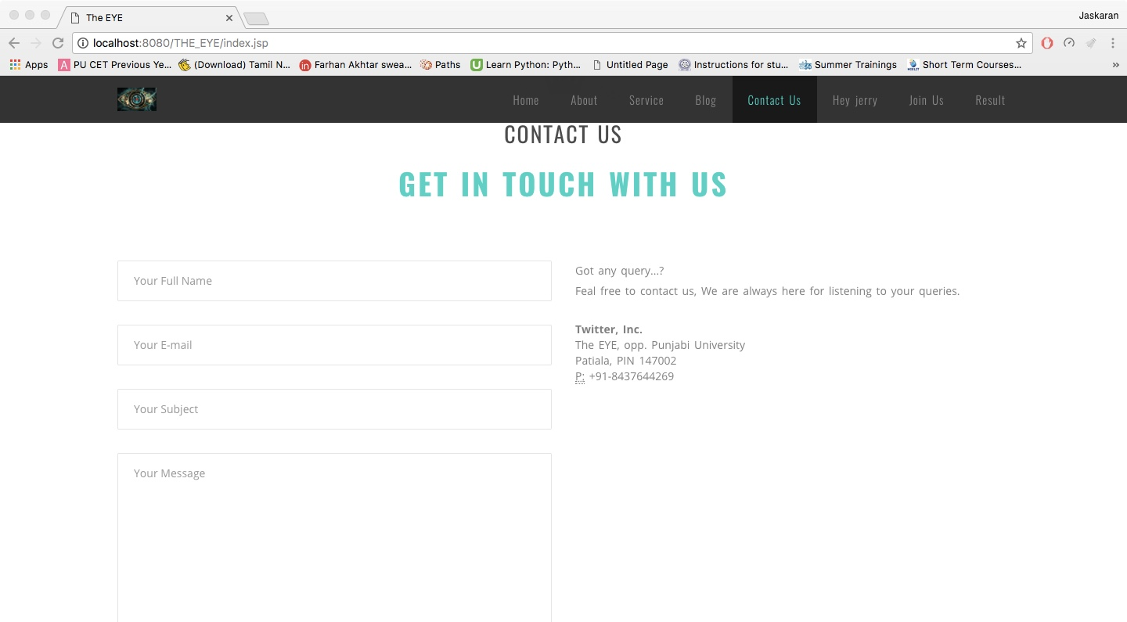
Contact us

Slide 37
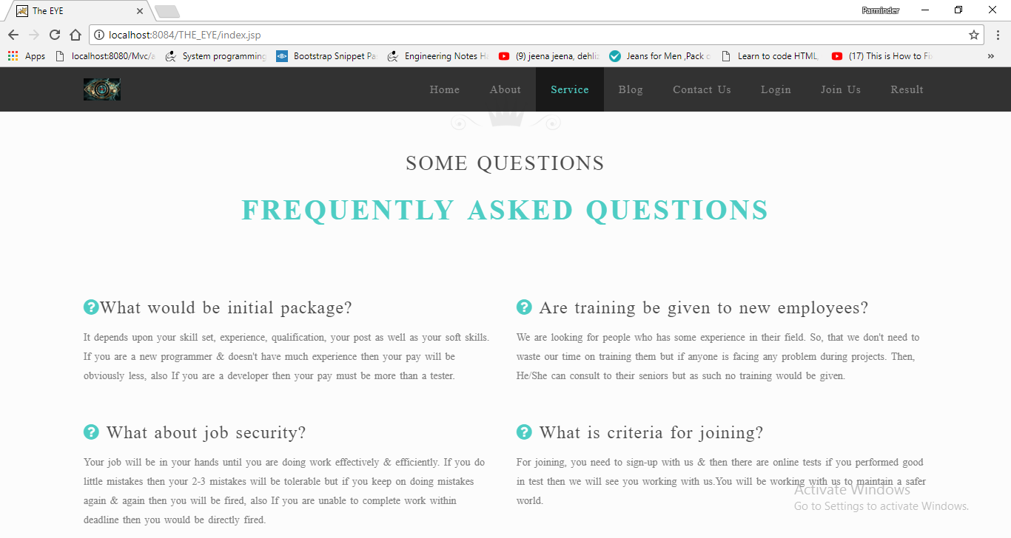
FAQs

Slide 38
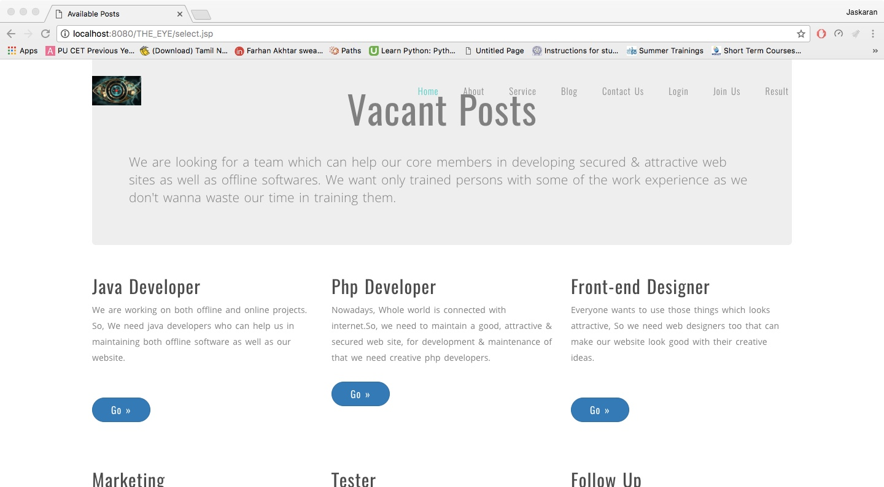
Register

Slide 39
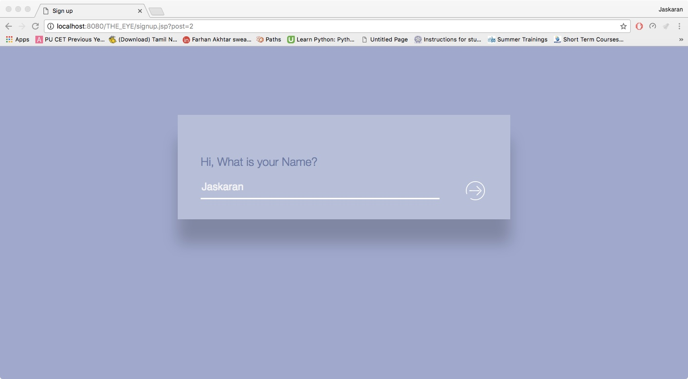
Register

Slide 40
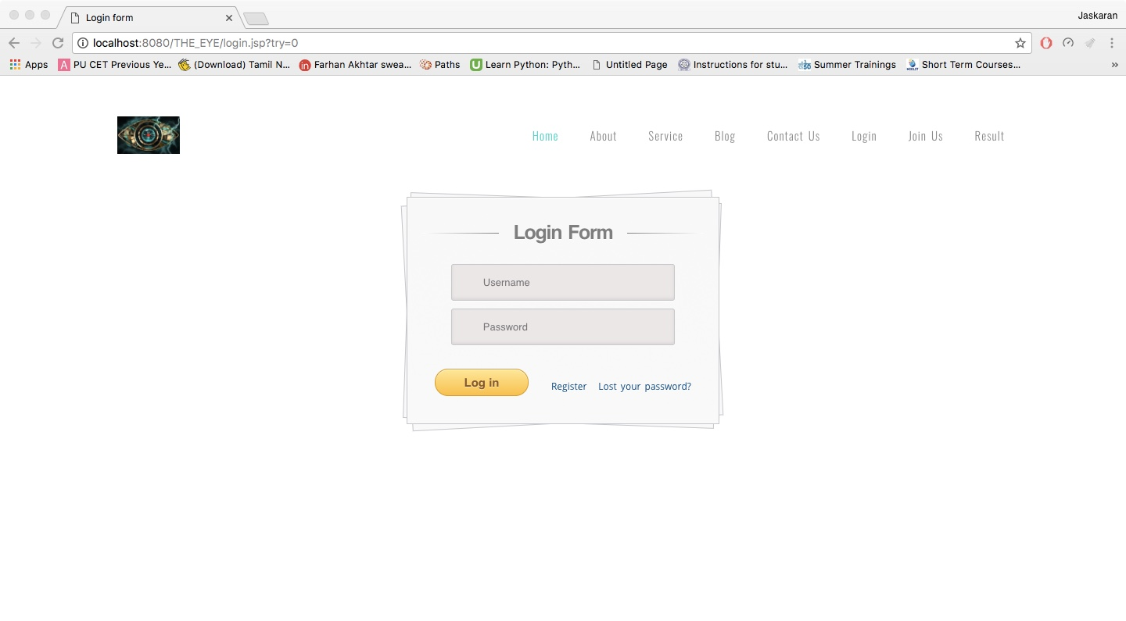
Login

Slide 41
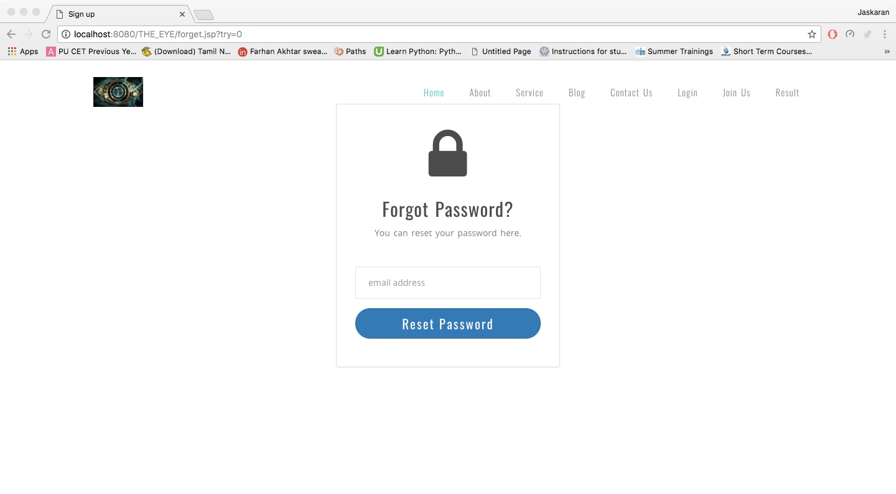
Forget Password

Slide 42
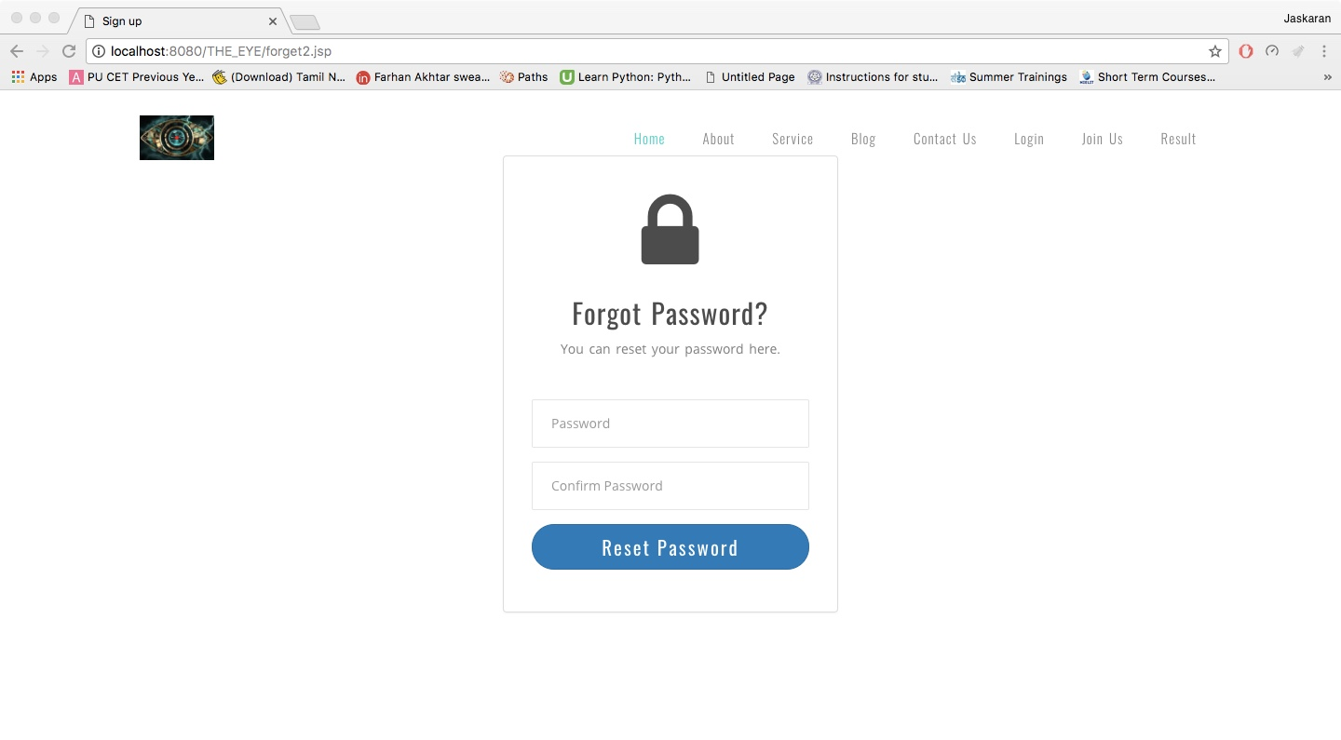
Forget Password

Slide 43
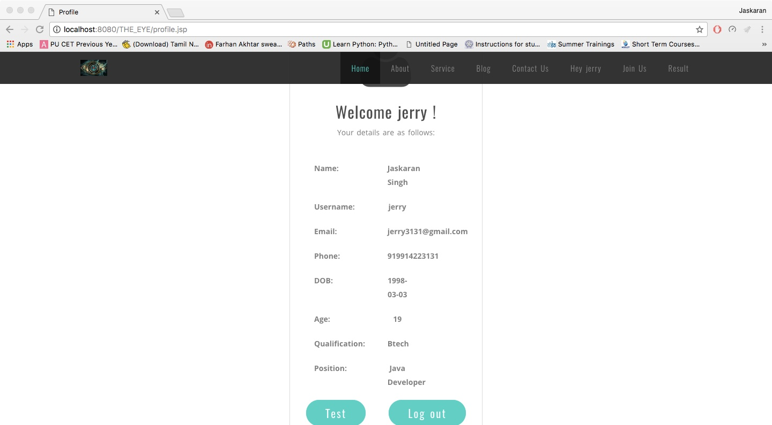
Profile

Slide 44
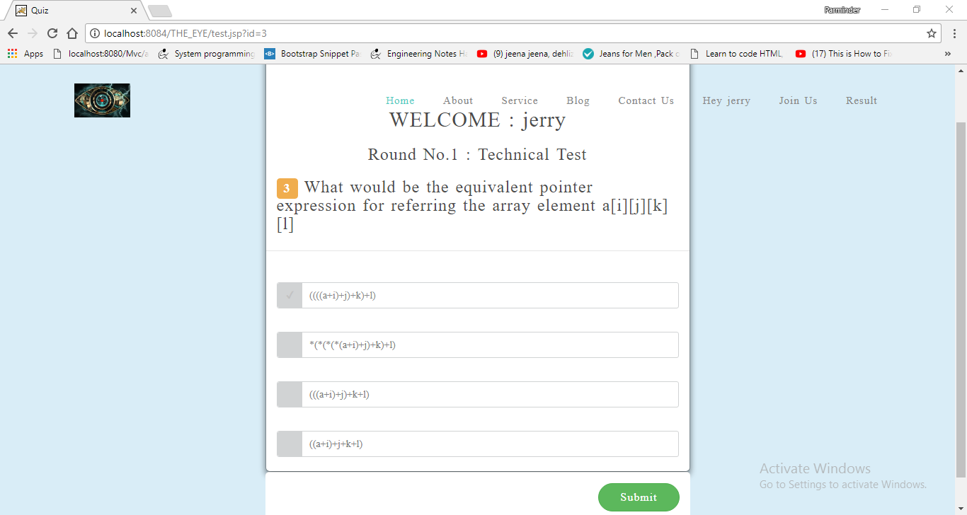
Test

Slide 45
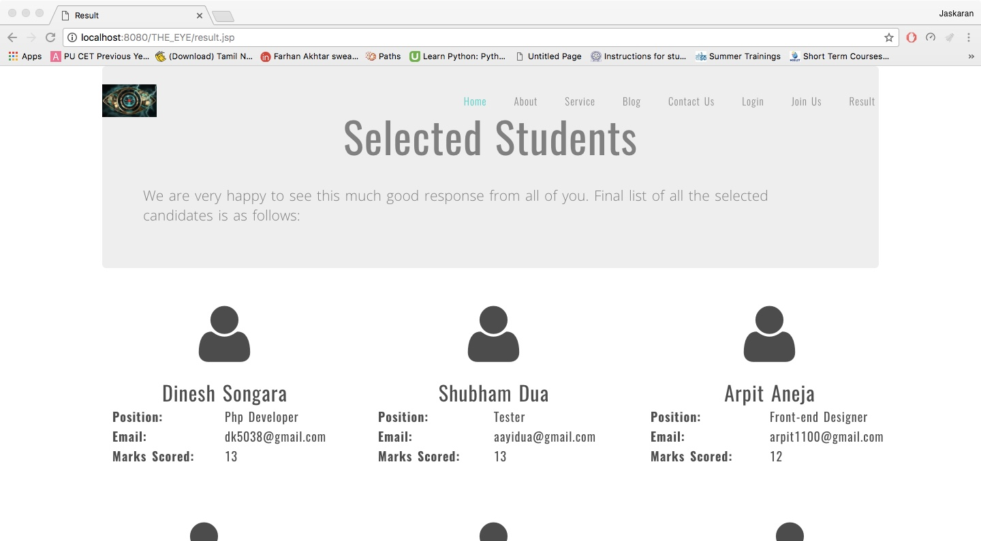
Result

Slide 46
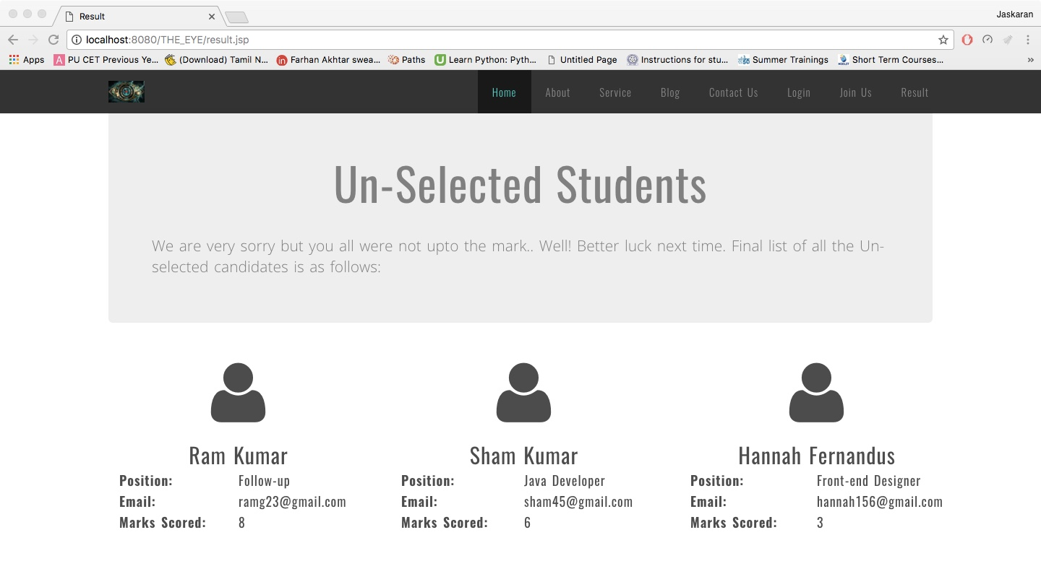
Result

Slide 47
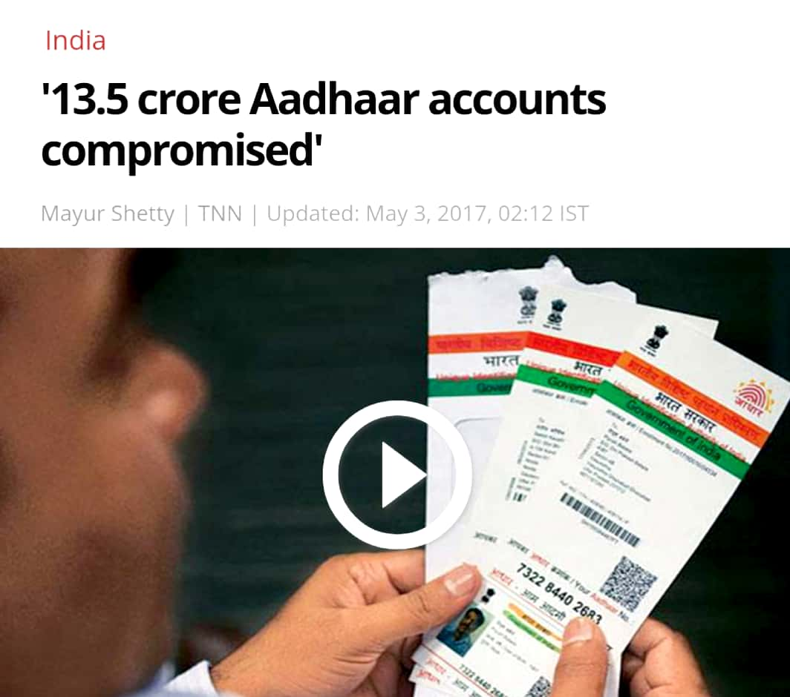
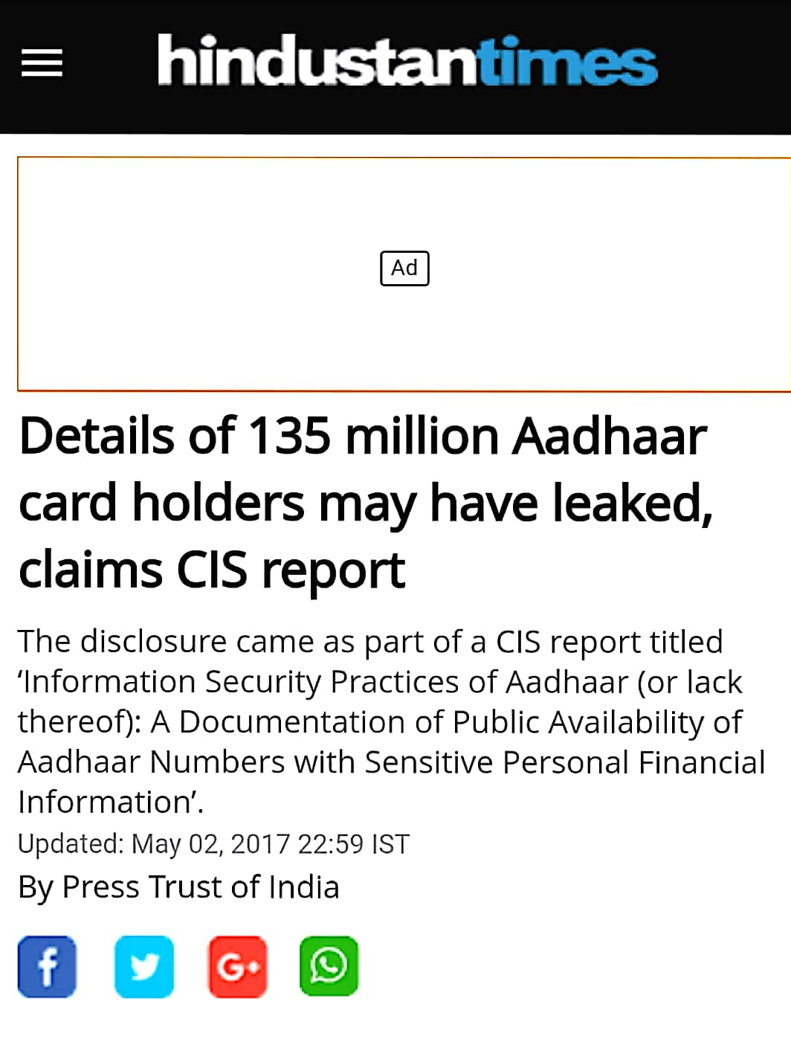

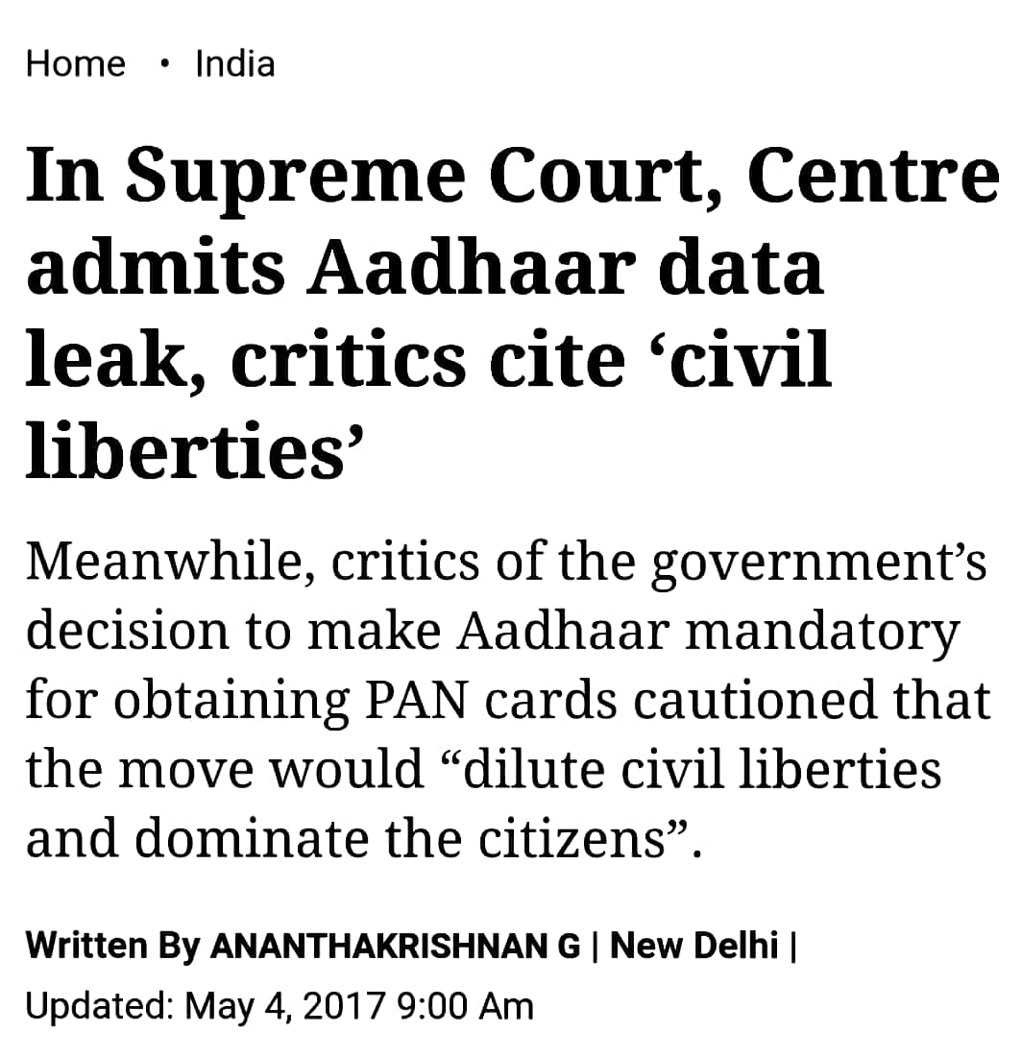

Slide 48
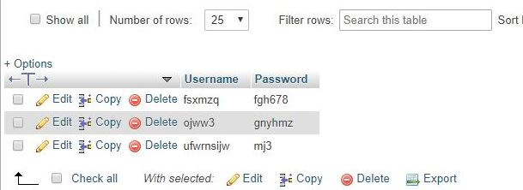
Encryption of Data

Slide 49
Thank You

