Slide 1
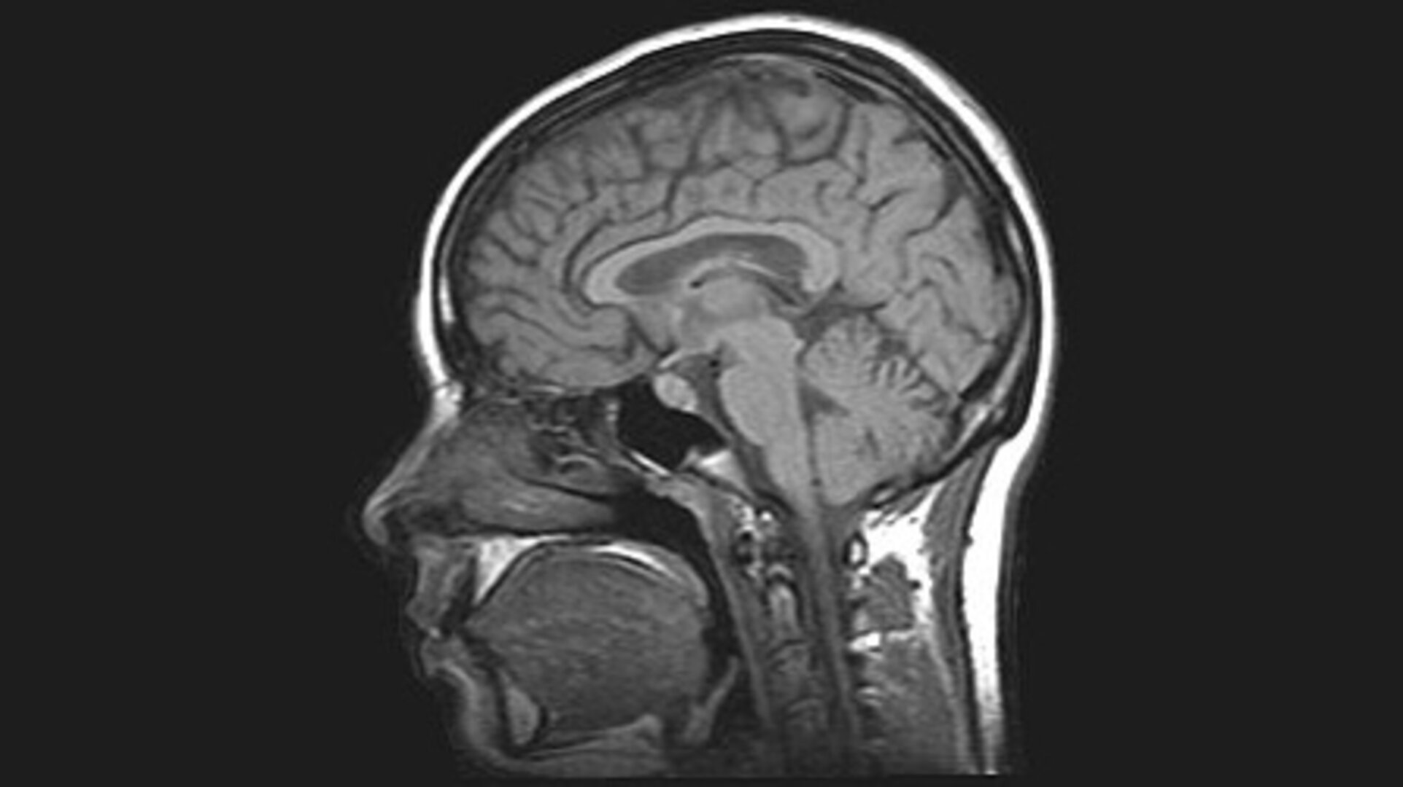
MLOps · SPRING 2026
Brain Tumor
Detection &
Localization
An end-to-end MLOps pipeline for MRI brain scans
TEAM
Gabriel Gillmann · Helena Martínez Río · Nathan Massicot · Jahnavi Patil
01

Slide 2
Project Goal
The Problem
Interpreting brain MRI scans is complex, time-consuming, and requires highly trained radiologists. Early and accurate detection of tumors like low-grade gliomas (LGG) is critical for patient outcomes.
Our Goal
Build a complete MLOps system that detects and localizes brain tumors in MRI scans .Combining a PyTorch deep-learning model with a reproducible, version-controlled, and deployable pipeline.
TCGA_CS_4941_19960909 — slice 1
Axial brain MRI slice from the LGG Segmentation dataset (TCIA / TCGA lower-grade glioma collection). Patient TCGA-CS-4941, acquired 1996-09-09.
Note: no tumor mask on this slice, the cut is too low (mandible / sinus level), brain tissue not yet visible.
Our Way
Detect
Localize
Deploy
Classify tumor / no tumor
Segment the tumor region
Real-time API access
MRI brain scan · LGG dataset sample
MLOps · Brain Tumor Detection & Localization
02

Slide 3
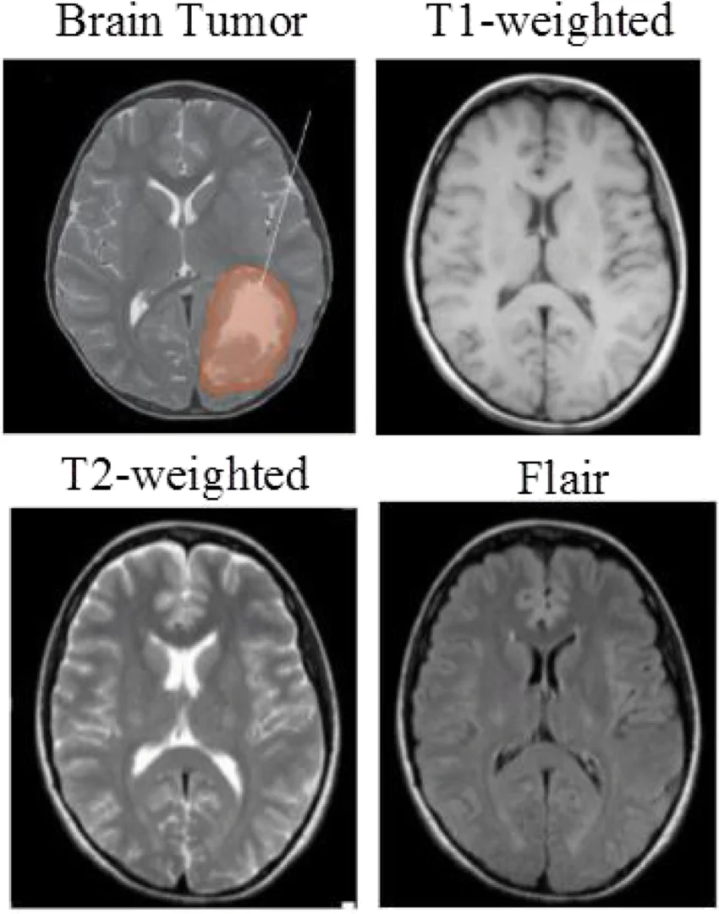
Data
LGG MRI Segmentation Dataset
Source: Kaggle — mateuszbuda/lgg-mri-segmentation
110
3,929
Patients
MRI slices
from TCIA LGG collection
pre- and post-contrast FLAIR
FLAIR
.tif
Abnormality masks
Paired image + mask
manually annotated ground truth
channel-wise MRI + segmentation
Manual FLAIR abnormality mask provides pixel-level tumor localization.
MLOps · Brain Tumor Detection & Localization
03

Slide 4






Important to Consider
What we aim to achieve
Version the code
Version the data
Track experiments
Roll back to any working state and collaborate safely across the team.
Always know which dataset version produced which model : reproducible by design.
Log metrics, losses, and hyperparameters for every run to compare models.
Register models
Serve predictions
Containerize everything
Manage model versions and promote from experimental to production-ready.
Expose the model through a lightweight API so clinicians can query it.
One command to deploy = identical behavior on any machine.
MLOps · Brain Tumor Detection & Localization
04

Slide 5
Components & Tooling
Every MLOps component mapped to a concrete tool in our pipeline.
Component | Requirement | Tooling
Data source | Provides labeled MRI images with segmentation masks | Kaggle
Data analysis | Explore slices, check class balance, visualize masks | Jupyter Notebook
Experimentation | Train CNN ( U-net), track metrics and hyperparameters | PyTorch + W&B
Code repository | Version code and configs, run CI on push | GitHub + GitHub Actions
ML pipeline | Version datasets and orchestrate pipeline stages | DVC
Model registry | Version and promote trained models across stages | Weights & Biases
Model serving | Serve predictions via a lightweight REST API | FastAPI + Docker
MLOps · Brain Tumor Detection & Localization
05

Slide 6








Why These Tools
Each choice is tuned for reproducibility, speed, and collaboration.
PyTorch
Kaggle
Weights & Biases
Flexible deep-learning framework with pretrained backbones for transfer learning on a small medical dataset.
Open, curated LGG MRI dataset with pixel-level masks — ideal benchmark for segmentation.
Real-time experiment tracking, hyperparameter sweeps, and a built-in model registry.
DVC
GitHub + Actions
FastAPI + Docker
Git-like versioning for large MRI data; reproducible pipelines tied to each commit.
Code hosting, collaboration, and CI/CD — tests and model sanity checks run on every push.
High-performance async API, shipped in a container — same behavior from a laptop to the cloud.
MLOps · Brain Tumor Detection & Localization
06

Slide 7

Pipeline Architecture
From raw MRI scans to a containerized inference API.
DATA SOURCE
DATA ANALYSIS
EXPERIMENTATION
Kaggle
Jupyter Notebook
PyTorch · W&B
CODE REPOSITORY
ML PIPELINE
MODEL REGISTRY
MODEL SERVING
GitHub · Actions
DVC
Weights & Biases
FastAPI · Docker
End result: a containerized FastAPI service that ingests a brain MRI, returns a tumor classification and a pixel-level mask — with every prediction traceable back to a versioned model, dataset, and commit.
MLOps · Brain Tumor Detection & Localization
07

Slide 8
Drift Detection
Three drift signals we monitor in production
INPUT
OUTPUT
QUALITY
Data Drift
Concept Drift
Performance Drift
The input distribution shifts
The input ↔ output relationship changes
Accuracy decays over time
New MRIs differ statistically from training data — different scanner, new acquisition protocol, another hospital.
The proportion of tumor / no-tumor predictions drifts over time, suggesting the underlying clinical population is changing.
Model precision drops on real cases — requires labels back from the field, i.e. radiologist feedback on flagged scans.
Detection: pixel-stat distributions, KS / PSI tests on image features.
Detection: track prediction class ratios and confidence distributions.
Detection: sampled audits, Dice / IoU vs. radiologist mask.
MLOps · Brain Tumor Detection & Localization
08

Slide 9



Production Monitoring
Metrics logged on every single inference call
Inference latency · ms
Where they go
P50 / P95 response time per request — alert on spikes that signal scaling or GPU issues.
Every prediction emits a structured log line streamed to W&B + a time-series store. Dashboards visualize each metric over rolling windows; alerts fire when statistical tests flag drift.
Model confidence score · softmax max
Distribution of max-softmax across predictions — collapsing confidence flags drift.
Image size & resolution · px × px
Reject or flag inputs that fall outside the training resolution envelope.
Tied back to the registry
Pixel statistics · mean / std / hist
Each log carries the model version + dataset commit (DVC). Any anomaly is traceable back to the exact training run that produced it.
Per-image distribution stats; baseline against the training set with PSI / KS tests.
Final prediction · class + mask
Stored with input hash and model version for full lineage and audit trail.
MLOps · Brain Tumor Detection & Localization
09

Slide 10
Retraining Loop · Level 2
Continuous training with mandatory human-in-the-loop validation
1
2
3
4
5
Monitor
Trigger
Retrain
Evaluate
Human Validation
Drift signals + metrics in production
Threshold crossed → CT pipeline launched
DVC pulls new data, PyTorch retrains, W&B logs
Auto tests + side-by-side metrics vs. champion
Radiologist + clinical lead approve promotion
Why a human always closes the loop
In a medical context, a new model is never auto-promoted. Even when every automated metric is green, the final promotion to production requires sign-off from a radiologist and the clinical team — the failure mode of a missed tumor is not the same as a missed ad click.
REGULATORY CONTEXT
CE marking
FDA clearance
EU MDR
Audit trail
MLOps · Brain Tumor Detection & Localization
10

