Slide 1



SMART ASSESS JA
Smarter Assessments.
Better Learning.
Built for Manchester High School
Strategic presentation and hands-on session
Notes:
TIMING: this slide appears right after the opening video (about 1.5 minutes). Allow 1 minute here.
SAY: Thank you for your time. The film showed an idea. In the next 30 minutes I will show how that idea is built for a real school, and then you will experience it yourselves.
NOTE: The picture is an AI-generated impression of a hillside school, used in the film. It is not a photograph of Manchester High School.

Slide 2


Today: the strategy, then the experience
PART 1 | THE STRATEGY
Part 1: The strategy
Part 2: Hands-on session
About 30 minutes
About 40 minutes
The problem, and the scale of it
Smart Assess, Smart Learning and Smart Play
How it fits the roles in your school
A pilot pathway we can shape together
Experience it as a teacher, a student and a leader
Explore on your own for 10 minutes
Tell us what works and what does not
Decide together where it could start
By the end: a shared view of where Smart Assess Ja could start at Manchester High School.
Notes:
TIMING: 1 minute.
SAY: Two parts. First, the strategy: why this matters and what the three products are. Then the part I am most looking forward to: you will log in and use it.
SET EXPECTATIONS: There is no contract to sign today. By the end I want us to have a shared view of where Smart Assess Ja could start at Manchester High School, if anywhere.

Slide 3

Technology finally organized around how a school actually works.
That is the idea behind Smart Assess Ja.
Notes:
TIMING: 45 seconds. Pause on this slide.
SAY: Schools do not work like generic software. They work through people and roles: students, teachers, heads of department, administrators, leadership. Smart Assess Ja is organized around that structure rather than asking a school to bend around a tool.
The three circles are the three products you are about to see.

Slide 4

Every term, learning travels onto paper, and back again
PART 1 | THE STRATEGY
1
2
3
Teacher creates the exam
Exam is printed
Copies multiply
4
5
6
Students sit the exam
Papers are collected
Teacher marks
7
8
9
Grades are recorded
Results are analyzed
Who needs help?
Time. Cost. Paper. Administration. Fragmentation.
Notes:
TIMING: 2 minutes.
SAY: This is not a criticism of how anyone here works. It is what exams require when everything moves through paper. Walk the chain: create, print, copy, sit, collect, mark, record, analyze. And only at the end, if there is time, do we ask the question that matters most: who needs help?
ASK THE ROOM (optional): "Which of these steps takes your department the longest?"
Picture: AI-generated, from the film.

Slide 5

One school of about 1,800 students
PART 1 | THE STRATEGY
≈1,800
Teachers
HODs
Manchester
High School
students
Every test, lesson and class creates information. The question is whether teachers and leaders can see it.
Students
Administrators
Leadership
Notes:
TIMING: 1.5 minutes.
SAY: About 1,800 students, and around them teachers, heads of department, administrators and school leadership. Every one of those people creates and needs information, every day.
The figure of about 1,800 students is the school size we were given. Correct it if the number has changed.

Slide 6
What 12 Manchester students told us
PART 1 | THE STRATEGY
What would help you learn a difficult topic?
If a platform showed your progress, what would you want to see?
IN THEIR WORDS
"Interactive quiz competitions where you could compete with students islandwide."
"It should be offline as well as online."
"Better wifi access."
"Challenges between students online."
"AI tutor."
10 of 12 want help studying for exams. 7 of 12 chose flashcards for practice. Wifi and offline access came up in their own words.
Manchester High School student survey. 12 students, who could tick as many answers as they liked. A small sample, so read it as a signal, not a verdict.
Notes:
TIMING: 1.5 minutes (this adds about 3 minutes to Part 1 together with the next slide).
SAY: Before we built anything for Manchester, we asked. Twelve students filled in a paper survey. They could tick as many answers as they liked, so these are counts of students, out of twelve.
READ THE CHARTS: 11 of 12 said step-by-step explanations would help them learn a difficult topic. When asked what they would want to see about their own progress, 9 of 12 said the topics they need to improve. In the right-hand box are three of their own written answers, lightly corrected for spelling.
BOTTOM LINE: 10 of 12 want help studying for exams; 7 of 12 picked flashcards as a way to practise; and wifi and offline access were raised in their own words by two students.
BE HONEST: twelve students is a small sample from one school. It is a signal about what matters to them, not a measurement of the whole school. Do not describe it as representative.
CONNECT: step-by-step lessons and check-your-understanding questions are what Smart Learning is built around; showing students the topics they need to improve is on our list and not built yet. Flashcards are not built yet either. Say so if asked.

Slide 7
What 10 Manchester teachers told us
PART 1 | THE STRATEGY
Which parts of assessment take the most time or effort?
What should a platform tell you about your students?
AND ALSO
9 of 10
want a platform to show what a student missed
9 of 10
want activities for different ability levels
8 of 10
want AI-assisted lesson planning
"A learning gap tracker that analyses assessment results, identifies areas where students need support and suggests suitable activities for reteaching and practice."
Manchester High School teacher survey. 10 teachers, who could tick as many answers as they liked. A small sample, so read it as a signal, not a verdict.
Notes:
TIMING: 1.5 minutes.
SAY: Ten teachers answered the same kind of survey. Marking was the part of assessment that takes the most time or effort: 8 of 10. Creating questions came next at 6 of 10.
When we asked what a platform should tell them about students, the top answers were who is struggling, who needs support and what mistakes are common: 7 or 8 of 10 each.
Right-hand box: 9 of 10 want a platform that shows what a student missed; 9 of 10 want activities for different ability levels; 8 of 10 want AI-assisted lesson planning.
The quote at the bottom is one teacher's own answer to "If you could add ONE feature to improve teaching at your school, what would it be?".
BE HONEST: ten teachers is a small sample. Say this is what the people who answered told us, and invite the room to add to it.
CONNECT: missed-class catch-up and AI-assisted lesson plans exist today. Essay marking is still by hand (AI only flags integrity concerns), and a per-question "most missed" view for a teacher is not built yet. Do not promise either.

Slide 8



Three products. One ecosystem
PART 1 | THE STRATEGY
SMART ASSESS
SMART LEARNING
SMART PLAY
Measure learning.
Deliver and recover learning.
Engage and reinforce learning.
Exams, tests and tasks, results, report cards and department insight.
Structured lessons, check-your-understanding, and a path back for students who miss class.
Practice that feels like play: Topic Mastery, Math Duels, live games and rewards.
Available now
Switched on at Manchester
Coming soon
Notes:
TIMING: 2 minutes.
SAY: Assess measures learning. Learning is what we do about the results. Play keeps practice engaging between assessments. They share one school, one set of people and one set of data.
STATUS (be precise): Smart Assess is in use. Smart Learning is switched on at Manchester. Smart Play is coming soon. Do not describe Smart Play as live.

Slide 9






Smart Assess: every assessment, one secure record
PART 1 | THE STRATEGY
From a five-minute pop quiz to a formal end-of-year exam, built once and kept in one place.
Exams, tests and tasks
Question bank
Pop quizzes through final exams
Reusable, so nothing starts from zero
Teachers stay in control of marking
Saved as students work
Results and report cards
Answers keep safe if the connection drops
Released when the teacher is ready
Department analytics
Integrity checks
How classes performed, at a glance
Flags go to a person to review
Notes:
TIMING: 2 minutes.
SAY: Smart Assess is the foundation. A teacher builds an assessment once, assigns it to a class, and students sit it on a device. Answers save as students work, including when the connection is unreliable.
ACCURACY: Objective questions can be marked by the system. Written answers are marked by the teacher. Say "teachers stay in control of marking"; never say everything is marked automatically.
Integrity checks produce flags for a person to review. They do not decide anything about a student.

Slide 10




Built around the roles already inside your school
PART 1 | THE STRATEGY
Student
Teacher
Head of department
Principal and administrators
Takes assigned work, sees results and progress.
Creates and assigns assessments, marks, plans lessons.
Reviews and publishes, sees the whole department.
Sets up the school and sees across it.
Your school chooses how exams are reviewed
Direct publish
Department review
Multi-stage review
A teacher writes and publishes to their class.
A head of department reviews and publishes.
Team lead, senior lead, then department head.
Notes:
TIMING: 2 minutes.
SAY: Everyone in a school has a different relationship with an assessment. The student sits it. The teacher writes and marks it. The head of department makes sure it is good. Leadership needs the picture across the school.
The review chain is the school's choice. Some schools publish directly; others want department review or a multi-stage review for formal exams.
ASK: "Which of these would fit how Manchester runs its formal exams today?"

Slide 11





Fair, secure and accessible by design
PART 1 | THE STRATEGY
Fullscreen lock and tab-switch detection
Single-device sign-in
The exam notices when a student leaves the window.
A student is signed in on one device at a time.
Safe if the connection drops
Read-aloud support
Answers are kept on the device and sync when it returns.
A teacher can switch it on for a student who needs it.
A person always decides. Integrity flags are for a teacher or leader to review; nothing is concluded about a student automatically.
Notes:
TIMING: 1.5 minutes.
SAY: Integrity and fairness matter most for formal exams. The platform makes it harder to switch away from an exam, limits a student to one device, and protects their work if the connection drops. A teacher can also switch on a read-aloud accommodation.
The principle on the bottom: flags are for people to review. We never want a system to accuse a student.
If asked about the desktop kiosk app or exact settings, say you will confirm details after the session rather than guess.

Slide 12






Smart Learning: deliver and recover learning
PART 1 | THE STRATEGY
Assessment tells us what happened. Learning tells us what we do next.
1
2
3
4
5
Engage
Explore
Explain
Elaborate
Evaluate
Spark interest
Investigate together
Build understanding
Go deeper
Check what was learned
Check-your-understanding questions
Student progress through each lesson
Topic coverage for teachers and HODs
Catch-up for students who were absent
A Library to read and listen to
Optional AI tutor, with adult oversight
Notes:
TIMING: 2 minutes.
SAY: Assessment tells us what happened. Smart Learning is about what we do next. Lessons follow the five-E model: Engage, Explore, Explain, Elaborate, Evaluate. Each lesson can carry check-your-understanding questions, so a teacher can see how a student is progressing. Beside the lessons sits the Library, which the next-but-one slide shows.
Status: Smart Learning is switched on at Manchester. The AI tutor is a separate, optional switch; do not say it is active unless the school has switched it on. Where it is on, it works inside a lesson, has daily limits, and conversations that raise a wellbeing or safety concern are flagged for an adult to read.
Catch-up works when the teacher records the day a lesson was taught and assigns it to the class; students absent on that day are then offered the catch-up.

Slide 13


When a student misses three days
PART 1 | THE STRATEGY
Mon to Wed
The student is away. The class moves on.
The lesson is waiting
The teacher assigned it with the day it was taught.
A path back in
Steps, check questions and progress, at their own pace.
The teacher can see it
Who has caught up, and where they got stuck.
Designed so that missing class does not mean missing the learning.
Notes:
TIMING: 2 minutes.
SAY: A student is out for three days with illness. In most schools the catch-up depends on the student asking, or the teacher finding time. Smart Learning is designed to give that student a clear path back into the lesson.
ACCURACY: This works when (1) the teacher assigns the lesson to the class, (2) records the day it was taught, and (3) the student's absence is recorded. Say "designed to", and explain that the teacher stays in the loop.
ASK THE ROOM: "What happens today when a student misses an important lesson?" Listen; write answers down. They are useful later.
Picture: AI-generated, from the film.

Slide 14
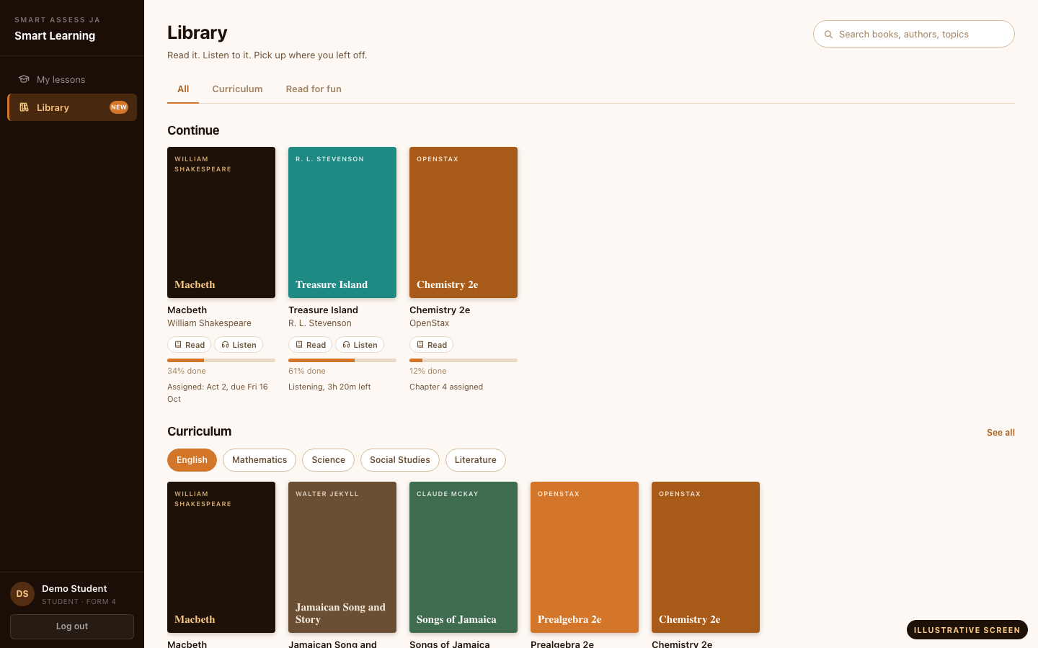

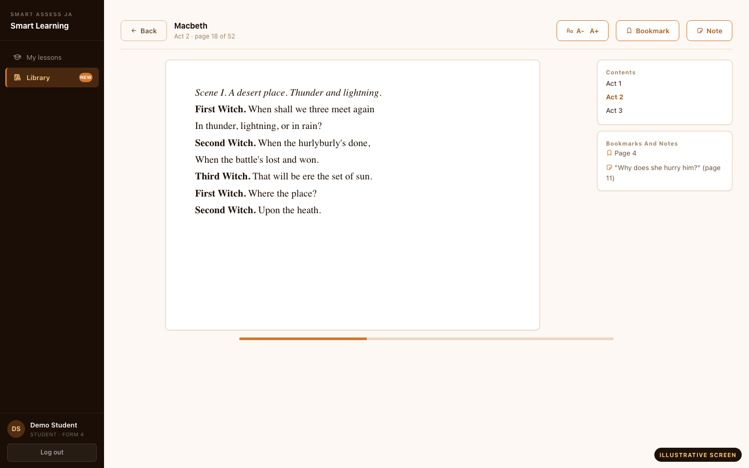

The Library: read it, listen to it
PART 1 | THE STRATEGY
Books for the curriculum and books for the joy of reading, in the same place as the lessons.
Read or listen
Page-by-page reading with bookmarks and notes, and audio that remembers where you stopped.
Two shelves
Curriculum titles such as the set Shakespeare plays, and a read-for-fun shelf.
Teachers assign reading
Pick a book, a class and a due date. The teacher sees who has read it.
The school stays in control
Switch the Library on, choose shelves and forms, hide any title.
ILLUSTRATIVE SCREENS
Every title is chosen and cleared by Smart Assess Ja. Public domain or openly licensed.
Notes:
TIMING: 2 minutes (this adds about 2 minutes to Part 1).
SAY: Smart Learning is not only lessons. Students also have a Library. It has a curriculum shelf, which includes set texts such as Shakespeare, and a read-for-fun shelf. A student can read a book page by page, bookmark a page, keep a private note, or listen to an audio recording, and the Library remembers where they stopped.
Teachers can assign a reading to a class with a due date, optionally with check-your-understanding questions, and see who has read it. Nothing about the Library is forced on a school: the school switches it on, chooses which shelves and forms see it, can switch audio off, and can hide any title.
SOURCING (say this if asked about copyright): Smart Assess Ja chooses and clears every title centrally. We use public-domain works (in Jamaica a work enters the public domain 95 years after the author's death), openly licensed texts and volunteer recordings. Schools do not upload books. A title is only published after rights are confirmed.
STATUS (be precise): the Library is built and tested, but it is switched on school by school. Confirm that it is on at Manchester and that real titles are published before you describe it as live. The screens on this slide are illustrative, not photographs of a live school account. Offline reading is NOT built; do not promise it.

Slide 15

Smart Play: engage and reinforce learning
PART 1 | THE STRATEGY
Coming soon
Topic Mastery
Math Duels
Live Quiz
Fractions
Same questions, compare scores
On the projector, answered on devices
You
8
Classmate
6
Join code 4 8 2 1
24 joined
72%
Which fraction equals 1/2?
7 × 8 = ?
mastery
2/4
3/5
54
56
2/3
1/3
7 day streak
+120 XP
63
48
Practise one topic at a time and watch mastery grow.
Challenge a student in your grade to the same questions.
Enter the code on the teacher's screen and race the class.
Illustrative mock-ups of planned Smart Play screens. Practice and reinforcement, not a replacement for formal assessment.
Notes:
TIMING: 2 minutes.
SAY: Not every learning activity should feel like an examination. Smart Play is where practice becomes engaging: single-player topic practice, head-to-head Math Duels between students in the same grade, and live quizzes the teacher runs on the projector while students answer on their own devices.
STATUS: Smart Play is coming soon at Manchester. These are illustrative mock-ups, not live screens. Say so plainly. All numbers on the screens are examples.
Smart Play does not replace formal assessment. It reinforces learning between assessments.

Slide 16
Assess, learn, practice, improve, assess again
PART 1 | THE STRATEGY
Assess
Information flows to the right people
School leadership
Head of department
Assess again
Learn
One view
of learning
Teacher
Student
Improve
Practice
Notes:
TIMING: 2 minutes.
SAY: The point of three products is the loop. Assess tells you where students are. Learn helps them recover and move forward. Practice reinforces it. Improve, and assess again to see whether it worked.
On the right: the same information is useful to different people at different levels. The student sees their own progress. The teacher sees the class. The head of department sees the department. Leadership gets the broader view.
This is the "one view of learning" idea from the film.

Slide 17
Teachers see classrooms. HODs see departments. Leaders see the school
PART 1 | THE STRATEGY
Teachers
Heads of department
Principal and administrators
Tests, tasks and the question bank
Lesson plans and Smart Learning lessons
Marking and results
Attendance for their classes
Report an absence and see cover
Classrooms and teachers in the department
Analytics and flagged sessions
Final exams and report cards
Department attendance and topics
Arrange cover for absent teachers
Staff, students and timetable
Attendance and alerts across the school
Integrity and AI tutor oversight
Messages across staff
School setup and settings
Notes:
TIMING: 1.5 minutes.
SAY: Different people need different views. A teacher needs their classrooms. A head of department needs the department. Leadership needs the school.
ACCURACY: Everything on this slide corresponds to a screen that exists in the platform today, but what each person sees depends on the roles and features switched on at Manchester. During the hands-on session, use only screens that are actually available to the accounts in the room.

Slide 18
Trust, data and AI with a person in charge
PART 1 | THE STRATEGY
Your data
AI on a short leash
Each school's data lives in its own separate environment
Access rules are enforced by the database itself
Two-factor sign-in is required for all staff
Handled in line with Jamaica's Data Protection Act
AI helps a teacher write: polish a question, import from a PDF, draft a lesson plan
AI never grades a student
Every suggestion is reviewed by a person before it is used
The optional AI tutor stays inside a lesson, with adult review of flagged conversations
Notes:
TIMING: 2 minutes.
SAY: Leadership will want to know where student data lives and what the AI does. Each school gets its own separate environment. Staff accounts require two-factor sign-in. AI is used to help teachers draft, and a person always reviews.
The AI tutor is optional and switched on school by school. Where it is on, flagged conversations go to an adult to read.
If asked for detail on the Data Protection Act or hosting, say you will send a written summary after the session. Do not improvise legal claims.

Slide 19
A pathway we can shape together
PART 1 | THE STRATEGY
1
2
3
4
5
Experience
Choose a start
Pilot
Review
Expand
Today: use it hands-on and tell us what you see.
Pick departments, classes and assessment types.
Run it for a defined period with real classes.
Look at the evidence together.
Decide how and when to widen it.
How we would measure success
Teacher hours saved preparing and marking
Paper no longer printed and copied
Time from exam to usable results
Learning gaps found and acted on
Teacher and student feedback
Scope, timing and measures are decided with you. This is a starting proposal.
Notes:
TIMING: 2 minutes.
SAY: I do not want to hand you a contract. This is a pathway. Step 1 is what we are doing today. Step 2 is for you to choose a starting point that matters: which departments, which classes, which kinds of assessment. Then a pilot of a defined length, a review against measures you care about, and only then a decision on how to widen it.
Everything on this slide is a proposal for discussion. Do not commit to dates, scope or numbers here. Leave the final slide of Part 2 to draw out where the room would start.
The measures are examples of what to track, not claims about results.

Slide 20
Now, experience it.
Teacher. Student. Leadership.
Notes:
TIMING: 30 seconds.
SAY: That is the strategy. Now you are going to experience it. Everyone will see Smart Assess from a different seat.
Before moving on: confirm everyone has their login details, a device, and the sign-in page open. Hand out the printed challenge sheets (one page per role) and the feedback capture sheet to whoever is taking notes.

Slide 21

The hands-on session: about 40 minutes
PART 2 | HANDS-ON SESSION
3
10
7
5
5
5
5
min
min
min
min
min
min
min
1
2
3
4
5
6
7
Orientation
Teacher
Student
Results
Smart Learning
Smart Play
Leadership
Then: explore on your own
And finally: decide together
10 minutes to try the challenge sheet for your role.
What would need to be true, and where would you start?
Notes:
TIMING: 1 minute.
SAY: Here is the plan for the next 40 minutes: orientation, then the teacher view, the student view, results, Smart Learning, Smart Play, and the leadership view. After that you explore on your own for 10 minutes, and we finish with a group discussion.
The bar is drawn to scale. If time is short, shorten Phase 2 or Phase 7 rather than dropping the hands-on exploration.
FACILITATOR RULE: during hands-on testing do not take over anyone's screen. Ask: "What are you trying to do?" and guide from there. Write down what you see.

Slide 22



PHASE 1 | ORIENTATION | 3 MIN
Everyone will experience Smart Assess from a different perspective
Teacher
Student
Leadership
Create, assign, mark
Take it, submit it, see progress
See across classes and departments
The ecosystem connects these experiences.
Notes:
TIMING: 3 minutes.
SAY: Everyone is going to experience Smart Assess from a different perspective. If you have a teacher account, you will see how an assessment is built and marked. If you have a student account, you will take one. If you are in leadership, you will see what school-wide information looks like.
The ecosystem connects these experiences: what a teacher builds, a student completes, and a leader reviews is the same assessment.
SETUP CHECK: staff use their own real accounts. Student accounts and data are demo data only. Remind everyone not to use real student information during the exercise.

Slide 23
Teacher experience: ten things to find
PHASE 2 | TEACHER | 10 MIN
1
Log in
6
Review the question types
At every stage, ask:
2
Explore the teacher dashboard
7
Explore class assignment
How much time would this normally take?
3
Identify the assessment tools
8
Explore marking and results
4
Explore the question bank
9
Explore lesson planning
Then compare with the paper way: write, print, copy, collect, mark.
5
Open or create an assessment
10
Observe the whole workflow
Notes:
TIMING: 10 minutes.
FACILITATE: Teachers log in with their own accounts. Walk through the list in order, but let people wander. At each stage, ask: "How much time would this normally take?" and connect the answer to the paper workflow (write, print, copy, collect, mark).
DO NOT take over anyone's screen. Ask "What are you trying to do?" and guide.
CAPTURE: Write down confusing navigation, missing information, questions, and concerns on the feedback sheet.
QUESTIONS TO USE HERE: (1) "What currently takes the most time when preparing an examination?" (2) "How much printing does assessment require?"

Slide 24
Student experience: take it, submit it, see it
PHASE 3 | STUDENT | 7 MIN
1
Log in
Smart Assess is not simply digitizing a PDF.
2
Open assigned work
3
Experience the assessment
It is a structured digital assessment workflow.
4
Answer the questions
5
Navigate the assessment
What the teacher sees
What the student sees
6
Submit
Builds, assigns, marks and reviews results.
Only their own work, in a focused view they can save and submit.
7
See the result or progress view
Notes:
TIMING: 7 minutes.
FACILITATE: Anyone with a student account logs in and takes the demo assessment. Students (or staff using student demo accounts) open the assigned work, answer, navigate between questions, and submit.
SAY: This is not a PDF on a screen. The platform saves answers as students work, keeps a record, and passes the responses to marking and results.
DEMO DATA: Student accounts and data are demo data only. If anyone asks, confirm no real student information is used.
Then ask: "How is this different from the teacher experience?"

Slide 25
From assessment to performance information
PHASE 4 | RESULTS | 5 MIN
Assessment
Student responses
Marking
Results
Performance information
Ask the room
Then connect it to Smart Learning
What would you normally do after receiving these results?
Results show what happened. Learning decides what happens next.
Notes:
TIMING: 5 minutes.
FACILITATE: Return to the teacher or administrator view. Show the path: assessment, student responses, marking, results, performance information. Show how the information could support instructional decisions: which questions were missed, which classes struggled.
ASK: "What would you normally do after receiving these results?" Listen for answers like re-teaching, extra classes, or nothing, because there was no time. Then connect to Smart Learning.
QUESTION TO USE HERE: "How long does it normally take before teachers can analyze results?"
ACCURACY: Show only the screens that exist for the accounts in the room.

Slide 26
Assessment tells us what happened. Learning tells us what we do next
PHASE 5 | SMART LEARNING | 5 MIN
Show, where enabled:
The 5E lesson
Topic
THE MANCHESTER SCENARIO
A student misses three days of school.
Student progress
Check-your-understanding
Coverage
The Library, if on
Show how Smart Learning is designed to give that student a path back into the learning.
Smart Learning is switched on at Manchester. Demonstrate only what is enabled.
Notes:
TIMING: 5 minutes.
SAY: Assessment tells us what happened. Learning tells us what we do next.
FACILITATE: Open a Smart Learning lesson. Show the structure (the five steps), the topic, student progress, a check-your-understanding question, and the coverage view. Then tell the Manchester scenario: a student misses three days. Show how the lesson, once assigned with the day it was taught, is offered to that student as a catch-up.
LIBRARY: if the Library is switched on for the demo accounts, open it from the student menu: show the two shelves, open a book, turn a page, add a bookmark. For the teacher account, show Assign reading. If the Library menu item is not there, say it is switched on school by school and show the Library slide from Part 1 instead.
ACCURACY: Smart Learning is switched on at Manchester, so you can demo it live. The AI tutor is a separate switch. Only show it if it is enabled; otherwise describe it as optional.
QUESTION TO USE HERE: "What happens when a student misses an important lesson?"

Slide 27




Not every learning activity should feel like an examination
PHASE 6 | SMART PLAY | 5 MIN
Coming soon
Jeopardy-style board
Tug of War
XP, badges, streaks, leaderboards
Fractions
Algebra
Shapes
Data
Team A
Team B
100
100
Weekly XP
7 day streak
200
200
200
300
300
300
300
Student A
400
400
400
400
Student B
Student C
Students buzz in from their own devices
Every student appears on the field
Pick categories and run a buzz-in board on the projector.
Two teams race through quick questions and pull the rope.
Rewards that keep practice going.
Illustrative mock-ups of planned Smart Play screens. Not live at Manchester.
Notes:
TIMING: 5 minutes.
SAY: Not every learning activity should feel like an examination. Smart Play turns reinforcement and practice into something students want to do.
STATUS: Smart Play is coming soon at Manchester, so you are showing illustrative mock-ups on this slide, not a live environment. Say that plainly. Do not pretend it is live.
Walk through: the Jeopardy-style board (the teacher picks categories and runs a buzz-in board on the projector), Tug of War (two teams race through quick questions, every student appears on the field), and the rewards that keep practice going: XP, streaks, badges and class leaderboards. All names and numbers here are examples.
REMIND: Smart Play is not a replacement for formal assessment.

Slide 28
Leadership: a broader view of the school
PHASE 7 | LEADERSHIP | 5 MIN
Leadership gets a broader view of the school
Show, where appropriate
Department information
Analytics
Attendance
Student performance
Teacher and class information
Curriculum and topic coverage
Leadership oversight
HODs see their departments
Teachers see their classrooms
Notes:
TIMING: 5 minutes.
FACILITATE: For the principal, vice principal and heads of department: log in with their own accounts and look at what is available to them. Teachers see their classrooms; HODs see their departments; leadership gets a broader view of the school.
ACCURACY: Show only screens and permissions that are actually implemented for these accounts. If something on the list is not available at Manchester yet (for example, attendance if not set up), say so; do not demonstrate or promise it.
QUESTIONS TO USE HERE: (5) "How do HODs currently identify learning gaps across classes?" (6) "What information would leadership like to see that is difficult to get today?"

Slide 29
THE "AHA" MOMENT
Think about the current process for creating, printing, administering, marking and analyzing an examination.
Create
Print
Copy
Administer
Collect
Mark
Record
Analyze
How many steps just disappeared?
Notes:
TIMING: 2 minutes. Stop the demonstration here.
SAY: Pause. Close the laptops for a moment. Think about how an examination works today: creating, printing, administering, marking and analyzing.
ASK: "How many steps just disappeared?"
Let the room answer. Do not give a number yourself and do not claim a specific figure; only name what you actually demonstrated (for example: printing, copying, collecting, and manual recording).

Slide 30
And what becomes possible when assessment data is connected to learning and reinforcement?
SMART ASSESS
Measure
SMART LEARNING
Teach
SMART PLAY
Engage
Notes:
TIMING: 1.5 minutes.
SAY: And what becomes possible when assessment data is connected to learning and reinforcement? Results from Smart Assess tell a teacher who needs help. Smart Learning gives those students a structured way back in. Smart Play keeps practice going between assessments.
This is the ecosystem. Then move straight to the hands-on exercise.

Slide 31
Your turn: 10 minutes to explore
HANDS-ON EXERCISE | 10 MIN
Teacher
Student
HOD or administrator
Find your class
Find your assigned work
Find department information
Find or create an assessment
Complete an assessment
Find analytics
Find the question bank
Submit
Find attendance
Find lesson planning
Find your progress and results
Find student and teacher information
Find student results
Find progress information
Stuck? Say what you are trying to do. We will guide you rather than take over your screen.
Notes:
TIMING: 10 minutes.
FACILITATE: Everyone works independently on the challenge sheet for their role. Hand out the printed sheets. Walk the room.
RULES: Do NOT immediately take over someone's screen. Ask: "What are you trying to do?" and guide. Write down: confusing navigation, missing information, questions, bugs, feature requests, and teacher, student and administrator concerns on the feedback capture sheet. These become post-meeting product feedback.
KEEP IT LIGHT: This is exploration, not a test of the participants. If someone cannot find something, that is feedback about the product.

Slide 32
Eight questions to keep the conversation open
QUESTIONS FOR THE ROOM
What currently takes the most time when preparing an examination?
How much printing does assessment require?
Phase 2
Phase 2
How long does it normally take before teachers can analyze results?
What happens when a student misses an important lesson?
Phase 4
Phase 5
How do HODs currently identify learning gaps across classes?
What information would leadership like to see that is difficult to get today?
Phase 7
Phase 7
Which part of this workflow would save teachers the most time?
Which feature would you want your department to use first?
Any time
Any time
Notes:
TIMING: reference slide; not shown for long.
USE: These eight questions make the session collaborative rather than a one-way pitch. Ask them at the phase shown on each card (or any time the conversation allows). Write the answers down on the feedback sheet; they are the raw material for the next implementation conversation.
Do not rush to answer. Silence is fine.

Slide 33



What would need to be true for Manchester High School to adopt this?
FINAL DISCUSSION
People
Process
Technology
Who would lead? Who needs to be on board?
What changes in how exams are set, marked and reviewed?
Devices, connectivity, sign-ins and support.
Training
Data
Implementation
Who needs training, and when?
What do leaders need to see, and how is it protected?
Where does it start, and what is the first term like?
Notes:
TIMING: 8 to 10 minutes.
ASK: "What would need to be true for Manchester High School to successfully adopt this?"
FACILITATE: Capture the answers on a whiteboard or flip chart under six headings: People, Process, Technology, Training, Data, Implementation. Let the room fill them in; use the prompts on the cards only if the room goes quiet.
Then discuss a potential pilot or adoption pathway (see the pathway slide in Part 1). Do not pitch a contract.

Slide 34
WHAT COULD MANCHESTER HIGH SCHOOL LOOK LIKE WITH SMART ASSESS JA?
SMART ASSESS
SMART LEARNING
SMART PLAY
Measure learning.
Deliver and recover learning.
Engage and reinforce learning.
ONE SCHOOL. ONE ECOSYSTEM. ONE CONNECTED LEARNING EXPERIENCE.
Where would you start?
Notes:
TIMING: as long as the room needs.
ASK: "Where would you start?"
Then stop talking. Do not immediately pitch a contract. Let the room identify the highest-value starting point. Their answers decide the next implementation conversation: which department, which kind of assessment, which problem hurts most.
Before you leave: collect the feedback sheets, photograph any whiteboard notes, and agree who will follow up and by when.

