Slide 1

SURVEY
STRATEGY SESSION AND LIVE DEMONSTRATION
SMART
ASSESS
JA
ASSESS
LEARN
PLAY
Smarter assessments. Better learning.
WHY US
BUILT FOR MANCHESTER HIGH SCHOOL
Presented by: Steven Gordon
Notes:
About 1 minute.
Welcome everyone. The ice breaker answers on page 1 of your guide will come back at the end. Today: a short film (already shown), then this strategy section, then a live demo, then questions.

Slide 2
WHY WE BUILT IT
SURVEY
TECHNOLOGY FINALLY ORGANISED AROUND HOW A SCHOOL ACTUALLY WORKS.
ASSESS
LEARN
PLAY
That is the idea behind Smart Assess Ja.
ASSESS
LEARN
PRACTISE
WHY US
One school. One group. One platform.
Notes:
About 1 minute.
This is the idea in one line. Schools run on many separate tools. We built one connected system around how a school actually works: assess, learn, practise.

Slide 3
THE PROBLEM
SURVEY
EVERY YEAR, LEARNING TRAVELS ONTO PAPER.
ASSESS
1
2
3
4
CREATE
PRINT
COPY
ADMINISTER
Teacher creates the exam
Copies are printed
Enough papers are prepared
Students sit the exam
LEARN
5
6
7
8
COLLECT
MARK
RECORD
ANALYSE
PLAY
Papers come back
Teacher marks
Grades are entered
Results are interpreted
This consumes time, money, paper and administrative effort.
WHY US
The assessment itself may take one hour. The work around it will take longer.
Notes:
About 1.5 minutes.
Walk the eight steps. The assessment itself may take one hour; the work around it takes much longer. Ask: where does the time go in your department? (Their ice breaker answers may already mention it.)

Slide 4
YOUR SCHOOL
SURVEY
ONE SCHOOL OF ABOUT 1,800 STUDENTS AND 100+ STAFF
ASSESS
≈1,800
STUDENTS
Take work, see results, catch up
STUDENTS
TEACHERS
LEARN
100+
Set, mark and teach
HEADS OF DEPARTMENT
MEMBERS OF STAFF
See a whole department
PLAY
Every test, lesson and class creates information. Can teachers and leaders really see it?
PRINCIPAL AND ADMINISTRATORS
See the whole school
WHY US
Notes:
About 1 minute.
Manchester High School is about 1,800 students and more than 100 members of staff. Every test, lesson and class produces information. The question is whether teachers and leaders can see it, in time to act.

Slide 5
WHAT MANCHESTER HIGH SCHOOL STUDENTS TOLD US
SURVEY
STUDENTS WANT TO BE SHOWN HOW
WHAT WOULD HELP YOU LEARN A DIFFICULT TOPIC?
WHAT WOULD YOU WANT TO SEE ABOUT YOUR PROGRESS?
ASSESS
LEARN
PLAY
WHY US
83% want help studying for exams. 58% chose flashcards for practice; we built it.
Notes:
About 1.5 minutes.
Twelve students filled in a short paper survey. A small sample, so read it as a signal, not a verdict. Step-by-step explanations came first, then practice questions. Ask the room: do these sound like your students? Wifi and offline access came up unprompted.

Slide 6
WHAT MANCHESTER HIGH SCHOOL TEACHERS TOLD US
SURVEY
MARKING IS WHERE THE TIME GOES
WHICH PARTS OF ASSESSMENT TAKE THE MOST TIME OR EFFORT?
ASSESS
90%
Wants a system to show what an absent student missed
90%
want different activities for different ability levels
LEARN
80%
want AI-assisted lesson planning
PLAY
"A learning gap tracker that analyses assessment results and suggests activities for reteaching and practice."
WHY US
Notes:
About 1.5 minutes.
Ten teachers. Marking is the biggest time cost (80% of teachers). 90% want the system to show what an absent student missed, and 90% want activities for different ability levels. 80% want AI-assisted lesson planning. Everything on this slide is something we have now built; the last two slides before the demo show how.

Slide 7
ONE PLATFORM, THREE PRODUCTS
SURVEY
ALREADY BUILT. READY TO USE.
ASSESS
1
SMART ASSESS
ALREADY BUILT
Measure learning. Set, sit, mark and understand tests, exams and results.
LEARN
2
SMART LEARNING
ALREADY BUILT
Deliver and recover learning. Lessons, plans, study support and catch-up.
PLAY
3
SMART PLAY
COMING SOON
Engage and reinforce learning. Quick games, duels and rewards.
WHY US
They share one school, one set of people and one platform.
Notes:
About 1 minute.
One platform, three products with three different jobs. Assess measures learning. Learning delivers and recovers it. Play makes practice engaging. Two are already built and in use at Manchester; Play is built and held back until you choose to launch it.

Slide 8
MEET THE PRODUCT
SURVEY
ASSESS
1
LEARN
SMART
ASSESS
WHAT IT DOES
Build tests and exams, with the help of AI.
PLAY
Mark automatically, give assignments / homework from one system
Measure learning.
See what the class is lacking and who needs support
WHY US
For teachers, students, heads of department and leaders.
ALREADY BUILT
Notes:
About half a minute. One line: Smart Assess is for assessment only. The next four slides show building, marking, results and security. 80% of teachers named marking as their biggest time cost, so that is where we start.

Slide 9
SMART ASSESS
ALREADY BUILT
SURVEY
EVERY ASSESSMENT, ONE SECURE RECORD
ASSESS
EXAMS, TESTS AND TASKS
QUESTION BANK
SUBJECT TOOLS
LEARN
Pop quizzes to end-of-year exams, plus assignments and homework. Five question types, with images and audio.
Save a question once, tag it to a topic, reuse it in future tests.
Built for each subject, starting with an equation toolbar and calculator for maths.
PLAY
PDF IMPORT AND AI DRAFTING
SECURE SITTING
MARKING AND RESULTS
Turn an exam PDF into questions, or draft questions from a topic. You review every one.
One device, tab-switch logging, blocked pasting, a desktop lock-down app, saved answers.
Automatic marking, essay marking points, controlled release and report cards.
WHY US
For assessment only. Lessons belong to Smart Learning, games to mart Play.
Notes:
About 1.5 minutes.
Smart Assess is for assessments only: set it, sit it, mark it, understand it. Walk the six cards quickly. The demo will show building a test and the results screens.

Slide 10
SMART ASSESS
SURVEY
MARKING THAT SAVES TIME
ASSESS
1
2
3
4
5
STUDENT SUBMITS
OBJECTIVE ITEMS MARKED
ESSAYS: MARKING POINTS
AI SUGGESTS, YOU DECIDE
RELEASE WHEN READY
LEARN
Answers are saved as they go
Instantly, with no teacher time
The teacher writes what earns marks
Words that earned each mark, flagged where unsure
Students are emailed
PLAY
THE AI NEVER SAVES A MARK.
It never sees a student's name, and it runs only when a teacher asks.
WHY US
80% of teachers named marking as the biggest drain on their time.
Notes:
About 1.5 minutes.
This answers the biggest survey signal: marking. Objective questions are marked the moment a student submits. For essays the teacher defines marking points; the AI can suggest a mark for each point with the words that earned it, flags where it is unsure, and the teacher edits and saves. The AI never saves a mark, never sees a student name, and only runs when a teacher asks. It is switched on per school.

Slide 11
SMART ASSESS
SURVEY
RESULTS THAT TELL YOU WHAT TO DO
ASSESS
EXAM INSIGHT
MY TOPICS
SCHOOL ANALYTICS
Which questions the class missed
The wrong answer most students chose
Who may need support, and why
Compared with the last five tests
Students see which topics need work
Built from released, marked results
‘One tap’ to practise a weak topic
Links to lessons on that topic
Pass rates by subject and department
Flagged exam sessions in one place
Report cards for every student
Downloadable as a spreadsheet
LEARN
PLAY
FOR TEACHERS
FOR STUDENTS
FOR HODS AND LEADERS
WHY US
Notes:
About 1.5 minutes.
Teachers asked who is struggling and what the common mistakes are (80% and 70%). Exam insight shows, per test, which questions the class missed, the wrong answer most students chose, which students may need support and why, and the class against its last five tests. Students get My Topics: their own results by topic, with a practise button. Leaders get department and school analytics.

Slide 12
SMART ASSESS
SURVEY
FAIR, SECURE AND SUPPORTIVE OF EACH STUDENT'S ACCESSIBILITY
ASSESS
LOCK-DOWN AND TAB LOGGING
ONE DEVICE AT A TIME
A desktop app for Windows and Mac locks the screen to the exam. Tab switches are logged and pasting is blocked.
A student is signed in on one device at a time.
LEARN
SAFE IF THE CONNECTION DROPS
ACCESSIBILITY
PLAY
Answers are kept on the device and sent when the connection returns. Late work is flagged, not lost.
A teacher can switch on read-aloud and other accommodations for a student who needs them.
WHY US
Notes:
OPTIONAL: skip if you are short of time.
About 1 minute.
Fair and secure by design. Tab switches are logged and pasting is blocked. A student can only be signed in on one device. A lost connection does not lose the exam. Teachers can switch on read-aloud support. Integrity flags are only prompts: a person always decides.

Slide 13
MEET THE PRODUCT
SURVEY
ASSESS
2
LEARN
SMART
LEARNING
WHAT IT DOES
5E Lesson Plan, 4 Level DOK, YouTube Short’s Style Learning
PLAY
Catch-up for absent students, flashcards and the Library
Deliver and recover learning.
AI lesson plans shaped by Jamaica and the national curriculum
WHY US
For teachers, students, heads of department and leaders.
ALREADY BUILT
Notes:
About half a minute. Assessment tells you what happened; Smart Learning helps you act on it. The next slides cover lessons, catch-up, study support and the Library.

Slide 14
SMART LEARNING
ALREADY BUILT
SURVEY
DELIVER AND RECOVER LEARNING
Assessment tells you what happened. Learning helps you act on what we found.
ASSESS
1
ENGAGE
2
EXPLORE
3
EXPLAIN
4
ELABORATE
5
EVALUATE
LEARN
CHECK YOUR UNDERSTANDING
AI LESSON PLANS
SHARED PLAN LIBRARY
Short questions in each lesson, at support, core and stretch levels.
A full 5E plan with objectives and a DOK level, shaped by Jamaica. You review it.
Browse and copy published plans from teachers at other schools.
PLAY
COVERAGE GRID
CATCH-UP
TEACHER RESOURCES
WHY US
Which topics each class has been taught, and where gaps remain.
Absent students are offered the lesson they missed.
Share links and files with your department, tagged by subject and topic.
Notes:
About 1.5 minutes.
Smart Learning is for learning only: lessons, study support, catch-up and reading. Assessment tells you what happened; Learning helps you act on it. Lessons follow the national curriculum 5E model. Short check questions come at three levels, support, core and stretch, which answers the 90% who asked for different activities for different ability levels. The AI drafts a lesson plan from a subject, grade and topic; the teacher reviews it.

Slide 15
SMART LEARNING
ALREADY BUILT
SURVEY
DOK: HOW DEEPLY STUDENTS THINK
Every lesson plan has a general objective, specific objectives and a DOK level from 1 to 4.
ASSESS
LEVEL 3
LEVEL 4
LEVEL 1
LEVEL 2
LEARN
REASONING
EXTENDED THINKING
RECALL
SKILL
Explain why, compare, and justify an answer.
Investigate a real problem over days or weeks.
Remember a fact, a term or a step.
Use a method on a familiar problem.
PLAY
EXAMPLE
EXAMPLE
EXAMPLE
EXAMPLE
State the formula for simple interest.
Find the interest on J$20,000 saved for 2 years at 5%.
Compare two savings accounts and justify the better one for a student.
Plan and present a savings goal for a class trip, using real bank rates.
WHY US
The AI suggests a level. The teacher reviews it and can change it. Aim for a mix, not all level 4.
Notes:
About 1 minute.
DOK is Depth of Knowledge, a simple scale from 1 to 4 for how deeply a student has to think. It is about the thinking, not how hard the topic is. Level 1 is recall, level 2 is using a method, level 3 is reasoning and justifying, and level 4 is an extended investigation. Every lesson plan in Smart Learning carries a DOK level next to a general objective and specific objectives. When a teacher asks the AI to draft a plan it suggests a level, and the teacher always reviews and can change it. The point is balance: it helps a teacher see when every task has stayed at recall, without turning everything into a project. The examples use simple interest because it is in the Grade 9 mathematics topic list.

Slide 16
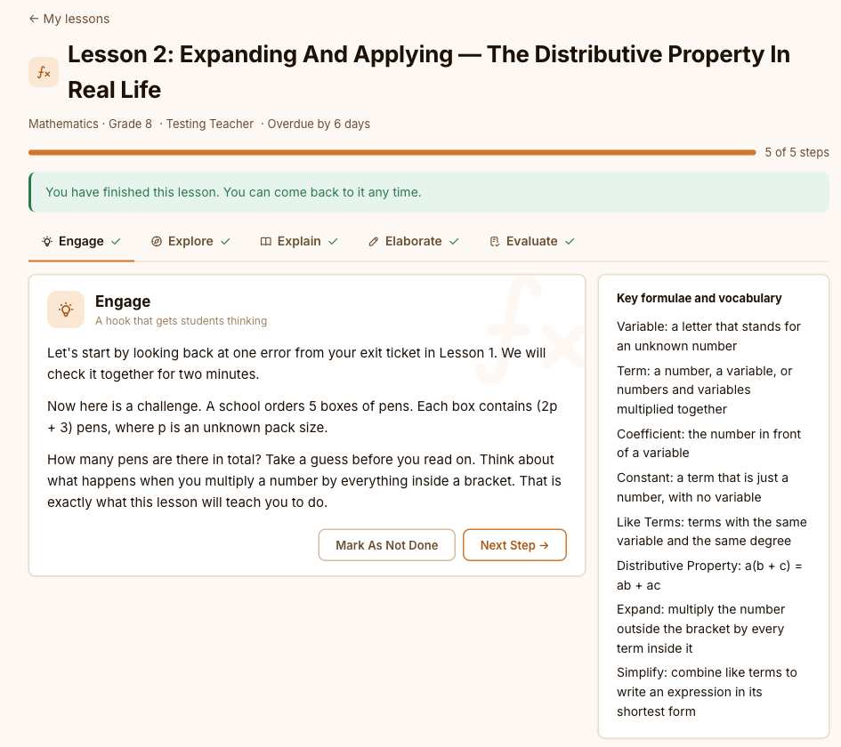
SMART LEARNING
SURVEY
WHEN A STUDENT MISSES ONE OR MORE DAYS
1
ASSESS
MON TO WED
The student is away. The class moves on.
2
THE LESSON IS WAITING
LEARN
It is offered as a catch-up, the day it was taught.
3
A WAY BACK IN
Steps, check questions and progress, at their own pace.
PLAY
4
THE TEACHER CAN SEE IT
Who has caught up, and where they got stuck.
WHY US
Missing class should not mean losing the opportunity to adequetly learning.
Notes:
About 1.5 minutes.
The scenario: a student misses three days. The teacher records when each lesson was taught. The absent student is offered the lesson as a catch-up, works through it at their own pace, and the teacher sees who has caught up. 90% of teachers asked for exactly this. The screen on the left is a real lesson from the Manchester demo school.

Slide 17
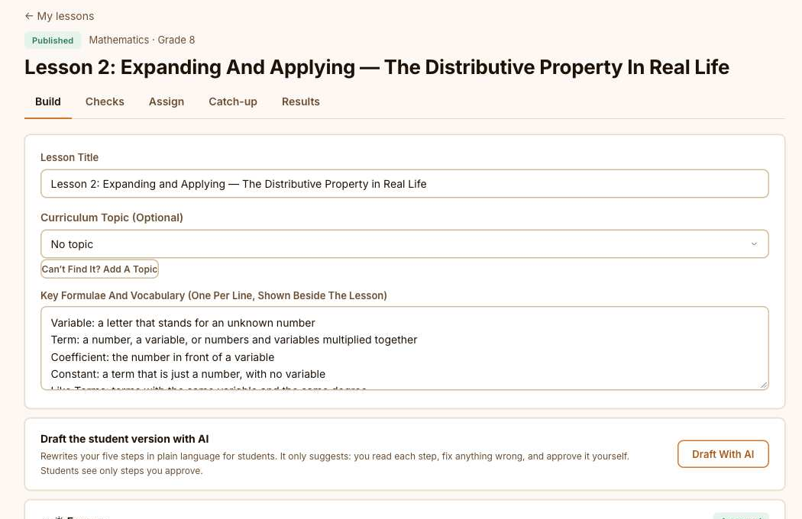
SMART LEARNING
SURVEY
STUDY SUPPORT THAT FITS EACH STUDENT
ASSESS
FLASHCARDS
Students build their own decks. Flip, then "Got it" or "Not yet". Cards you miss come back sooner.
THREE LEVELS OF PRACTICE
LEARN
Support, core and stretch questions for each lesson, suggested from a student's topic results.
CURRENT AND FUTURE
What is happening now and what is coming, for students and teachers, with upcoming assignment reminders. No email.
PLAY
A teacher's lesson builder, with the optional "Draft with AI" button. Demo data.
WEAK TOPIC TO LESSON
From a weak topic in Smart Assess, ‘one tap’ to the lessons and practice for it.
WHY US
58% of students chose flashcards. 90% of teachers asked for activities at different ability levels.
Notes:
About 1.5 minutes.
What students and teachers told us they want, and what is built: flashcards (58% of students chose them) with review spacing, so cards you miss come back sooner; support, core and stretch practice per lesson; a "Current and future" page for students and teachers (what is happening now and what is coming, including upcoming assignment reminders, with no email); and the teacher resource space. The screen on the right is a real lesson builder from the demo school, with the optional AI drafting button.

Slide 18
SMART LEARNING
ALREADY BUILT
SURVEY
HEAR FROM EVERY CLASS, EVERY WEEK
ASSESS
1
2
3
STUDENTS
TEACHERS
THE REPORT
LEARN
One minute per class. How well did you follow? Which topic was hardest? Was the pace right? Anything that helped?
A short end-of-week reflection for each class: where you are against plan, what went well, what to do next.
A progress report for each class, with plain advice and an AI summary you check. Printable.
PLAY
PRIVATE BY DESIGN
Only the class teacher and head of department see names, and only so they can help. Everything else is anonymous. The administrative team sees anonymous results.
WHY US
A teacher with reflections still to write gets one email on Friday afternoon.
Notes:
About 1.5 minutes.
Teachers asked how they would know whether lessons are landing. Each week, every student gives a one-minute evaluation of each class on their timetable: how well they understood, which topic was hardest, whether they want help, the pace, and what helped. Each teacher writes a short end-of-week reflection. The system then builds a progress report for each class with plain advice, for example "many students said the lessons went too fast", and an optional AI summary the teacher checks. Privacy is built into the database, not just the screen: the class teacher and head of department see names against the first three answers so they can help; everything else is anonymous and appears only once five students have answered. The principal team sees anonymous results only. A teacher who still has reflections to write gets one email on Friday afternoon.

Slide 19
SMART LEARNING
ALREADY BUILT
SURVEY
HELP STUDENTS BEFORE THEY FALL BEHIND
ASSESS
A CLEAR LIST FOR STAFF
SUPPORT PLANS
Who may need help, and why, in plain words: marks below the school average or falling, absences, unfinished lessons.
A goal, a review date and what was done. Shows whether results moved: "Up 12 points in Science".
LEARN
MY PROGRESS FOR STUDENTS
GENTLE NUDGES
Compared only with their own earlier results. Never classmates, never the school average.
Away from school? Lessons past their date? A kind prompt with a button to the right place.
PLAY
Teachers see marks only in the subjects they teach.
WHY US
Notes:
About 1.5 minutes.
You asked how to focus on students below the school average. Four parts. One: a staff list that shows, in plain words, who may need help and why: results well below the school average or falling, absences, lessons left unfinished, a long time since sign-in, or asking for help in class feedback. Two: a support plan for each student with a goal, a review date and a record of what was done, and it shows whether their results moved afterwards. Three: for the student, a My progress page that compares them only with their own earlier results, never with classmates. Four: gentle nudges to the student, such as lessons past their date. The school average is only shown once five students have results. Teachers see marks only in the subjects they teach; heads of department see their department; the principal team sees all subjects. Students never see the staff list, a plan or the school average.

Slide 20
SMART LEARNING
ALREADY BUILT
SURVEY
VIDEOS TEACHERS HAVE CHOSEN
ASSESS
1
ADD A LINK
YouTube, Vimeo or Khan Academy. Nothing is uploaded, so the school hosts nothing.
2
APPROVED FIRST
A teacher's video waits for the head of department. A head's video is live at once.
LEARN
3
A SHORT-VIDEO FEED
By subject and grade. YouTube and Vimeo play right inside Smart Learning.
4
LOW-DATA MODE
No pictures, and a video loads only when tapped. On by itself for slow connections.
PLAY
5
REPORT A PROBLEM
Two student reports hide a video until a teacher checks it.
WHY US
Videos stay on their own site.
Notes:
OPTIONAL: skip if you are short of time.
About 1 minute.
Videos: teachers and heads of department add links to videos that already exist on YouTube, Vimeo or Khan Academy. Nothing is uploaded or hosted by the school. A teacher's video waits for the head of department to approve it; a head's video is live at once. Students get a short-video feed by subject and for their grade, and a YouTube or Vimeo video plays right inside Smart Learning. Low-data mode shows no pictures and loads a video only when tapped, and turns on by itself for a phone that is saving data or on a slow connection. Students can report a problem: two reports hide the video until a teacher looks.

Slide 21
SMART LEARNING
SURVEY
THE LIBRARY: READ IT, LISTEN TO IT, ASSIGN IT
ASSESS
1
READ OR LISTEN
Page by page, or audio that remembers where the student stopped.
2
BROWSE YOUR WAY
By shelf, genre or subject: curriculum books and reading for fun.
LEARN
3
TEACHER ASSIGNMENTS
Give assignments on a book or chapter with a due date and see who finished.
4
BOOKMARKS AND NOTES
Students keep private bookmarks and notes. Teachers cannot read them.
PLAY
5
SCHOOL CONTROLS
The school chooses shelves, year groups, audio and which titles are visible.
WHY US
Every title is chosen and cleared by Smart Asses Ja. Schools do not upload books.
Notes:
OPTIONAL: skip if you are short of time.
About 1 minute.
The Library: books for the curriculum and books for the joy of reading, in the same place as the lessons. Smart Assess Ja chooses and clears every title (public domain or openly licensed), so schools do not upload books. The Library is built and switched on; titles are being added.

Slide 22
MEET THE PRODUCT
SURVEY
ASSESS
3
LEARN
SMART
PLAY
WHAT IT DOES
Duels, live quizzes, boards and team games
PLAY
Points, streaks, badges and class leaderboards
Make practice fun.
Questions from the same topic list as lessons and tests
WHY US
For students and teachers.
COMING SOON
Notes:
About half a minute. Built and tested, held back until the school chooses to launch it. The next slide shows the games.

Slide 23
SMART PLAY
COMING SOON
SURVEY
ENGAGE AND REINFORCE LEARNING
ASSESS
TOPIC MASTERY
MATH DUELS
LIVE QUIZ
Practise one topic and watch mastery grow.
Two students race through maths questions.
A quiz on the projector, answered on own devices.
LEARN
JEOPARDY-STYLE BOARDS
TUG OF WAR
REWARDS
PLAY
Categories and points, with buzz-in for teams.
Go head-head with teams in mathematical questions and see which team has the most force.
Points, streaks, badges and class leaderboards.
WHY US
Notes:
About 1 minute.
Smart Play is built and tested but held back until you choose to launch it. Quick, fun practice for the classroom. It does not replace formal assessment and it never holds the school's official results. Games and exams are kept apart on purpose.

Slide 24
JOINED UP
SURVEY
ASSESS, LEARN, PRACTISE, IMPROVE, ASSESS AGAIN
ASSESS
ASSESS
LEARN
PRACTISE
IMPROVE
ASSESS AGAIN
→
→
→
→
LEARN
Find what was missed
Teach it again, or catch up
Flashcards and games
See the change
Check it worked
PLAY
One shared topic list connects them. A weak topic in Smart Assess leads to a lesson in Smart Learning or a game in Smart Play.
WHY US
Notes:
About 1 minute.
This is the point of one connected system. A weak topic found in Smart Assess leads to a lesson in Smart Learning or a game in Smart Play, then back to assessment to see if it worked. No product reaches into another product's data; they share the school, the people and the topic list.

Slide 25
BUILT AROUND YOUR ROLES
SURVEY
TEACHERS SEE CLASSROOMS. HODS SEE DEPARTMENTS. LEADERS SEE THE SCHOOL.
ASSESS
TEACHERS
HEADS OF DEPARTMENT
PRINCIPAL AND ADMINISTRATORS
LEARN
Tests and the question bank
Lessons, plans and catch-up
Marking and results
Attendance for their classes
Report an absence, request cover
Their department's classes and teachers
Analytics and flagged sessions
Vet and publish school exams
Department attendance and topics
Arrange cover for absent teachers
Staff, students and the timetable
Attendance and alerts school-wide
Integrity and AI tutor oversight
Messages to staff
School setup and settings
PLAY
WHY US
Notes:
OPTIONAL: skip if you are short of time.
About 1.5 minutes.
Everyone sees what they need and nothing more. Teachers see classrooms. Heads of department see departments. Principals and administrators see the school. Each role has its own home page and menu.

Slide 26





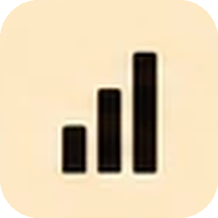


THE DIFFERENCE
SURVEY
ONE CONNECTED SYSTEM,
NOT A STACK OF TOOLS.
ASSESS
Many schools use different tools for different jobs. Smart Assess Ja brings assessment, learning and practice together in one platform, with one login, one set of people and one topic list.
MOST SCHOOLS TODAY
SMART ASSESS JA
Different tools. Different logins. Different data.
One platform. One login. One connected view.
LEARN
Separate tools
One login for everything
Quizzes, lessons and games are often in different platforms, each with its own login and setup.
Assess, learn and practice share one login, one set of people and one topic list.
Different security
Built in security
Each tool has its own lock-down, for example managed Chromebooks, Windows Take a Test app or Safe Exam Browser.
Includes a lock-down desktop app for Windows and Mac, with integrity flags and protected exam settings.
PLAY
Fragmented results
Meaningful results
Some tools report on each question, others only give a quiz score.
Missed questions, common wrong answers, who needs support and results by topic, linked to lessons and practice.
Built for other contexts
Made for Jamaica
General tools, designed differently by each company.
Lesson plans in the Ministry’s 5E format, and data handled in line with Jamaica’s Data Protection Act.
WHY US
The other tools do their own jobs well.
We connect the jobs.
Notes:
About 1.5 minutes.
Say it as written. Many schools use different tools for different jobs. Smart Assess Ja brings assessment, learning and practice together in one platform, with one login, one set of people and one topic list. Walk down the two columns together: separate tools and one login for everything; different security and built in security; fragmented results and meaningful results; built for other contexts and made for Jamaica. The other tools do their own jobs well. We connect the jobs.

Slide 27
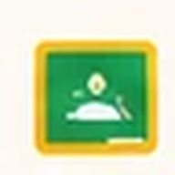






THE LANDSCAPE
STRONG TOOLS. DIFFERENT JOBS.
SURVEY
Each platform has strengths. Smart Assess Ja is different because it brings assessment, learning and practice together in one school platform.
FEATURE / JOB | Google Classroom | Microsoft Teams | Moodle | Canvas | Kahoot! | Quizizz | Smart Assess Ja
ASSESSMENT
Create and deliver exams | – | – | ✔ | ✔ | – | – | ✔
Question bank | – | – | ✔ | ✔ | Limited | Limited | ✔
Different question types (MC, short answer, essay, etc.) | ✔ | ✔ | ✔ | ✔ | Limited | Limited | ✔
Automatic marking (objective questions) | ✔ | ✔ | ✔ | ✔ | ✔ | ✔ | ✔
Exam security and lock-down | – | – | ✔ | ✔ | – | – | ✔
Integrity flags for essays | – | – | – | – | – | – | ✔
LEARNING
Lesson planning (5E format) | – | – | Limited | Limited | – | – | ✔
Structured lessons | ✔ | ✔ | ✔ | ✔ | – | – | ✔
Catch-up learning for absent students | – | – | Limited | Limited | – | – | ✔
AI-assisted lesson creation | Limited | Limited | Limited | Limited | – | – | ✔
Shared lesson library | Limited | Limited | ✔ | ✔ | – | – | ✔
Student progress by topic | Limited | Limited | ✔ | ✔ | Limited | Limited | ✔
PRACTICE AND ENGAGEMENT
Live games and quizzes | Limited | Limited | Limited | Limited | ✔ | ✔ | ✔
Topic Mastery and Math Duels | – | – | – | – | – | – | ✔
XP, badges, streaks, leaderboards | – | – | – | Limited | ✔ | ✔ | ✔
SCHOOL-WIDE
One login and one topic list | – | – | – | – | – | – | ✔
Built for Jamaican schools | – | – | – | – | – | – | ✔
Attendance, timetable, staff tools (in the same platform) | – | – | Limited | Limited | – | – | ✔
ASSESS
LEARN
PLAY
WHY US
The question is not "can another tool do one of these things?"
It is "how many tools and handoffs does the school need?"
Other tools are excellent in their areas. Smart Assess Ja is designed to connect the whole learning process.
Notes:
About 2 minutes.
Walk down the table one section at a time: assessment, learning, practice and engagement, school-wide. Each platform has strengths. Smart Assess Ja is different because it brings assessment, learning and practice together in one school platform. The question is not "can another tool do one of these things?" It is "how many tools and handoffs does the school need?" Other tools are excellent in their areas. Smart Assess Ja is designed to connect the whole learning process.

Slide 28
THE DIFFERENCE IN WORDS
SURVEY
Other platforms are good at what they do. Smart Assess JA is designed to connect assessment, learning and practice around the same students, classes and curriculum topics, while reducing the work teachers do between those activities.
ASSESS
LEARN
Google Classroom is useful for managing classwork. Smart Assess is designed to go further into the assessment process, from creating and administering examinations to marking, understanding results and supporting learning through connected products.
PLAY
WHY US
Notes:
About 1.5 minutes.
Say these two paragraphs as written.
Other platforms are good at what they do. Smart Assess JA is designed to connect assessment, learning and practice around the same students, classes and curriculum topics, while reducing the work teachers do between those activities.
Google Classroom is useful for managing classwork. Smart Assess is designed to go further into the assessment process, from creating and administering examinations to marking, understanding results and supporting learning through connected products.

Slide 29
CLARITY
SURVEY
WHAT SMART ASSESS IS NOT
ASSESS
NOT A TEACHER REPLACEMENT
NOT AI MAKING FINAL DECISIONS
Teachers stay in control of questions, marking and decisions.
AI can help draft and suggest. A person decides, every time.
LEARN
NOT JUST A PDF ON A SCREEN
NOT THREE DISCONNECTED APPS
PLAY
It supports the work before, during and after an assessment.
The products share the school, the people and the topic list.
WHY US
Notes:
About 1 minute.
Be clear about what this is not. It is not a teacher replacement: teachers stay in control of questions, marking and decisions. AI can assist with drafting and review; a person decides. It is not just a PDF on a screen: it supports the work before, during and after an assessment. And it is not three disconnected apps: the products share the school, the people and the topics.

Slide 30
TRUST
SURVEY
TRUST, DATA AND AI WITH A PERSON IN CHARGE
ASSESS
YOUR DATA
AI ON A SHORT LEASH
Each school's data lives in its own separate environment
Access rules are enforced by the database itself
Two-factor sign-in is required for all staff
Handled in line with Jamaica's Data Protection Act
AI helps a teacher write: polish a question, import a PDF, draft a lesson plan
AI suggests essay marks. It never saves one; the teacher edits and decides
Every suggestion is reviewed by a person before it is used
The optional AI tutor stays inside a lesson; the principal can switch it off
AI is told to use Jamaican examples, the National Standards Curriculum and Vision 2030
LEARN
PLAY
WHY US
Notes:
About 1.5 minutes.
Trust, data and AI. Each school's data lives in its own separate environment. Access rules are enforced by the database itself. Two-factor sign-in is required for every staff account, which you set up today. AI helps a teacher write and suggest; it never saves a mark and never decides. Every suggestion is reviewed by a person before it is used. The optional AI tutor stays inside a lesson, is switched on by the school, can be switched off by the principal at any time, and its conversations can be read by the teacher; worrying conversations are flagged for an adult.

Slide 31
YOU ASKED. WE BUILT.
SURVEY
WHAT YOU TOLD US, AND WHAT IS BUILT
YOU SAID | WHAT EXISTS | STATUS
Marking takes the most time (80% of teachers) | Auto-marking, marking points, AI-suggested essay marks | BUILT
Who is struggling, what mistakes are common (80% and 70% of teachers) | Exam insight for every test | BUILT
What a missed student missed (90% of teachers) | Catch-up lessons for absent students | BUILT
Activities for different ability levels (90% of teachers) | Support, core and stretch practice | BUILT
AI-assisted lesson planning (80% of teachers) | AI-drafted 5E lesson plans | BUILT
Topics I need to improve (75% of students) | My Topics, with a "practise this topic" button | BUILT
Flashcards (58% of students) | Flashcards with review spacing | BUILT
Wifi and offline access (raised unprompted) | Flashcards and opened lessons offline | IN TESTING
ASSESS
LEARN
PLAY
WHY US
Notes:
About 1.5 minutes.
This closes the loop on the survey. Left: what Manchester students and teachers told us. Right: what now exists. Be honest about the two that are not finished: step-by-step explanations are partly covered by lessons and the optional AI tutor, and offline use of flashcards and opened lessons is built and in testing.

Slide 32
THE NEXT STEP
SURVEY
A PATHWAY WE CAN SHAPE TOGETHER
ASSESS
1
2
3
4
5
EXPERIENCE
CHOOSE A START
PILOT
REVIEW
EXPAND
LEARN
Today: use it hands-on and tell us what you see.
Pick departments, classes and assessment types.
Run it for a defined period with real classes.
Look at the evidence together.
Decide how and when to widen it.
PLAY
HOW WE WOULD MEASURE SUCCESS
Teacher hours saved marking and preparing
Paper no longer printed and copied
Time from exam to usable results
Learning gaps found and acted on
Teacher and student feedback
WHY US
Notes:
About 1 minute.
A starting proposal, not a plan handed down. Today is step one: experience it. Then choose where to start, pilot it with real classes, review the evidence together, and decide how to widen it. Scope, timing and measures are decided with you.

Slide 33
SURVEY
YOU'VE SEEN IT.
ASSESS
NOW SEE IT LIVE.
LEARN
Teacher. Student. Leadership.
PLAY
Open page 6 of your guide and sign in at
WHY US
mhs.smartassessja.com
Notes:
About 0.5 minutes.
Hand over to the live demo. Teacher, student, leadership. Everyone signs in using page 6 of their guide. Remind them the password changes on first sign-in and that they will need their authenticator app. The system administrator is signed in by the facilitator. The questions page of the guide is for anything that comes up; we come back to questions at the end.

