Slide 1
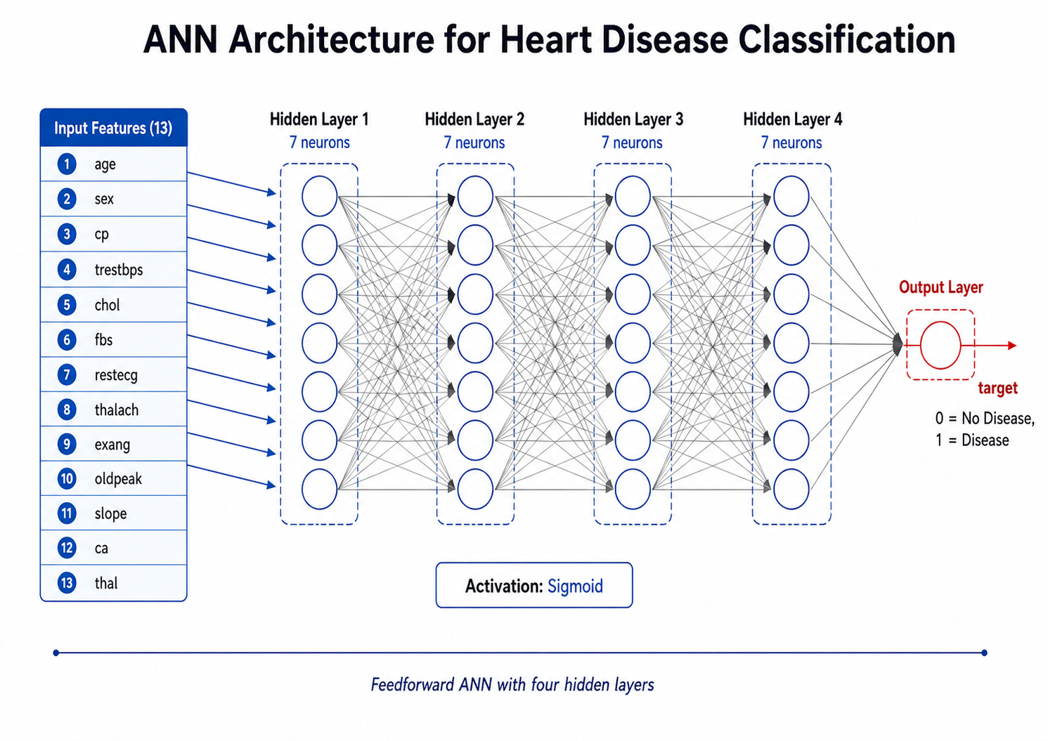
HEART DISEASE PREDICTION USING A CUSTOM NEURAL NETWORK
Machine Learning Course Project Built from scratch using NumPy
National University of Sciences & Technology Military College of Signals Department of Information Security
ANN Architecture: 13 → 7 → 7 → 7 → 7 → 1

Slide 2
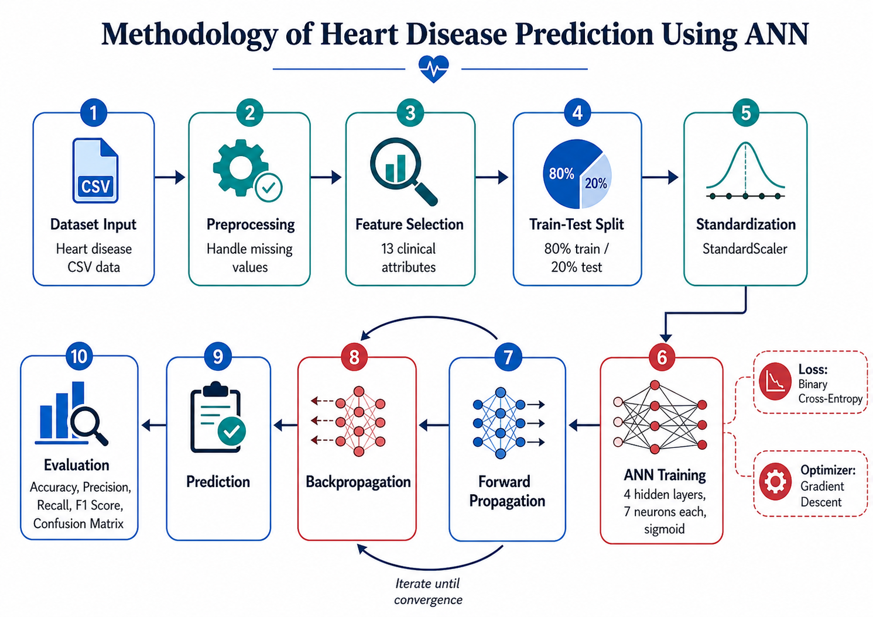
INTRODUCTION
Binary classification using a neural network implemented from scratch.
This project builds a system that predicts whether a patient is likely to have heart disease or not.
The prediction is based on clinical attributes such as age, chest pain type, blood pressure, cholesterol, maximum heart rate, and other medical indicators.
The neural network is implemented manually using NumPy instead of deep learning libraries such as TensorFlow or PyTorch.
Forward propagation, loss calculation, backpropagation, and gradient descent are coded step by step.
Heart Disease ANN Project • 2

Slide 3
TEAM MEMBERS
S. No | Names
1 | NC Ali
2 | NC Haider
3 | NC Haris Abdullah
4 | NC Huzaifa
Project: Heart Disease Prediction Using Custom ANN
Heart Disease ANN Project • 3

Slide 4
GOAL
Understand and implement the mathematical foundations of artificial neural networks.
Build a multi-layer feedforward neural network for binary classification.
Apply the model to a real-world heart disease dataset and evaluate its performance.
Use sigmoid activation in each node as required by the project statement.
Analyze the model using accuracy, precision, recall, F1 score, and confusion matrix.
Heart Disease ANN Project • 4

Slide 5
DATASET
Heart disease dataset with clinical attributes and a binary target label.
The dataset is stored in CSV format as heart.csv.
Each record represents one patient sample.
The dataset contains 13 input features and 1 target column.
The target column shows whether heart disease is absent or present.
target = 0 means No Disease; target = 1 means Disease.
Part | Description
Input features | 13 clinical parameters
Target label | target
Task type | Binary classification
Model output | 0 or 1
Heart Disease ANN Project • 5

Slide 6
FEATURES
Input parameters used by the ANN.
Feature | Type | Description
age | Numerical | Age of the patient
sex | Binary | Sex of the patient
cp | Categorical | Chest pain type
trestbps | Numerical | Resting blood pressure
chol | Numerical | Serum cholesterol
fbs | Binary | Fasting blood sugar
restecg | Categorical | Resting ECG result
thalach | Numerical | Maximum heart rate
exang | Binary | Exercise induced angina
oldpeak | Numerical | ST depression value
slope | Categorical | Slope of ST segment
ca | Numerical | Major vessels count
thal | Categorical | Thalassemia result
target | Binary | 0 = No Disease, 1 = Disease
Heart Disease ANN Project • 6

Slide 7
PRE-PROCESSING
Preparing the raw CSV data for neural network training.
The CSV file was loaded using Pandas.
Missing values were removed using dropna() so the model receives clean numerical input.
The 13 clinical columns were selected as input features.
The target column was separated as the output label.
Features were standardized using StandardScaler to improve training stability.
No duplicate filtering was applied, so the dataset remained in its original form except for missing-value handling.
Heart Disease ANN Project • 7

Slide 8
TRAIN / TEST SPLIT
The dataset was divided into training and testing portions.
80% of the data was used for training the ANN.
20% of the data was reserved for testing the final model performance.
Stratified splitting was used so both classes remained balanced in training and testing sets.
The model only learned from the training set, while evaluation was performed on the testing set.
Parameter | Value
Train size | 80%
Test size | 20%
Random state | 42
Stratify | target
Heart Disease ANN Project • 8

Slide 9
METHODOLOGY
Overall workflow of the heart disease prediction system.
Heart Disease ANN Project • 9

Slide 10
NEURAL NETWORK ARCHITECTURE
Fully connected feedforward ANN with four hidden layers.
Heart Disease ANN Project • 10

Slide 11
NETWORK STRUCTURE
Layer-by-layer structure of the ANN.
Layer | Type | Neurons | Activation
Layer 0 | Input | 13 | -
Layer 1 | Hidden | 7 | Sigmoid
Layer 2 | Hidden | 7 | Sigmoid
Layer 3 | Hidden | 7 | Sigmoid
Layer 4 | Hidden | 7 | Sigmoid
Layer 5 | Output | 1 | Sigmoid
The output neuron produces a probability value between 0 and 1. A threshold of 0.5 is used to convert it into the final class.
Heart Disease ANN Project • 11

Slide 12
WEIGHT MATRICES
Weights and biases connecting each layer.
Matrix | Shape | Bias Shape | Connection
W1, b1 | (13, 7) | (1, 7) | Input → Hidden 1
W2, b2 | (7, 7) | (1, 7) | Hidden 1 → Hidden 2
W3, b3 | (7, 7) | (1, 7) | Hidden 2 → Hidden 3
W4, b4 | (7, 7) | (1, 7) | Hidden 3 → Hidden 4
W5, b5 | (7, 1) | (1, 1) | Hidden 4 → Output
Weights were initialized using random normal values with scaled initialization. Biases were initialized to zero.
Heart Disease ANN Project • 12

Slide 13
METHODS
Core mathematical components of the ANN.
Activation Function: Sigmoid function was used on all hidden and output neurons.
Forward Propagation: input data moves layer by layer through weighted sums and activations.
Loss Function: Binary Cross-Entropy measures the difference between predicted and actual labels.
Backpropagation: gradients are calculated using the chain rule from output layer back to input layer.
Gradient Descent: weights and biases are updated to reduce the loss.
Heart Disease ANN Project • 13

Slide 14
TRAINING
How the model learns from data.
The training loop runs for multiple epochs.
At each epoch, forward propagation calculates predictions for the training set.
Binary cross-entropy loss is calculated from the predicted and actual target values.
Backpropagation calculates gradients for W1 to W5 and b1 to b5.
Gradient descent updates all weights and biases using the learning rate.
Training loss is stored and plotted to observe model learning progress.
Hyperparameter | Value
Epochs | 5000
Learning Rate | 0.1
Activation | Sigmoid
Loss | Binary Cross-Entropy
Optimizer | Gradient Descent
Heart Disease ANN Project • 14

Slide 15
RESULTS AND EVALUATION
Performance metrics calculated on the testing set.
Metric | Value
Training Accuracy | 82.44%
Testing Accuracy | 80.98%
Precision | 77%
Recall | 89.52%
F1 Score | 82.82%
Accuracy shows the overall percentage of correct predictions.
Precision shows how many predicted disease cases were actually disease cases.
Recall shows how many real disease cases were correctly identified.
F1 Score balances Precision and Recall into one metric.
Heart Disease ANN Project • 15

Slide 16
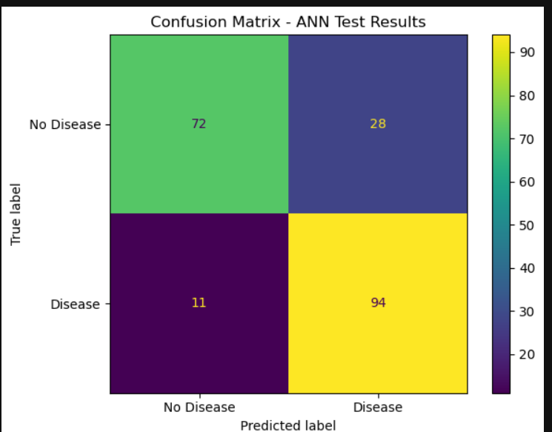
RESULTS AND EVALUATION
Confusion matrix interpretation.
True Negatives (TN): 72
False Positives (FP): 28
False Negatives (FN): 11
True Positives (TP): 94
Heart Disease ANN Project • 16

Slide 17
ANALYSIS
Understanding the model output.
The model achieved high testing performance on the given dataset.
The sigmoid-based feedforward network was able to learn important patterns from the clinical attributes.
High performance may also be influenced by repeated patterns or similarity between records in the dataset.
Standardization helped stabilize the numerical features before training.
The confusion matrix shows that the number of incorrect predictions was low compared to correct predictions.
Heart Disease ANN Project • 17

Slide 18
CHALLENGES
Limitations observed in the ANN approach.
Using sigmoid activation in all hidden layers can cause vanishing gradients in deep networks.
The model uses full-batch gradient descent, which can be slower than mini-batch training.
The dataset is relatively small for a deep neural network architecture.
No regularization techniques such as dropout or L2 penalty were used.
Very high accuracy should be discussed carefully because dataset repetition can make results look better.
Heart Disease ANN Project • 18

Slide 19
CONCLUSION
Summary of the project.
This project successfully implemented an artificial neural network from scratch using NumPy.
The ANN used 13 input features, four hidden layers with seven neurons each, and one output neuron.
Forward propagation, binary cross-entropy loss, backpropagation, and gradient descent were manually coded.
The model was evaluated using accuracy, precision, recall, F1 score, and confusion matrix.
The project demonstrates a strong understanding of the complete neural network training pipeline.
Heart Disease ANN Project • 19

Slide 20
THANK YOU
Heart Disease Prediction Using a Custom Neural Network

