Slide 1
Cardiovascular Health Monitoring and Prediction System Using IoT and Quantum-Inspired SVM
MTech in Information Technology (IOT)
Presented By:
SUBHADIP MANNA
Roll No : 30060823005
Registration No : 233000410850
Guided By:
Dr. Jadav Chandra Das
Department of Information Technology.
Maulana Abul Kalam Azad University Technology, West Bengal, India

Slide 2
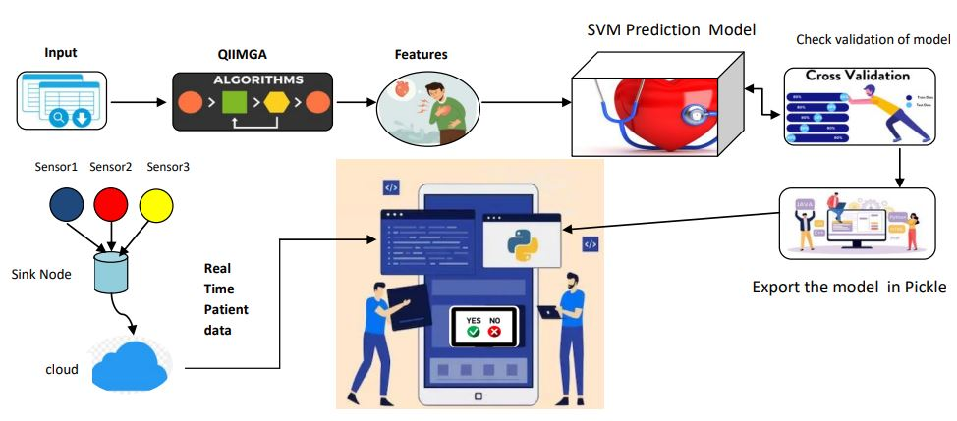
1. Introduction
Objective : Develop a robust heart disease prediction model integrating Quantum-Inspired Island Model Genetic Algorithm (QIIMGA) with Support Vector Machine (SVM) [4 ,7].
Motivation : Address the need for early detection of heart disease to reduce mortality rates.
Leverage IoT technology and AI to provide real-time monitoring and accurate predictions [1,2].
Technological Framework:Use of IoT-enabled sensors (ECG, heart rate monitors) to collect patient data remotely. Application of QIIMGA for feature selection and SVM for classification [4,5,6].
Figure : 1 ( Technological Framework )

Slide 3
2. Literature Review
The literature review explores the existing research on quantum-inspired algorithms, feature selection methods, and machine learning models applied in heart disease prediction. The focus is on the synergy between Quantum Inspired Genetic Algorithms (QIGA), Support Vector Machine (SVM), and their application to healthcare datasets, particularly for heart disease diagnosis.
Aspect | Key Insights | Citations
Real-Time Patient Monitoring Using IoT | Real-time health monitoring using IoT devices enables early detection. Combining IoT with AI models like SVM improves intervention efficiency. | Lu, H., Feng, X., & Zhang, J. (2024).[1]. Sadad et al. (2023) [2]
Quantum-Inspired Genetic Algorithms (QIGA) | QIGA leverages quantum computing principles for feature selection in large datasets, improving machine learning performance in healthcare. | Samanta et al. (2024) [4], Chandrasekhar & Peddakrishna (2023) [5]
Support Vector Machine (SVM) | SVM achieves high accuracy in medical diagnosis, particularly for heart disease prediction, outperforming k-NN and Decision Trees. | Hoque et al. (2024) [7], Anggoro & Kurnia (2020)
Combined QIGA and SVM Approach | The combined approach enhances prediction accuracy, reduces computational costs, and efficiently handles complex datasets. | Desai et al. (2019) [6]

Slide 4
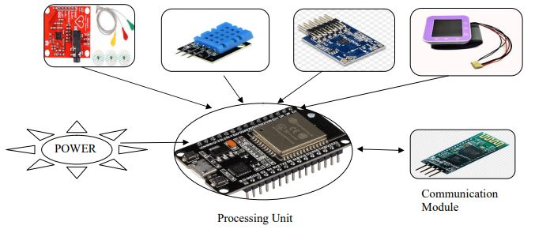
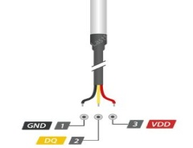
3. Background Study
A brief introduction of IOT Sensor Node , Data Preprocessing ,Quantum Computing and the Island Model Genetic Algorithm (IMGA) , Machine Learning SVM Model has been discussed in this section.
3.1 IOT Sensor Node : is a device that collects data from its Human Body , processes it, and transmits it to other devices or a central system for analysis and decision-making. They have made by four components :
i) Sensor: Collects data on physical phenomena like temperature, humidity, pressure, light, motion, or health metrics (e.g., heart rate).
ii) Communication Module: Enables communication with other nodes or a central hub using protocols such as Wi-Fi or Bluetooth.
iii) Microcontroller/Processor: Processes sensor data, performs computations, and may include embedded AI for real-time decision-making.
iv) Power Source: Uses batteries, solar panels, or energy harvesting for long-term autonomous operation, emphasizing power efficiency.
ECG Sensor Temperature Sensor MAX30100 BP Sensor
Figure : 2 (Sensor Node)

Slide 5
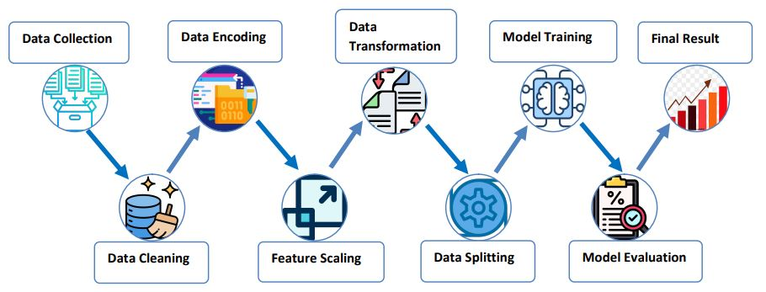








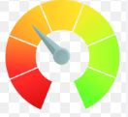

3.2 Data Pre-Processing:
Data pre-processing is a crucial step in machine learning and data analysis. It involves cleaning, transforming, and organizing raw data to prepare it for modeling. The goal is to ensure that the data is in a suitable format for training machine learning algorithms, which in turn helps improve the model's accuracy and performance.
Data set
Learning Model
Training Data
Feature
Trained Model
Data Cleaning
Evaluate Model
New Data
Score Model
Figure : 3 (Data Processing Steps)
3.3 Island Model Genetic Algorithm :
The Island Model Genetic Algorithm (IMGA) is a distributed genetic algorithm that involves multiple subpopulations, or islands, evolving independently. Individuals migrate between islands to exchange genetic information, enhancing convergence speed and solution quality. It leverages features like parallelism, exploration, information exchange, and diversity preservation. IMGA has been applied to various problems such as course timetabling, job-shop scheduling, and feature selection.

Slide 6
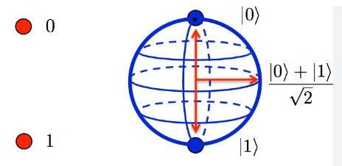
3.4 Support Vector Machine (SVM) : is a supervised machine learning algorithm used for classification and regression. In heart disease prediction, SVM works by classifying patients into two categories: those with heart disease and those without. It:
Maximizes the Margin: Finds the hyperplane that separates the data points with the maximum margin,
improving classification accuracy.
Uses Kernels: If data isn't linearly separable, SVM applies kernels (like RBF) to map the data into a higher-
dimensional space for linear separation. This approach helps predict heart disease risk based on
patient data.
3.5 Quantum computing : is a type of computing that uses quantum bits (qubits) to process information in ways that
classical computers can't. It takes advantage of quantum phenomena like superposition and
entanglement.
i. Qubit: The basic unit of quantum information, capable of being in multiple states simultaneously.
Figure : 4(Qubits Representation)

Slide 7
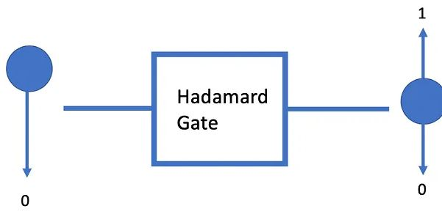
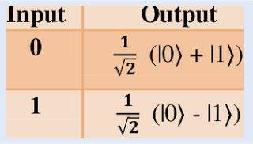
ii. Hadamard Gate :
This quantum gate is used to create a superposition of states in a qubit. When applied to a qubit that is in the state |0⟩ (representing 0), it transforms it into a state that is equally likely to be measured as 0 or 1. Mathematically, it transforms the qubit as follows: H∣0⟩=1/2(∣0⟩+∣1⟩) This means the qubit is now in a superposition, with both |0⟩ and |1⟩ being present at the same time, though it's not determined until measurement occurs.
Figure 5 : Hadamard Gate with qubits in superposition
iii. Rotation Gate : This quantum gate rotates the qubit's state around the Bloch sphere, which is a representation of the qubit's possible states. The rotation can occur in different directions (X, Y, or Z axes), and the angle of rotation determines how much the qubit's state is shifted. It allows for precise manipulation of the qubit's state, which is crucial for quantum algorithms.

Slide 8
4. Proposed Methodology
4.1 Model Training & Evaluation (Phase 1) :
i. Dataset :
The dataset contains 303 patient health records with 14 features, including demographic, medical history, and health metrics. It is used for heart disease prediction, with the target variable indicating risk presence (binary classification). Features include both categorical and numerical data.
ii. Preprocessing:
Clean and normalize raw data, handle missing values, and encode categorical data.
iii. Feature Selection using QIIMGA:
Features are divided into subgroups (islands), evolved independently using quantum-inspired operations.
Quantum rotation gates adjust feature selection probabilities, optimizing the dataset for accuracy and computational efficiency.
iv. Model Training with SVM:
Optimized feature subset is used to train the SVM model for classifying health conditions (e.g., 'normal' vs. 'at-risk').
v. Optimization and Validation:
Iterative process to refine model performance, validate with test datasets.
DATASET
Preprocessing
QIIMGA Features Selection
SVM Model Trained
Cross Validation For Validate checking
Export The Model
Figure 7: Data Preprocessing Flow Diagram.

Slide 9
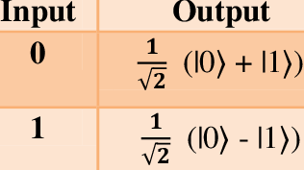
HADAMART GATE
2^N number of initial Population
Data Set
Input Each Feature Set (e.g. Bp , Cp , Bs….)
q11 , q12 --- q1n
q21 , q22 ---- q2n
q31 , q32 ---- q3n
qn1,qn2 , ----- qnn
FS1
FS2
FS N
QIGA
QIGA
QIGA
Calculate fitness score of each Chromosomes = Accuracy – λ × (Number of Features)
FS PREV >= FS NEXT
YES
U
NO
Apply Quantum Rotation gate update Chromosomes
Apply Genetic Algorithm : selection , crossover , mutation
Optimal each Feature Set
Optimized Feature Set
QIIMGA
QIGA
Figure : 8 ( QIIMGA Flow Diagram )

Slide 10
QIIMGA Explanation :
1. Data Preparation & Feature Subsets (Islands):
Dataset: 303 samples, 14 features (e.g., Age, Cholesterol, BP etc.).
Divide into 4 subsets (islands): FS1: [Age, Sex, Chest Pain, BP] FS2: [Cholesterol, Sugar, ECG] FS3: [Heart Rate, Angina, ST Depression, Slope] FS4: [Vessels, Thalassemia].
3. Measure & Evaluate Chromosomes:
Measurement: Convert qubits into binary (e.g., [1, 0, 1, 0]).
Fitness: Maximize accuracy, minimize features. Formula: Fitness = Accuracy - λ × Features.
2. Quantum Population Initialization:
Chromosomes: Represent feature selection with qubits (e.g., [q1, q2, q3, q4]).
Population: 20 chromosomes per subset, initialized using Hadamard Gates for superposition.
4. . Genetic Operations:
Selection: Pick top chromosomes based on fitness.
Crossover: Combine parents (e.g., [1, 0, 1, 0] + [0, 1, 1, 1]).
Mutation: Introduce diversity (e.g., [1, 0, 1, 1] → [1, 1, 1, 1]).
5: Update Quantum Chromosomes Using Quantum Rotation
Gates :
Quantum Rotation Gate:
Adjust the qubits based on the fitness score.
Rotation Logic:
High fitness → rotate qubits to favor 1 (feature selected).
Low fitness → rotate qubits to favor 0 (feature not selected).
6. Iteration Until Convergence:
Repeat for multiple generations (e.g., 20) until stability
with high accuracy and minimal features.
7. Final Feature Set Combination:
Merge optimized subsets into the final feature set
(FSm). { FSm= FS1 U FS2 U FS3 U FS4 . }

Slide 11
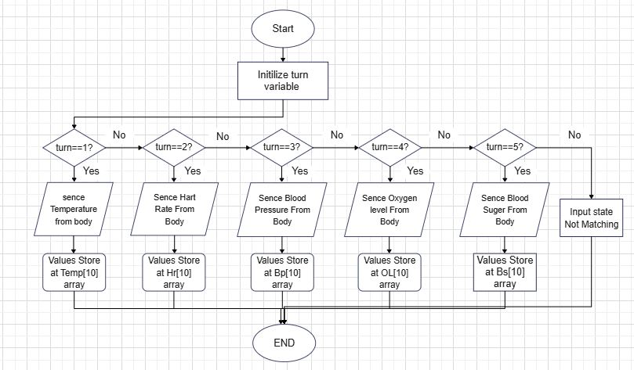
4.2 . IoT System Creation (Phase 2) :
i) Turn On Device , See MAC Address On LCD 16*2 Display.
ii) Enter MAC Address on Controller App , Now System Can connected .
iii) IN App background map each button to each turn value { temp.button 1 -> turn 1, … } .
iv) When you press any button then corresponding Sensor Can enable 500ms time , read data in every 50 ms time delay [figure :9 ].
v) Store the data corresponding array , Then store the array in Cloud Database Firebase.
Figure 9 : IoT Device Worked Flow Chart

Slide 12
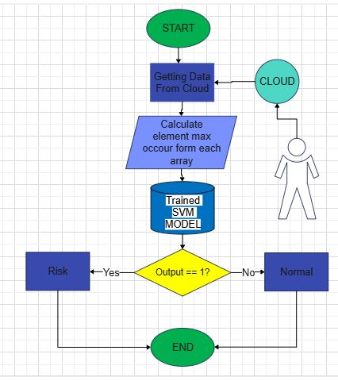
4.3 . HOW App Backend Worked (Phase 3) :
Data Fetching : Fetched data from Cloud Database (Firebase).
Calculate Max occured : Find out Which value can mostly present from the array . Ex. Let this is temp array [86 ,98,99,89,98,98,96,98,97,98 ] , 98 present 5 times so temp value is 95. Similarly others Features are calculated .
Some Features are directly input from App-UI Interface like Age .
Input the features to the pre-trained SVM model . Now model can predected Output .
If ( Output == 1) the show Risk Detected otherwise show Normal.
Figure 10 : App Backend Flow Chart

Slide 13
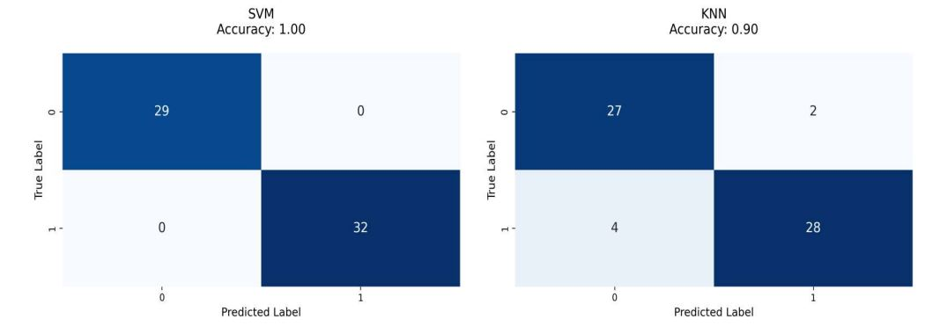
5. Results and Discussion
5.1 Performance Analysis : To analyze the Quantum Inspired Island Model Genetic algorithm feature selection after the effectiveness of classification models, a confusion matrix was mainly employed to determine key performance evaluation metrics: accuracy, precision, recall, and F1-score.
a. After applying QIIMGA Selected 12 features out of 16 .
Features List : ['sex', 'cp', 'bp', 'bol', 'fbs', 'restecg', 'thalach', 'exang', 'bodytemp', 'slope', 'pal', 'thal']
Performance Analysis Different classifiers After Apply QIIMGA using confusion matrix.

Slide 14
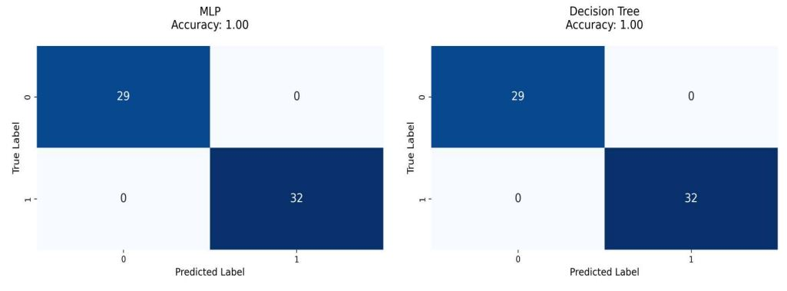
b. After applying PCA Selected 12 features out of 16 .
Features List : ['sex', 'age', 'bp', 'chol', 'fbs', 'restecg', 'thalach', 'exang' ,`öldpeak', 'slope', 'ca', 'thal'].
Performance Analysis Different classifiers After Apply PCA

Slide 15
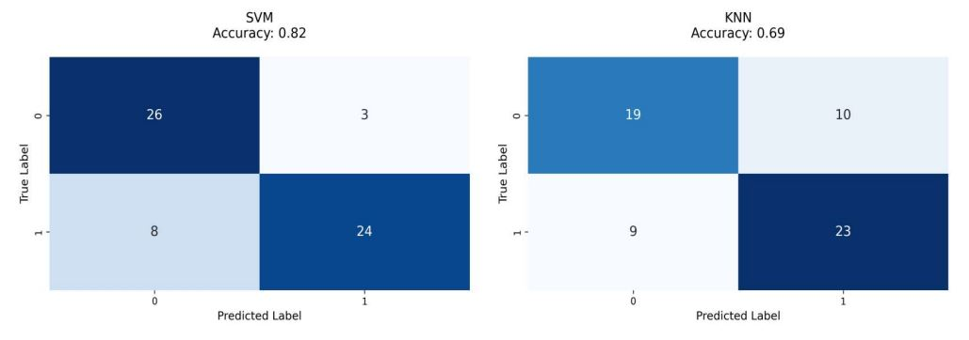
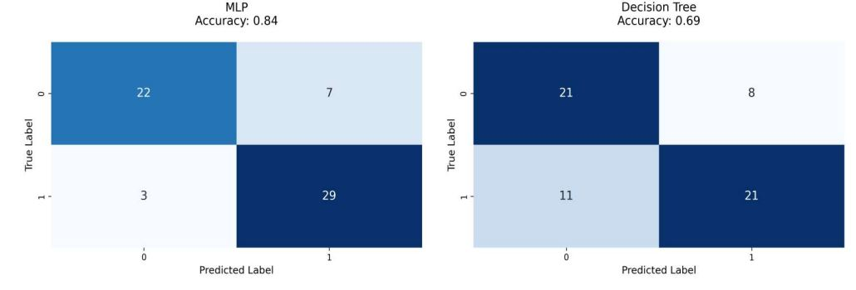

Slide 16
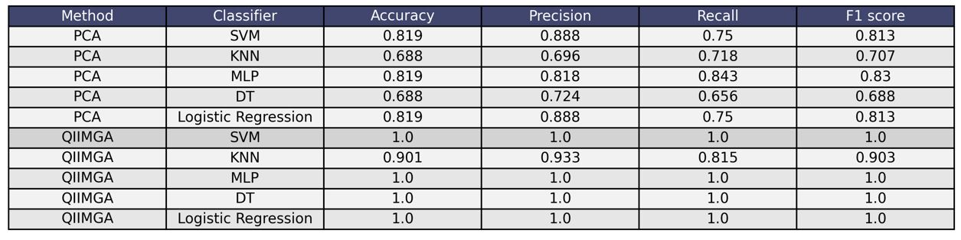
5.2 Performance comparison QIIMGA vs PCA :
QIIMGA outperformed PCA, achieving perfect scores (1.0) in Accuracy, Precision, Recall, and F1 Score with SVM,
MLP, DT, and Logistic Regression.
KNN with QIIMGA performed well, scoring 0.901 Accuracy, 0.933 Precision, 0.815 Recall, and 0.903 F1 Score .
PCA-based models showed average performance, with SVM, MLP, and Logistic Regression achieving a maximum
Accuracy and F1 Score of 0.819.PCA Precision ranged from 0.696 to 0.888, and Recall ranged from 0.656 to 0.843,
showing variability in performance.
PCA struggled with KNN and DT, achieving only 0.688 Accuracy and F1 Score, indicating poor feature
representation.
QIIMGA provides superior feature extraction, leading to significantly better classification performance compared
to PCA.

Slide 17
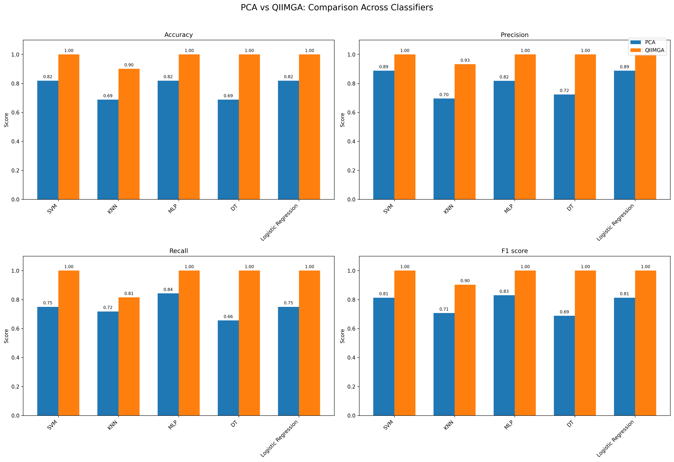

Slide 18
Conclusion
The integration of QIIMGA with SVM significantly enhances heart disease prediction accuracy and efficiency.
Utilizes real-time patient data collected via IoT sensors, making the solution scalable and practical for remote healthcare monitoring.
Balances between high accuracy and reduced computational complexity by selecting the most relevant features.
Future Directions:
Integration with Advanced AI Models:
Explore the use of deep learning models (e.g., neural networks, ensemble methods) to further enhance predictive performance.
Enhanced IoT Infrastructure:
Develop comprehensive IoT Health Kits for continuous, real-time data collection from patients.
User-Centric Application Development:
Design mobile apps and user-friendly interfaces for real-time monitoring, alerts, and actionable insights.

Slide 19
References
[1] . Lu, H., Feng, X., & Zhang, J. (2024). Early detection of cardiorespiratory complications and training monitoring using wearable ECG sensors and CNN. BMC Medical Informatics and Decision Making.
[2]. Sadad T, Safran M, Khan I, Alfarhood S, Khan R, Ashraf I. Efficient classification of ECG images using a lightweight CNN with attention Module and IoT. Sens 2023. Sep. 2023;23(18):7697.
3]. Parashar G, Chaudhary A, Pandey D. Machine learning for Prediction of Cardiovascular Disease and Respiratory Disease: a review. SN Comput Sci. Jan. 2024;5(1):1–27.
[4] . Samanta, S., Chatterji, S., & Pratihar, S. (2024). Feature selection using quantum-inspired island model genetic algorithm for wheat rust disease detection and severity estimation. Proceedings of the 19th International Joint Conference on Computer Vision, Imaging and Computer Graphics Theory and Applications (VISIGRAPP 2024).
[5]. Chandrasekhar, N., & Peddakrishna, S. (2023). Enhancing heart disease prediction accuracy through machine learning techniques and optimization. Processes, 11(4), 1210.
[6]. Liu, Y., Ghandar, A., and Theodoropoulos, G. (2019). Is land model genetic algorithm for feature selection in non-traditional credit risk evaluation. In 2019 IEEE Congress on Evolutionary Computation (CEC). IEEE.
[7]. Hoque, R., Billah, M., Debnath, A., Hossain, S. M. S., & Sharif, N. B. (2024). Heart Disease Prediction using SVM. International Journal of Science and Research Archive, 11(02), 412–420.
[8]. [14]. Astorino, A., Gorgone, E., Gaudioso, M., & Pallaschke, D. (2010). Data preprocessing in semi-supervised SVM classification. Optimization, 60(1–2), 143–151.

