Slide 1
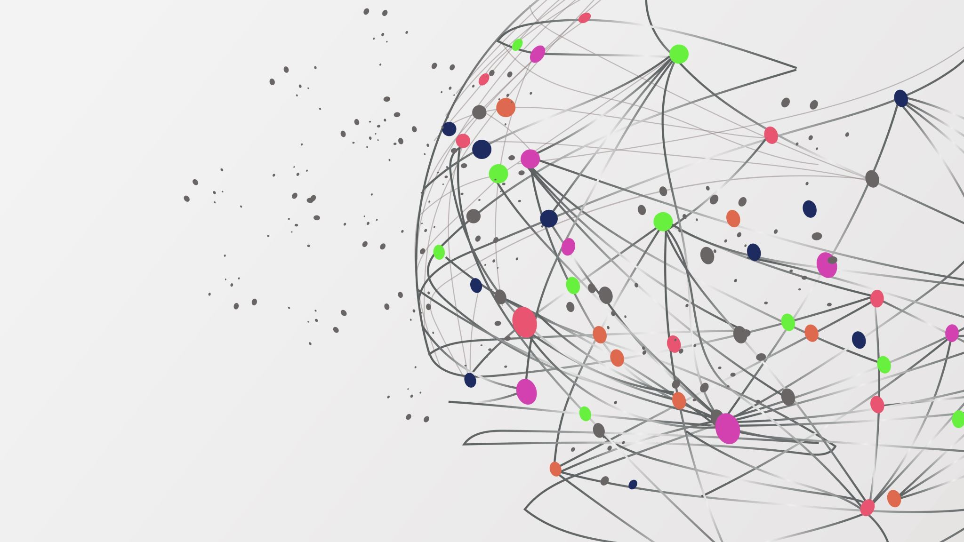
Cryptographic Protocols and Their Vulnerabilities
NAME: SUBHADIP MANNA
ROLL: 30060821005
Date: 28.06.24

Slide 2
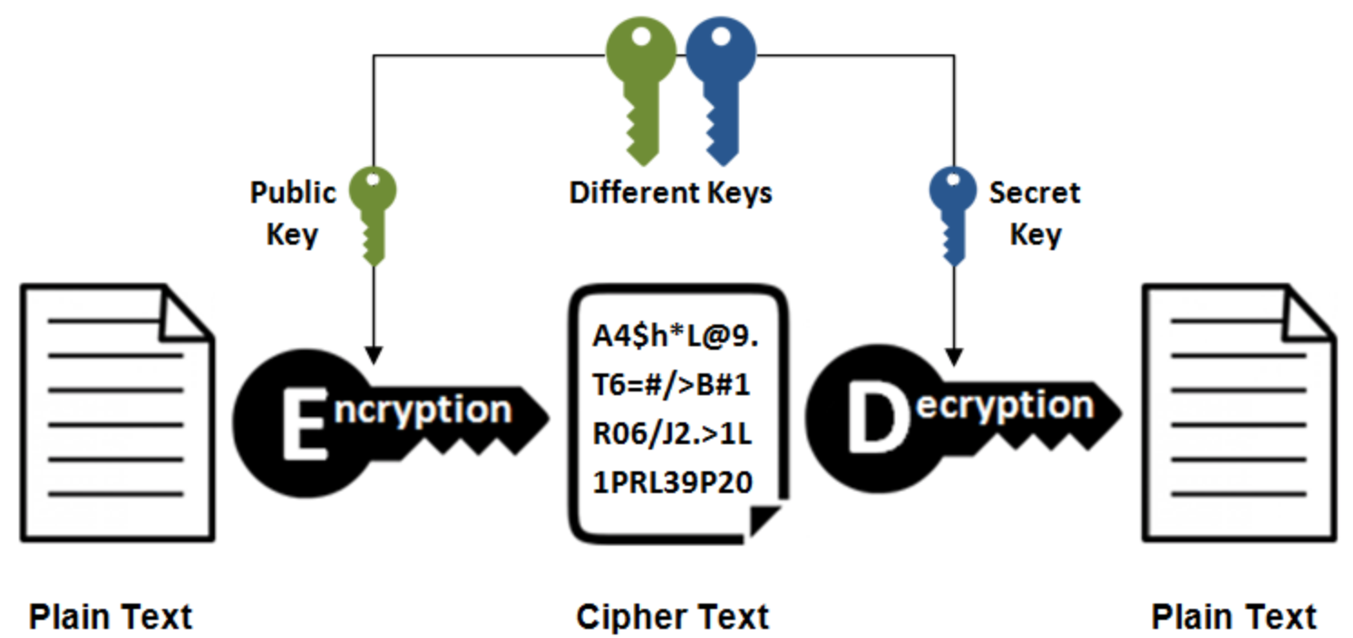
Introduction to Cryptographic Protocols
Definition: Cryptographic protocols are sets of rules that help secure data exchange over networks
Purpose: They ensure that data remains private, accurate, and is exchanged between the right parties
Examples: Common examples include SSL/TLS , Kerberos , and IPsec

Slide 3
Overview of Kerberos
Definition: Kerberos is a system that helps computers verify the identity of users trying to access them over a network
Developer: Created by MIT to improve network security
Primary Components :
Key Distribution Center : The "control center" that manages keys and tickets
Ticket Granting Ticket : A special ticket given after a user logs in
Service Tickets: Tickets used to access specific services like email or file servers

Slide 4

How Kerberos Works
User Requests TGT: When a user logs in, they ask the KDC for a TGT
KDC Verifies and Issues TGT: The KDC checks the user's details and gives them a TGT
User Requests Service Tickets: The user uses the TGT to ask the KDC for tickets to access different services
User Accesses Services: The user presents the service tickets to the required service to access it

Slide 5
Benefits of Kerberos
Strong Authentication: Kerberos uses secret codes to verify identities, making it very secure
Single Sign-On : Users need to log in only once to access multiple services, making it convenient
Mutual Authentication: Both the user and the service verify each other to ensure they are legitimate
Scalability: Kerberos works well in large networks with many users and services

Slide 6
Common Attacks on Cryptographic Protocols
Eavesdropping: Spying on data being exchanged
Replay Attacks: Reusing old data to trick the system into giving access
Man-in-the-Middle : Intercepting and altering communication between two parties
Dictionary Attacks: Trying many common passwords to guess the correct one
Brute Force Attacks: Trying all possible passwords or keys until the correct one is found

Slide 7
Specific Attacks on Kerberos
Password Guessing: If users have weak passwords, attackers can guess or crack them easily
TGT Theft: If an attacker gets hold of a TGT, they can use it to access services
Replay Attacks: Reusing valid tickets within their lifetime to gain access
AS-REP Roasting: An attack that takes advantage of Kerberos's pre-authentication to break passwords offline

Slide 8
Mitigation Strategies for Kerberos
Strong Password Policies: Encourage users to create complex passwords and change them regularly
Ticket Lifetimes: Set shorter time limits for how long tickets are valid to minimize misuse
Network Security: Use firewalls and monitoring systems to detect and block suspicious activities
Encryption: Ensure all data exchanged in the Kerberos process is encrypted to prevent eavesdropping

Slide 9

Case Studies and Real-World Examples
Example 1: Attackers used weak passwords to break into a network and steal sensitive data
Example 2: An incident where TGTs were stolen, allowing unauthorized access to services
Lessons Learned: It's crucial to enforce strong security measures and regularly update systems to prevent such attacks

Slide 10
Conclusion
Summary: Cryptographic protocols like Kerberos are essential for network security but are vulnerable to various attacks
Final Thoughts: Continuous updates, strong policies, and vigilant monitoring are necessary to protect these systems

