Slide 1
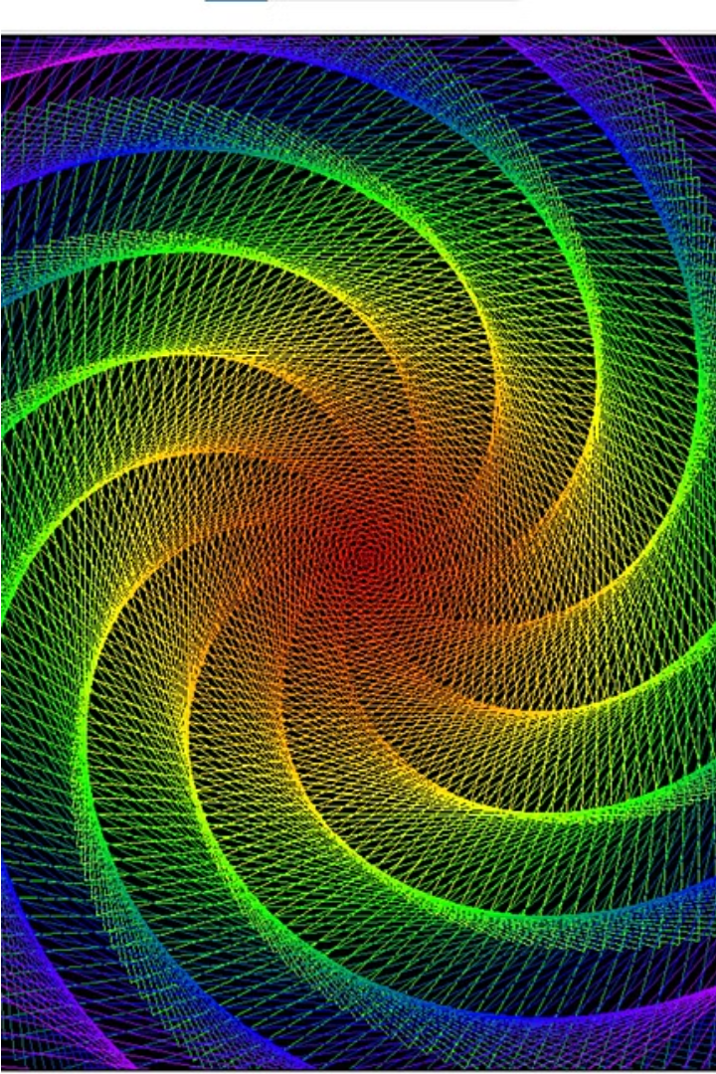
Turtle Graphics
🐢❌ ➤✅

Slide 2

The Turtle Object and Its Properties
Heading
Position
Pen
The turtle's orientation, measured in degrees from 0 to 360.
The turtle's location on the coordinate plane, represented by (x, y) coordinates.
The turtle's drawing tool, which can be raised, lowered, or customized in color and thickness.

Slide 3
Basic Turtle Commands
1
Forward()
2
Backward()
Moves the turtle forward by a specified distance.
Moves the turtle backward by a specified distance.
3
Right()
4
Left()
Rotates the turtle to the right by a specified angle.
Rotates the turtle to the left by a specified angle.

Slide 4

Drawing Shapes and Patterns
Geometric Shapes
Repeating Patterns
Customized Designs

Slide 5
Practical Applications of Turtle Graphics
Education
Art and Design
Game Development
Algorithmic Thinking

Slide 6
Thank You

