Slide 1
Learning to Listen: Machine Learning for Adaptive Wireless Adversary Detection

Slide 2
About Me
@JohnDunlap2
Security Researcher
Reverse Engineer
Avid collector of bad software
Work for GDSSecurity doing code review / RE / Research

Slide 3
I swear this will not be a buzzword laden talk
BINGO!
Deep Learning | Inference | Tensorflow
Training | FREE | Keras
AI Revolution | Cyber | APT

Slide 4
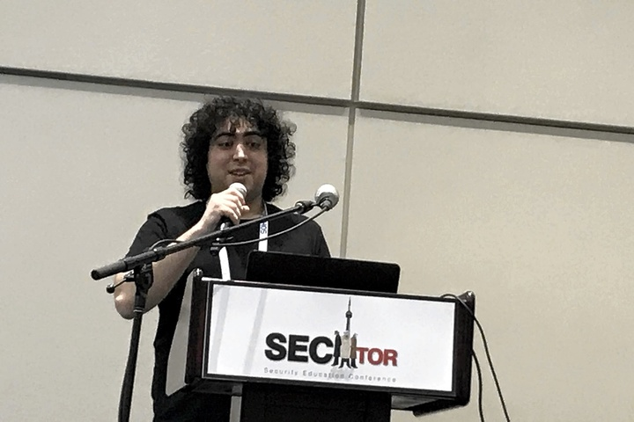
A Wild Gabe Appears

Slide 5
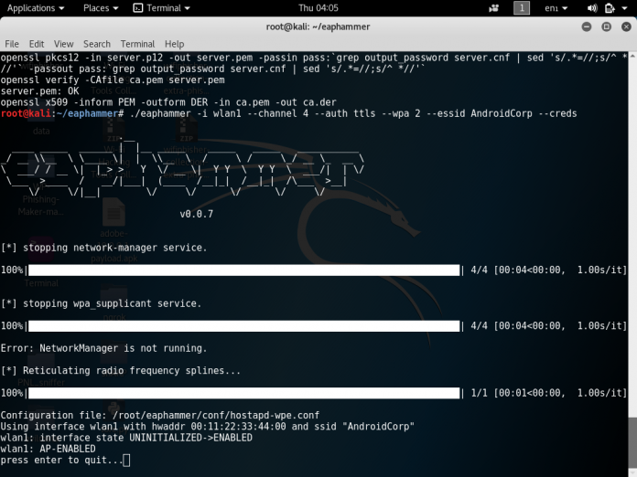
Gabe is a wireless Ninja.

Slide 6
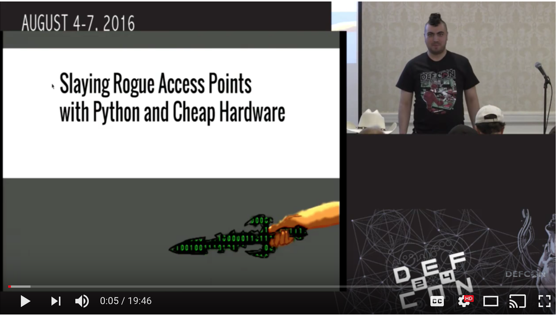
Two years ago he gave this talk

Slide 7

Gabe invented a way to take out rogue Aps. That’s Metal!

Slide 8
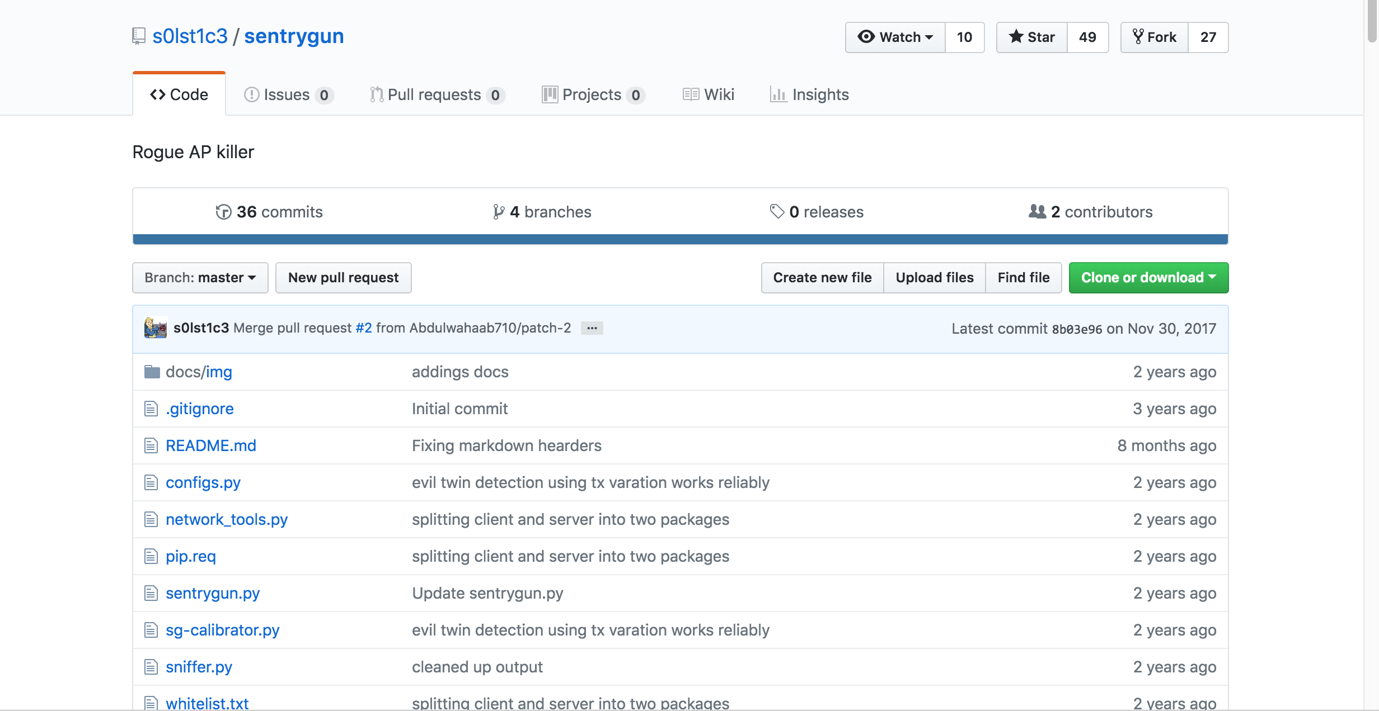
Sentry Gun

Slide 9
What does it do?
Detects Rogue Aps
Tries to locate them
Tries to DOS them

Slide 10
How is it Tracking Rogue A.Ps?
Spatially distributed sensor array
Do benchmarking on the network in a trusted environment to obtain normal signal strength levels
Flag abnormal behavior
Location is inferred from signal strength relative to a known sensor position

Slide 11
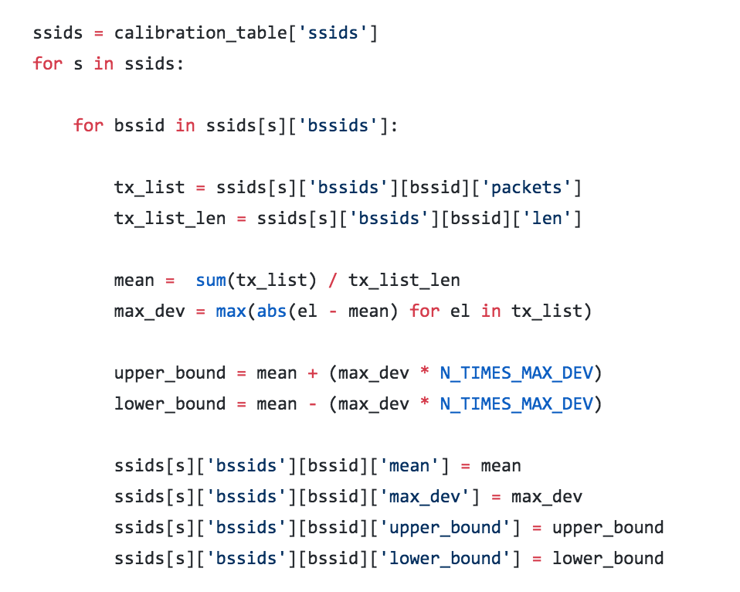
Basically arithmetic mean

Slide 12
This actually worked quite well in practice
Gabe was able to find and eliminate rogue AP’s in his tests
Because of the multi-sensor setup he was able to locate attackers

Slide 13

But I’m one of those engineers

Slide 14
So my mind demanded more
More math
More features
Deeper characterization of attackers

Slide 15
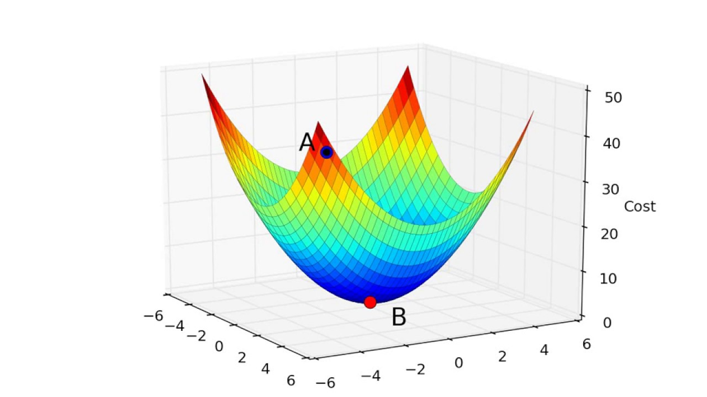
How about machine learning

Slide 16
The idea:
Add machine learning algorithms to Gabe’s tool to train a model to better identify and classify attackers
Try to identify signals that don’t fit well within Gabe’s algorithm.
Predict recurring attack types and locations

Slide 17
The Prior Work
Surely someone has tried something like this in the literature
Turns out there are a lot of close calls but no exact matches

Slide 18
Why is ML Good for this?
Classification
Over time

Slide 19
YANG, SONG AND GU: ACTIVE USER-SIDE EVIL TWIN ACCESS POINT DETECTION USING STATISTICAL TECHNIQUES 2012
“We propose to exploit the intrinsic communication structure and property of evil twin attacks. Furthermore, we propose two statistical anomaly detection algorithms for evil twin detection, TMM and HDT. In particular, our HDT improves TMM by removing the training requirement. HDT is resistant to the environment change such as network saturation and RSSI fluctuation.”
HDT – Hop Differentiation Technique
TMT - Trained Mean Matching
Uses SPRT - Sequential Probability Ratio Test
Learning and non-learning variants
Able to measure difference between rogue and non-rogue without a whitelist by measuring statistical properties of the wifi radio signal itself (e.g s/n ratio)
Client side approach - each workstation runs this
Seeks to distinguish one hop versus multi-hop communications.

Slide 20
Kim,Seo,Shon,Moon: A novel approach to detection of mobile rogue access points (2013)
Round trip time analysis
Specifically detects differences between mobile and wired networks by analyzing RTT
Assuming the attacker is exfiltrating via 3G, the difference in latency should be a dead giveaway
Uses ICMP packets for the timing analysis

Slide 21
Jana, Kasera: On Fast and Accurate Detection of Unauthorized Wireless Access Points Using Clock Skews
Detects endpoints via differences in clock skew
Classifier is trained on whitelisted network and compares expected results to the live network
Gets clock skew from Time Synchronization Function (TSF) timestamps in the IEEE 802.11 beacon/probe response messages sent by the AP
Server based. Requires a whitelist and training.

Slide 22
Learning

Slide 23
The side channels
Clock Skew
Signal strength
Timestamp

Slide 24
Picking a good network
This is time series data
Data has both long time scale and short time scale attributes
Our adversary may be evolving to counteract the model
Adversaries may be extremely heterogeneous

Slide 25
The Network
LSTM – Long short term memory
Adapted from LSTMs used to in medical diagnostics time series data
LSTMs are good because they can capture long term and short term time series data

Slide 26
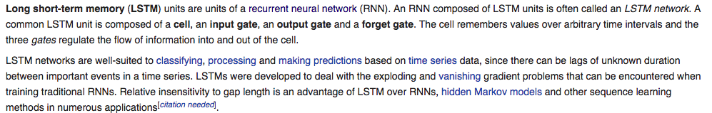
LSTM

Slide 27
The Features
Training label
Signal strength
Timestamp
Time packet received

Slide 28
The Training
2k rounds of training.

Slide 29
Avoiding Overtraining
Used a variety of rogue AP’s
Largest data set possible

Slide 30
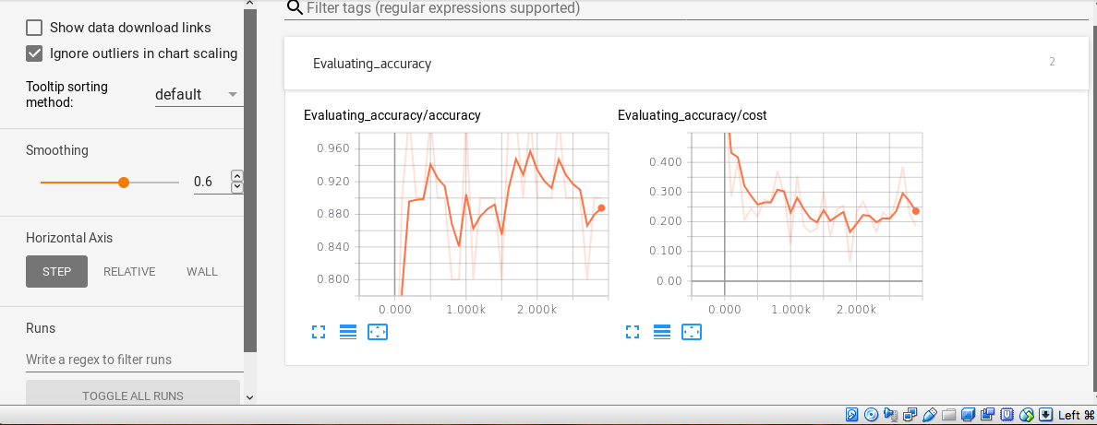
The fancy graph

Slide 31
The Results
Up to 90% accuracy!
LSTM detects recurring patterns in the data
No signs of overtraining

Slide 32
Did we do better than before?
Gabe’s algorithm has a FP rate of up to 50%
Single packets may either live inside the mean or legitimate packets may live outside of it.
With better training ML may be able to do in depth fingerprinting with extremely low FP rates.

