Slide 1
CYBERRESILIENCE CLOUD / SOFTWARE ENGINEERING CHECKPOINT
CyberResilience Cloud
A cloud-native, privacy-aware cybersecurity readiness assessment
MSc Software Engineering · Taher Amine ELHOUARI
Taher Amine ELHOUARI · Academic research demonstrator
Notes:
Presenter notes: A cloud-native, privacy-aware cybersecurity readiness assessment
MSc Software Engineering · Taher Amine ELHOUARI Explain the substantive detail in the accompanying ten-minute demo script. Show actual working UI and explain any unverified deployment status.

Slide 2
CYBERRESILIENCE CLOUD / SOFTWARE ENGINEERING CHECKPOINT
The real-world challenge
Resource-constrained teams have difficulty turning broad cybersecurity guidance into decisions.
Our response: 18 clear questions, six functions, three prioritized actions.
Taher Amine ELHOUARI · Academic research demonstrator
Notes:
Presenter notes: Resource-constrained teams have difficulty turning broad cybersecurity guidance into decisions.
Our response: 18 clear questions, six functions, three prioritized actions. Explain the substantive detail in the accompanying ten-minute demo script. Show actual working UI and explain any unverified deployment status.

Slide 3
CYBERRESILIENCE CLOUD / SOFTWARE ENGINEERING CHECKPOINT
Research foundation
NIST CSF 2.0: six outcome areas
NIST SP 1300: small-business entry point
CISA CPGs: achievable high-impact measures
OWASP ASVS: web application security mindset
Taher Amine ELHOUARI · Academic research demonstrator
Notes:
Presenter notes: NIST CSF 2.0: six outcome areas
NIST SP 1300: small-business entry point
CISA CPGs: achievable high-impact measures
OWASP ASVS: web application security mindset Explain the substantive detail in the accompanying ten-minute demo script. Show actual working UI and explain any unverified deployment status.

Slide 4
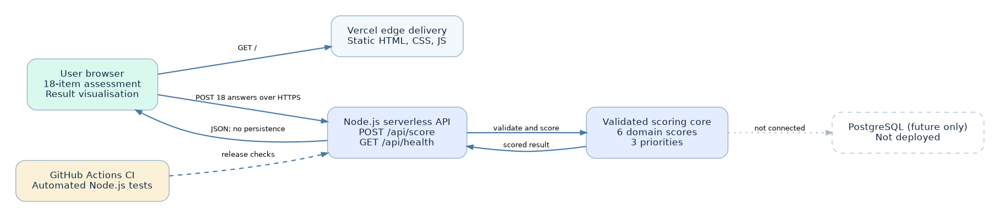
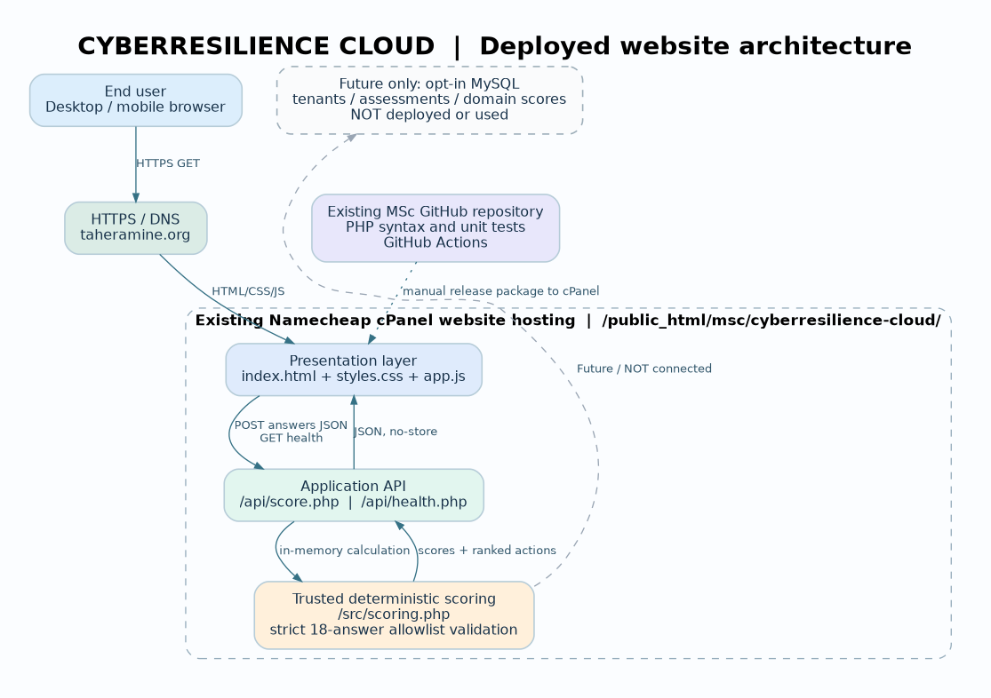
CYBERRESILIENCE CLOUD / SOFTWARE ENGINEERING CHECKPOINT
System architecture
01 / BROWSER
02 / HTTPS
03 / API
04 / ENGINE
HTML · CSS · JS
Existing TaherAmine.org
score.php · health.php
src/scoring.php
→
→
→
18-question assessment
Namecheap cPanel
Strict JSON validation
6 function readiness scores
Desktop + mobile
Apache / LiteSpeed
No-store HTTP response
3 priority recommendations
SOURCE CONTROL + CI
FUTURE DATABASE ONLY
MSc GitHub repo · PHP tests · release ZIP
MySQL schema documented · NOT deployed
Taher Amine ELHOUARI · Academic research demonstrator
Notes:
Presenter notes: Browser interface → Vercel edge/static delivery → Node.js API → validated scoring
No active persistence; PostgreSQL is a future-only design option. Explain the substantive detail in the accompanying ten-minute demo script. Show actual working UI and explain any unverified deployment status.

Slide 5
CYBERRESILIENCE CLOUD / SOFTWARE ENGINEERING CHECKPOINT
Product walkthrough
Visit home page → start assessment → answer 18 questions → calculate readiness → explore priorities → save to PDF
Taher Amine ELHOUARI · Academic research demonstrator
Notes:
Presenter notes: Visit home page → start assessment → answer 18 questions → calculate readiness → explore priorities → save to PDF Explain the substantive detail in the accompanying ten-minute demo script. Show actual working UI and explain any unverified deployment status.

Slide 6
CYBERRESILIENCE CLOUD / SOFTWARE ENGINEERING CHECKPOINT
Transparent scoring
Domain = sum of three responses ÷ 12 × 100
Overall = mean of six domain results
Project-defined bands: Initial · Developing · Defined · Adaptive
Taher Amine ELHOUARI · Academic research demonstrator
Notes:
Presenter notes: Domain = sum of three responses ÷ 12 × 100
Overall = mean of six domain results
Project-defined bands: Initial · Developing · Defined · Adaptive Explain the substantive detail in the accompanying ten-minute demo script. Show actual working UI and explain any unverified deployment status.

Slide 7
CYBERRESILIENCE CLOUD / SOFTWARE ENGINEERING CHECKPOINT
Security and privacy
Strict API validation and method checks
No application-level response storage
No-store API responses, restrictive browser headers
No claim of formal compliance or certification
Taher Amine ELHOUARI · Academic research demonstrator
Notes:
Presenter notes: Strict API validation and method checks
No application-level response storage
No-store API responses, restrictive browser headers
No claim of formal compliance or certification Explain the substantive detail in the accompanying ten-minute demo script. Show actual working UI and explain any unverified deployment status.

Slide 8
CYBERRESILIENCE CLOUD / SOFTWARE ENGINEERING CHECKPOINT
Verification results
9 of 9 PHP unit tests passed
PHP syntax checks passed; live health check pending
Home page returned HTTP 200 locally
Website release is PENDING cPanel upload
Taher Amine ELHOUARI · Academic research demonstrator
Notes:
Presenter notes: 8 of 8 local unit tests passed
GET /api/health returned 200 and expected JSON
Home page returned HTTP 200 locally
Public Vercel release is NOT VERIFIED Explain the substantive detail in the accompanying ten-minute demo script. Show actual working UI and explain any unverified deployment status.

Slide 9
CYBERRESILIENCE CLOUD / SOFTWARE ENGINEERING CHECKPOINT
Limitations & responsible roadmap
18 self-reported questions are not a professional assessment
Future: tenant-specific history, evidence, access controls, monitoring
Site upload and GitHub commit pending — verify URLs before submission
Taher Amine ELHOUARI · Academic research demonstrator
Notes:
Presenter notes: 18 self-reported questions are not a professional assessment
Future: tenant-specific history, evidence, access controls, monitoring
Cloud project creation blocked by permissions — public deploy pending Explain the substantive detail in the accompanying ten-minute demo script. Show actual working UI and explain any unverified deployment status.

Slide 10
CYBERRESILIENCE CLOUD / SOFTWARE ENGINEERING CHECKPOINT
Conclusion & resubmission evidence
Source code · tests · architecture visual · report · ten-minute script
Record and link the demo; publish and verify the actual production URL
Taher Amine ELHOUARI · Academic research demonstrator
Notes:
Presenter notes: Source code · tests · architecture visual · report · ten-minute script
Record and link the demo; publish and verify the actual production URL Explain the substantive detail in the accompanying ten-minute demo script. Show actual working UI and explain any unverified deployment status.

