Slide 1
https://paperswithcode.com/task/real-time-instance-segmentation

Slide 2
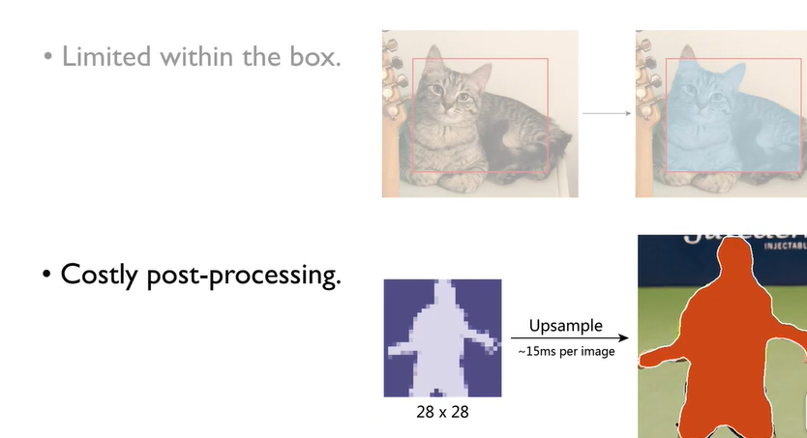
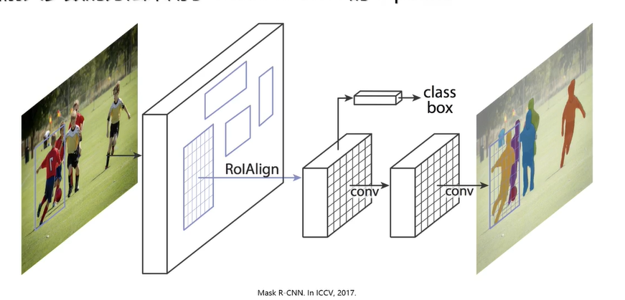
需求：accuracy and efficiency.
问题：
Most of the state-of-the-art instance segmentation methods perform pixel-wise segmentation within a bounding box given by an object detector，which may be sensitive to the inaccurate bounding box.
Moreover, representing an object shape as dense binary pixels generally results in costly post processing

Slide 3
传统方法object contour代替对象的信息相比像素级别
a contour is not limited within a bounding box and has fewer parameters
Such a contour-based representation has long been used in image segmentation since the seminal work by Kass et al.
传统的object contour问题：
optimizing an energy functional defined with low-level features, 。。。。
these methods are prone to local optima as the objective functions are handcrafted and typically nonconvex

Slide 4
最近的方法object contour代替对象的信息
方法一：recent learning-based segmentation methods also represent objects as contours
过程：try to directly regress the coordinates of contour vertices from an RGB image.
好处：Although such methods are fast,
劣势：most of them do not perform as well as pixel-based methods.
方法二（http://www.cs.toronto.edu/~linghuan/）：
Ling et al. [25] adopt the deformation pipeline of traditional snake algorithms and train a neural network to evolve an initial contour to match the object boundary.
过程：Given a contour with image features, it regards the input contour as a graph and uses a graph convolutional network (GCN) to predict vertex-wise offsets between contour points and the target boundary points.
好处：It achieves competitive accuracy compared with pixel-based methods while being much faster.
问题：However, the method proposed in [25] is designed to help annotation and lacks a complete pipeline for automatic instance segmentation. Moreover, treating the contour as a general graph with a generic GCN does not fully exploit the special topology of a contour.

Slide 5
作者的方法总结
First, our approach can deal with errors in the object localization stage and thus allows a light detector. Second, the contour representation has fewer parameters than the pixel-based representation and does not require costly post-processing, e.g., mask upsampling
创新点
•提出了一种基于学习的snake算法, 用于实时实例分割，并介绍了在轮廓上进行特征学习的circular convolution。
•提出了一个两阶段pipline的实例分割：初始contour与contour deformation。这两个阶段都可以处理object location 的误差。
•证明在Cityscapes, KINS, SBD and COCO数据集的使用。对于 512 × 512 图像，我们的算法运行在32.3 fps，适用于实时应用。

Slide 6
Related work
1）region proposal
代表：Mask R-CNN
优点： proposal-based approaches achieve
state-of-the-art performance.
劣势：One limitation of these methods is that they cannot resolve errors in localization,
Pixel-based methods.
2）free of region proposals
每个像素生成辅助信息，然后聚类算法根据像素信息将像素分组到对象实例中。
劣势：
the post-clustering algorithms tend to be time-consuming.

Slide 7
1）Traditional snake algorithms
First introduced the contour-based representation for image segmentation.
They deform an initial contour to the object boundary by optimizing a handcrafted energy with respect to the contour coordinates.
2）some recent learning-based methods
To improve the robustness of these methods proposed to learn the energy function in a data-driven manner. Instead of iteratively optimizing the contour。
好处：try to regress the coordinates of contour points from an RGB image, which is much faster.
劣势： their reported accuracy is not on par with state-of-the-art pixel-based methods
Contour-based methods
3）semi-automatic annotation
follows the pipeline of snake algorithms and uses a graph convolutional network to predict vertex-wise offsets for contour deformation.
好处:This strategy significantly improves the annotation speed while being as accurate as pixel-based methods. (速度和精度)
劣势：lacks a pipeline for instance segmentation and does not fully exploit the special topology of a contour.

Slide 8
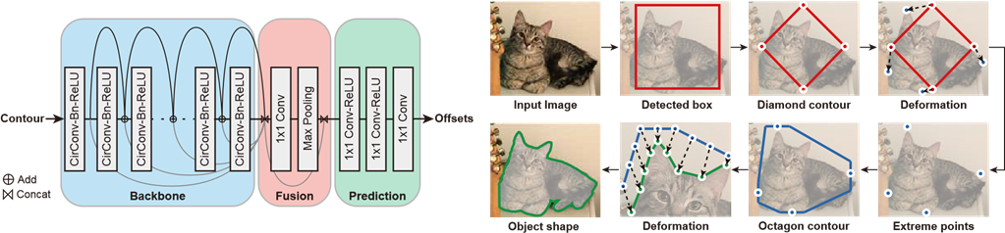
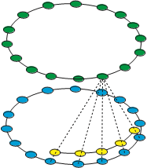

Slide 10
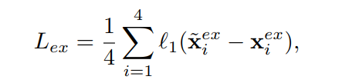
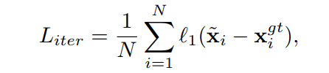
The loss function for extreme point prediction is defined as where x~ex i is the predicted extreme point.
the loss function for iterative contour deformation is defined as

Slide 11
