Slide 1
Kuberflow
https://www.kubeflow.org/docs/

Slide 2
系统发展趋势：实体->虚机->容器
实体机
虚拟机
容器
应用代码
应用代码
应用代码
依赖库
依赖库
依赖库
OS
Guest OS
硬件
hypervisor
容器引擎
Host OS
Host OS
硬件
硬件

Slide 3
实体机的缺点
实体机
价格成本高
部署麻烦，时间按照月/周计算
迁移麻烦
各个app的隔离差，app1能看到app2的文件
资源侵占很厉害，一个app容易把整个系统搞死
资源利用率难提升
app1
app2
依赖库
OS
硬件

Slide 4
扩容非常麻烦
部署周期太长
机架，网络，系统，LB配置

Slide 5
虚拟机的Pros & Cons
虚拟机1
虚拟机1
虚拟机1
Pros
部署简单，分钟计算
各个app间的隔离好
资源利用率有提升
Cons
启动慢，分钟级别
Image比较大，G级别
系统性能损失比较大
app
app
app
依赖库
依赖库
依赖库
OS
OS
OS
hypervisor
Host OS
硬件

Slide 6
扩容/缩容效率不高
Image是一个OS，boot 耗时，扩容做不到秒级
Image大，占用资源多，造成系统资源浪费
虚拟化成本带来性能损失

Slide 7
容器的Pros & Cons
容器1
容器1
容器1
Pros
启动秒开
占资源少，单机可开1000以上容器
系统性能损失少
App间资源隔离
Cons
安全和隔离对比虚机要差
app
app
app
依赖库
依赖库
依赖库
容器引擎
Host OS
硬件

Slide 8
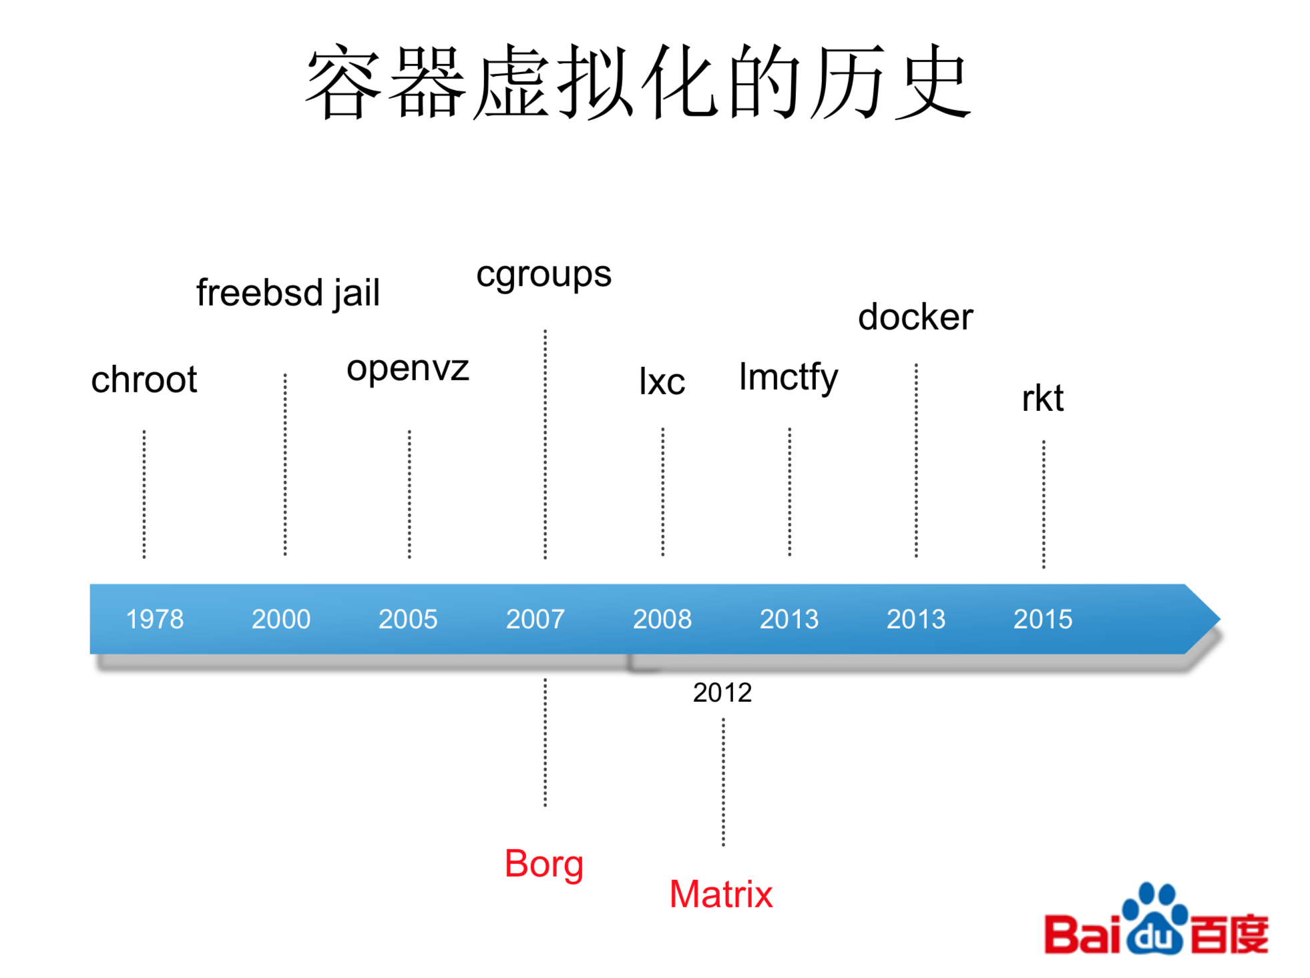
虚拟化发展的历史

Slide 9
Docker发展历史
Docker is a platform for developers and sysadmins to develop, deploy, and run applications with containers.
创始人：Solomon Hykes
2013年 Docker对外开源
2014年 全球开始流行
Docker相对之前的Borg等最大的进步
Docker image 把应用程序和依赖库打成一个包
包有版本，并有独立的Registry提供管理

Slide 10
Docker是新瓶装旧酒
是容器虚拟化的相关技术的组合
Cgroups（limits how much you can use）
一组进程放在放在一个控制组里，通过给这个控制组分配指定的可用资源，达到控制这一组进程可用资源的目的
Namespace (limits what you can see)
又称为命名空间，它主要做访问隔离，即同一个命名空间的多个资源(memory, CPU, network, pid) 可以互相看到，但是之外的看不到
Union Mount FS（AU FS）
https://www.youtube.com/watch?v=sK5i-N34im8&t=1092s

Slide 11
Cgroup
Cgroup又称为Linux Control Group， 是Linux Kernel的一个功能
由Google工程师发起并贡献
作用是限制一个进程组的资源（包括内存，CPU ，磁盘IO，网络等）
参考：https://en.wikipedia.org/wiki/Cgroups
https://coolshell.cn/articles/17049.html

Slide 12
Namespace
是Linux Kernel提供的一种内核级别环境隔离的方法
作用：
进程空间隔离
文件系统隔离
域名空间隔离
等等
参考：https://coolshell.cn/articles/17010.html

Slide 13
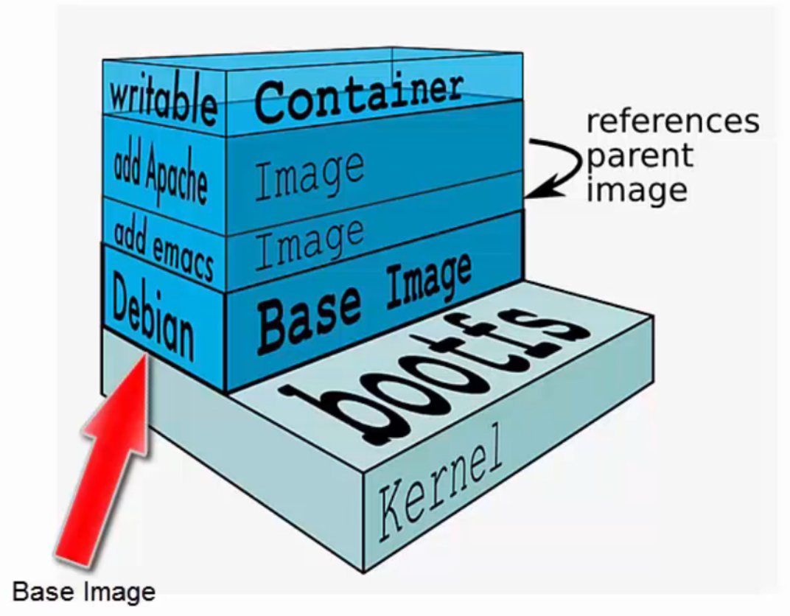
Union Mount FS
用于制作image
例如：
AU FS
Overlay FS
Devicemapper
btrfs
。。。
参考：https://en.wikipedia.org/wiki/Union_mount

Slide 14
Docker 的好处
一处成功，处处成功
横跨开发，测试，部署环境
也不用管是在实体机，虚拟机，还是在云上
一个大包，很方便
创建和部署都很快
可以跟CI/CD方便集成
跟微服务结合很方便
隔离，解藕，弹性

Slide 15
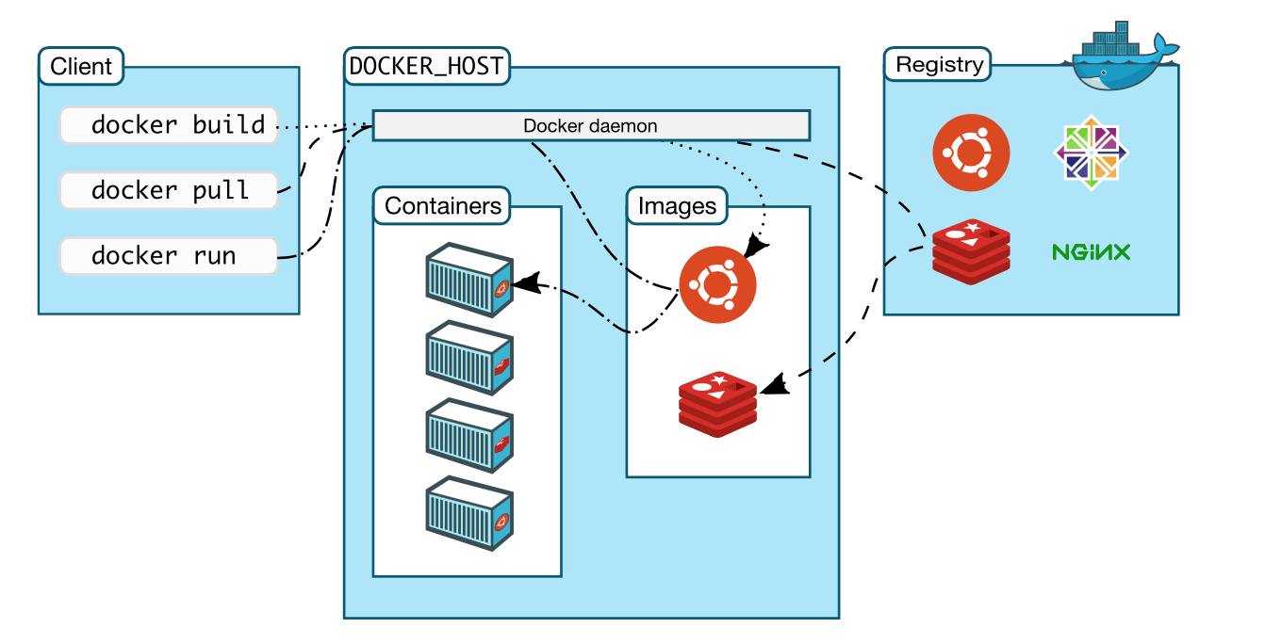
Docker的组成部分：典型C/S架构
From Docker.com

Slide 16
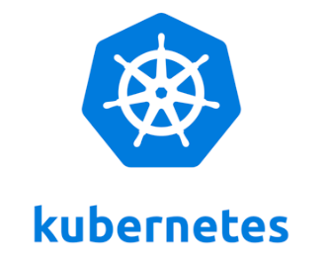
What is Kubernetes
发音：[koo-ber-nay’ tace]
来源是希腊语”舵手“的意思，logo中也带有7个轮辐，是纪念星际迷航的意思
From Kubernetes 官网
Kubernetes是用于自动部署，扩展和管理容器化应用程序的开源系统
它将组成应用程序的容器组合成逻辑单元，以便于管理和服务发现，Kubernetes 构建在Google 15年生产环境经验基础之上，并结合来自社区的最佳创意和实践
Container Orchestrator

Slide 17
Kubernetes 特性 (From Kubernetes官网）
服务发现和负载均衡
自我修复-重新启动失败的容器
横向缩放-使用简单的命令或 UI，或者根据 CPU 的使用情况自动调整应用程序副本数
自动部署和回滚
密钥和配置管理-部署和更新密钥和应用程序配置，不会重新编译镜像，不会暴露
更多

Slide 18
K8s的集群架构-全景图
A kube-scheduler process runs on the master node and determines where (on which worker nodes) to assign new pods to run.
Kubectl： a command-line tool to interact with a Kubernetes cluster through the Kubernetes API.
A kubelet is an agent that runs on each node in the cluster, communicates with the master, and manages activities and resources on the node, such as running pod containers via Docker.
Master Node
.Yaml
Scheduler
kubectl
API Server
Controller
Worker Node
Worker Node
Kubelet
Kube-Proxy
Kubelet
Kube-Proxy
Pod
Pod
Pod
Pod

Slide 19
K8s的集群架构-全景图
Master Node
Scheduler
.Yaml
kubectl
API Server
Controller
Worker Node
Worker Node
Kubelet
Kube-Proxy
Kubelet
Kube-Proxy
Pod
Pod
Pod
Pod

Slide 20
K8s的集群架构-Master & Workers
A kube-scheduler process runs on the master node and determines where (on which worker nodes) to assign new pods to run.
Master Node
Scheduler
Worker Node
Worker Node

Slide 21
K8s的集群架构-API server & client
Kubectl： a command-line tool to interact with a Kubernetes cluster through the Kubernetes API.
Master Node
Scheduler
kubectl
API Server
Worker Node
Worker Node

Slide 22
K8s的集群架构-Worker & kubelet
A kubelet is an agent that runs on each node in the cluster, communicates with the master, and manages activities and resources on the node, such as running pod containers via Docker.
Master Node
Scheduler
kubectl
API Server
Worker Node
Worker Node
Kubelet
Kubelet

Slide 23
K8s的集群架构-Yaml file
You can create a deployment .yaml file to tell Kubernetes how to deploy and manage application instances on the cluster. In this script, you can specify the container configuration and other Kubernetes resources that are required to run the application, such as persistent storage, services, and annotations.
Master Node
Scheduler
.Yaml
kubectl
API Server
Worker Node
Worker Node
Kubelet
Kubelet

Slide 24
K8s的集群架构-Pod & Container
A pod can include one or more application containers and some shared resources, such as storage, networking information, and so on. The containers in a pod share an IP Address and port space, are always co-located and co-scheduled, and run in a shared context on the same node.
Master Node
Scheduler
.Yaml
kubectl
API Server
Worker Node
Worker Node
Kubelet
Kubelet
Pod
Pod
Pod
Pod

Slide 25
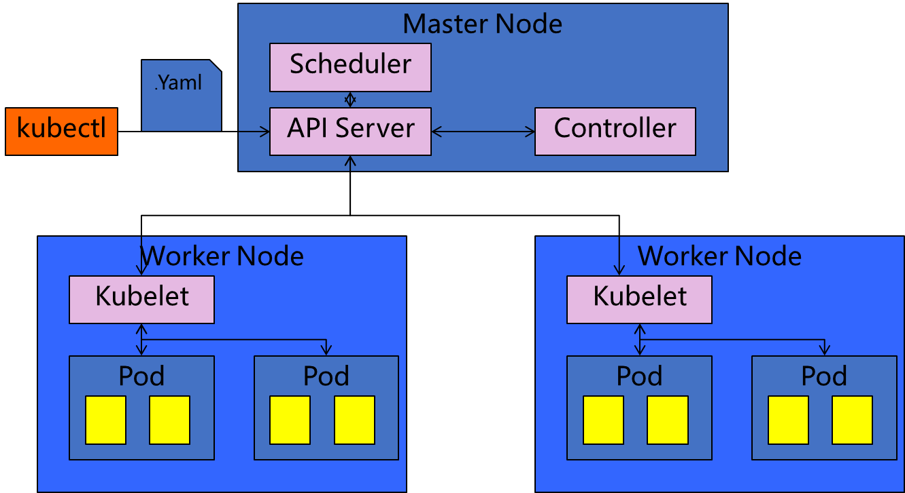
K8s的集群架构-Controller
A set of controllers, which run as background threads on the master node, manage routine tasks in the cluster. For example, the node controller monitors the status of nodes, and responds when one goes down. There is also a replication controller for maintaining the correct number of pods for a deployment, an endpoint controller for connecting services with pods, and others. These controllers are compiled into a single binary process called kube-controller-manager.
A Repolication Controller is a controller that is part of the master node's controller manager. It makes sure the specified number of replicas for a Pod is running at any given point in time. If there are more Pods than the desired count, the ReplicationController would kill the extra Pods, and, if there are less Pods, then the ReplicationController would create more Pods to match the desired count
Notes:
A set of controllers, which run as background threads on the master node, manage routine tasks in the cluster. For example, the node controller monitors the status of nodes, and responds when one goes down. There is also a replication controller for maintaining the correct number of pods for a deployment, an endpoint controller for connecting services with pods, and others. These controllers are compiled into a single binary process called kube-controller-manager.
A Repolication Controller is a controller that is part of the master node's controller manager. It makes sure the specified number of replicas for a Pod is running at any given point in time. If there are more Pods than the desired count, the ReplicationController would kill the extra Pods, and, if there are less Pods, then the ReplicationController would create more Pods to match the desired count

Slide 26
K8s的集群架构-kube-proxy
Kube-proxy ：maintains network rules on the host and performs connection forwarding.
kube-proxy is the network proxy which runs on each worker node and listens to the API server for each Service endpoint creation/deletion. For each Service endpoint, kube-proxy sets up the routes so that it can reach to it.
Master Node
Scheduler
.Yaml
kubectl
API Server
Controller
Worker Node
Worker Node
Kubelet
Kube-Proxy
Kubelet
Kube-Proxy
Pod
Pod
Pod
Pod

Slide 27
更多架构
Master还跑着etcd，用于存放全局数据
当然Node还有Container Runtime，用于启动容器（缺省是Docker Runtime，但是也支持rkt）

Slide 28
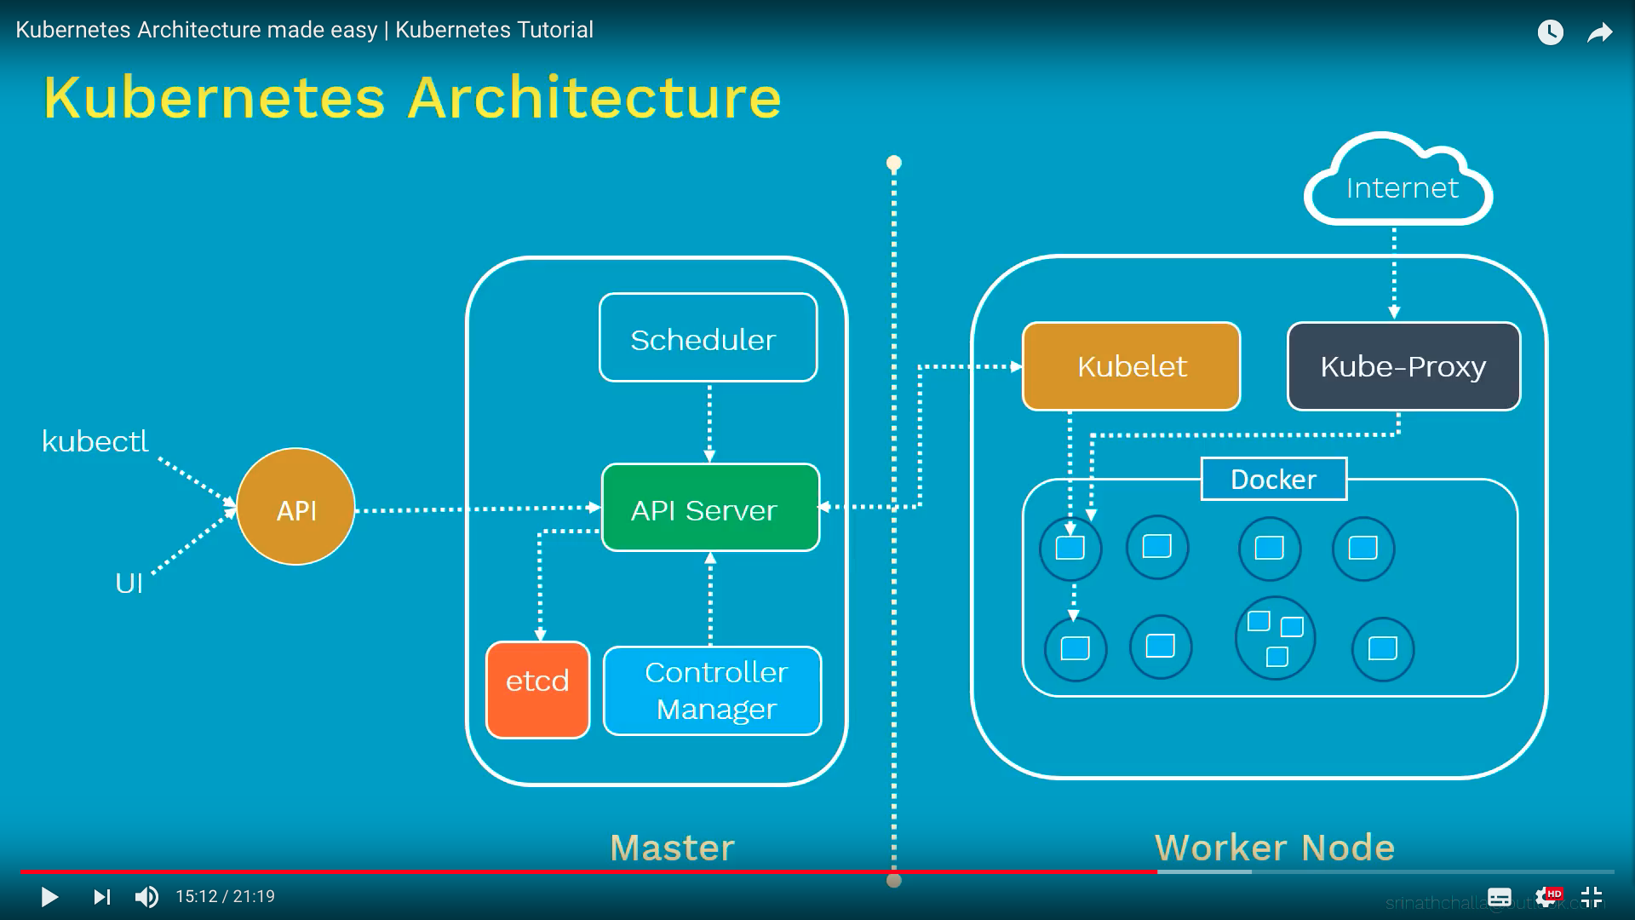
整体架构（图来自youtube）

