Slide 1
Chapter 8 Objects and Classes

Slide 2

Motivations
After learning the preceding chapters, you are capable of solving many programming problems using selections, loops, methods, and arrays. However, these Java features are not sufficient for developing graphical user interfaces and large scale software systems. Suppose you want to develop a graphical user interface as shown below. How do you program it?

Slide 3
Objectives
To describe objects and classes, and use classes to model objects (§8.2).
To use UML graphical notations to describe classes and objects (§8.2).
To demonstrate defining classes and creating objects (§8.3).
To create objects using constructors (§8.4).
To access objects via object reference variables (§8.5).
To define a reference variable using a reference type (§8.5.1).
To access an object’s data and methods using the object member access operator (.) (§8.5.2).
To define data fields of reference types and assign default values for an object’s data fields (§8.5.3).
To distinguish between object reference variables and primitive data type variables (§8.5.4).
To use classes Date, Random, and JFrame in the Java library (§8.6).
To distinguish between instance and static variables and methods (§8.7).
To define private data fields with appropriate get and set methods (§8.8).
To encapsulate data fields to make classes easy to maintain (§8.9).
To develop methods with object arguments and differentiate between primitive-type arguments and object-type arguments (§8.10).
To store and process objects in arrays (§8.11).

Slide 4
OO Programming Concepts
Object-oriented programming (OOP) involves programming using objects. An object represents an entity in the real world that can be distinctly identified. For example, a student, a desk, a circle, a button, and even a loan can all be viewed as objects. An object has a unique identity, state, and behaviors. The state of an object consists of a set of data fields (also known as properties) with their current values. The behavior of an object is defined by a set of methods.

Slide 5
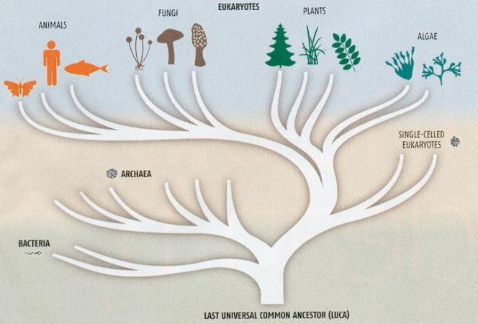
The universe

Slide 6

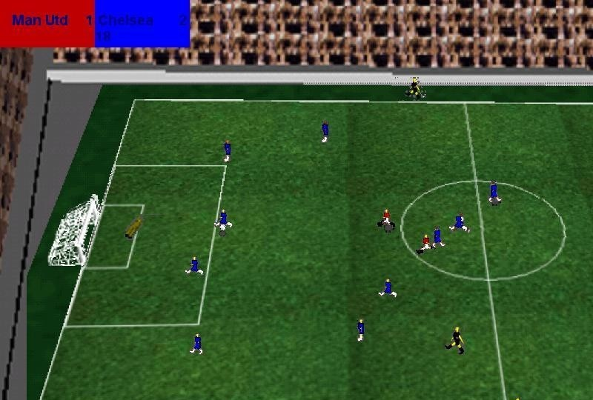
Code Reusability

Slide 7
Objects
An object has both a state and behavior. The state defines the object, and the behavior defines what the object does.

Slide 8

Class and instances Example

Slide 9
Classes
Classes are constructs that define objects of the same type. A Java class uses variables to define data fields and methods to define behaviors. Additionally, a class provides a special type of methods, known as constructors, which are invoked to construct objects from the class.

Slide 10
Classes

Slide 11
UML Class Diagram

Slide 12
Example: Defining Classes and Creating Objects
Objective: Demonstrate creating objects, accessing data, and using methods.
TestCircle1
Run

Slide 13
Example: Defining Classes and Creating Objects
Objective: Demonstrate creating objects, accessing data, and using methods.
TV
TestTV
Run

Slide 14
Constructors
Constructors are a special kind of methods that are invoked to construct objects.
Circle() {
}
Circle(double newRadius) {
radius = newRadius;
}

Slide 15
Constructors, cont.
A constructor with no parameters is referred to as a no-arg constructor.
· Constructors must have the same name as the class itself.
· Constructors do not have a return type—not even void.
· Constructors are invoked using the new operator when an object is created. Constructors play the role of initializing objects.

Slide 16
Creating Objects Using Constructors
new ClassName();
Example:
new Circle();
new Circle(5.0);

Slide 17
Default Constructor
A class may be declared without constructors. In this case, a no-arg constructor with an empty body is implicitly declared in the class. This constructor, called a default constructor, is provided automatically only if no constructors are explicitly declared in the class.

Slide 18
Declaring Object Reference Variables
To reference an object, assign the object to a reference variable.
To declare a reference variable, use the syntax:
ClassName objectRefVar;
Example:
Circle myCircle;

Slide 19
Declaring/Creating Objects in a Single Step
ClassName objectRefVar = new ClassName();
Example:
Circle myCircle = new Circle();
Assign object reference
Create an object

Slide 20
Accessing Objects
Referencing the object’s data:
objectRefVar.data
e.g., myCircle.radius
Invoking the object’s method:
objectRefVar.methodName(arguments)
e.g., myCircle.getArea()

Slide 21
Trace Code
animation
Declare myCircle
Circle myCircle = new Circle(5.0);
SCircle yourCircle = new Circle();
yourCircle.radius = 100;
myCircle
no value

Slide 22
Trace Code, cont.
animation
Circle myCircle = new Circle(5.0);
Circle yourCircle = new Circle();
yourCircle.radius = 100;
myCircle
no value
Create a circle

Slide 23
Trace Code, cont.
animation
Circle myCircle = new Circle(5.0);
Circle yourCircle = new Circle();
yourCircle.radius = 100;
myCircle
reference value
Assign object reference to myCircle

Slide 24
Trace Code, cont.
animation
Circle myCircle = new Circle(5.0);
Circle yourCircle = new Circle();
yourCircle.radius = 100;
myCircle
reference value
yourCircle
no value
Declare yourCircle

Slide 25
Trace Code, cont.
animation
Circle myCircle = new Circle(5.0);
Circle yourCircle = new Circle();
yourCircle.radius = 100;
myCircle
reference value
yourCircle
no value
Create a new Circle object

Slide 26
Trace Code, cont.
animation
Circle myCircle = new Circle(5.0);
Circle yourCircle = new Circle();
yourCircle.radius = 100;
myCircle
reference value
yourCircle
reference value
Assign object reference to yourCircle

Slide 27
Trace Code, cont.
animation
Circle myCircle = new Circle(5.0);
Circle yourCircle = new Circle();
yourCircle.radius = 100;
myCircle
reference value
yourCircle
reference value
Change radius in yourCircle

Slide 28
Caution
Recall that you use
Math.methodName(arguments) (e.g., Math.pow(3, 2.5))
to invoke a method in the Math class. Can you invoke getArea() using Circle1.getArea()? The answer is no. All the methods used before this chapter are static methods, which are defined using the static keyword. However, getArea() is non-static. It must be invoked from an object using
objectRefVar.methodName(arguments) (e.g., myCircle.getArea()).
More explanations will be given in the section on “Static Variables, Constants, and Methods.”

Slide 29
Reference Data Fields
The data fields can be of reference types. For example, the following Student class contains a data field name of the String type.
public class Student {
String name; // name has default value null
int age; // age has default value 0
boolean isScienceMajor; // isScienceMajor has default value false
char gender; // c has default value '\u0000'
}

Slide 30
The null Value
If a data field of a reference type does not reference any object, the data field holds a special literal value, null.

Slide 31
Default Value for a Data Field
The default value of a data field is null for a reference type, 0 for a numeric type, false for a boolean type, and '\u0000' for a char type. However, Java assigns no default value to a local variable inside a method.
public class Test {
public static void main(String[] args) {
Student student = new Student();
System.out.println("name? " + student.name);
System.out.println("age? " + student.age);
System.out.println("isScienceMajor? " + student.isScienceMajor);
System.out.println("gender? " + student.gender);
}
}

Slide 32
Example
Java assigns no default value to a local variable inside a method.
public class Test {
public static void main(String[] args) {
int x; // x has no default value
String y; // y has no default value
System.out.println("x is " + x);
System.out.println("y is " + y);
}
}
Compilation error: variables not initialized

Slide 33
Differences between Variables of Primitive Data Types and Object Types

Slide 34
Copying Variables of Primitive Data Types and Object Types

Slide 35
Garbage Collection
As shown in the previous figure, after the assignment statement c1 = c2, c1 points to the same object referenced by c2. The object previously referenced by c1 is no longer referenced. This object is known as garbage. Garbage is automatically collected by JVM.

Slide 36
Garbage Collection, cont
TIP: If you know that an object is no longer needed, you can explicitly assign null to a reference variable for the object. The JVM will automatically collect the space if the object is not referenced by any variable.

Slide 37
The Date Class
Java provides a system-independent encapsulation of date and time in the java.util.Date class. You can use the Date class to create an instance for the current date and time and use its toString method to return the date and time as a string.

Slide 38
The Date Class Example
For example, the following code
java.util.Date date = new java.util.Date();
System.out.println(date.toString());
displays a string like Sun Mar 09 13:50:19 EST 2003.

Slide 39
The Random Class
You have used Math.random() to obtain a random double value between 0.0 and 1.0 (excluding 1.0). A more useful random number generator is provided in the java.util.Random class.

Slide 40
The Random Class Example
If two Random objects have the same seed, they will generate identical sequences of numbers. For example, the following code creates two Random objects with the same seed 3.
Random random1 = new Random(3);
System.out.print("From random1: ");
for (int i = 0; i < 10; i++)
System.out.print(random1.nextInt(1000) + " ");
Random random2 = new Random(3);
System.out.print("\nFrom random2: ");
for (int i = 0; i < 10; i++)
System.out.print(random2.nextInt(1000) + " ");
From random1: 734 660 210 581 128 202 549 564 459 961
From random2: 734 660 210 581 128 202 549 564 459 961

Slide 41
Displaying GUI Components
When you develop programs to create graphical user interfaces, you will use Java classes such as JFrame, JButton, JRadioButton, JComboBox, and JList to create frames, buttons, radio buttons, combo boxes, lists, and so on. Here is an example that creates two windows using the JFrame class.
TestFrame
Run

Slide 42
Trace Code
animation
Declare, create, and assign in one statement
JFrame frame1 = new JFrame(); frame1.setTitle("Window 1"); frame1.setSize(200, 150); frame1.setVisible(true); JFrame frame2 = new JFrame(); frame2.setTitle("Window 2"); frame2.setSize(200, 150); frame2.setVisible(true);
frame1
reference
: JFrame
title:
width:
height:
visible:

Slide 43
Trace Code
animation
JFrame frame1 = new JFrame(); frame1.setTitle("Window 1"); frame1.setSize(200, 150); frame1.setVisible(true); JFrame frame2 = new JFrame(); frame2.setTitle("Window 2"); frame2.setSize(200, 150); frame2.setVisible(true);
frame1
reference
Set title property
: JFrame
title: "Window 1"
width:
height:
visible:

Slide 44
Trace Code
animation
JFrame frame1 = new JFrame(); frame1.setTitle("Window 1"); frame1.setSize(200, 150); frame1.setVisible(true);
JFrame frame2 = new JFrame(); frame2.setTitle("Window 2"); frame2.setSize(200, 150); frame2.setVisible(true);
frame1
reference
: JFrame
title: "Window 1"
width: 200
height: 150
visible:
Set size property

Slide 45
Trace Code
animation
JFrame frame1 = new JFrame(); frame1.setTitle("Window 1"); frame1.setSize(200, 150); frame1.setVisible(true);
JFrame frame2 = new JFrame(); frame2.setTitle("Window 2"); frame2.setSize(200, 150); frame2.setVisible(true);
frame1
reference
: JFrame
title: "Window 1"
width: 200
height: 150
visible: true
Set visible property

Slide 46
Trace Code
animation
JFrame frame1 = new JFrame(); frame1.setTitle("Window 1"); frame1.setSize(200, 150); frame1.setVisible(true);
JFrame frame2 = new JFrame(); frame2.setTitle("Window 2"); frame2.setSize(200, 150); frame2.setVisible(true);
frame1
reference
: JFrame
title: "Window 1"
width: 200
height: 150
visible: true
Declare, create, and assign in one statement
frame2
reference
: JFrame
title:
width:
height:
visible:

Slide 47
Trace Code
animation
JFrame frame1 = new JFrame(); frame1.setTitle("Window 1"); frame1.setSize(200, 150); frame1.setVisible(true);
JFrame frame2 = new JFrame(); frame2.setTitle("Window 2"); frame2.setSize(200, 150); frame2.setVisible(true);
frame1
reference
: JFrame
title: "Window 1"
width: 200
height: 150
visible: true
frame2
reference
Set title property
: JFrame
title: "Window 2"
width:
height:
visible:

Slide 48
Trace Code
animation
JFrame frame1 = new JFrame(); frame1.setTitle("Window 1"); frame1.setSize(200, 150); frame1.setVisible(true);
JFrame frame2 = new JFrame(); frame2.setTitle("Window 2"); frame2.setSize(200, 150); frame2.setVisible(true);
frame1
reference
: JFrame
title: "Window 1"
width: 200
height: 150
visible: true
frame2
reference
: JFrame
title: "Window 2"
width: 200
height: 150
visible:
Set size property

Slide 49
Trace Code
animation
JFrame frame1 = new JFrame(); frame1.setTitle("Window 1"); frame1.setSize(200, 150); frame1.setVisible(true);
JFrame frame2 = new JFrame(); frame2.setTitle("Window 2"); frame2.setSize(200, 150); frame2.setVisible(true);
frame1
reference
: JFrame
title: "Window 1"
width: 200
height: 150
visible: true
frame2
reference
: JFrame
title: "Window 2"
width: 200
height: 150
visible: true
Set visible property

Slide 50
Adding GUI Components to Window
You can add graphical user interface components, such as buttons, labels, text fields, combo boxes, lists, and menus, to the window. The components are defined using classes. Here is an example to create buttons, labels, text fields, check boxes, radio buttons, and combo boxes.
GUIComponents
Run

Slide 51
Instance Variables, and Methods
Instance variables belong to a specific instance. Instance methods are invoked by an instance of the class.

Slide 52
Static Variables, Constants, and Methods
Static variables are shared by all the instances of the class. Static methods are not tied to a specific object.
Static constants are final variables shared by all the instances of the class.

Slide 53
Static Variables, Constants, and Methods, cont.
To declare static variables, constants, and methods, use the static modifier.

Slide 54
Static Variables, Constants, and Methods, cont.

Slide 55
Example of Using Instance and Class Variables and Method
Objective: Demonstrate the roles of instance and class variables and their uses. This example adds a class variable numberOfObjects to track the number of Circle objects created.
Circle2
TestCircle2
Run

Slide 56
Visibility Modifiers and Accessor/Mutator Methods
By default, the class, variable, or method can be accessed by any class in the same package.
public
The class, data, or method is visible to any class in any package.
private
The data or methods can be accessed only by the declaring class.
The get and set methods are used to read and modify private properties.

Slide 57
The private modifier restricts access to within a class, the default modifier restricts access to within a package, and the public modifier enables unrestricted access.

Slide 58
NOTE
An object cannot access its private members, as shown in (b). It is OK, however, if the object is declared in its own class, as shown in (a).

Slide 59
Why Data Fields Should Be private?
To protect data.
To make class easy to maintain.

Slide 60
Example of Data Field Encapsulation
Circle3
TestCircle3
Run

Slide 61
Passing Objects to Methods
Passing by value for primitive type value (the value is passed to the parameter)
Passing by value for reference type value (the value is the reference to the object)
TestPassObject
Run

Slide 62
Passing Objects to Methods, cont.

Slide 63
Array of Objects
Circle[] circleArray = new Circle[10];
An array of objects is actually an array of reference variables. So invoking circleArray[1].getArea() involves two levels of referencing as shown in the next figure. circleArray references to the entire array. circleArray[1] references to a Circle object.

Slide 64
Array of Objects, cont.
Circle[] circleArray = new Circle[10];

Slide 65
Array of Objects, cont.
Summarizing the areas of the circles
TotalArea
Run

