Slide 1
Welcome to Advanced Programming
Lecture #1
By
Dr. Hitham M. Abo Bakr

Slide 2
Agenda
Course Materials
Work with Java

Slide 3
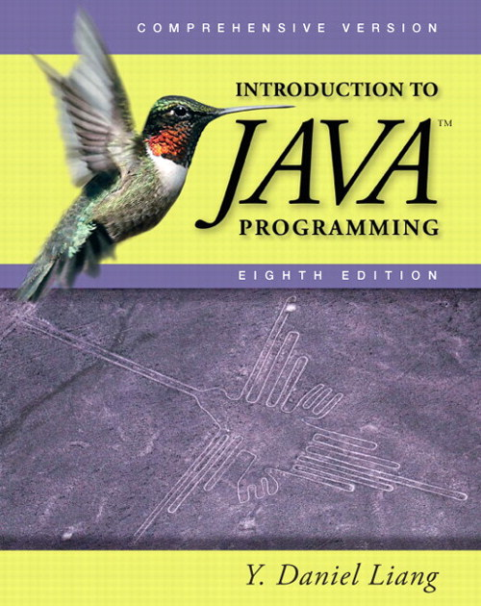
Course Material
BOOK

Slide 4
Compiling Source Code
A program written in a high-level language is called a source program. Since a computer cannot understand a source program. Program called a compiler is used to translate the source program into a machine language program called an object program. The object program is often then linked with other supporting library code before the object can be executed on the machine.

Slide 5
Compiling Java Source Code
You can port a source program to any machine with appropriate compilers. The source program must be recompiled, however, because the object program can only run on a specific machine. Nowadays computers are networked to work together. Java was designed to run object programs on any platform. With Java, you write the program once, and compile the source program into a special type of object code, known as bytecode. The bytecode can then run on any computer with a Java Virtual Machine, as shown below. Java Virtual Machine is a software that interprets Java bytecode.

Slide 6
Operating Systems

Slide 7
Why Java?
The answer is that Java enables users to develop and deploy applications on the Internet for servers, desktop computers, and small hand-held devices. The future of computing is being profoundly influenced by the Internet, and Java promises to remain a big part of that future. Java is the Internet programming language.
Java is a general purpose programming language.
Java is the Internet programming language.

Slide 8
Java, Web, and Beyond
Java can be used to develop Web applications.
Java Applets
Java Web Applications
Java can also be used to develop applications for Mobiles

Slide 9
JDK Editions
Java Standard Edition (J2SE)
J2SE can be used to develop client-side standalone applications or applets.
Java Enterprise Edition (J2EE)
J2EE can be used to develop server-side applications such as Java servlets and Java ServerPages.
Java Micro Edition (J2ME).
J2ME can be used to develop applications for mobile devices such as cell phones.
.

Slide 10
Popular Java IDEs
NetBeans Open Source by Sun
Eclipse Open Source by IBM
Borland JBuilder 2007 (Based on Eclipse)

Slide 11
A Simple Java Program
Listing 1.1
//This program prints Welcome to Java!
public class Welcome {
public static void main(String[] args) {
System.out.println("Welcome to Java!");
}
}
Welcome
IMPORTANT NOTE: To enable the buttons, you must download the entire slide file slide.zip and unzip the files into a directory (e.g., c:\slide) .
Run

Slide 12

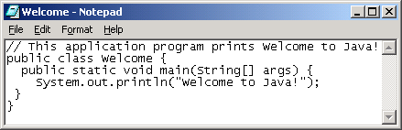
Creating and Editing Using NotePad
To use NotePad, type
notepad Welcome.java
from the DOS prompt.

Slide 13

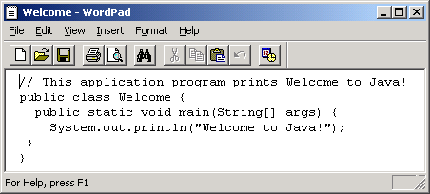
Creating and Editing Using WordPad
To use WordPad, type
write Welcome.java
from the DOS prompt.

Slide 14
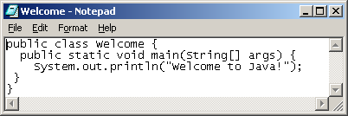
Creating, Compiling, and Running Programs

Slide 15
Trace a Program Execution
animation
Enter main method
//This program prints Welcome to Java!
public class Welcome {
public static void main(String[] args) {
System.out.println("Welcome to Java!");
}
}

Slide 16
Trace a Program Execution
animation
Execute statement
//This program prints Welcome to Java!
public class Welcome {
public static void main(String[] args) {
System.out.println("Welcome to Java!");
}
}

Slide 17
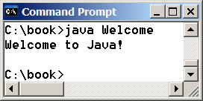
Trace a Program Execution
animation
//This program prints Welcome to Java!
public class Welcome {
public static void main(String[] args) {
System.out.println("Welcome to Java!");
}
}
print a message to the console

Slide 18
Introducing Programming with an Example
Listing 2.1 Computing the Area of a Circle
This program computes the area of the circle.
ComputeArea
IMPORTANT NOTE: To enable the buttons, you must download the entire slide file slide.zip and unzip the files into a directory (e.g., c:\slide) .
Run

Slide 19
Trace a Program Execution
animation
allocate memory for radius
public class ComputeArea {
/** Main method */
public static void main(String[] args) {
double radius;
double area;
// Assign a radius
radius = 20;
// Compute area
area = radius * radius * 3.14159;
// Display results
System.out.println("The area for the circle of radius " +
radius + " is " + area);
}
}
radius
no value

Slide 20
Trace a Program Execution
animation
public class ComputeArea {
/** Main method */
public static void main(String[] args) {
double radius;
double area;
// Assign a radius
radius = 20;
// Compute area
area = radius * radius * 3.14159;
// Display results
System.out.println("The area for the circle of radius " +
radius + " is " + area);
}
}
memory
radius
no value
area
no value
allocate memory for area

Slide 21
Constants
final datatype CONSTANTNAME = VALUE;
final double PI = 3.14159;
final int SIZE = 3;

Slide 22
Numerical Data Types

Slide 23
Numeric Operators

Slide 24
Integer Division
+, -, *, /, and %
5 / 2 yields an integer 2.
5.0 / 2 yields a double value 2.5
5 % 2 yields 1 (the remainder of the division)

Slide 25
Remainder Operator
Remainder is very useful in programming. For example, an even number % 2 is always 0 and an odd number % 2 is always 1. So you can use this property to determine whether a number is even or odd. Suppose today is Saturday and you and your friends are going to meet in 10 days. What day is in 10 days? You can find that day is Tuesday using the following expression:

Slide 26
How to Evaluate an Expression
Though Java has its own way to evaluate an expression behind the scene, the result of a Java expression and its corresponding arithmetic expression are the same. Therefore, you can safely apply the arithmetic rule for evaluating a Java expression.

Slide 27
Problem: Converting Temperatures
Write a program that converts a Fahrenheit degree to Celsius using the formula:
FahrenheitToCelsius
Run

Slide 28
Shortcut Assignment Operators
Operator Example Equivalent
+= i += 8 i = i + 8
-= f -= 8.0 f = f - 8.0
*= i *= 8 i = i * 8
/= i /= 8 i = i / 8
%= i %= 8 i = i % 8

Slide 29
Increment and Decrement Operators
Operator Name Description
++var preincrement The expression (++var) increments var
by 1 and evaluates to the new value in var after the increment.
var++ postincrement The expression (var++) evaluates to the original value in var and increments var by 1.
--var predecrement The expression (--var) decrements var by 1 and evaluates to the new value in var after the decrement.
var-- postdecrement The expression (var--) evaluates to the original value in var and decrements var by 1.

Slide 30
Increment and Decrement Operators, cont.

Slide 31
Increment and DecrementOperators, cont.
Using increment and decrement operators makes expressions short, but it also makes them complex and difficult to read. Avoid using these operators in expressions that modify multiple variables, or the same variable for multiple times such as this: int k = ++i + i.

Slide 32
Conversion Rules
When performing a binary operation involving two operands of different types, Java automatically converts the operand based on the following rules:
1. If one of the operands is double, the other is converted into double.
2. Otherwise, if one of the operands is float, the other is converted into float.
3. Otherwise, if one of the operands is long, the other is converted into long.
4. Otherwise, both operands are converted into int.

Slide 33
Type Casting
Implicit casting
double d = 3; (type widening)
Explicit casting
int i = (int)3.0; (type narrowing)
int i = (int)3.9; (Fraction part is truncated)
What is wrong? int x = 5 / 2.0;

Slide 34
String Concatenation
// Three strings are concatenated
String message = "Welcome " + "to " + "Java";
// String Chapter is concatenated with number 2
String s = "Chapter" + 2; // s becomes Chapter2
// String Supplement is concatenated with character B
String s1 = "Supplement" + 'B'; // s becomes SupplementB

Slide 35
Getting Input Using Scanner
1. Create a Scanner object
Scanner scanner = new Scanner(System.in);
2. Use the methods next(), nextByte(), nextShort(), nextInt(), nextLong(), nextFloat(), nextDouble(), or nextBoolean() to obtain to a string, byte, short, int, long, float, double, or boolean value. For example,
System.out.print("Enter a double value: ");
Scanner scanner = new Scanner(System.in);
double d = scanner.nextDouble();
TestScanner
Run

Slide 36
Problem: Computing Loan Payments
This program lets the user enter the interest rate, number of years, and loan amount and computes monthly payment and total payment.
ComputeLoan
Run

Slide 37
Problem: Monetary Units
This program lets the user enter the amount in decimal representing dollars and cents and output a report listing the monetary equivalent in single dollars, quarters, dimes, nickels, and pennies. Your program should report maximum number of dollars, then the maximum number of quarters, and so on, in this order.
ComputeChange
Run

Slide 38
Programming Style and Documentation
Appropriate Comments
Naming Conventions
Proper Indentation and Spacing Lines
Block Styles

Slide 39
Appropriate Comments
Include a summary at the beginning of the program to explain what the program does, its key features, its supporting data structures, and any unique techniques it uses.
Include your name, class section, instructor, date, and a brief description at the beginning of the program.

Slide 40
Naming Conventions
Choose meaningful and descriptive names.
Variables and method names:
Use lowercase. If the name consists of several words, concatenate all in one, use lowercase for the first word, and capitalize the first letter of each subsequent word in the name. For example, the variables radius and area, and the method computeArea.

Slide 41
Naming Conventions, cont.
Class names:
Capitalize the first letter of each word in the name. For example, the class name ComputeArea.
Constants:
Capitalize all letters in constants, and use underscores to connect words. For example, the constant PI and MAX_VALUE

Slide 42
Proper Indentation and Spacing
Indentation
Indent two spaces.
Spacing
Use blank line to separate segments of the code.

Slide 43
Block Styles
Use end-of-line style for braces.

Slide 44
Programming Errors
Syntax Errors
Detected by the compiler
Runtime Errors
Causes the program to abort
Logic Errors
Produces incorrect result

Slide 45
Syntax Errors
public class ShowSyntaxErrors {
public static void main(String[] args) {
i = 30;
System.out.println(i + 4);
}
}

Slide 46
Runtime Errors
public class ShowRuntimeErrors {
public static void main(String[] args) {
int i = 1 / 0;
}
}

Slide 47
Logic Errors
public class ShowLogicErrors {
// Determine if a number is between 1 and 100 inclusively
public static void main(String[] args) {
// Prompt the user to enter a number
String input = JOptionPane.showInputDialog(null,
"Please enter an integer:",
"ShowLogicErrors", JOptionPane.QUESTION_MESSAGE);
int number = Integer.parseInt(input);
// Display the result
System.out.println("The number is between 1 and 100, " +
"inclusively? " + ((1 < number) && (number < 100)));
System.exit(0);
}
}

Slide 48
Debugging
Logic errors are called bugs. The process of finding and correcting errors is called debugging. A common approach to debugging is to use a combination of methods to narrow down to the part of the program where the bug is located. You can hand-trace the program (i.e., catch errors by reading the program), or you can insert print statements in order to show the values of the variables or the execution flow of the program. This approach might work for a short, simple program. But for a large, complex program, the most effective approach for debugging is to use a debugger utility.

Slide 49
Debugger
Debugger is a program that facilitates debugging. You can use a debugger to
Execute a single statement at a time.
Trace into or stepping over a method.
Set breakpoints.
Display variables.
Display call stack.
Modify variables.

Slide 50
Tasks
Install Netbeans
Run an application on Java IDE
Search Points:
Debug application using Netbeans

Slide 51
Thanks

