Slide 1
Chapter 16 Event-Driven Programming

Slide 2
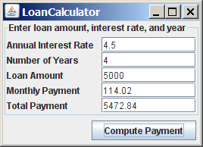
Motivations
Suppose you wish to write a GUI program that lets the user enter the loan amount, annual interest rate, and number of years, and click the Compute Loan button to obtain the monthly payment and total payment. How do you accomplish the task? You have to use event-driven programming to write the code to respond to the button-clicking event.
LoanCalculator
Run

Slide 3
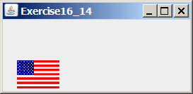
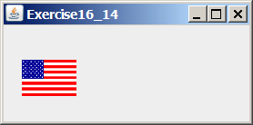
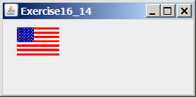
Motivations
Suppose you wish to write a program that animates a rising flag, as shown in Figure 16.1(b-d). How do you accomplish the task? There are several solutions to this problem. An effective way to solve it is to use a timer in event-driven programming, which is the subject of this chapter.

Slide 4
Procedural vs. Event-Driven Programming
Procedural programming is executed in procedural order.
In event-driven programming, code is executed upon activation of events.

Slide 5
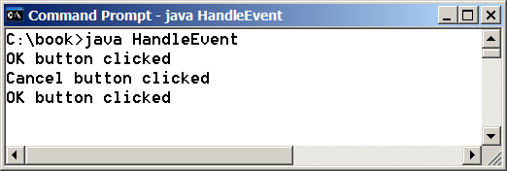
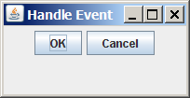
Revisit Listing 11.7 Taste of Event-Driven Programming
The example displays a button in the frame. A message is displayed on the console when a button is clicked.
HandleEvent
Run

Slide 6
Events
An event can be defined as a type of signal to the program that something has happened.
The event is generated by external user actions such as mouse movements, mouse clicks, and keystrokes, or by the operating system, such as a timer.

Slide 7
Event Classes

Slide 8
Event Information
An event object contains whatever properties are pertinent to the event. You can identify the source object of the event using the getSource() instance method in the EventObject class. The subclasses of EventObject deal with special types of events, such as button actions, window events, component events, mouse movements, and keystrokes. Table 15.1 lists external user actions, source objects, and event types generated.

Slide 9
Selected User Actions
Source Event Type User Action Object Generated
Click a button JButton ActionEvent
Click a check box JCheckBox ItemEvent, ActionEvent
Click a radio button JRadioButton ItemEvent, ActionEvent
Press return on a text field JTextField ActionEvent
Select a new item JComboBox ItemEvent, ActionEvent
Window opened, closed, etc. Window WindowEvent
Mouse pressed, released, etc. Component MouseEvent
Key released, pressed, etc. Component KeyEvent

Slide 10
The Delegation Model: Example
JButton jbt = new JButton("OK");
ActionListener listener = new OKListener();
jbt.addActionListener(listener);

Slide 11
Selected Event Handlers
Event Class Listener Interface Listener Methods (Handlers) ActionEvent ActionListener actionPerformed(ActionEvent)
ItemEvent ItemListener itemStateChanged(ItemEvent)
WindowEvent WindowListener windowClosing(WindowEvent)
windowOpened(WindowEvent)
windowIconified(WindowEvent)
windowDeiconified(WindowEvent)
windowClosed(WindowEvent)
windowActivated(WindowEvent)
windowDeactivated(WindowEvent)
ContainerEvent ContainerListener componentAdded(ContainerEvent)
componentRemoved(ContainerEvent) MouseEvent MouseListener mousePressed(MouseEvent)
mouseReleased(MouseEvent)
mouseClicked(MouseEvent)
mouseExited(MouseEvent)
mouseEntered(MouseEvent)
KeyEvent KeyListener keyPressed(KeyEvent)
keyReleased(KeyEvent)
keyTypeed(KeyEvent)

Slide 12
java.awt.event.ActionEvent

Slide 13
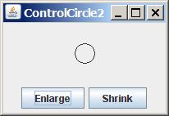
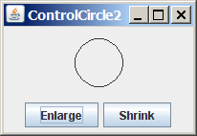
Example: First Version for ControlCircle (no listeners)
Now let us consider to write a program that uses two buttons to control the size of a circle.
ControlCircle1
Run

Slide 14
Example: Second Version for ControlCircle (with listener for Enlarge)
Now let us consider to write a program that uses two buttons to control the size of a circle.
ControlCircle2
Run

Slide 15
Inner Class Listeners
A listener class is designed specifically to create a listener object for a GUI component (e.g., a button). It will not be shared by other applications. So, it is appropriate to define the listener class inside the frame class as an inner class.

Slide 16
Inner Classes
Inner class: A class is a member of another class.
Advantages: In some applications, you can use an inner class to make programs simple.
An inner class can reference the data and methods defined in the outer class in which it nests, so you do not need to pass the reference of the outer class to the constructor of the inner class.
ShowInnerClass

Slide 17
Inner Classes, cont.

Slide 18
Inner Classes (cont.)
Inner classes can make programs simple and concise.
An inner class supports the work of its containing outer class and is compiled into a class named OuterClassName$InnerClassName.class. For example, the inner class InnerClass in OuterClass is compiled into OuterClass$InnerClass.class.

Slide 19
Inner Classes (cont.)
An inner class can be declared public, protected, or private subject to the same visibility rules applied to a member of the class.
An inner class can be declared static. A static inner class can be accessed using the outer class name. A static inner class cannot access nonstatic members of the outer class

Slide 20
Anonymous Inner Classes
An anonymous inner class must always extend a superclass or implement an interface, but it cannot have an explicit extends or implements clause.
An anonymous inner class must implement all the abstract methods in the superclass or in the interface.
An anonymous inner class always uses the no-arg constructor from its superclass to create an instance. If an anonymous inner class implements an interface, the constructor is Object().
An anonymous inner class is compiled into a class named OuterClassName$n.class. For example, if the outer class Test has two anonymous inner classes, these two classes are compiled into Test$1.class and Test$2.class.

Slide 21
Anonymous Inner Classes (cont.)
Inner class listeners can be shortened using anonymous inner classes. An anonymous inner class is an inner class without a name. It combines declaring an inner class and creating an instance of the class in one step. An anonymous inner class is declared as follows:
new SuperClassName/InterfaceName() {
// Implement or override methods in superclass or interface
// Other methods if necessary
}
AnonymousListenerDemo
Run

Slide 22
Alternative Ways of Defining Listener Classes
There are many other ways to define the listener classes. For example, you may rewrite Listing 6.3 by creating just one listener, register the listener with the buttons, and let the listener detect the event source, i.e., which button fires the event.
DetectSourceDemo
Run

Slide 23
Alternative Ways of Defining Listener Classes
You may also define the custom frame class that implements ActionListener.
FrameAsListenerDemo
Run

Slide 24
Problem: Loan Calculator
LoanCalculator
Run

Slide 25
Example: Handling Window Events
Objective: Demonstrate handling the window events. Any subclass of the Window class can generate the following window events: window opened, closing, closed, activated, deactivated, iconified, and deiconified. This program creates a frame, listens to the window events, and displays a message to indicate the occurring event.
TestWindowEvent
Run

Slide 26
Remember
Event Class Listener Interface Listener Methods (Handlers) ActionEvent ActionListener actionPerformed(ActionEvent)
ItemEvent ItemListener itemStateChanged(ItemEvent)
WindowEvent WindowListener windowClosing(WindowEvent)
windowOpened(WindowEvent)
windowIconified(WindowEvent)
windowDeiconified(WindowEvent)
windowClosed(WindowEvent)
windowActivated(WindowEvent)
windowDeactivated(WindowEvent)
ContainerEvent ContainerListener componentAdded(ContainerEvent)
componentRemoved(ContainerEvent) MouseEvent MouseListener mousePressed(MouseEvent)
mouseReleased(MouseEvent)
mouseClicked(MouseEvent)
mouseExited(MouseEvent)
mouseEntered(MouseEvent)
KeyEvent KeyListener keyPressed(KeyEvent)
keyReleased(KeyEvent)
keyTypeed(KeyEvent)

Slide 27
Listener Interface Adapters
Because the methods in the windowListener interface are abstract, you must implement all of them even if your program does not care about some of the events. For convenience, Java provides support classes, called convenience dapters, which provide default implementations for all the methods in the listener interface. The default implementation is simply an empty body.

Slide 28
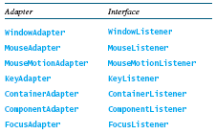
Listener Interface Adapters (Cont.)
Java provides convenience listener adapters for every AWT listener interface with multiple handlers. A convenience listener adapter is named XAdapter for XListener. For example, WindowAdapter is a convenience listener adapter for WindowListener. Table 16.3 lists the convenience adapters.
Run
AdaptorDemo

Slide 29
MouseEvent

Slide 30
Remember
Event Class Listener Interface Listener Methods (Handlers) ActionEvent ActionListener actionPerformed(ActionEvent)
ItemEvent ItemListener itemStateChanged(ItemEvent)
WindowEvent WindowListener windowClosing(WindowEvent)
windowOpened(WindowEvent)
windowIconified(WindowEvent)
windowDeiconified(WindowEvent)
windowClosed(WindowEvent)
windowActivated(WindowEvent)
windowDeactivated(WindowEvent)
ContainerEvent ContainerListener componentAdded(ContainerEvent)
componentRemoved(ContainerEvent) MouseEvent MouseListener mousePressed(MouseEvent)
mouseReleased(MouseEvent)
mouseClicked(MouseEvent)
mouseExited(MouseEvent)
mouseEntered(MouseEvent)
KeyEvent KeyListener keyPressed(KeyEvent)
keyReleased(KeyEvent)
keyTypeed(KeyEvent)

Slide 31
Handling Mouse Events
Java provides two listener interfaces, MouseListener and MouseMotionListener, to handle mouse events.
The MouseListener listens for actions such as when the mouse is pressed, released, entered, exited, or clicked.
The MouseMotionListener listens for actions such as dragging or moving the mouse.

Slide 32
Handling Mouse Events

Slide 33
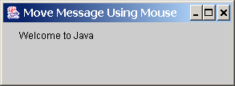
Example: Moving Message Using Mouse
Objective: Create a program to display a message in a panel. You can use the mouse to move the message. The message moves as the mouse drags and is always displayed at the mouse point.
MoveMessageDemo
Run

Slide 34
Handling Keyboard Events
To process a keyboard event, use the following handlers in the KeyListener interface:
keyPressed(KeyEvent e)
Called when a key is pressed.
keyReleased(KeyEvent e)
Called when a key is released.
keyTyped(KeyEvent e)
Called when a key is pressed and then released.

Slide 35
The KeyEvent Class
Methods:
getKeyChar() method
getKeyCode() method
Keys:
Home VK_HOME
End VK_END
Page Up VK_PGUP
Page Down VK_PGDN
etc...

Slide 36
The KeyEvent Class, cont.

Slide 37
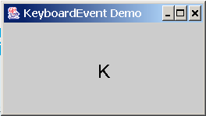
Example: Keyboard Events Demo
Objective: Display a user-input character. The user can also move the character up, down, left, and right using the arrow keys.
KeyEventDemo
Run

Slide 38
The Timer Class
Some non-GUI components can fire events. The javax.swing.Timer class is a source component that fires an ActionEvent at a predefined rate.
The Timer class can be used to control animations. For example, you can use it to display a moving message.
AnimationDemo
Run

Slide 39
Clock Animation
In Chapter 14, you drew a StillClock to show the current time. The clock does not tick after it is displayed. What can you do to make the clock display a new current time every second? The key to making the clock tick is to repaint it every second with a new current time. You can use a timer to control how to repaint the clock.
ClockAnimation
Run

Slide 40
Chapter 18 Applets and Multimedia

Slide 41
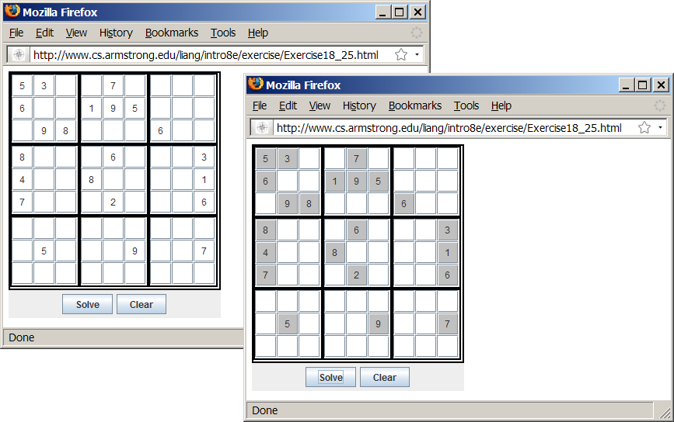
Motivations
When browsing the Web, you frequently see the graphical user interface and animation developed using Java. These programs are called Java applets. Suppose you want to develop a Java applet for the Sudoku game. How do you write this program?
Sudoku

Slide 42
Objectives
To convert GUI applications to applets (§18.2).
To embed applets in Web pages (§18.3).
To run applets from Web browsers and from the appletviewer (§§18.3.1-18.3.2).
To write a Java program that can run as both an application and an applet (§18.4).
To override the init, start, stop, and destroy methods in the Applet class (§18.5).
To pass string values to applets from HTML (§18.6).
To develop an applet for the TicTacToe game (§18.7).
To develop an animation for a bouncing ball (§18.8).
To locate resources (images and audio) using the URL class (§18.9).
To play audio in any Java program (§18.10).

Slide 43
Developing Applets

Slide 44
The <applet> HTML Tag
<applet
code=classfilename.class
width=applet_viewing_width_in_pixels
height=applet_viewing_height_in_pixels
[archive=archivefile]
[codebase=applet_url]
[vspace=vertical_margin]
[hspace=horizontal_margin]
[align=applet_alignment]
[alt=alternative_text]
>
<param name=param_name1 value=param_value1>
</applet>

Slide 45
First Simple Applet
<html>
<head>
<title>Java Applet Demo</title>
</head>
<body>
<applet
code = "DisplayLabel.class"
width = 350
height = 200>
</applet>
</body>
</html>
DisplayLabel
Run Applet Viewer

Slide 46
Applications vs. Applets
Similarities
Since JFrame and JApplet both are subclasses of the Container class, all the user interface components, layout managers, and event-handling features are the same for both classes.
Differences
Applications are invoked from the static main method by the Java interpreter, and applets are run by the Web browser. The Web browser creates an instance of the applet using the applet’s no-arg constructor and controls and executes the applet through the init, start, stop, and destroy methods.
Applets have security restrictions
Web browser creates graphical environment for applets, GUI applications are placed in a frame.

Slide 47
Security Restrictions on Applets
Applets are not allowed to read from, or write to, the file system of the computer viewing the applets.
Applets are not allowed to run any programs on the browser’s computer.
Applets are not allowed to establish connections between the user’s computer and another computer except with the server where the applets are stored.

Slide 48
Conversions Between Applications and Applets
Conversions between applications and applets are simple and easy.
You can always convert an applet into an application.
You can convert an application to an applet as long as security restrictions are not violated.

