Slide 1
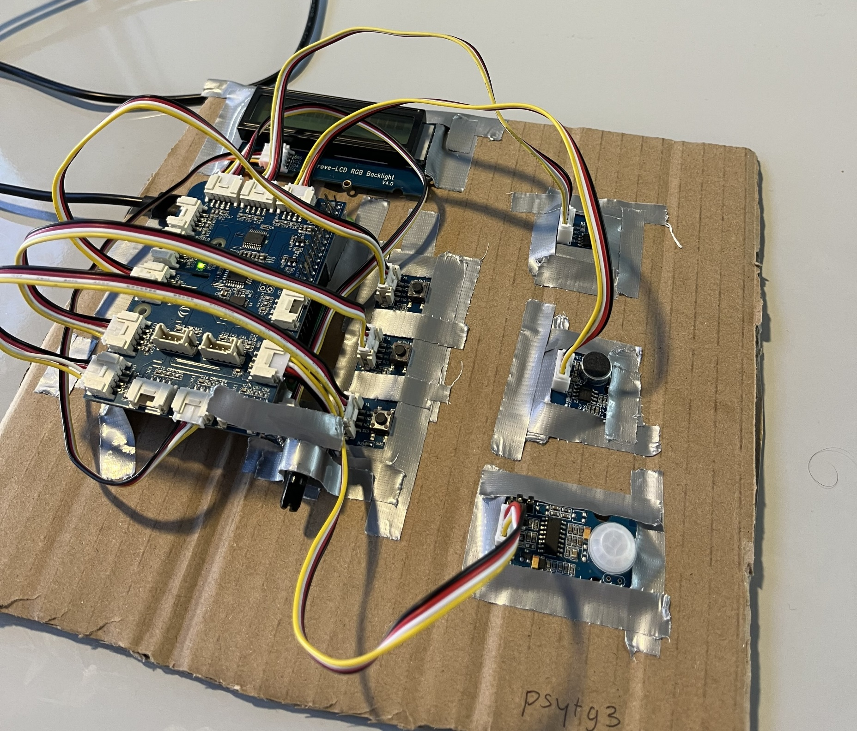
LCD Screen
Raspberry Pi with GrovePi
Light Sensor
Sound Sensor
PIR Sensor
Rotary Sensor
Buttons for activation code entry

