Slide 1
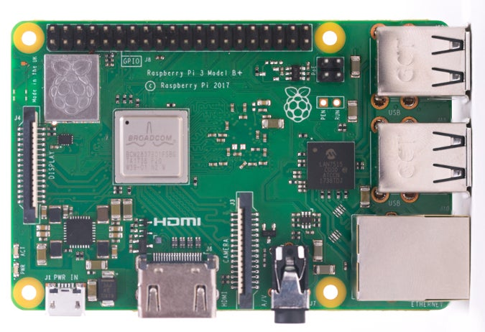
LCD Screen
Raspberry Pi
Rotary Sensor
Set Sensitivity:
Current = 0.6

