Slide 1
Air Heater Control System, Datalogger and Visualiser

Slide 2
Requirements
Create a PI controller for controlling an air heater
Perform frequency response and Stability Analysis on system and tune PI parameters using Ziegler Nichols method.
Control an air heater (simulator), retrieving data from it and publishing parameters using Modbus TCP
Create GUI for the controller and ability to have multiple controllers logging at once.
Log to Azure Cosmos DB
Create an ASP.NET Core Web Application for Monitoring Data
Deploy system to Microsoft Azure

Slide 3
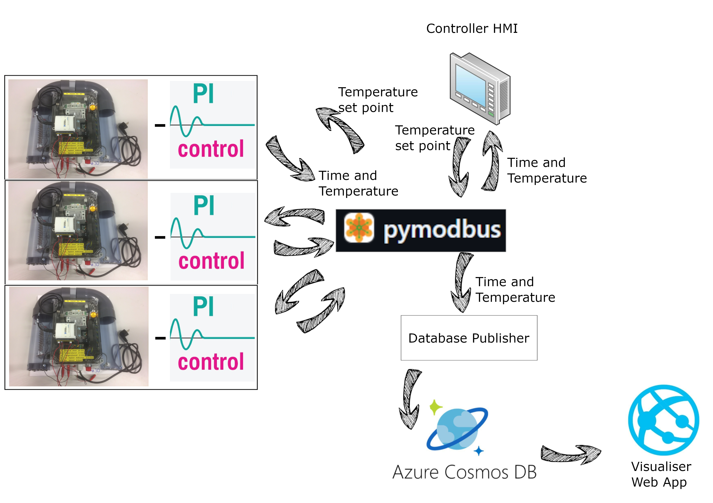
System Overview

Slide 4

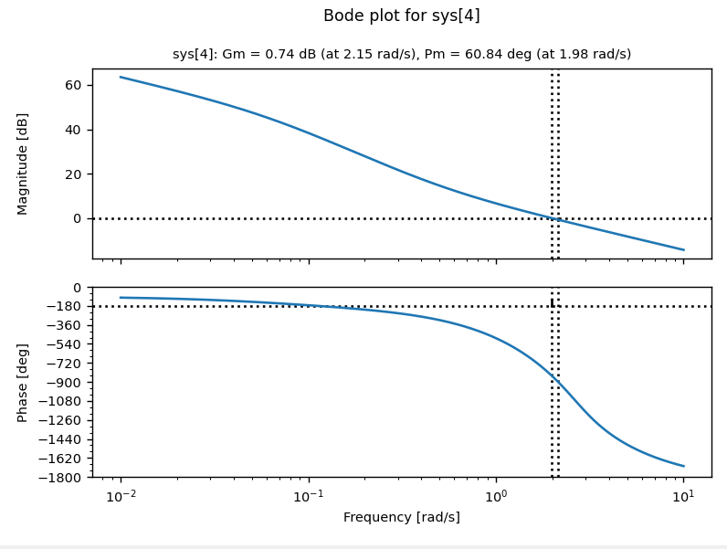

Control System
PI controller in python
Stability analysis and Ziegler-Nichols
Publishing to Modbus

Slide 5
Modbus TCP
Industrial communication protocol
Used Coils and Holding Registers
Used Pymodbus
Send integers lower than 65535
Limit of 100 holding registers per IP adresse
Solution:
Create one string
Turn message into byte and encode to int
Split into chunks smaller than limit
Send, and use coils to say if register has been updated
Reciver reads coil and register, then decodes.
Can only use two heaters per IP adresse, since message needs 50 holding registers.

Slide 6
Cosmos DB
Set up database in Cosmos DB running online on Microsoft Azure
Logs Time, Temperature and Sensor

Slide 7
Web App
Developed using ChatGPT
Gets data from database
Displays graph
Updates every minute
Can choose which sensor to plot

Slide 8
Code view

Slide 9
Live Demonstration

Slide 10
Discussing Bugs, Problems and the Future
Interacting with real air heater using USB-6008 DAQ
Modbus protocol limitations
Expand GUIs and fix scaling issues
Run controller embedded on a Raspberry pi
Security
The data stored here can be used to find out if someone are home and when to rob user. Controlling heaters can also be used by hackers to cost user lots of money and make rooms unlivable.
Air heater, controller and modbus server are ment for local network use.
Database publisher uses connection string and key stored as environment variable for security. No part lets user deside what to send to server, so SQL Injections are not a problem
Future versions of web app should have a login system. Then SQL Injections could become relevant.

Slide 11
References
[1] | F. A. Haugen, «Lab rig: Air Heater,» 27 September 2024. [Internett]. Available: https://techteach.no/lab/air_heater/. [Found 10 November 2025].
[2] | Python Tutorial, «Tkinter Tutorial,» [Internett]. Available: https://www.pythontutorial.net/tkinter/. [Found 17 November 2025].
[3] | bashwork og j. dhoomakethhu, «pymodbus 3.11.3,» [Internett]. Available: https://pypi.org/project/pymodbus/. [Found 18 November 2025].
[4] | S. Andrews, «quickstart-nosql-python,» 11 November 2024. [Internett]. Available: https://github.com/AzureCosmosDB/quickstart-nosql-python. [Found 21 November 2025].
[5] | OpenAI, «ChatGPT,» 7 August 2025. [Internett]. Available: https://chatgpt.com/share/69230fc6-b9e8-8011-b260-8d685b5c58f5. [Found 22 November 2025].

