Slide 1
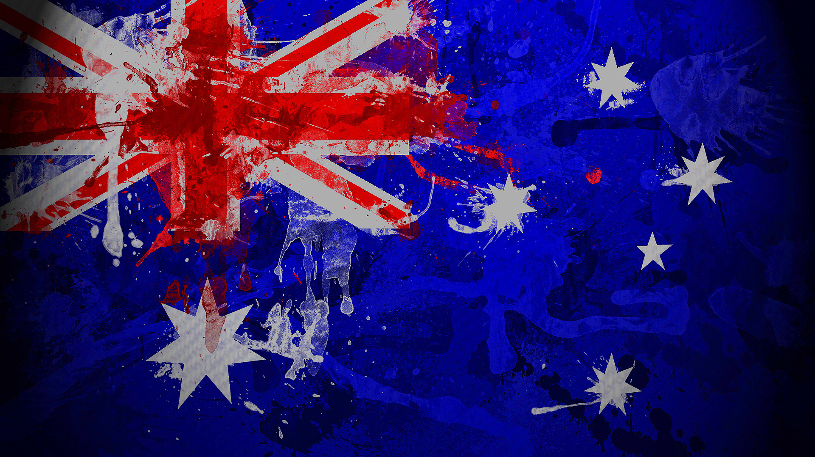
Australia

Slide 2
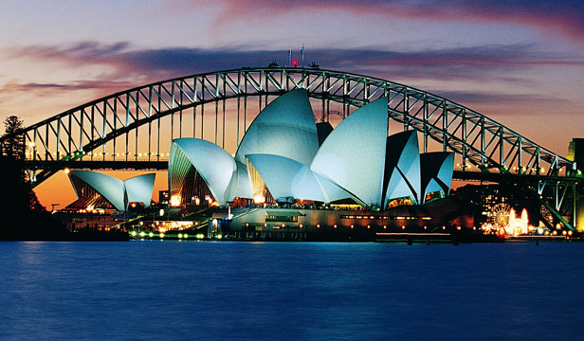
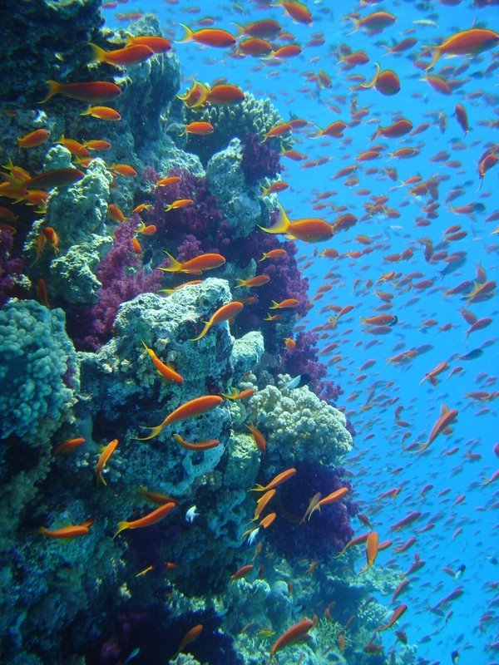
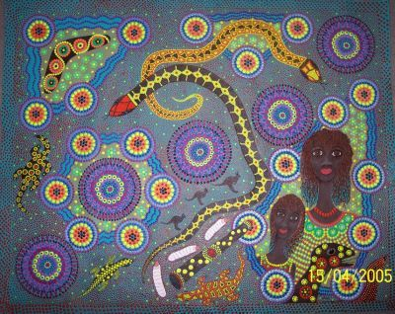
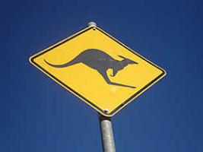
Tourist attractions

Slide 3
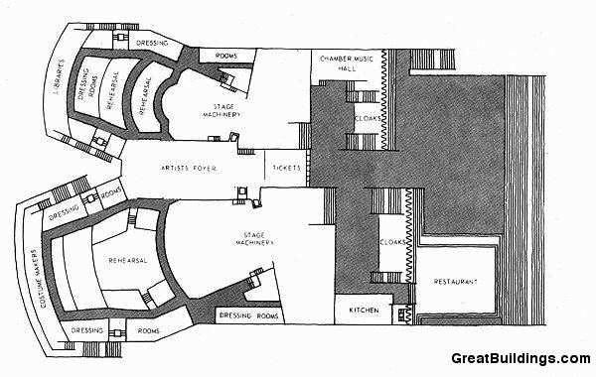
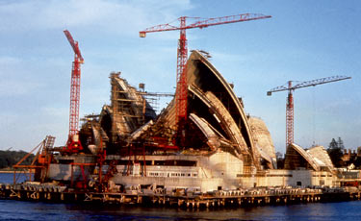
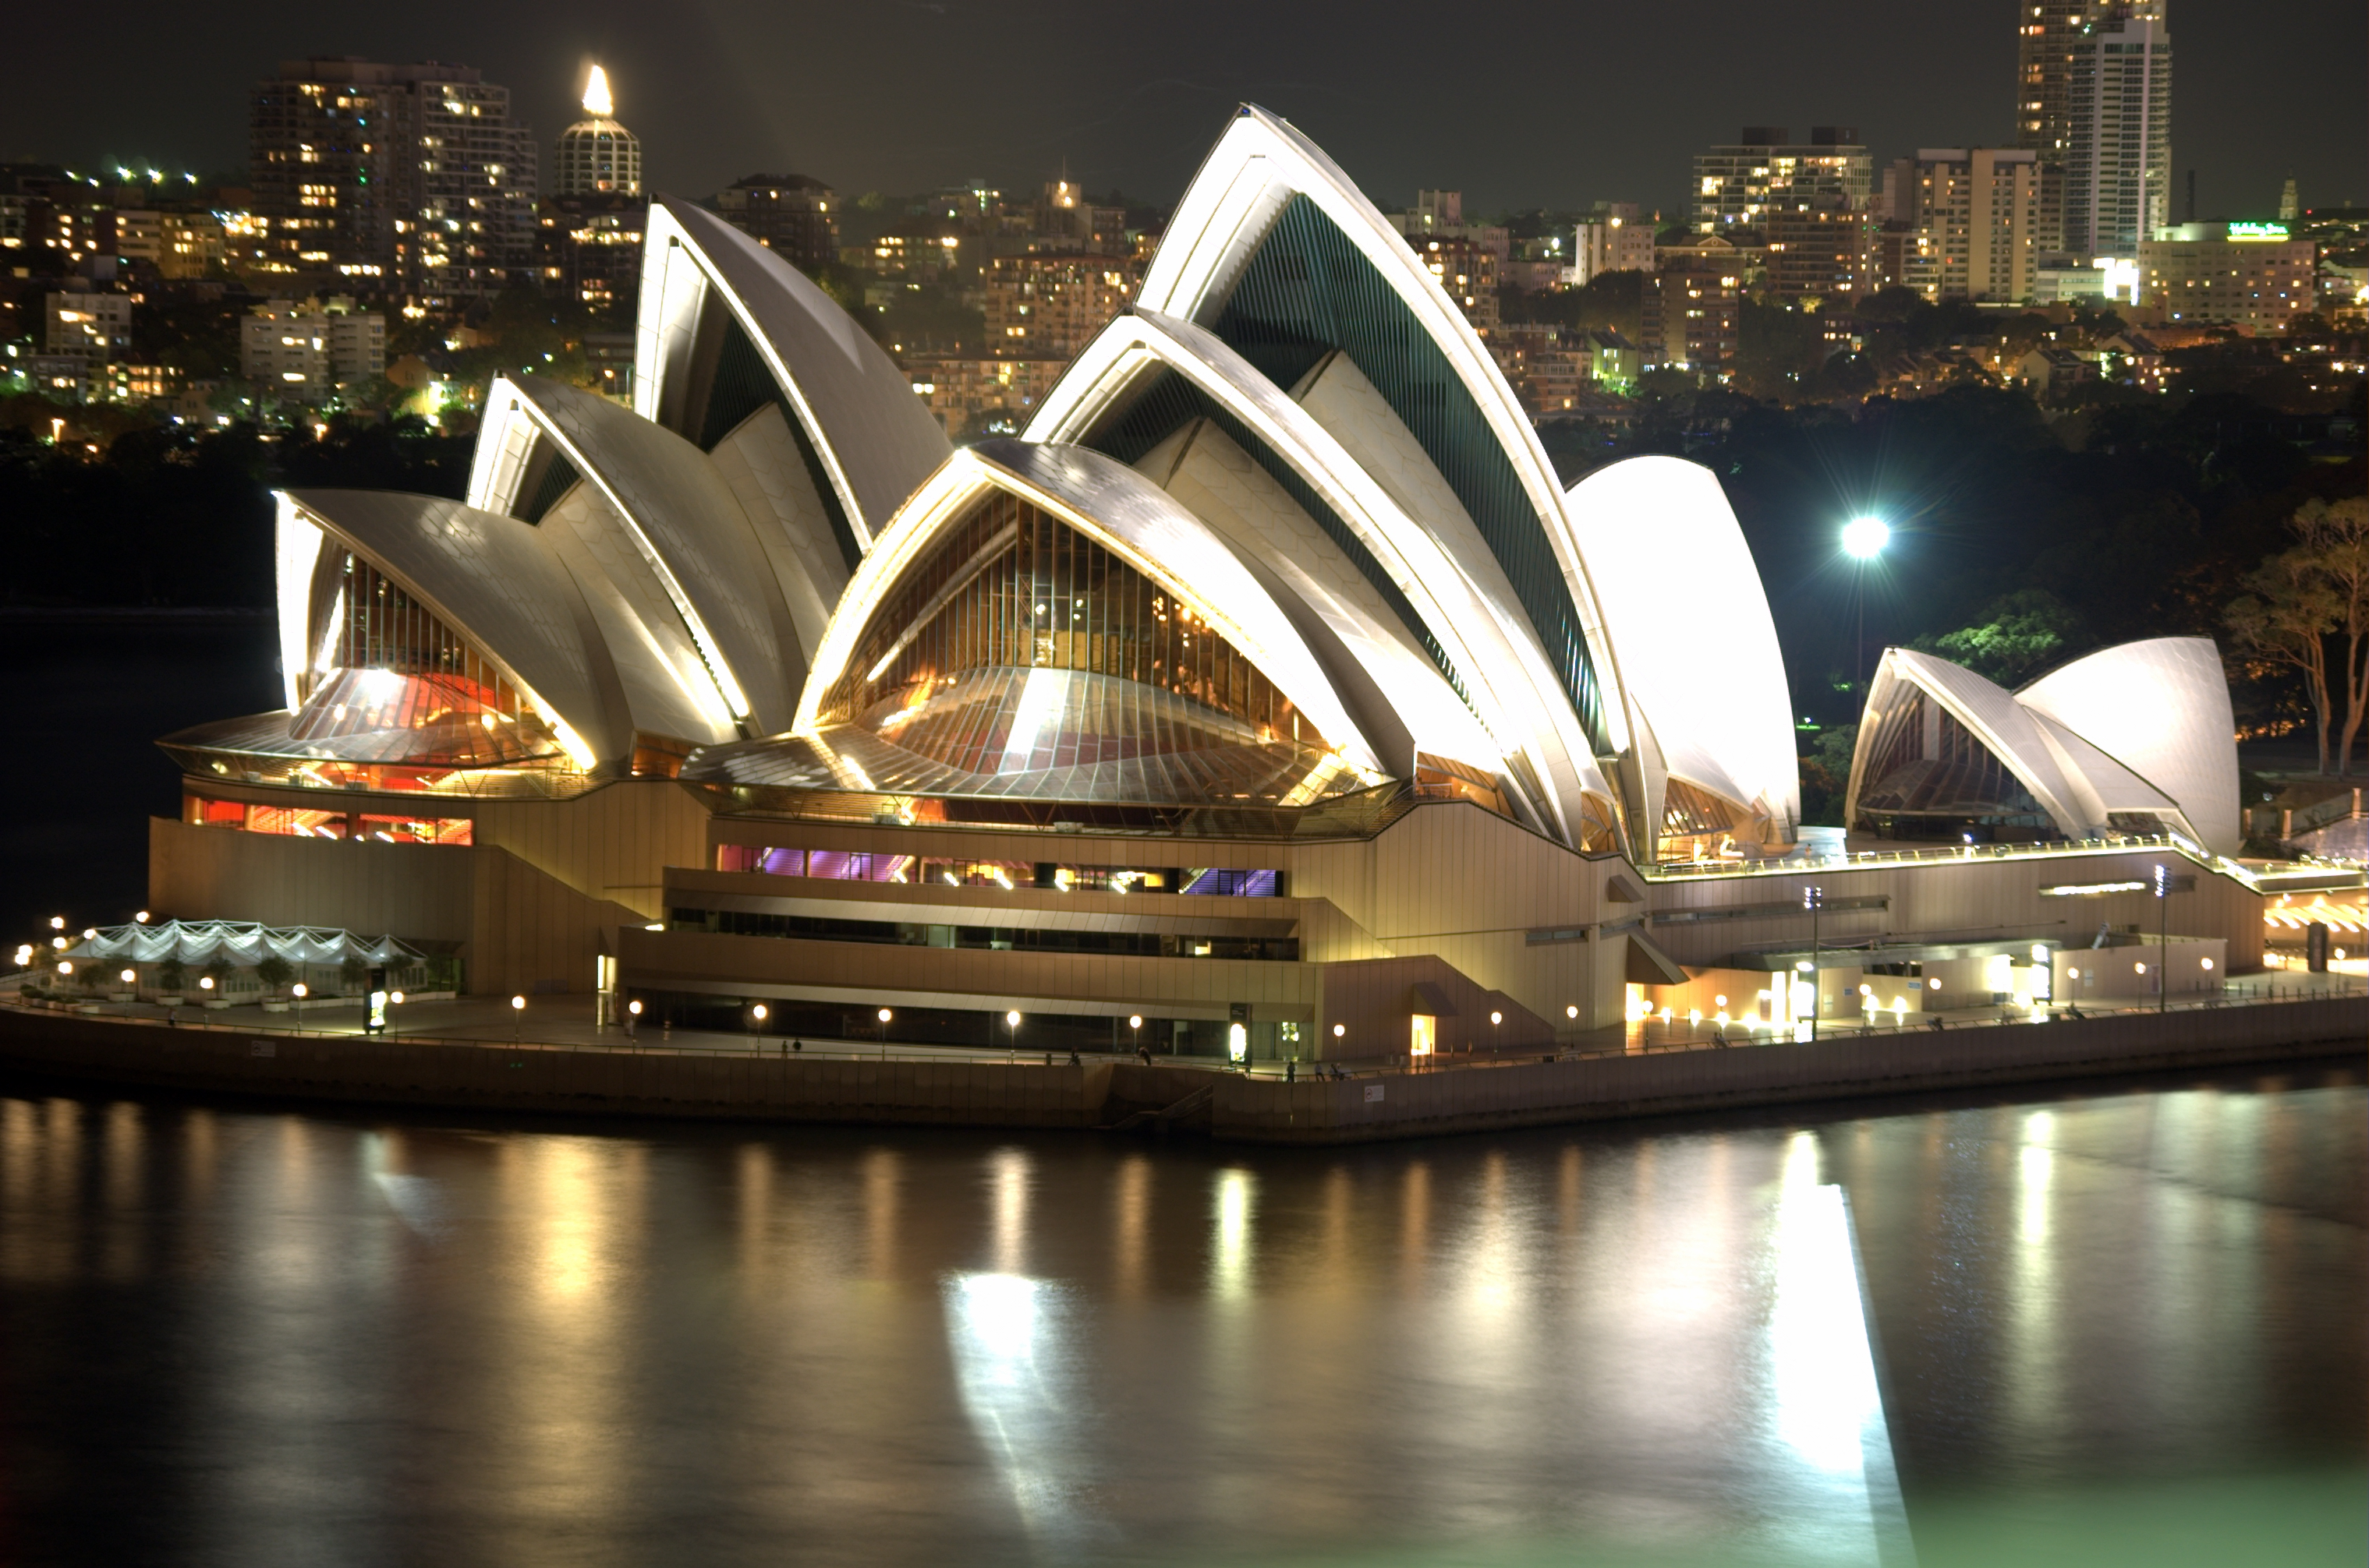
Sydney Opera
1957-1973
Jørn Utzon
inscribed UNESCO's World Heritage list
Competition

Slide 4
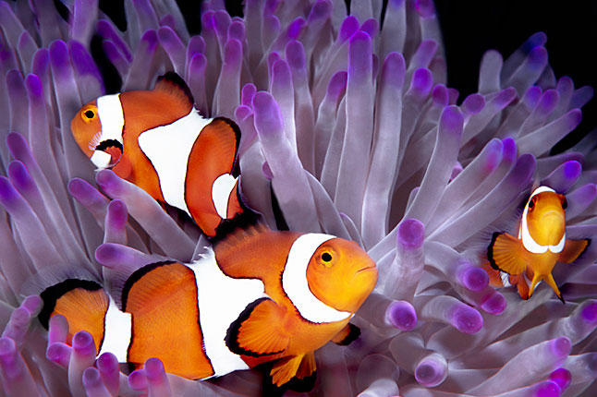
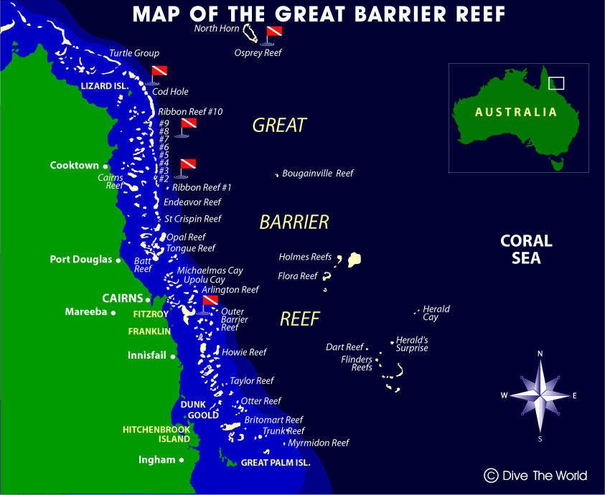
Great barrier Reef
Largest
2 900 reefs and 900 islands
2 mill-18mill
Beautiful
Great Barrier Reef Marine Park
1981
1 500 and 4000 mollusc

Slide 5
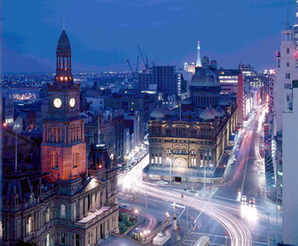
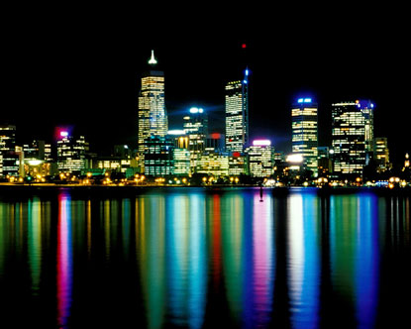
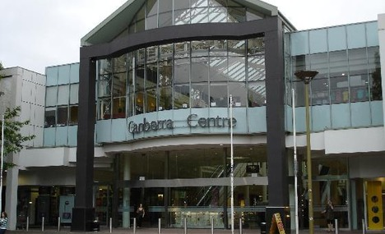
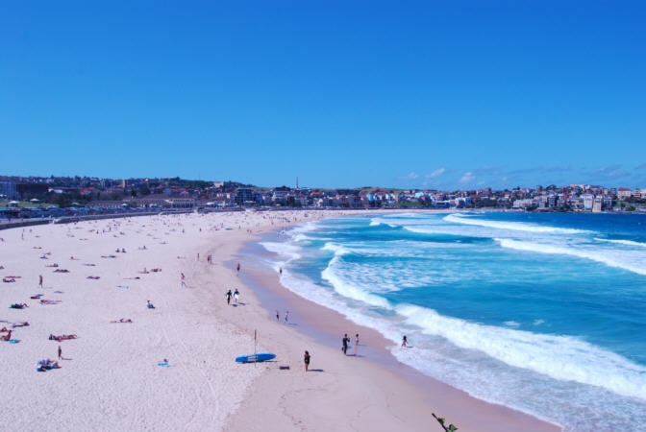
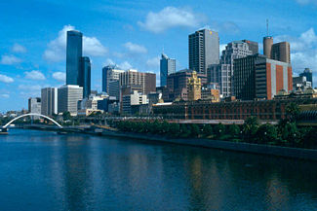
Major citis

Slide 6
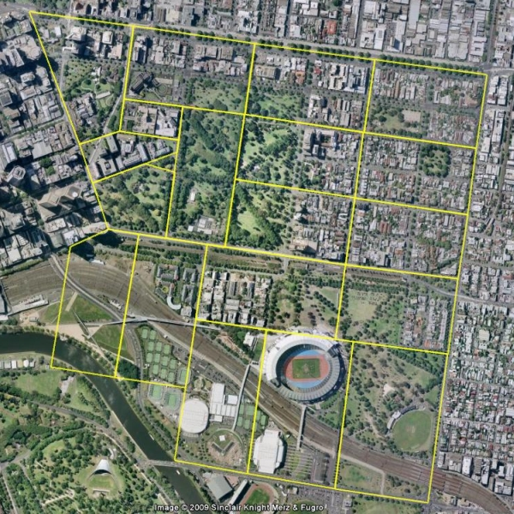
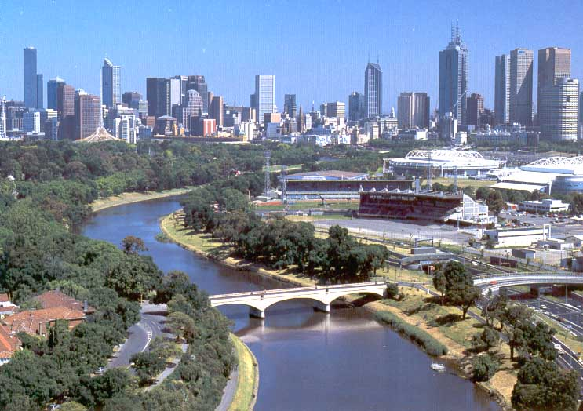
Melbourne
Capital
30 of August, 1835
4 170
Victoria
Yarra and Port Phillip
Four seasons
Tourist attractions

Slide 7
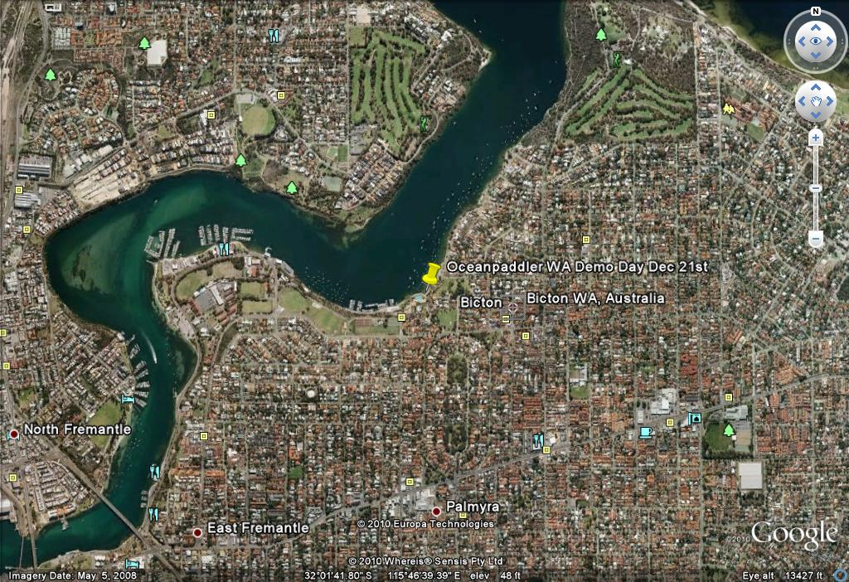
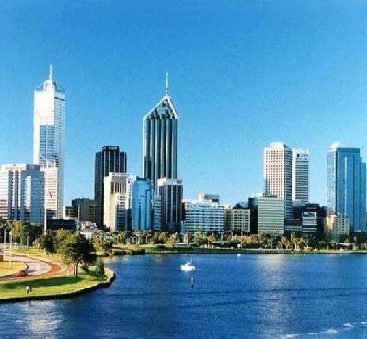
Perth
Capital
1 740
1829
Western Australia
Subtropic
Tourist attractions

