Slide 1

Hatchet

Slide 2

Story
Brian Robeson
Parents are separated
The plane crashes
He finds food.

Slide 3

Makes fire
Makes bow and arrow
Begins changing
A plane drives by
Changes fully
Shoots a bird
Loses nearly everything in the storm

Slide 4
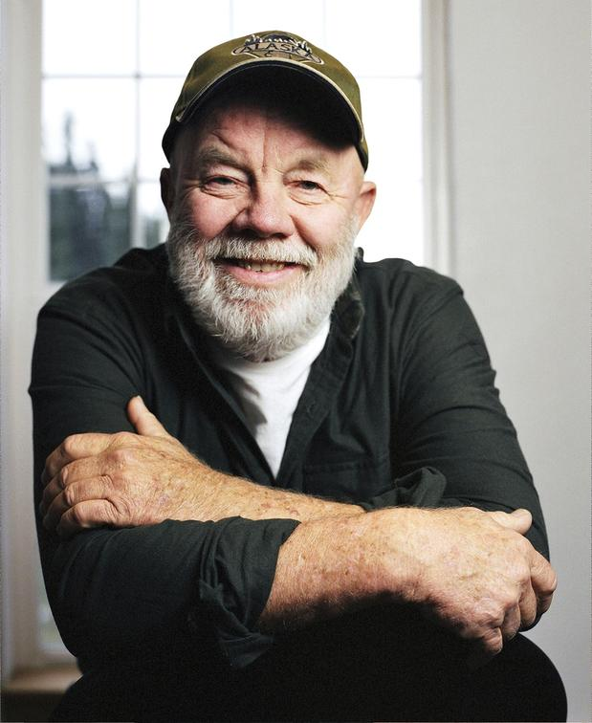
Gary Paulsen

