Slide 1
TeachBack AI
Document-grounded learning through teaching
RAG Final Project

Slide 2
The learning gap
Passive review can feel like mastery
Explain a topic instead of recognizing familiar words
Defend the explanation through contextual follow-up questions
Improve using evidence-grounded feedback and repeated attempts
Core idea: To teach is to learn twice.
Notes:
Open with the problem: students often mistake recognition for mastery. TeachBack AI asks them to produce, defend, and improve an explanation instead.

Slide 3
One focused learning workflow
1. Ground | 2. Teach | 3. Evaluate | 4. Improve
Upload PDF/TXT notes | Choose a topic and audience | Score the full conversation | Correct a mistake or reteach
Extract and index text | Explain for up to six turns | Find gaps, misconceptions, and jargon | Compare attempts over time
The same indexed documents support topic generation, contextual questions, cited answers, final evaluation, and progress tracking.
Notes:
Emphasize that this is more than document chat. The user teaches, the AI asks substantive questions, and the final feedback is grounded in the source material.

Slide 4
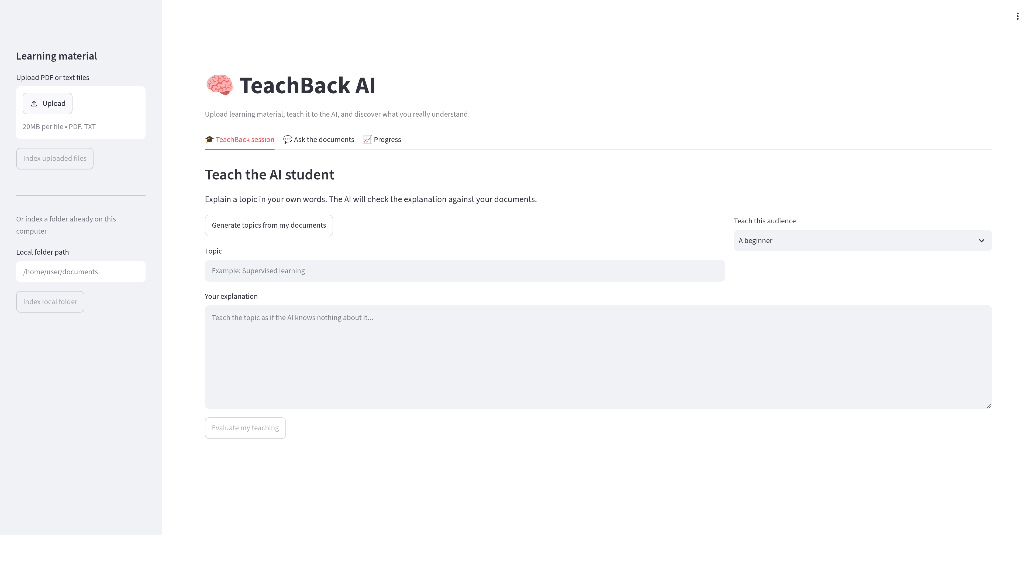
The product experience
Notes:
Point out the three tabs: TeachBack session, Ask the documents, and Progress. The sidebar accepts PDF/TXT uploads or a local folder.

Slide 5
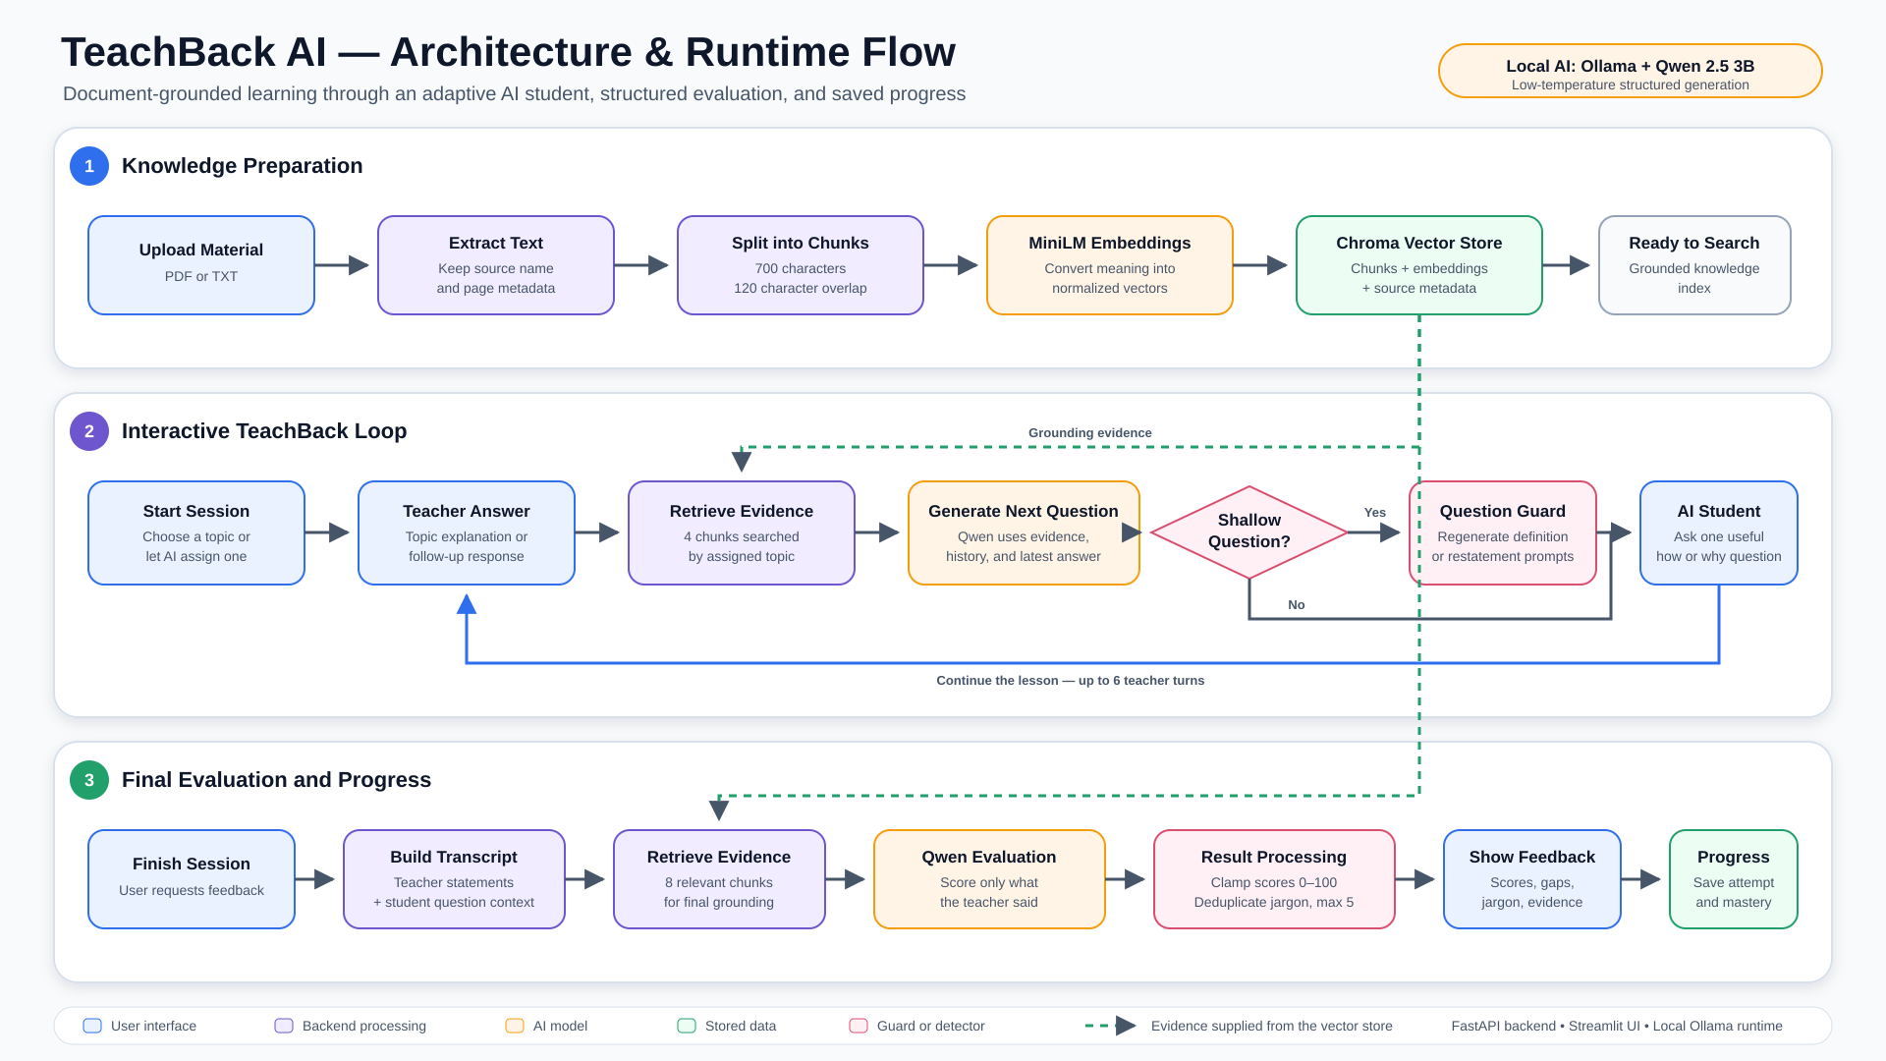
Architecture and runtime flow
Notes:
Walk through the three layers: knowledge preparation, the interactive TeachBack loop, and final evaluation. Green dashed lines show retrieved evidence supplied from ChromaDB.

Slide 6
Feedback designed for action
Scoring: accuracy, clarity, completeness, and overall mastery
Diagnosis: correct points, missing ideas, and misconceptions
Audience awareness: unexplained jargon paired with simpler wording
Active practice: mistake correction, citations, and progress across attempts
Notes:
Show an evaluated session during the demo. Expand the improved explanation and evidence, then open the mistake-correction challenge.

Slide 7
Local-first RAG implementation
Layer | Technology
Interface | Streamlit
API | FastAPI
Extraction | PyPDF + plain text
Embeddings | all-MiniLM-L6-v2
Retrieval | ChromaDB
Generation | Ollama + Qwen 2.5 3B
Validated: 15/15 automated tests pass; 9/10 saved RAG checks meet the expected result.
Notes:
The system runs locally, which keeps the learning material and generation workflow on the user’s machine. Mention that the remaining saved evaluation miss is visible in evaluation/results.csv rather than hidden.

Slide 8
Demo: from upload to mastery
Upload course notes and start an AI-assigned topic.
Teach, answer a contextual follow-up, and finish the session.
Review feedback, correct a mistake, and show saved progress.
Takeaway: Personal documents become an evidence-grounded AI student that exposes gaps and helps learners build mastery.
Notes:
Close by returning to the core idea: understanding becomes visible when a learner can teach, answer follow-ups, and correct mistakes using evidence.

