Slide 1
Worksheet-4 Solution
(From Lecture 4 given on 01/16/2019)

Slide 2
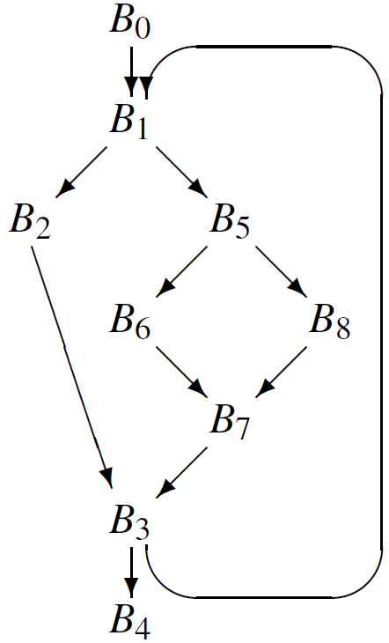
Q1 Compute dominator sets for each node in the CFG.
Q2 Draw the dominator tree of the CFG.

Slide 3
Q1 Solution
Dom(n) | Set of basic blocks that dominate Bn
Dom(B0) | {B0}
Dom(B1) | {B0, B1}
Dom(B2) | {B0, B1, B2}
Dom(B3) | {B0, B1, B3}
Dom(B4) | {B0, B1, B3, B4}
Dom(B5) | {B0, B1, B5}
Dom(B6) | {B0, B1, B5, B6}
Dom(B7) | {B0, B1, B5, B7}
Dom(B8) | {B0, B1, B5, B8}
By carefully examining the control flow graph and using the definition of dominators, it wasn’t too hard to figure out dominator sets by hand.

Slide 4
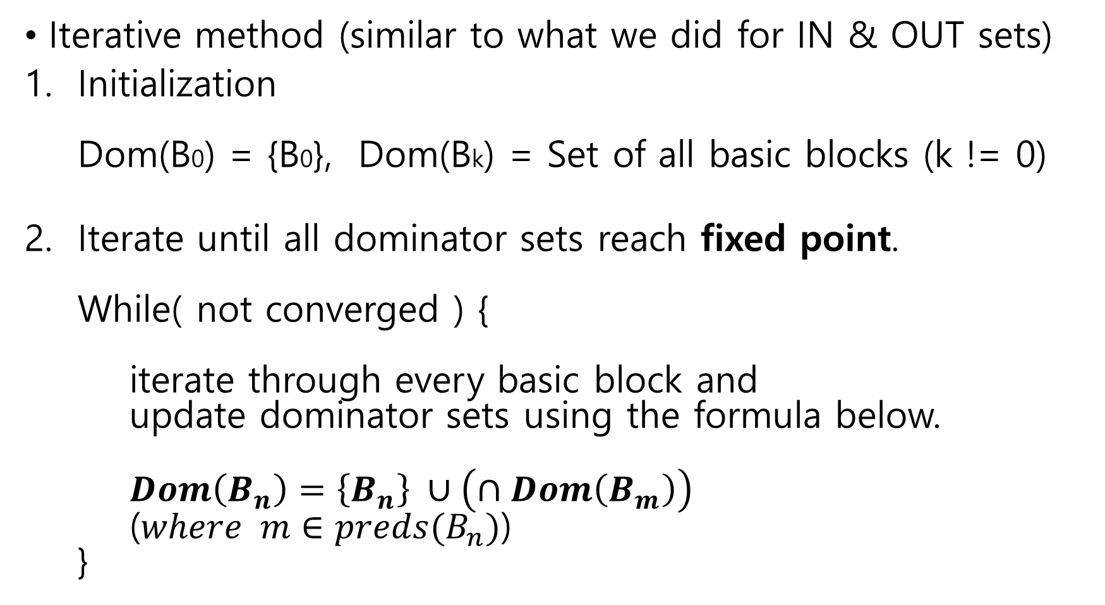
Formal way for solving Q1
Iterative method (similar to what we did for IN & OUT sets)
Initialization Dom(B0) = {B0}, Dom(Bk) = Set of all basic blocks (k != 0)
Iterate until all dominator sets reach fixed point. While( not converged ) { iterate through every basic block and update dominator sets using the formula below. $Dom\left(B_{n}\right)=\left\{B_{n}\right\} ∪\left(∩Dom\left(B_{m}\right)\right)$ ($where m∈preds(B_{n})$) }

Slide 5
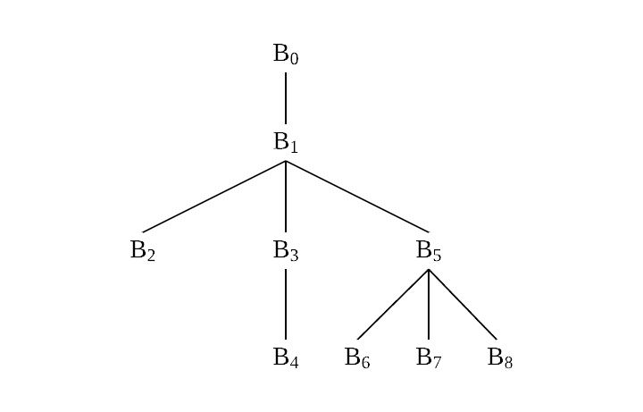
Q2 Solution
For each non-entry node B in the dominator tree, Parent(B) = IDom(B) (IDom = Immediate Dominator)

Slide 6
Comments on students’ answers
Most of the students got the answers right.
Common mistakes
Some students didn’t add B to Dom(B). (for each basic block B in the CFG)
Some students computed dominator sets correctly, but failed to draw the correct dominator tree.

