Slide 1

Phishing AWARENESS TRAINING
Protect Yourself and Your Organization
Vivek Maharaj @codealpha

Slide 2
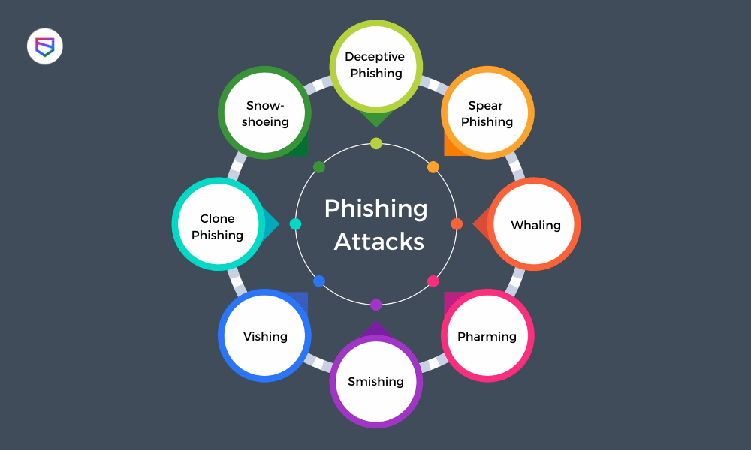
WHAT IS PHISHING?
Definition: Phishing is a type of cyber attack where attackers impersonate legitimate organizations via email, text message, or other communication channels to steal sensitive information.
Types of Phishing Attacks:
Email Phishing
Spear Phishing
Whaling
Smishing (SMS Phishing)
Vishing (Voice Phishing)

Slide 3
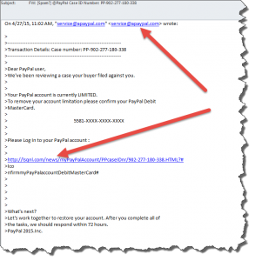
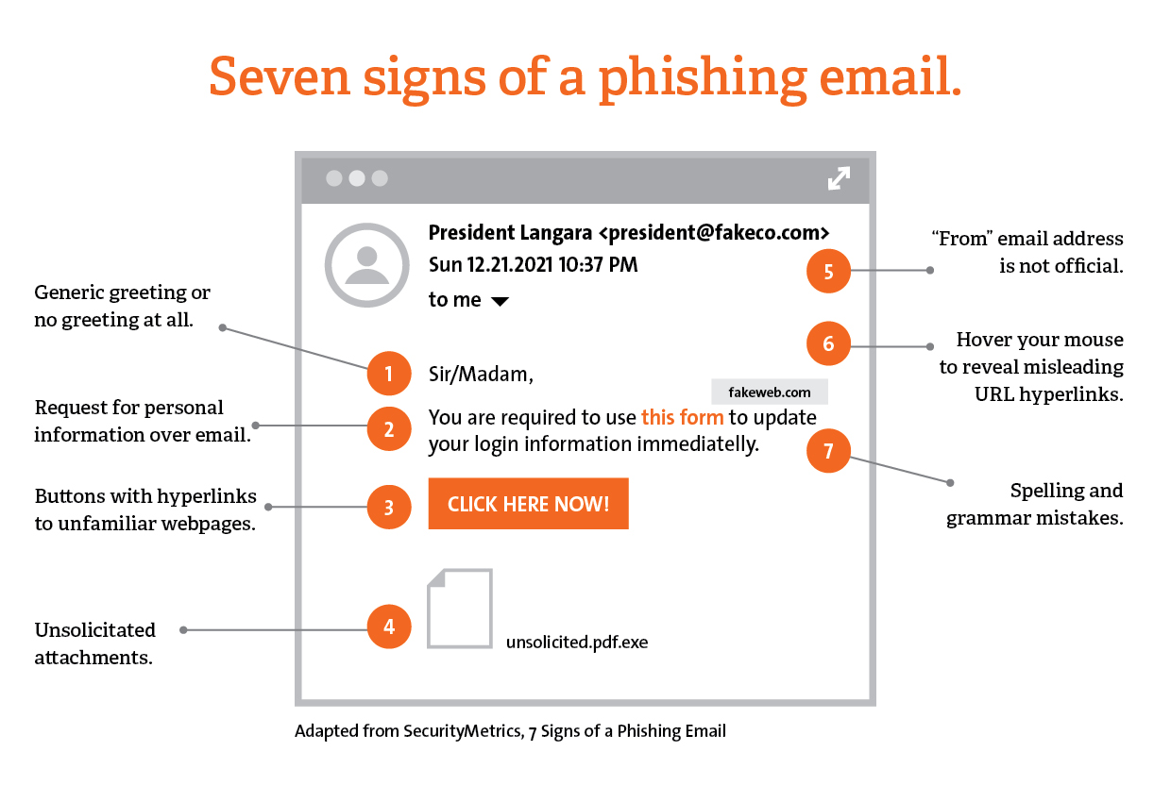
How to Spot Phishing Emails
Common Signs:
Suspicious sender addresses
Poor grammar and spelling
Urgent or threatening language
Unusual attachments or links

Slide 4
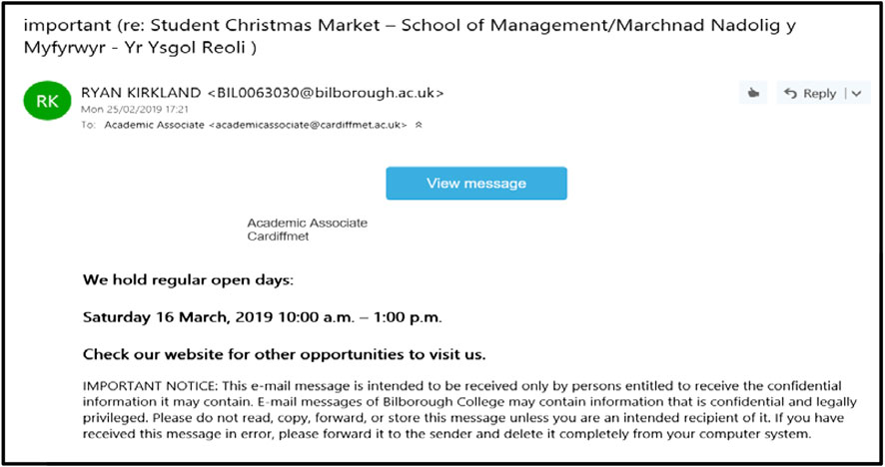
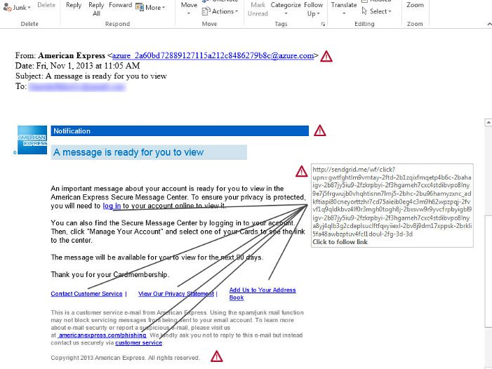
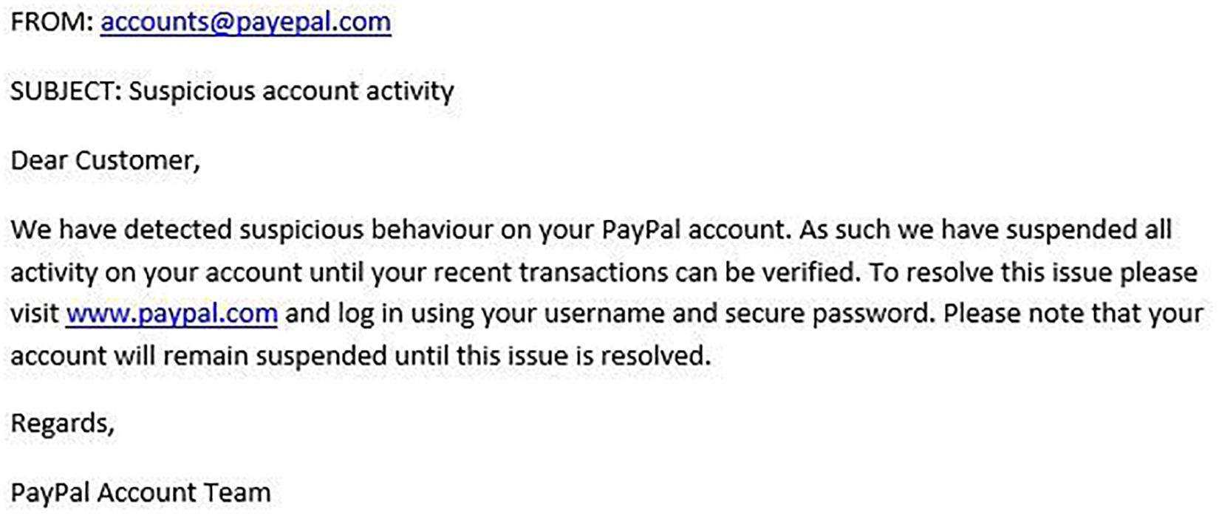
Real-life examples

Slide 5
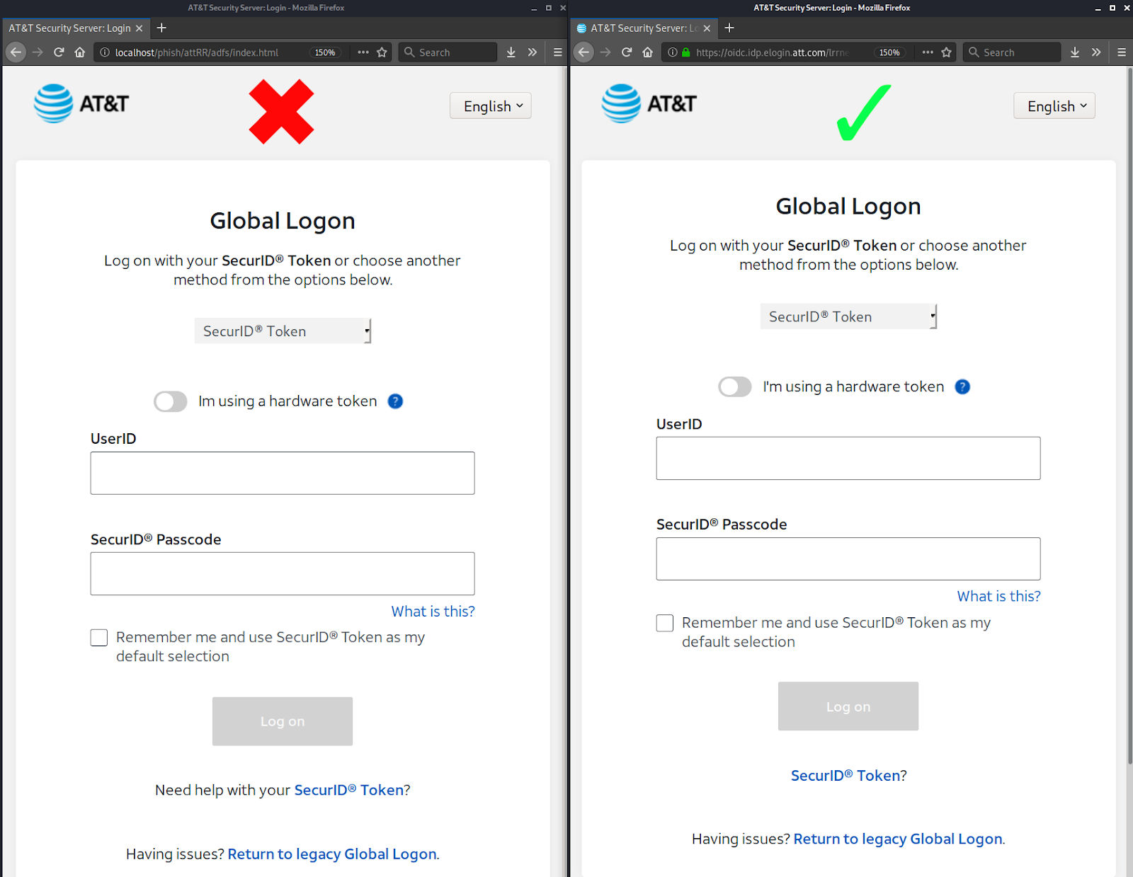

Identifying Phishing Websites
Checking URL Legitimacy: Hover over links to check the actual URL
Look for HTTPS: Ensure the site uses HTTPS

Slide 6
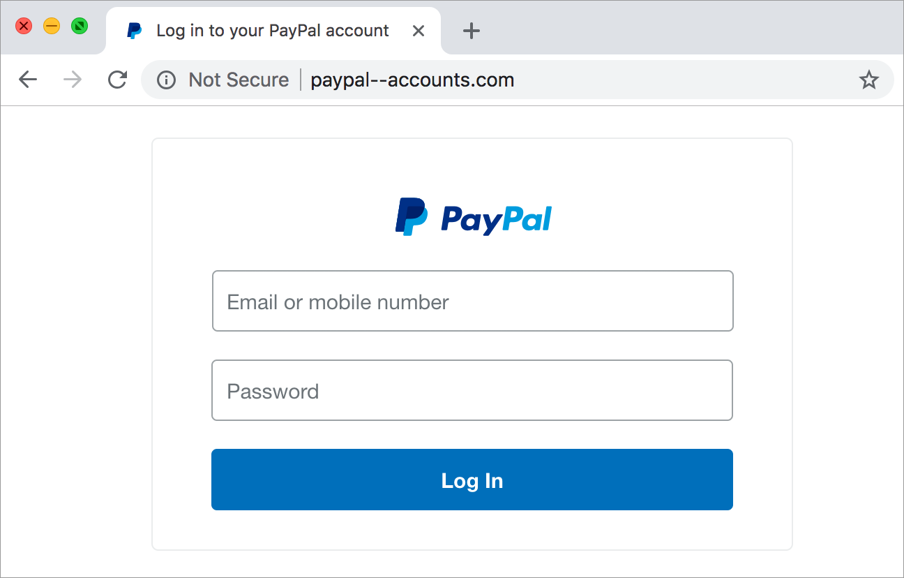
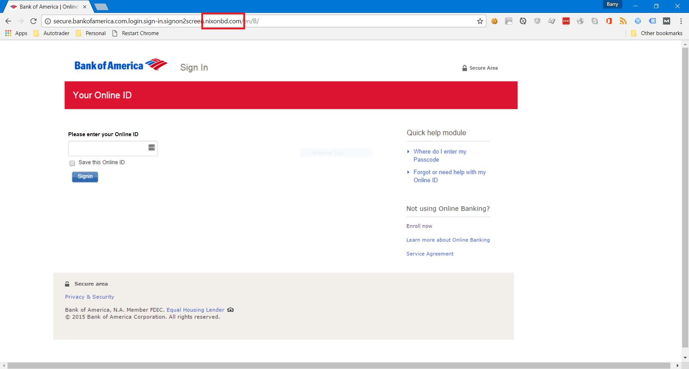
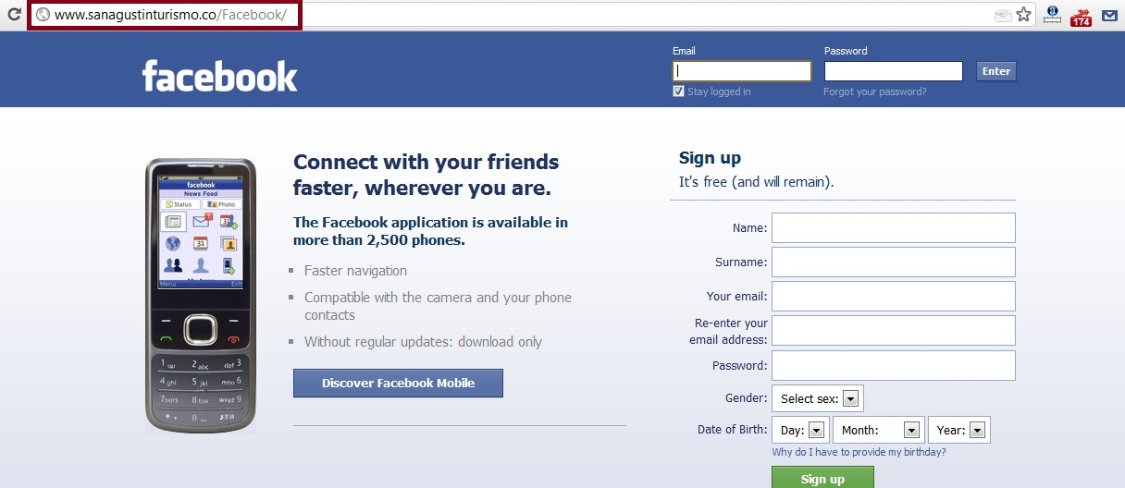
Phishing Website Examples

Slide 7
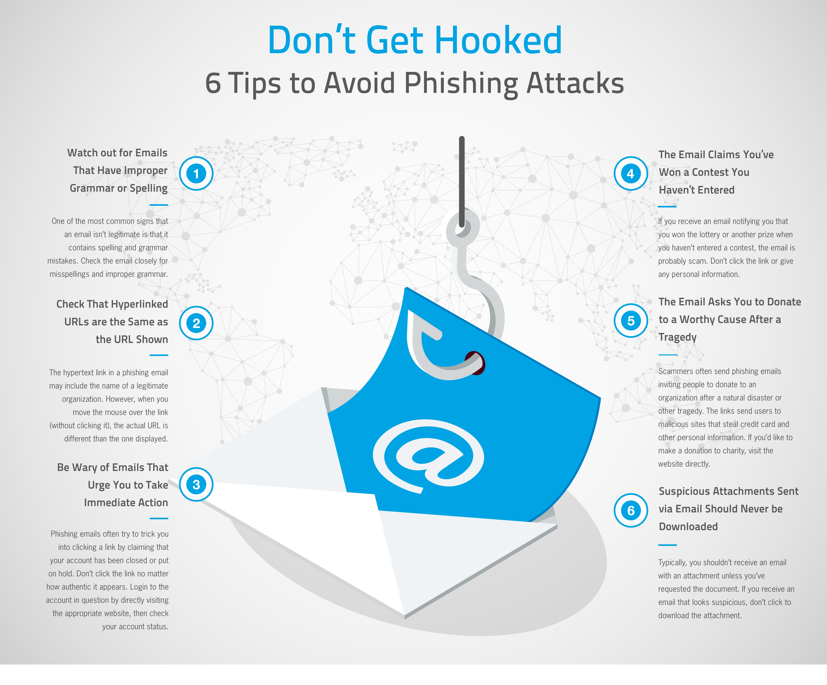
How to Avoid Phishing Attacks
Do not click on suspicious links
Verify the sender before providing personal information
Use anti-phishing tools and software
Regularly update your software and security settings

Slide 8
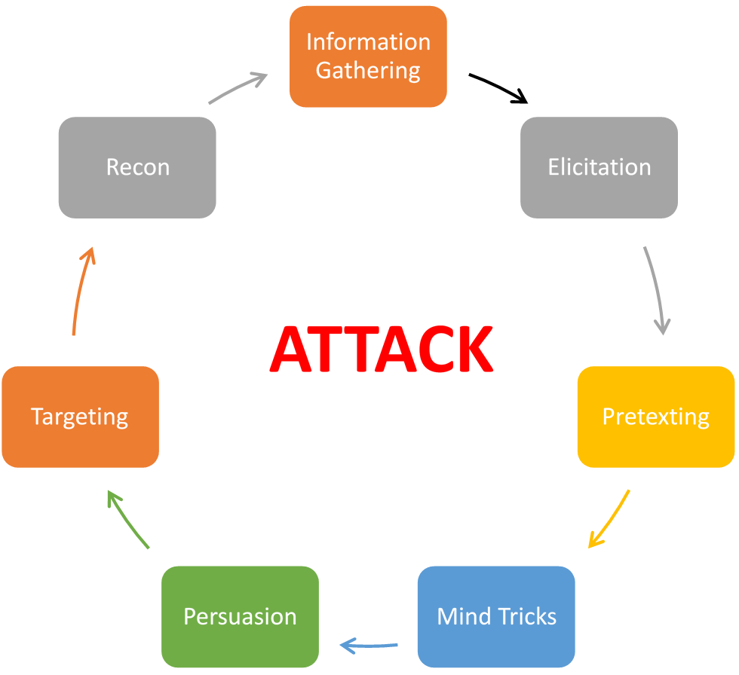
Understanding Social Engineering
Common Techniques:
Pretexting
Baiting
Quid Pro Quo
Tailgating
Incident: In 2016, a group of hackers used social engineering to trick an employee at a large technology company into revealing sensitive information.
Technique: Pretexting - The attackers posed as IT support staff and contacted the employee, claiming they needed to verify the employee's login credentials due to a supposed security issue.
Outcome: The employee, believing the request was legitimate, provided their login details. The attackers then used this information to gain access to the company's internal network, resulting in a significant data breach.
Lesson: Always verify the identity of individuals requesting sensitive information, even if they appear to be from within the organization.

Slide 9
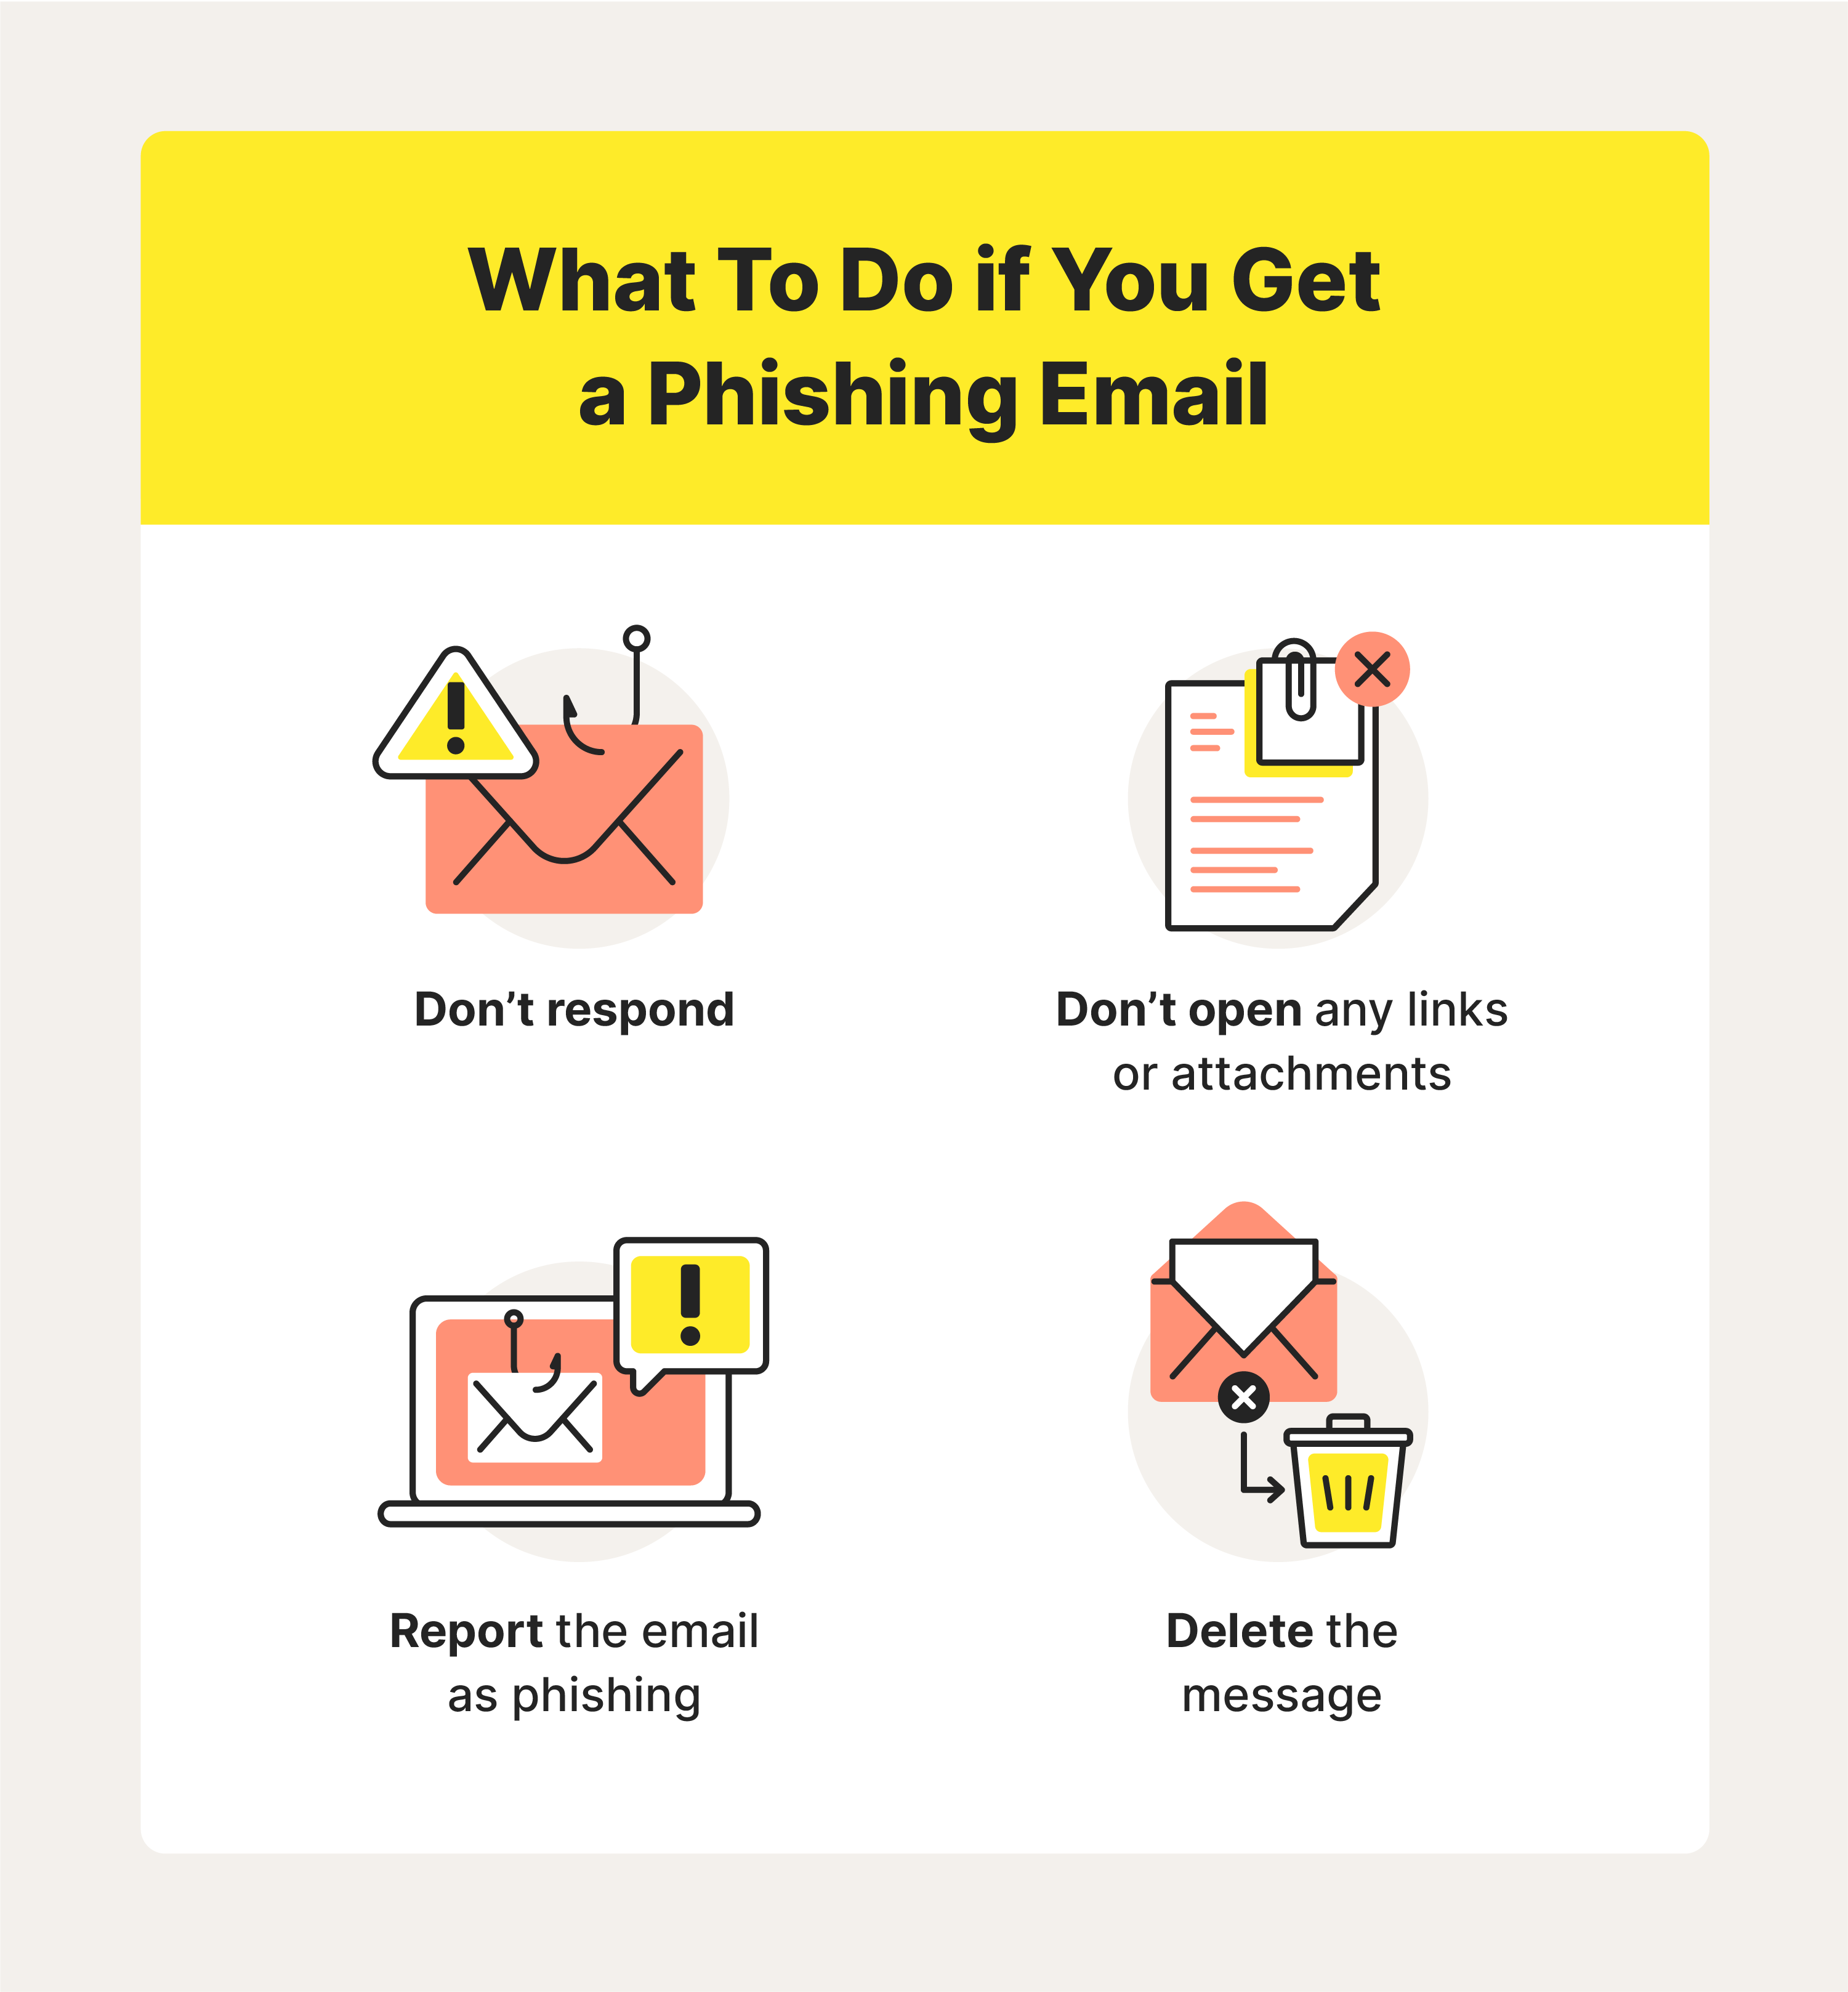
How to Report Phishing Attacks
Do Not Interact: Do not click any links or download any attachments from the suspected phishing message.
Collect Evidence: Take a screenshot of the email or website, including the URL and any suspicious elements.
Report Internally:
Forward the email to your IT or security team.
Include any relevant details about how you received the message and any actions you took.
Report Externally:
For emails: Forward the email to the Anti-Phishing Working Group at reportphishing@apwg.org.
For websites: Report the URL to Google Safe Browsing or Microsoft SmartScreen.
Follow Up: Monitor for any response or further instructions from your IT or security team.

Slide 10
Conclusion and Questions
Summary of Key Points:
Phishing Awareness: Understanding what phishing is and the different types of attacks.
Recognition: Identifying the signs of phishing emails and websites.
Prevention: Steps to avoid falling victim to phishing attacks.
Social Engineering: Awareness of common social engineering tactics.
Reporting: Knowing how to report phishing incidents effectively.
Closing Remarks:
Thank you for participating in the training.
Stay vigilant and always verify the authenticity of suspicious messages.
Q&A

Slide 11

Thank You
Presented by :
Vivek maharaj - as part of CODEALPHA Internship
vivekmaharaj41@gmail.com

