Slide 2
Predicting harvest cycles using IoT and ML
Learn module
Title
Speaker Name
Title

Slide 3
Prerequisites
An internet-connected browser, like Microsoft Edge.
Node.js, installed locally.
Azure account
Azure CLI

Slide 4
Learning objectives
Learn about IoT devices.
Connect to an IoT hub.
Create endpoints and routes in IoT hub.
Develop a machine learning model in ML studio.

Slide 5
Agenda
Introduction
What is IoT?
Create an IoT hub
Send data to IoT hub
Create endpoints and routes

Slide 6
Agenda continued
Test the endpoint
Create datastores and datasets
Develop a model
Knowledge check
Summary

Slide 7
Introduction

Slide 8
Introduction
A 2020 report found that nearly 690 million people—or 8.9 percent of the global population—are hungry, up by nearly 60 million in five years.
The challenge is intensified by agriculture’s extreme vulnerability to climate change. Climate change’s negative impacts are already being felt, in the form of increasing temperatures, weather variability, shifting agroecosystem boundaries, invasive crops and pests, and more frequent extreme weather events.
In such cases we would like to create a model which could make a simple prediction about the optimum time to harvest.

Slide 9
What is IoT?

Slide 10
What is IoT?
The Internet of Things (IoT) is a network of physical devices that connect to and exchange data with other devices and services over the Internet or other network. There are currently over ten billion connected devices in the world and more are added every year. Anything that can be embedded with the necessary sensors and software can be connected over the internet.
Azure IoT Hub is a managed service hosted in the cloud that acts as a central message hub for communication between an IoT application and its attached devices. You can connect millions of devices and their backend solutions reliably and securely. Almost any device can be connected to an IoT hub.

Slide 11
Create an IoT hub

Slide 12
Create an IoT hub
Use the Azure CLI to create a resource group and then add an IoT hub.
1. When you create an IoT hub, you must create it in a resource group. Either use an existing resource group, or run the following command to create a resource group:
Azure CLI
az group create --name {your resource group name} --location westus

Slide 13
2. Run the following command to create an IoT hub in your resource group, using a globally unique name for your IoT hub:
The previous command creates an IoT hub in the S1 pricing tier for which you are billed. For more information, see Azure IoT Hub pricing
JSON
az iot hub create --name {your iot hub name} \ --resource-group {your resource group name} --sku S1

Slide 14
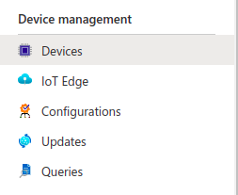
Add IoT devices to your hub
1. Go to the IoT hub via Azure Portal
2. Choose Devices under the Device management section in your IoT hub as shown.

Slide 15
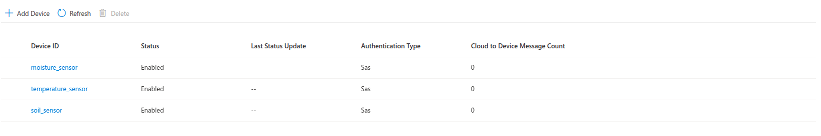
3. Click on the Add Device button in the devices tab.
4. Create 3 devices namely: moisture_sensor, temperature_sensor and soil_sensor.

Slide 16
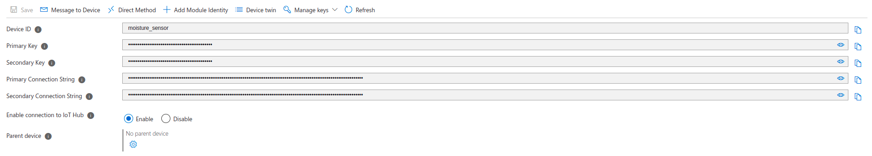
5. Click on each sensor and copy the Primary Connection String as shown below.

Slide 17
Knowledge check

Slide 18
Question 1
Identify the language preferred for IoT analytics.
Python
C++
C

Slide 19
Question 1
Identify the language preferred for IoT analytics.
Python
C++
C

Slide 20
Question 2
What methods of authentication are supported between the device and the IoT hub?
SAS token-based authentication
X509 certificate authentication
Both A & B
None of the above

Slide 21
Question 2
What methods of authentication are supported between the device and the IoT hub?
SAS token-based authentication
X509 certificate authentication
Both A & B
None of the above

Slide 22
Question 3
Data can be routed to different services. True or false?
True
False

Slide 23
Question 3
Data can be routed to different services. True or false?
True
False

Slide 24
Send data to IoT hub

Slide 25
Send data to IoT hub
1. You can create new devices using the Azure IoT Node.js SDK. The code for the 3 sensors: moisture_sensor, soil_sensor and temperature sensor can be found here.
2. The deviceConnectionString variable in line 17 of each file should be set to the respective primary connection strings.
3. Please do note that it is crucial to keep the connection strings private. If you want to share this code publicly then please use an environment variable.

Slide 26
4. 4. Use the following command to run the code samples and send data to your IoT hub.
Node.js
node {filename}

Slide 27
Create endpoints and routes

Slide 28
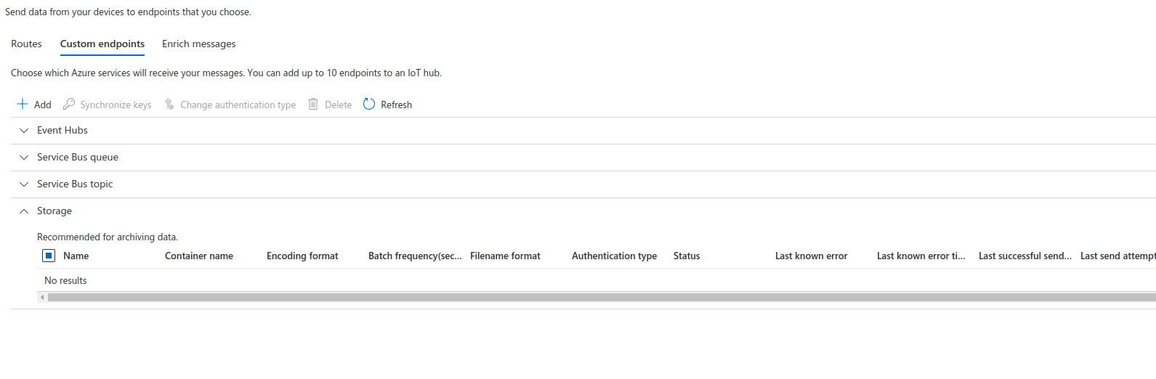
Create an endpoint
1. To begin with, choose the Message routing tab under the Hub settings section.
2. Click on the Custom endpoints tab and choose Add in the page shown below. Choose Storage from the drop-down menu.

Slide 29
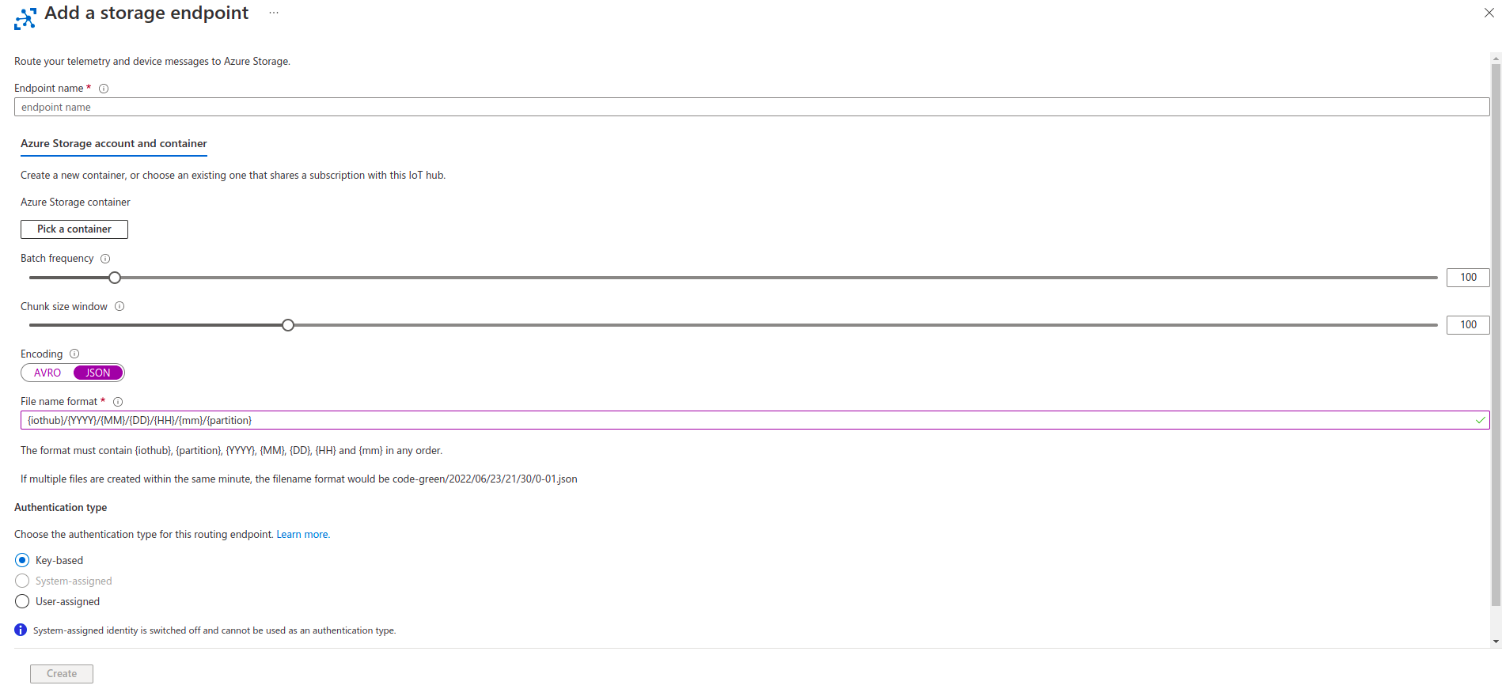
3. Name your endpoint crop-sensor-endpoint and ensure that the Encoding setting is set to JSON along with the File name format set to {iothub}/{YYYY}/{MM}/{DD}/{HH}/{mm}/{partition} as shown.

Slide 30
4. Create a new Azure Storage account and use it for the endpoint.
5. Create a new container in it called data and select it as the destination for the telemetry messages.
6. Click on the Create button in the bottom-left corner of your screen.

Slide 31
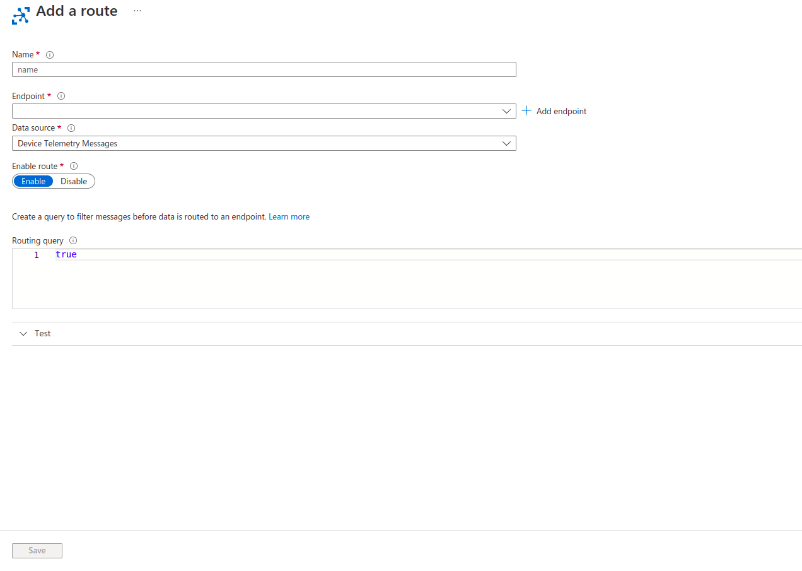
Create a route
1. To begin with, choose the Message routing tab under the Hub settings section.
2. Click on the routes tab and choose Add. You will be taken to page as shown.

Slide 32
3. Name your route crop-sensor-route and ensure that endpoint is selected as crop-sensor-endpoint.
4. Click on Save.

Slide 33
Test the endpoint

Slide 34
Test the endpoint
Run the sensor code from the given files and check out the stored data in the storage account.

Slide 35
Create datastores and datasets

Slide 36
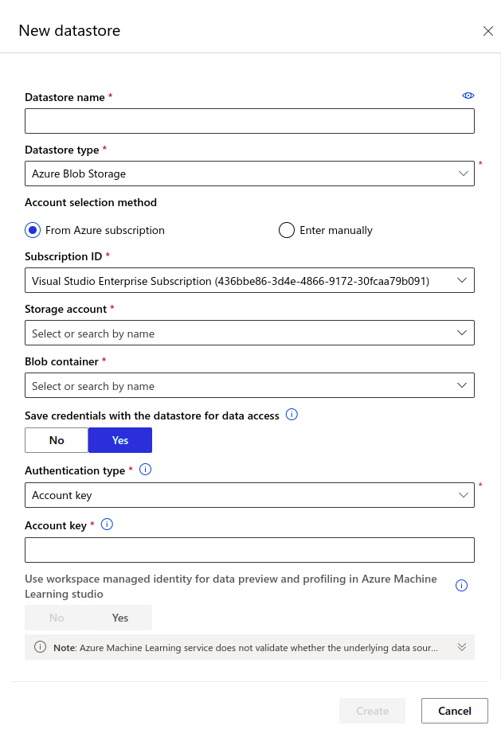
Create a datastore
1. Create a new Datastore by navigating to the Datastores tab under Manage section. Give it a name of cropdatastore and choose the storage account provisioned earlier. Choose the container by the name of data. If it does not exist, then create it.

Slide 37
2. Copy the account key from the Access keys tab in your storage account. Paste it in the required place. Click on Create.

Slide 38
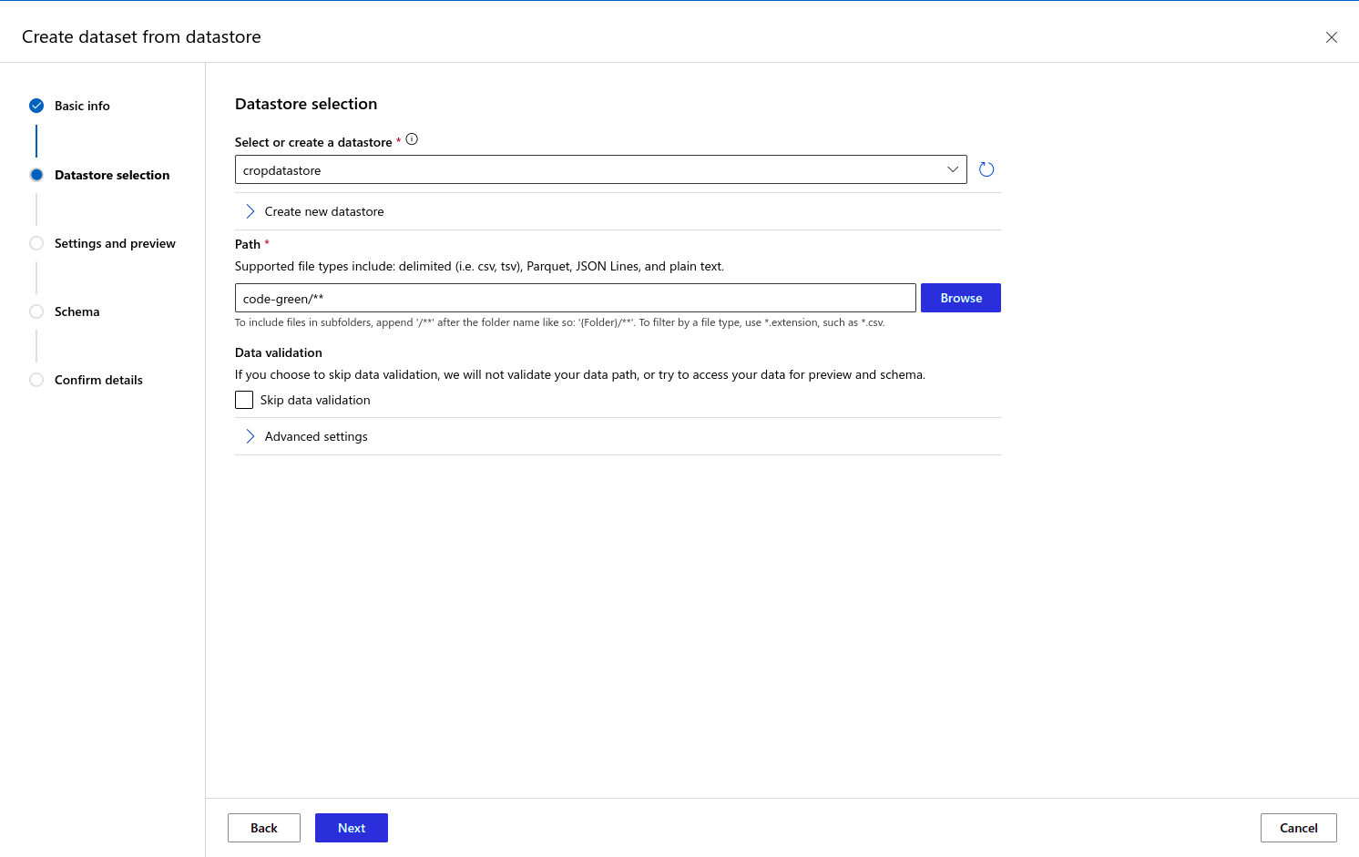
Create dataset
1. Create a dataset by navigating to Data tab under Assets section. Click on the Create button in the top-right corner and choose From Datastore from the drop-down menu. Give it a name of crop-asset and click Next.
2. Select cropdatastore from the drop down menu and provide the file path shown in the following picture. Click on Next.

Slide 39
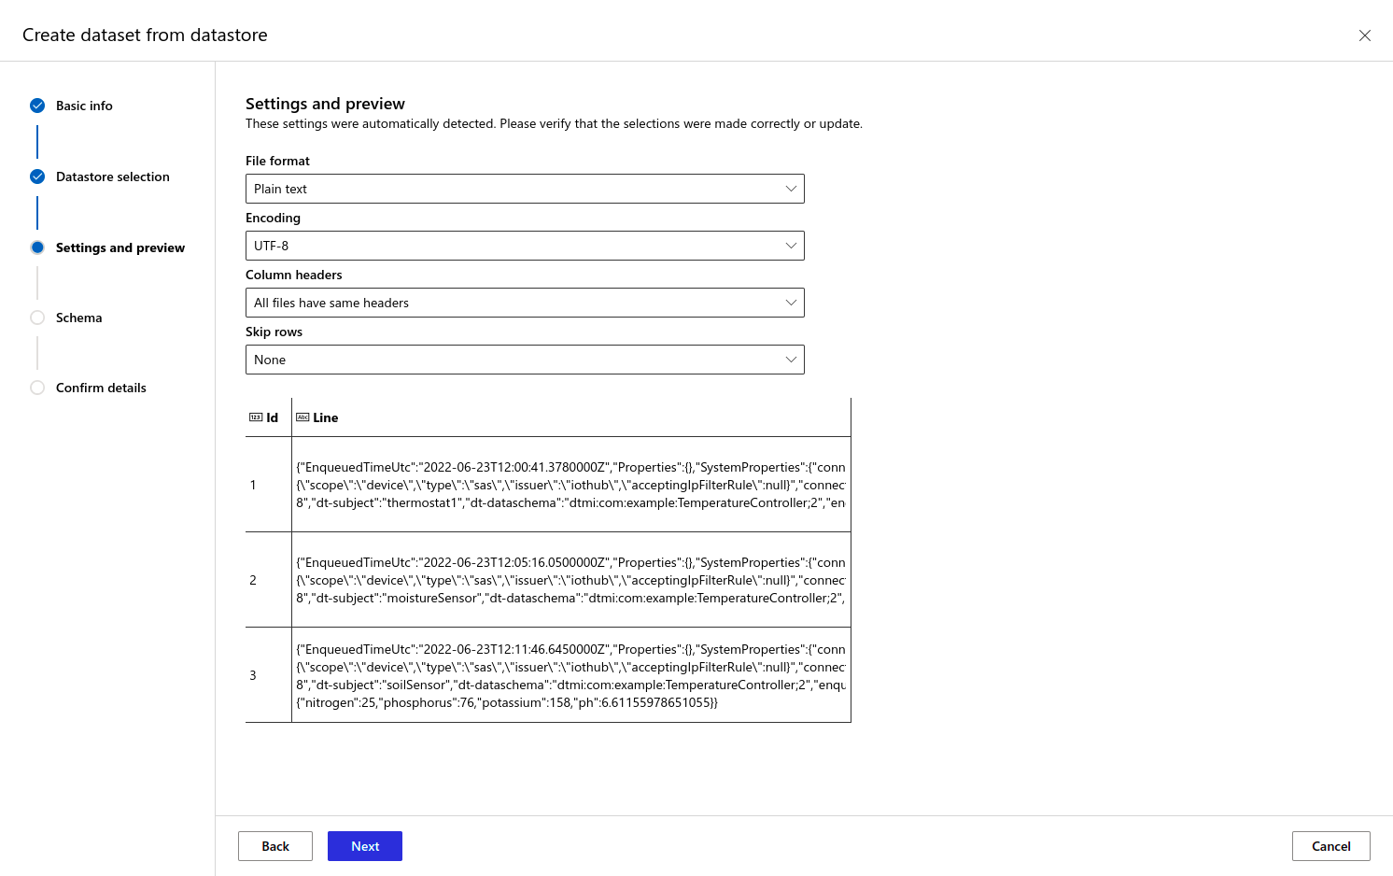
3. Ensure that the settings are set to the values as shown.
4. Click Next twice and then click Create.
5. Click on crop-asset from the datasets list and navigate to the Consume tab. Copy the code given.

Slide 40
Develop a model

Slide 41
Develop a model
1. Go to your Azure Machine Learning Workspace and launch the ML studio.
2. Upload the crop.ipynb file and crop-data.csv file to the studio. You will have access to a web editor and a terminal through which you can edit code or install packages using pip.
3. Insert the copied code under the Predicting optimum harvest time section in crop.ipynb.
4. Ensure that the Dataset.get_by_name function gets right dataset passed as variable.
5. Clear the existing JSON files from blob storage and then run crop.ipynb
Notes:
It's useful to test an API by sending queries over a browser's URL, complete with a query string populated by an access token. But in a production app, you might need to make a more complicated API call with various data assembled to form a query.
That's why many developers rely on libraries that standardize the process of working with APIs. For JavaScript developers, Axios is an excellent choice. Python programmers might use Requests. Using PowerShell? Try RestMethod.

Slide 42
Knowledge check

Slide 43
Question 1
It is impossible to create custom routes in IoT hub. True or false?
True
False

Slide 44
Question 1
It is impossible to create custom routes in IoT hub. True or false?
True
False

Slide 45
Question 2
What are the characteristics of Multi-Linear Regression?
Uses a single explanatory variable
Assumes that there is a linear relationship between dependent variables and independent variables
The independent variables are highly correlated with each other

Slide 46
Question 2
What is a characteristic of Multi-Linear Regression?
Uses a single explanatory variable
Assumes that there is a linear relationship between dependent variables and independent variables
The independent variables are highly correlated with each other

Slide 47
Question 3
Datasets can be accessed without authorization. True or false?
True
False

Slide 48
Question 3
Datasets can be accessed without authorization. True or false?
True
False

Slide 49
Summary

Slide 50
Summary
In this module, you learned what IoT refers to and how to manage IoT devices using IoT hub. You also learnt how to use the web editor to edit Jupyter Notebooks.
You were also introduced to datastores and datasets, which are often used in machine learning.

