Slide 1
Developing a Platform Game
using Python
Mr Valdez

Slide 2
You can find the code at
https://github.com/MrValdez/PyCon-2015-Gamedev-talk
Feel free to clone, fork, and make changes. I am looking forward to seeing your version

Slide 3
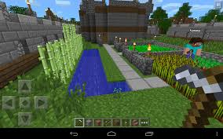
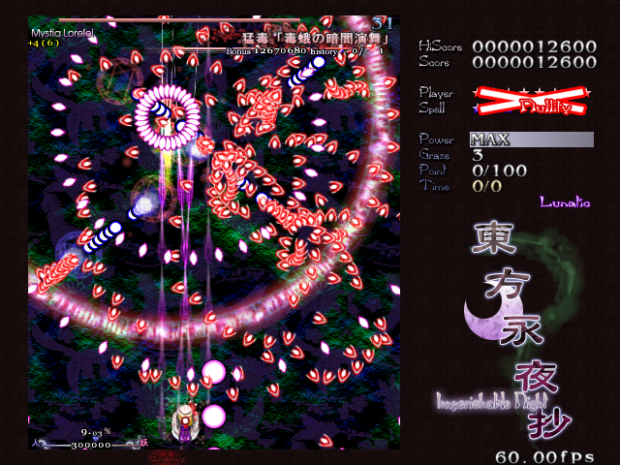
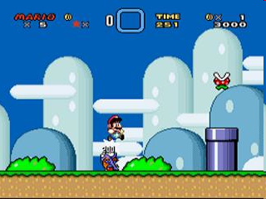
Video Games!
Who here are gamers?

Slide 4
Philippine Game Development Industry
Philippines Game Developers Community (PGDC)
  https://www.facebook.com/groups/igdamanila/
Game Developers Association of the Philippines (GDAP)
  http://www.gdap.org.ph/

Slide 5
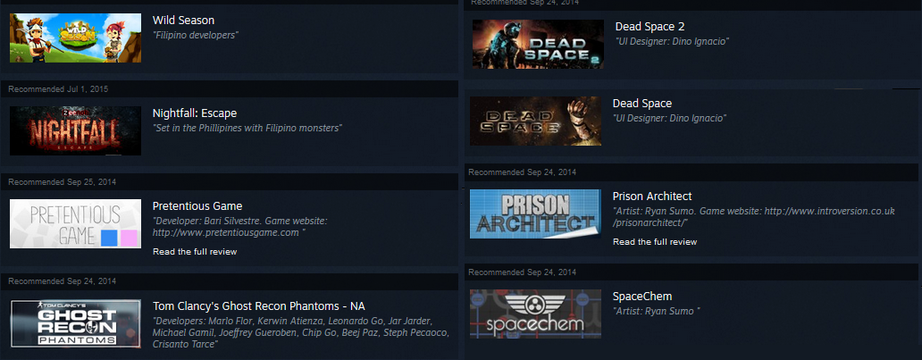
Philippine Game Development Industry
Games with Filipino Developers
  Anito by Anino Games
  Crazy Plane by Ocular
    https://play.google.com/store/apps/details?id=com.OcularGames.CrazyPlane
  Yurai Ninja
    https://itunes.apple.com/app/yurei-ninja/id934003228?mt=8
    https://play.google.com/store/apps/details?id=com.bulkypix.ninjaproject
  https://www.facebook.com/groups/igdamanila/permalink/10152298541776791/

Slide 6
What you need to know to program games
Programming Language
Maths
Game programming design patterns
Game platform
(optional) Scripting Language

Slide 7
Programming Languages for
Game Development
Traditional
  C
  C++
  C#
  Java
Modern
  Unity
  Unreal Engine
  Source 2

Slide 8
Programming Languages for
Game Development
Python is not usually used for game programming
There are games created with Python:
  Blade of Darkness
  Civilization IV (Scripting Engine)
  Eve Online (Stackless Python)
  Dangerous High School Girls in Trouble
  Galcon (First release)
  Ren'py games
    Long live the Queen
    Analogue: A Hate Story by Christine Love
    A sequel called Hate Plus
    Dysfunctional Systems: Learning to Manage Chaos by Dischan

Slide 9
Why Python
The major reason to use Python for game programming is its easier to learn the fundamentals of making games compared to other languages
  Biased opinion

Slide 10
Why Python
Python allows for fast prototyping, if you have a strong grasp of the fundamentals

Slide 11

Game platform for Python
http://www.pygame.org

Slide 12
Math
Coordinate System
Collision Detection

Slide 13
Coordinate System
0
1
2
3
4
5
6
7
8
9
10
0 1 2 3 4 5 6 7 8 9 10

Slide 14
Coordinate System
(0, 0)
0
1
2
3
4
5
6
7
8
9
10
0 1 2 3 4 5 6 7 8 9 10

Slide 15
Coordinate System
(0, 0)
0
1
2
3
4
5
6
7
8
9
10
(6, 10)
0 1 2 3 4 5 6 7 8 9 10

Slide 16
Coordinate System
(0, 0)
0
1
2
3
4
5
6
7
8
9
10
(3, 5)
(6, 10)
0 1 2 3 4 5 6 7 8 9 10

Slide 17
Coordinate System
(0, 0)
0
1
2
3
4
5
6
7
8
9
10
(3, 5)
(6, 10)
0 1 2 3 4 5 6 7 8 9 10

Slide 18
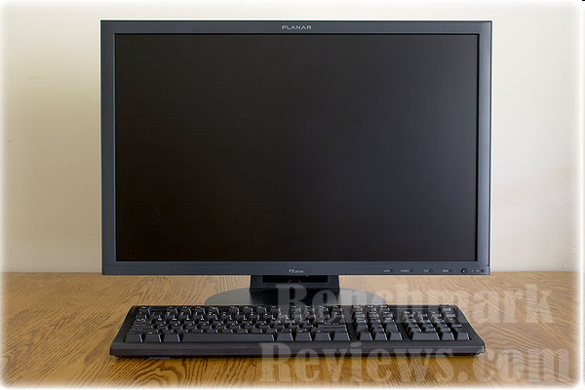
Coordinate System
0
1
2
3
4
5
6
7
8
9
10
640 x 480
800 x 600
1024 x 768
0 1 2 3 4 5 6 7 8 9 10

Slide 19
Collision Detection
Collision Detection is the algorithm used to see if two sprites intersects
A sprite is the image of a game object

Slide 20
Collision Detection
Are these two sprites touching?
How can the computer tell that these sprites are touching?

Slide 21
Collision Detection
Did these sprites touched?
We can use math to detect if they touched

Slide 22
Collision Detection
To simplify the math, sprites are represented by the computer as rectangles

Slide 23
Collision Detection
If the rectangle overlaps, it means there is a collision. An event is triggered.
An event is anything that can affect the game

Slide 24
Collision Detection
The event here, according to the game rules is that Mario loses.

Slide 25
Collision Detection
The formula to check if two rectangles have collided is:
Box1.x + Box1.Width > Box2.x &&
Box1.x < Box2.x + Box2.Width &&
Box1.y + Box1.Height > Box2.y &&
Box1.y < Box2.y + Box2.Height

Slide 26

Box1.x + Box1.Width > Box2.x &&
Box1.x < Box2.x + Box2.Width &&
Box1.y + Box1.Height > Box2.y &&
Box1.y < Box2.y + Box2.Height
(Hero)
Width: 10
Height: 50
(Monster)
Width: 50
Height: 40
(0, 0)
(100, 0)

Slide 27

Box1.x + Box1.Width > Box2.x &&
Box1.x < Box2.x + Box2.Width &&
Box1.y + Box1.Height > Box2.y &&
Box1.y < Box2.y + Box2.Height
(Hero)
Width: 10
Height: 50
(Monster)
Width: 50
Height: 40
(0, 0)
(9, 0)

Slide 28
Box1.x + Box1.Width > Box2.x &&
Box1.x < Box2.x + Box2.Width &&
Box1.y + Box1.Height > Box2.y &&
Box1.y < Box2.y + Box2.Height
(Hero)
Width: 10
Height: 50
(Monster)
Width: 50
Height: 40
(0, 0)
(100, 0)

Slide 29
Box1.x + Box1.Width > Box2.x &&
Box1.x < Box2.x + Box2.Width &&
Box1.y + Box1.Height > Box2.y &&
Box1.y < Box2.y + Box2.Height
Box1.rect.colliderect(Box2.rect)

Slide 30
Game Programming
Design Patterns
Game Loop
Game Object
Component-based behavior

Slide 31
Game Loop
The basic code for all games
Infinite loop
Runs after Game world setup
Each iteration is referred to as a “frame”
Game world setup
Input
Update
Draw

Slide 32
Game Object
Every frame, the game will update and draw the game objects.
All the objects in the game can be defined as a class
The class can contain functions for updating and drawing
class Monster
{
void Update();
void Draw();
}

Slide 33
Game Object Containers
New instances of the class are added to a container. This makes it easier to manage all the instances of that class.
Every frame, all the instances’ update and draw functions are called.
class Monster
{
void Update();
void Draw();
}
class MonsterContainer
{
void AddMonster(Monster *monster);
void DeleteMonster(Monster *monster);
void UpdateAll();
void DrawAll();
}

Slide 34
Component-based behavior
OOP approach: programming each game object how to behave
Component-based: we are programming behaviors that game objects can use
Example: Falling behavior
Falling behavior
component
Game object #1
Hero
Game object #2
Power-ups
Game object #3
Bullet

Slide 35
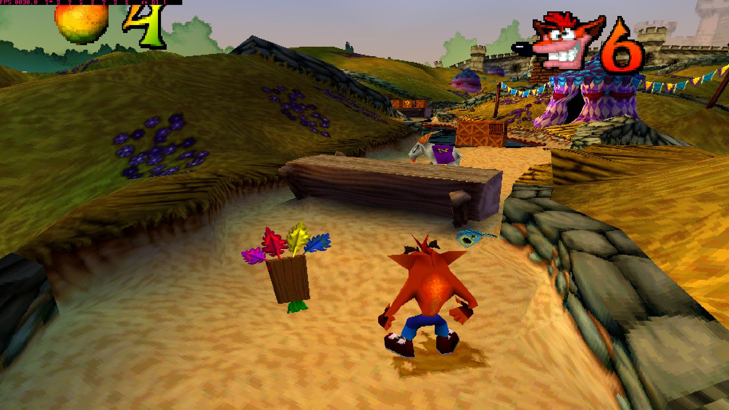
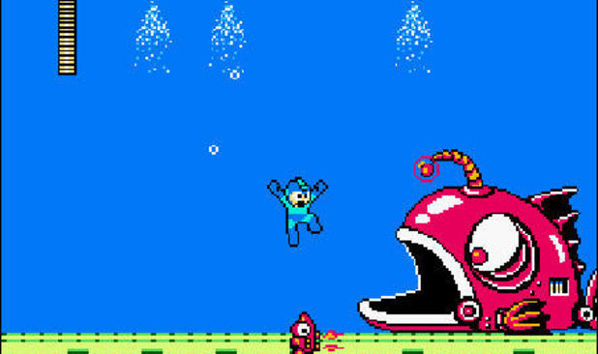
Platform Games!
Video Game Genre.
Walk right to win!

Slide 36
What you need to know to program platform games
Math: Acceleration and Velocity
Physics: How to defy gravity
AI: Walk from right to left without stopping
Engineering: Making levels with Bottomless pits

Slide 37
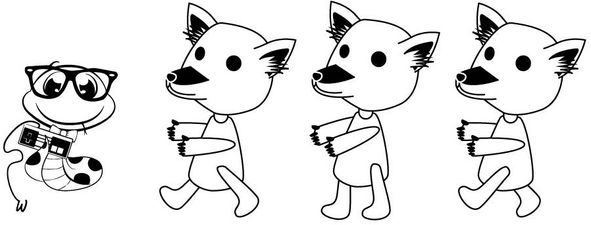
Let’s make a platform game
Shoutouts to Joy Lebrun for the Adorable Snake named Payton
and Richel Alexandria Valdez for the Moongoose

Slide 38
Basic pygame skeleton
import pygame
pygame.init()
clock = pygame.time.Clock()
resolution = [640, 480]
screen = pygame.display.set_mode(resolution)
while True:
screen.fill([255, 128, 255])
events = pygame.event.get()
for event in events:
if event.type == pygame.QUIT:
pygame.quit()
keystate = pygame.key.get_pressed()
if keystate[pygame.K_ESCAPE]:
pygame.quit()
pygame.display.update()
clock.tick(60)

