Slide 1

Nyoibo (Discord.py Bot)
Nyoibo#3080

Slide 2
Discord.py
Discord.py is a modern, easy to use, feature-rich, and async ready API wrapper for Discord.
Modern Pythonic API using async / await syntax.
Sane rate limit handling that prevents 429s which implements the entire Discord API.
Optimised in both speed and memory.
Command extension to aid with bot creation.
Easy to use with an object oriented design.

Slide 3
Bot Example with Discord.py
import discord
from discord.ext import commands
bot = commands.Bot(command_prefix='>')
@bot.command()
async def ping(ctx):
await ctx.send( ‘Bot is Online‘ )
bot.run('token')

Slide 4
Benefits of Using Discord Bots
Discord bots are AIs that can perform a number of useful automated tasks and bot commands on your server. They can be used for a number of automated tasks like :
welcoming new members
moderating content
banning rule breakers
warn members for violating any minor rules.
use bot commands to add music, memes, games, and other content to your server. Etc.

Slide 5
About our bot ‘Nyoibo’
Nyoibo is a name of a staff that was carried by Sun Wukong also known as ‘The Monkey King’, is a legendary mythical figure best known as one of the main characters in the 16th-century Chinese novel ‘Journey to the West’.
The staff was wielded by Sun Wukong himself and it possess extraordinary power : immense strength, ability to travel using clouds, immortality, shape shifting abilities and possession of a giant staff that he can expand and shrinks at his command.
So from its powers we though that this might be a suitable name for our bot which the Server Admins and Management can use for managing the server with ‘Nyoibo’.

Slide 6


Commands available with Nyoibo
The bot prefix is ‘n!’
You can check the commands and their usage here:
Hyperlinks\bot commands.xlsx

Slide 7
Auto-Moderation With Nyoibo
Auto-Moderation with Nyoibo is very simple and good. Basically for now we have only added response to the messages containing toxic words.
The bot instantly deletes the message if it detects any of the filtered words.
As soon as the bot deletes the message it mentions the user and warns them.
For now we haven’t added any type of database for this bot that’s why it cannot have any setup cool downs on separate users or a custom prefix for a particular server.

Slide 8
Flexibility with Nyoibo
As the program for this bot is open-source as of now, anyone can program their own modules with this bot and make it do amazing things for e.g. :
Make it play particular music on Voice channels on the command of the user,
manage economy of the members of the server,
custom games for the members to play with others,
search things or blogs on a particular site like Reddit, etc.,
Assign roles, welcome members who joined the server, send embedded messages in a particular discord channel, etc.

Slide 9

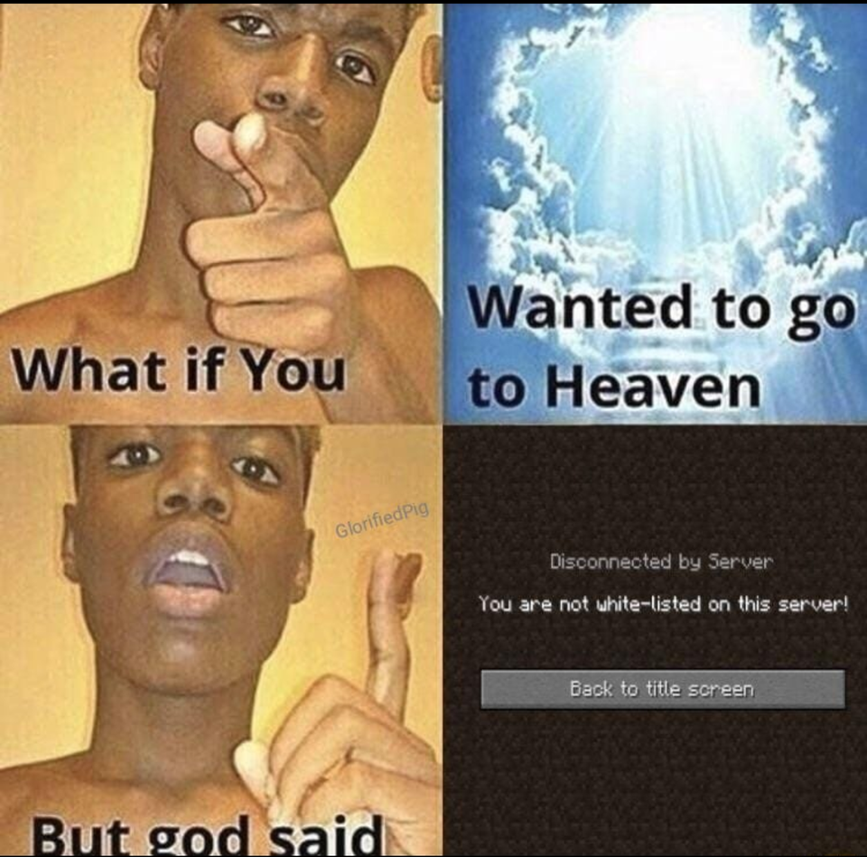

Memes with Nyoibo

Slide 10

All the memes that Nyoibo provides is straight from Reddit.
Reddit was one of the top most rated place for memes.
So we decided to use Reddit Developer console to create a web application that we connected with Nyoibo.
Which now provides you with latest and craziest memes available on Reddit.

Slide 11
That’s It!
Project :
Nyoibo (Discord Bot)
By:
Sarthak S
Vedant S
Thank You!

