Slide 1
VAST Challenge 2017 MC1
First progress presentation
Team Members: Hriday Mistry, Karan Narad, Ryan Hare, Luobin Cui, Tarun Teja Kairamkonda
Reporters: Hriday Mistry, Karan Narad

Slide 2
Overview of 2017 MC1 Challenge
The Mistford city has a small industrial area with four light-manufacturing endeavors
Rose-Crested Blue Pipit, a popular local bird due to its attractive plumage and pleasant songs, is decreasing!
The Boonsong Lekagul Nature Preserve is used by local residents and tourists for day-trips, overnight camping or sometimes just passing through
Entry gates are positioned at the Preserve entrances. Each vehicle receives an entry ticket at the gate and is assigned a vehicle class; the entry is recorded.
When vehicles enter the Preserve, they must proceed through a gate and obtain a pass. The gate categorizes vehicles as follows:
1. 2 axle car (or motorcycle)
2. 2 axle truck
2P Truck (Ranger)
3. 3 axle truck
4. 4 axle (and above) truck
5. 2 axle bus
6. 3 axle bus

Slide 3
Contributions
Hriday Mistry: Type-1: Car/Motorcycles - Slides 4-6
Karan Narad: Type-2: 2 Axle Truck - Slides 7-8
Luobin Cui: Type-2P: Ranger Vehicles - Slides 9-10.
Tarun Teja Kairamkonda: Type- 3 & 4: 3, 4 Axle Trucks - Slides 11-12
Ryan Hare: Type-5 & 6: Buses - Slides 13-14.

Slide 4
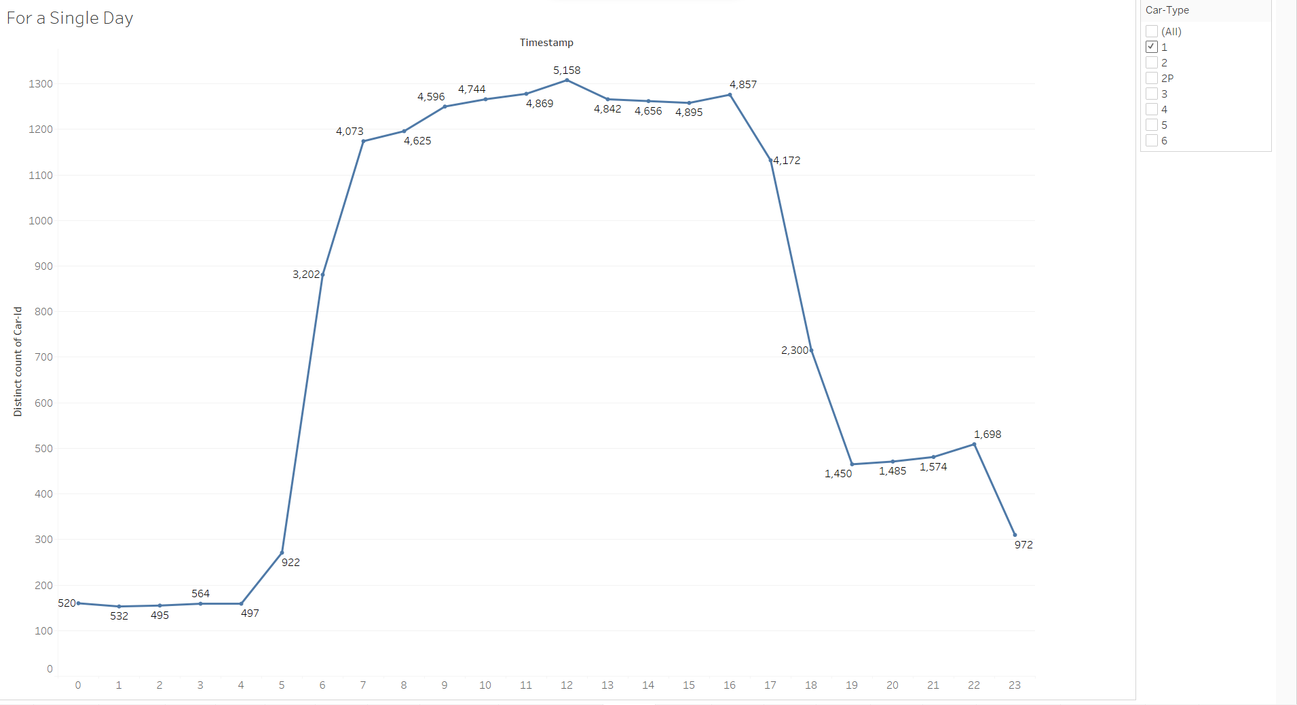
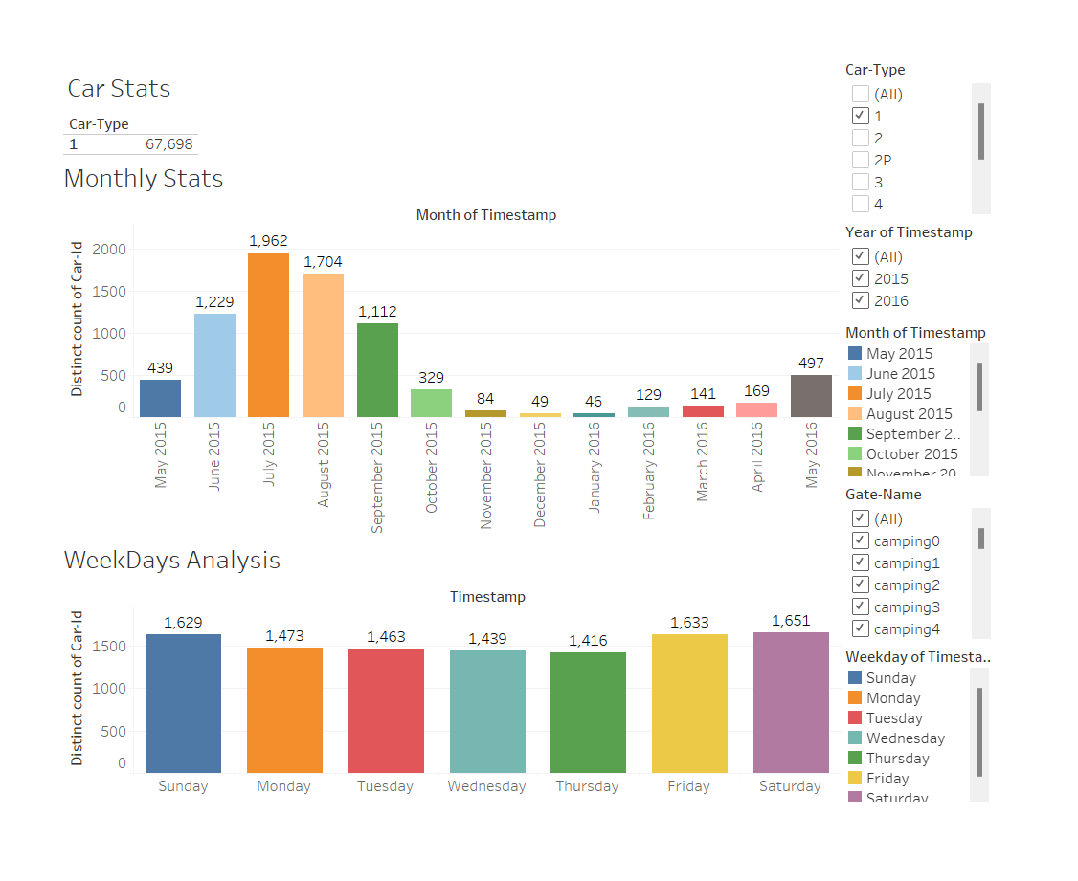
Overview of Car Type-1 (2-axle cars/Motorcycles )

Slide 5
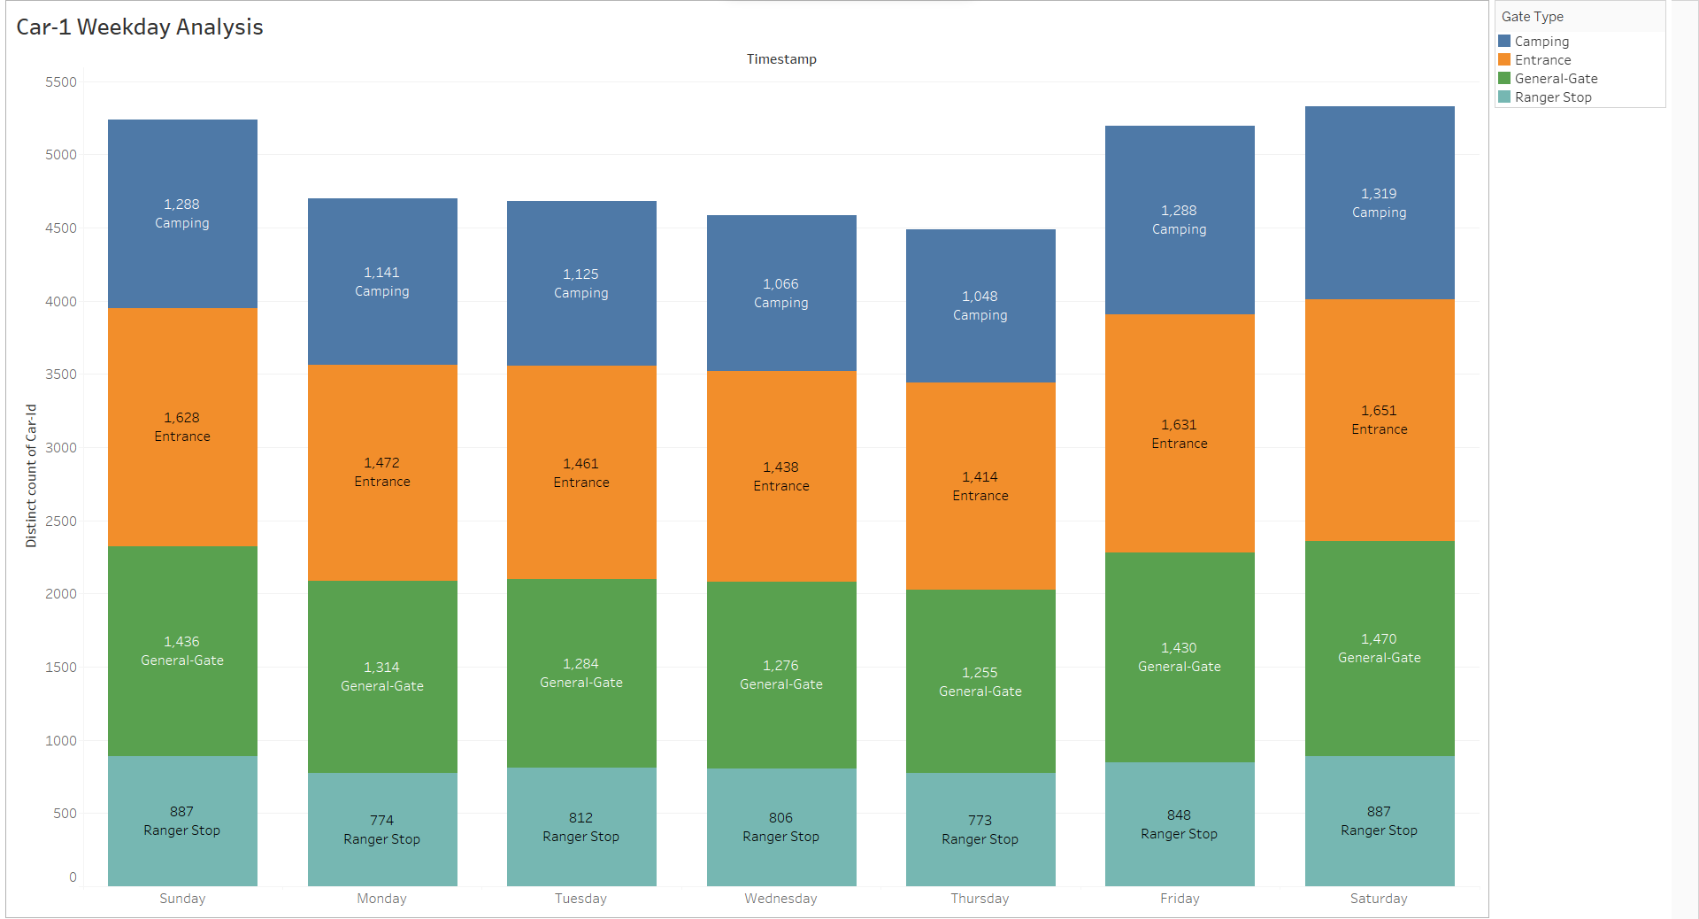
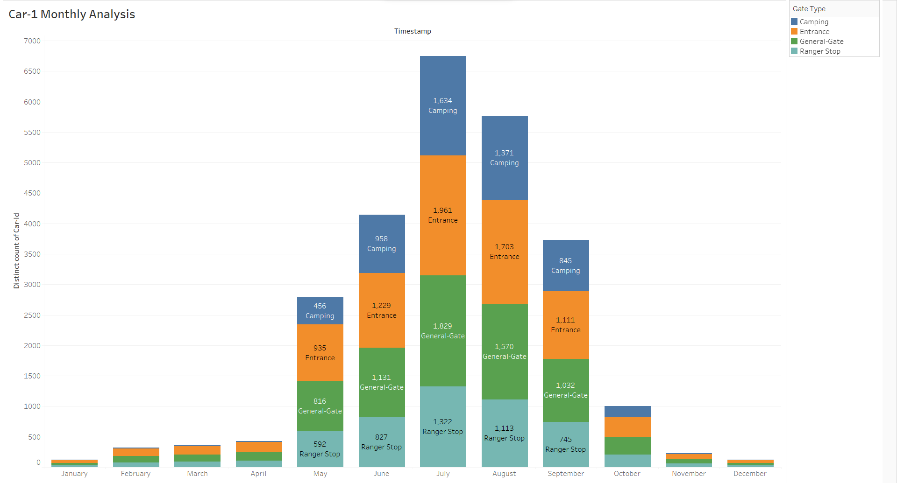

Slide 6
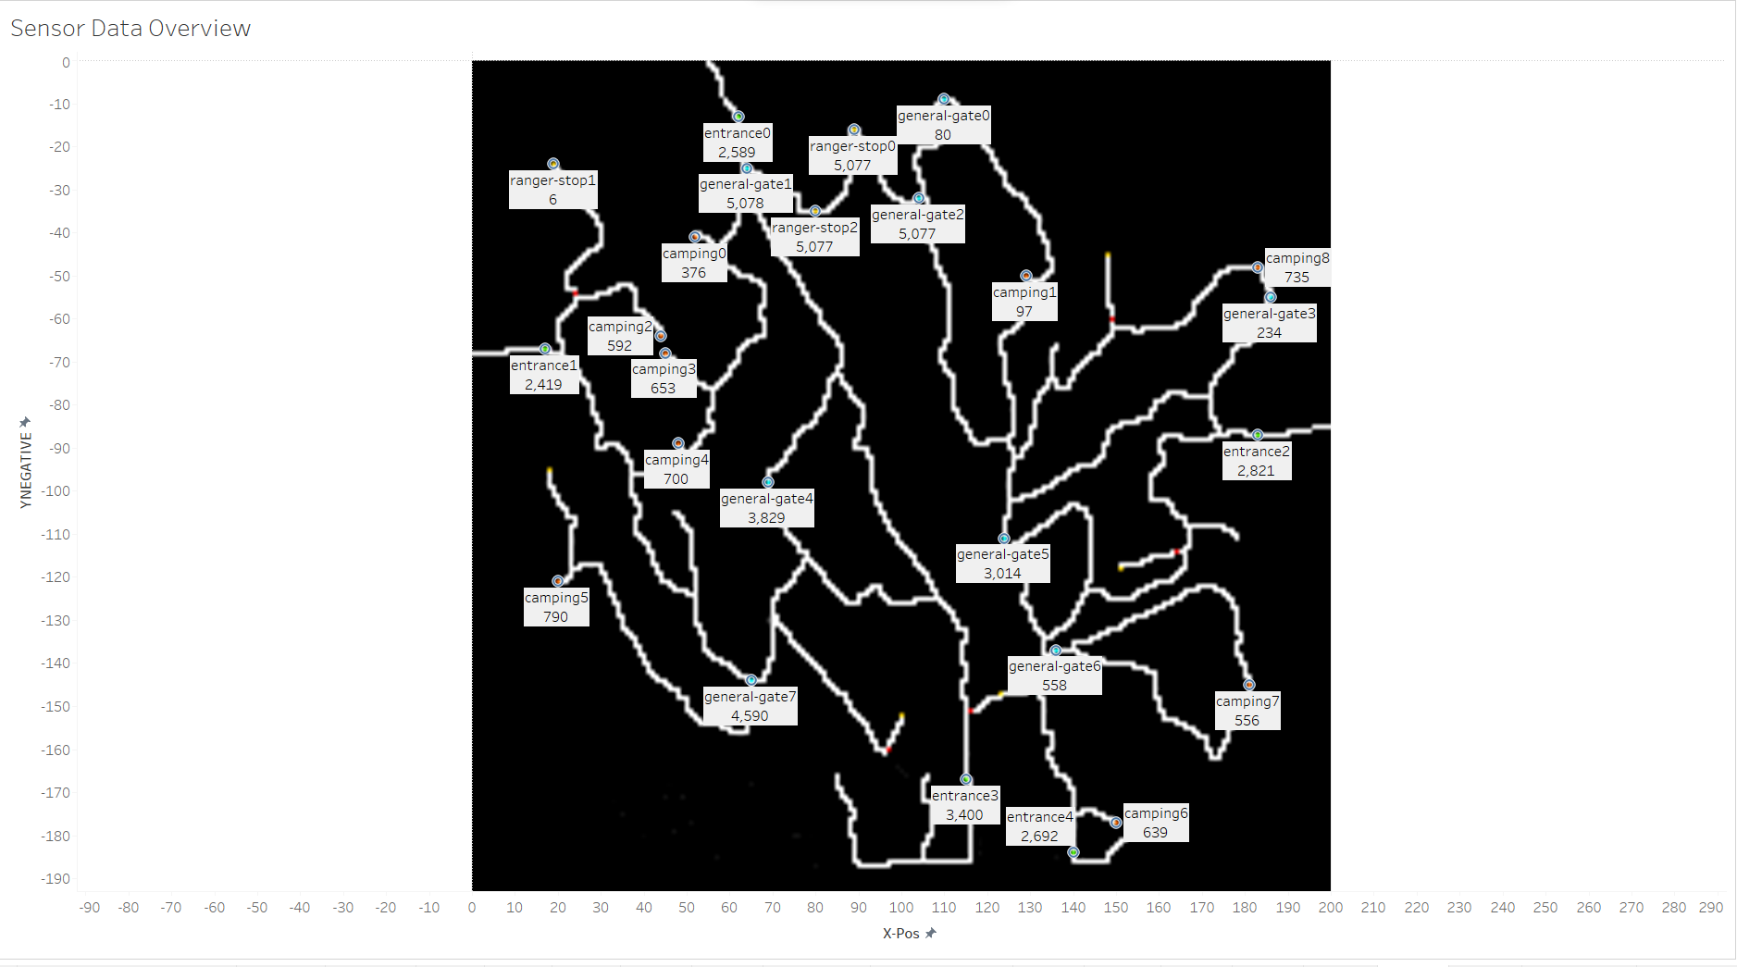

Slide 7
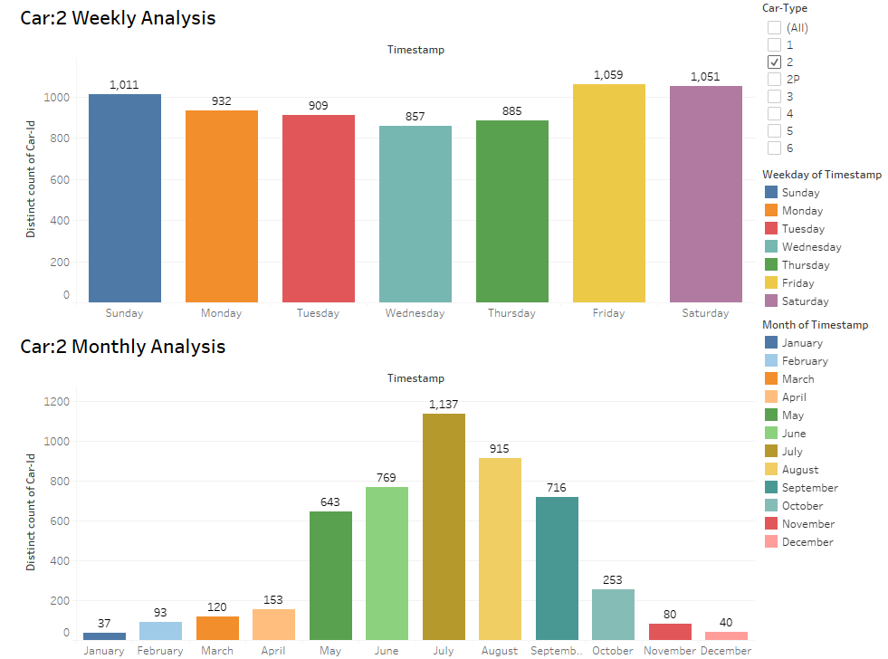
Overview of Car type-2(2 axle truck)
For type 2, the sensor picked up total 40,199 entries of data.
Weekday analysis: Maximum cars are observed on Friday, Saturday and Sunday respectively.
Monthly Analysis: Maximum cars are observed during July. Overall, more cars visit the Nature Preserve during Summer and least during Winter.

Slide 8
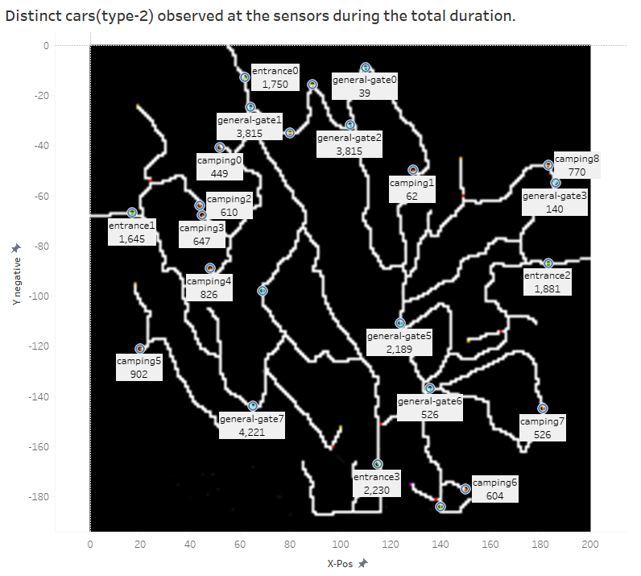
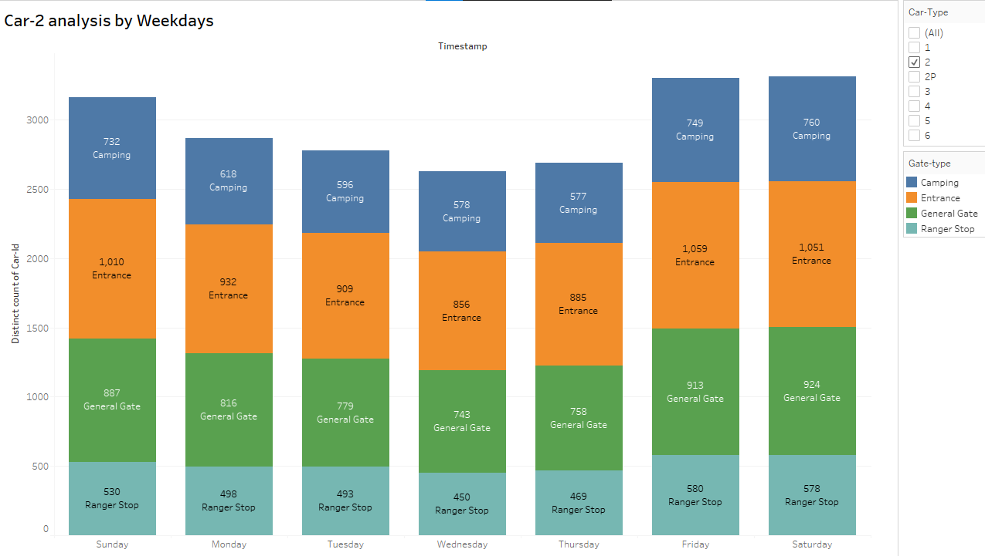
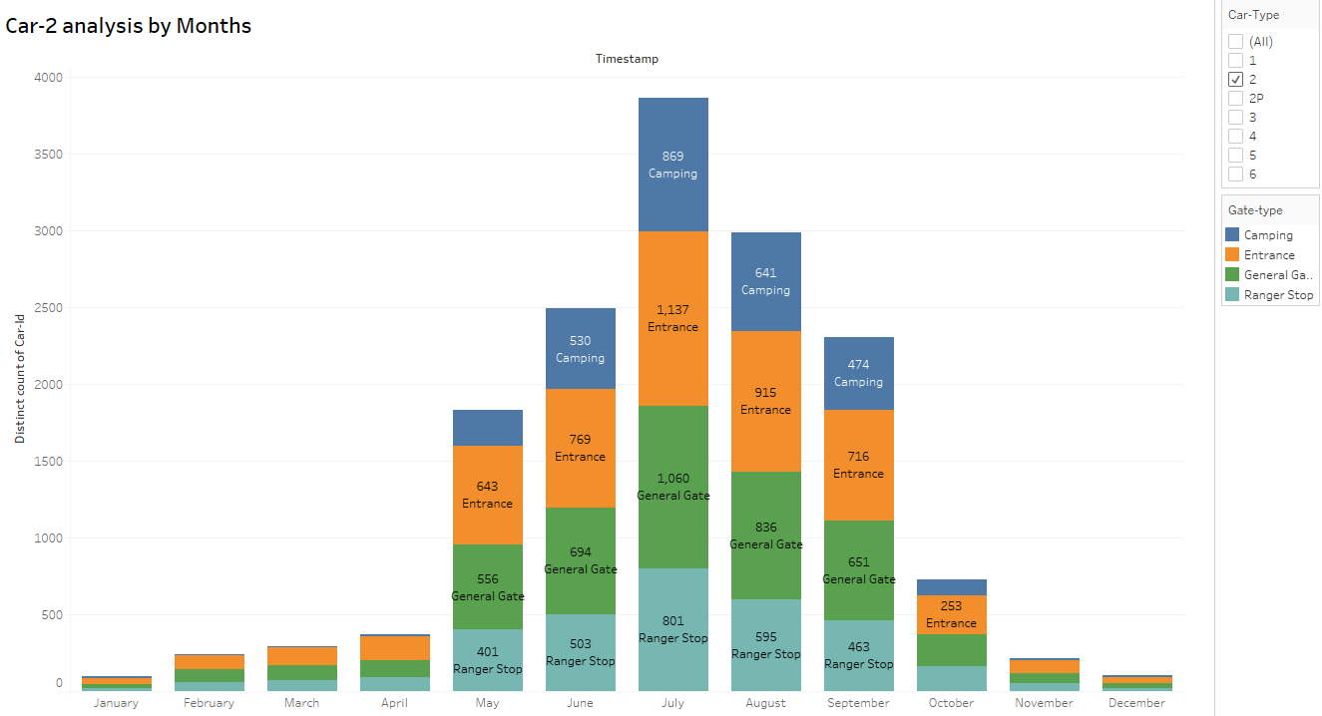
Analysis of Car type-2(2 axle truck) by Gate-type
Maximum car entrances and campers are observed during July.
Overall, more distinct cars like to visit the Nature preserve during summer for camping and sightseeing.
Most entrances are observed on Fridays.
Maximum distinct cars are observed during Saturday, we can infer that maximum cars are camping overnight during Fridays and then Saturdays.
Least entrances and campers are observed during Wednesdays and Thursdays.

Slide 9
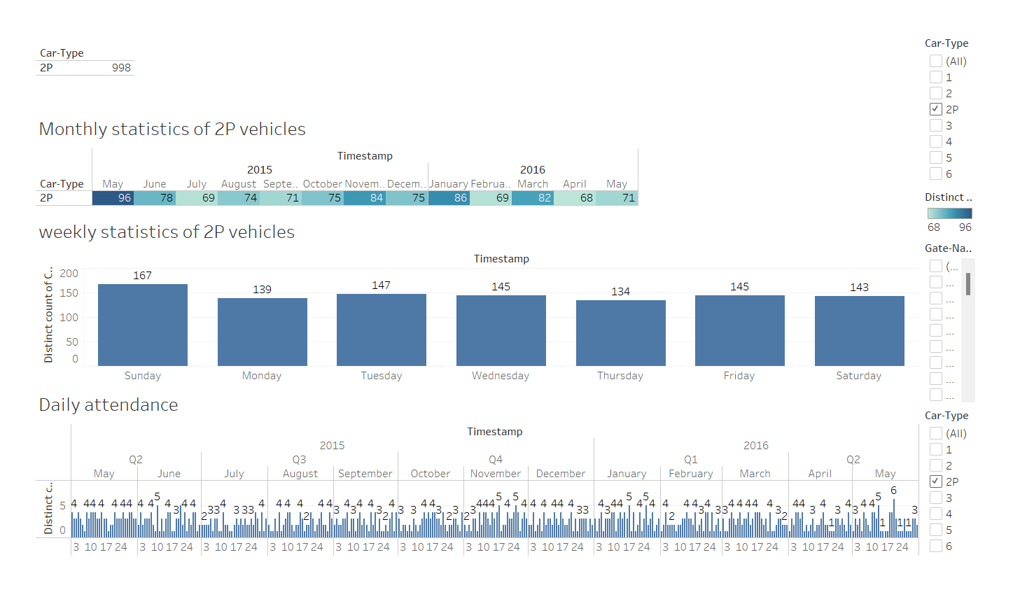
2p vehicle routes Part
Notes:
For 2p. It belongs to a Park service vehicle. A total of 998 patrols, with the highest number of patrols in May 2015. Maximum number of Sunday attendance per week Maximum number of daily attendance 6 times.

Slide 10
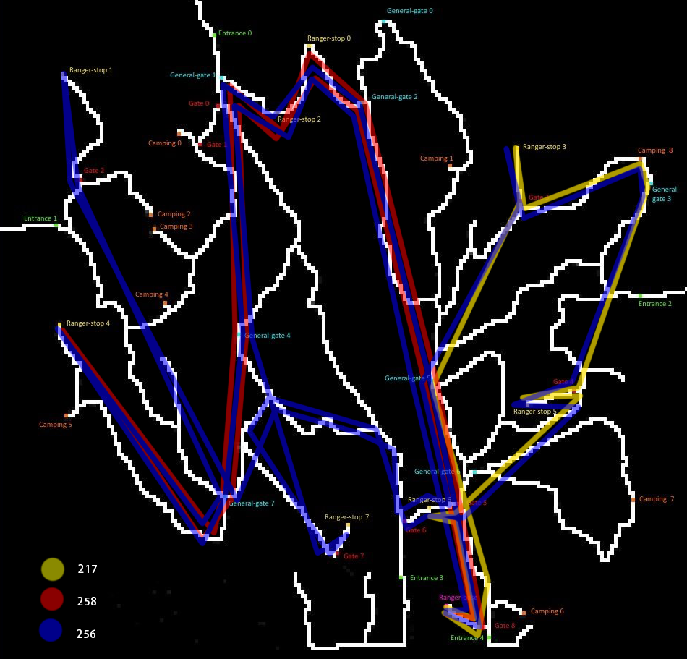
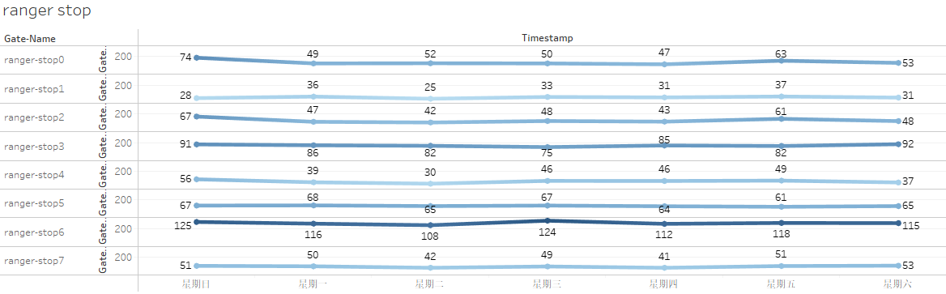
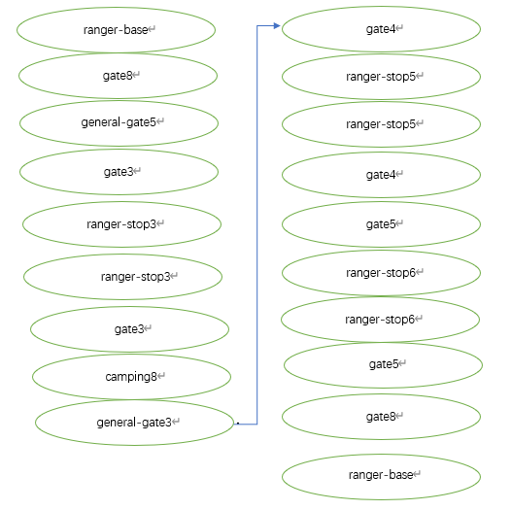
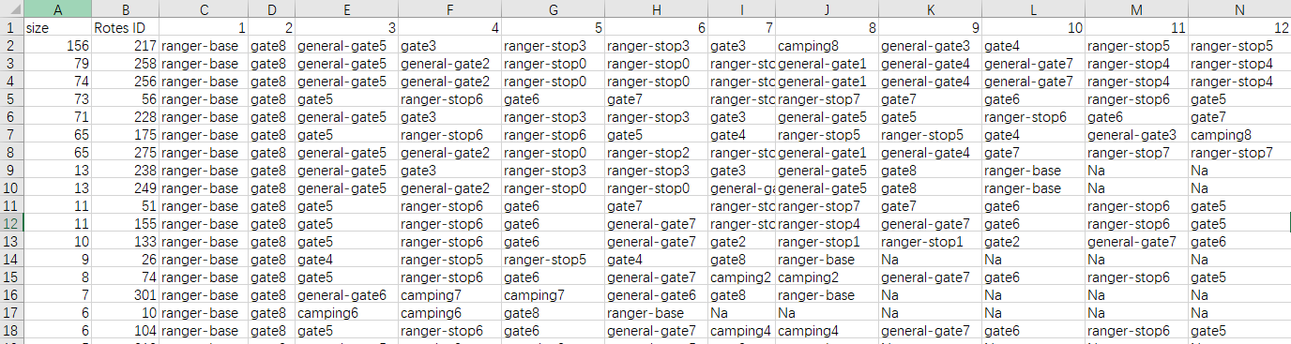
Notes:
308 times unique routers 690 times same routers Through data analysis. It mainly patrols ranger-stop There are many patrol routes for 2P vehicles. Most patrolled routes 156 times Let's look at the top three routes.The red, blue and yellow lines in the picture

Slide 11
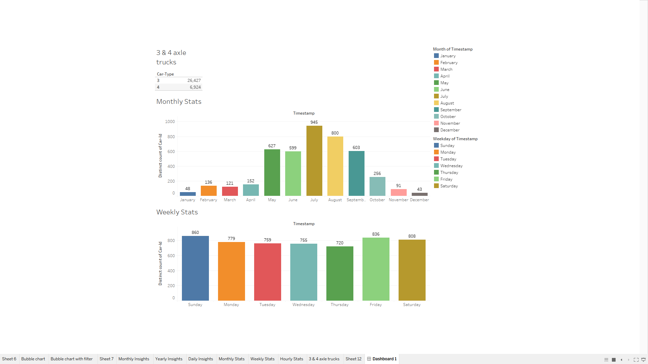
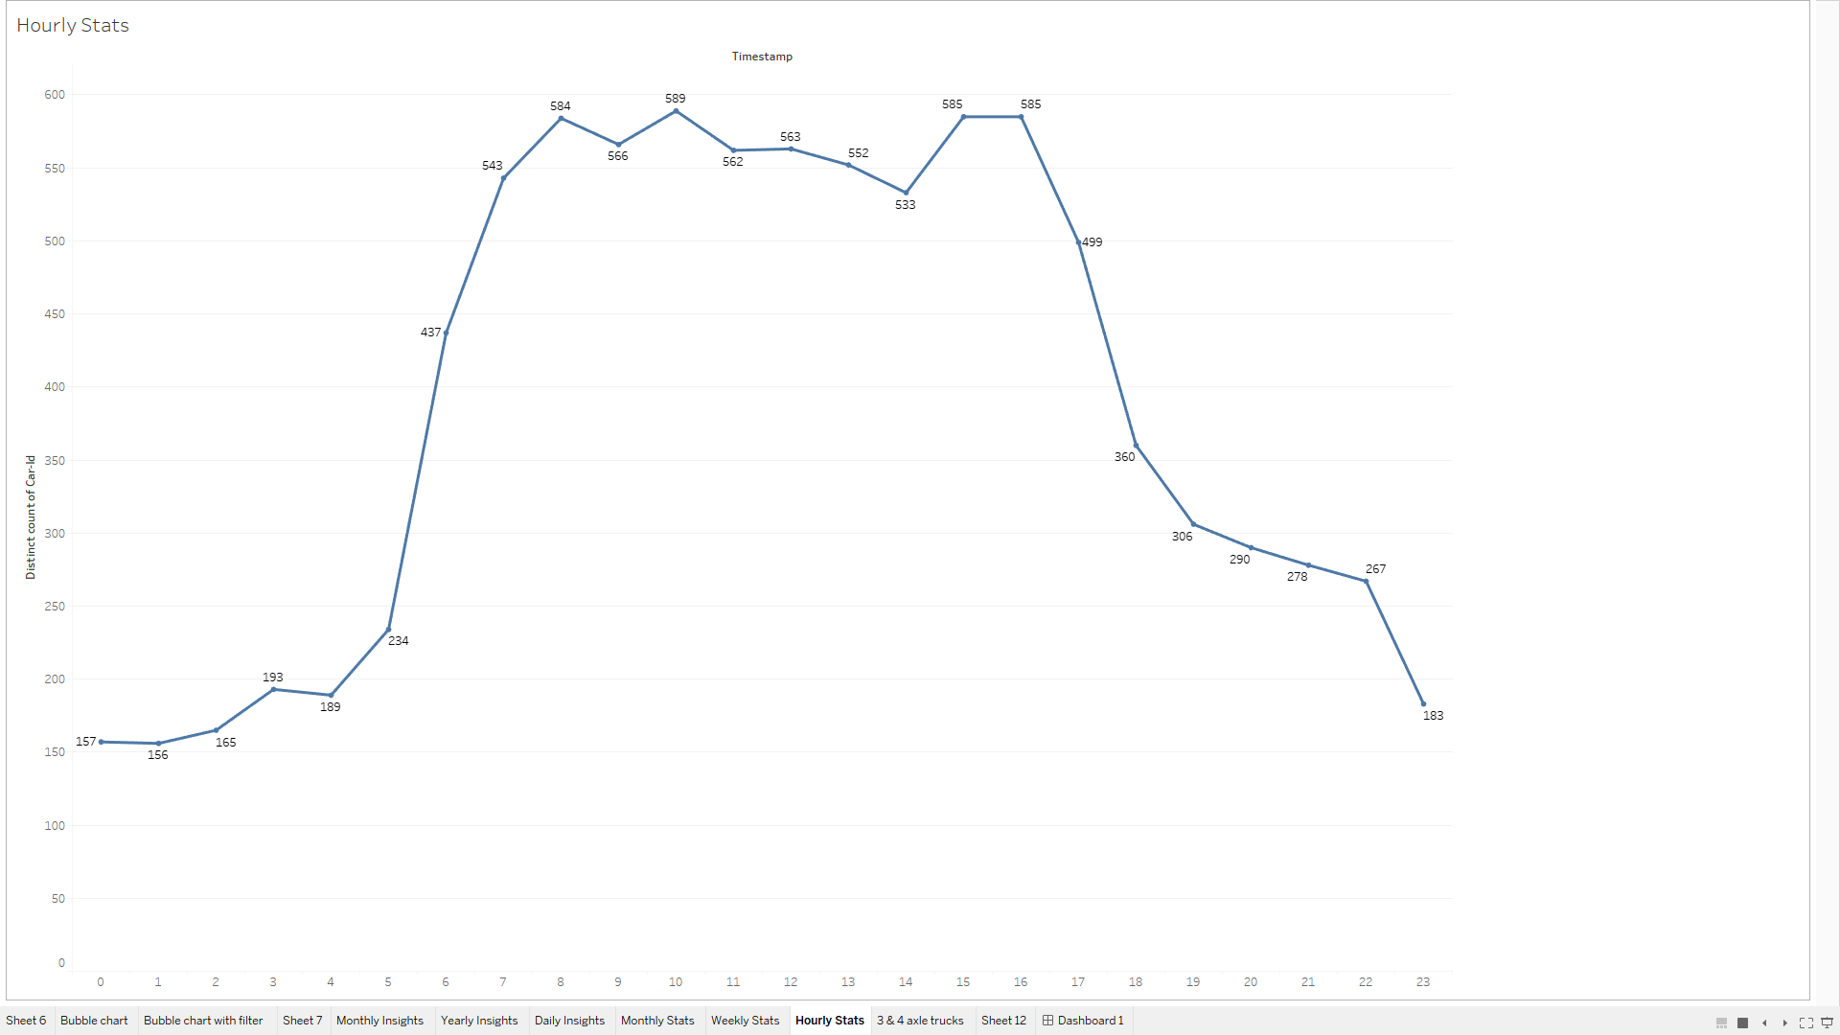
Overview of Type 3 & 4 (3 axle and 4 axle Trucks)

Slide 12
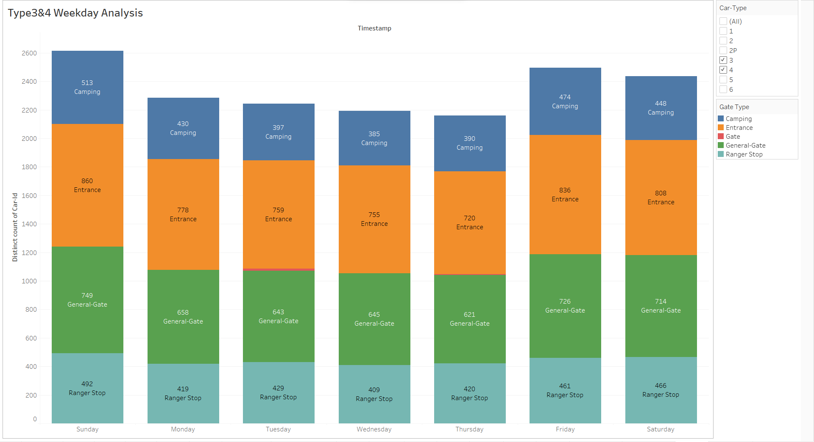
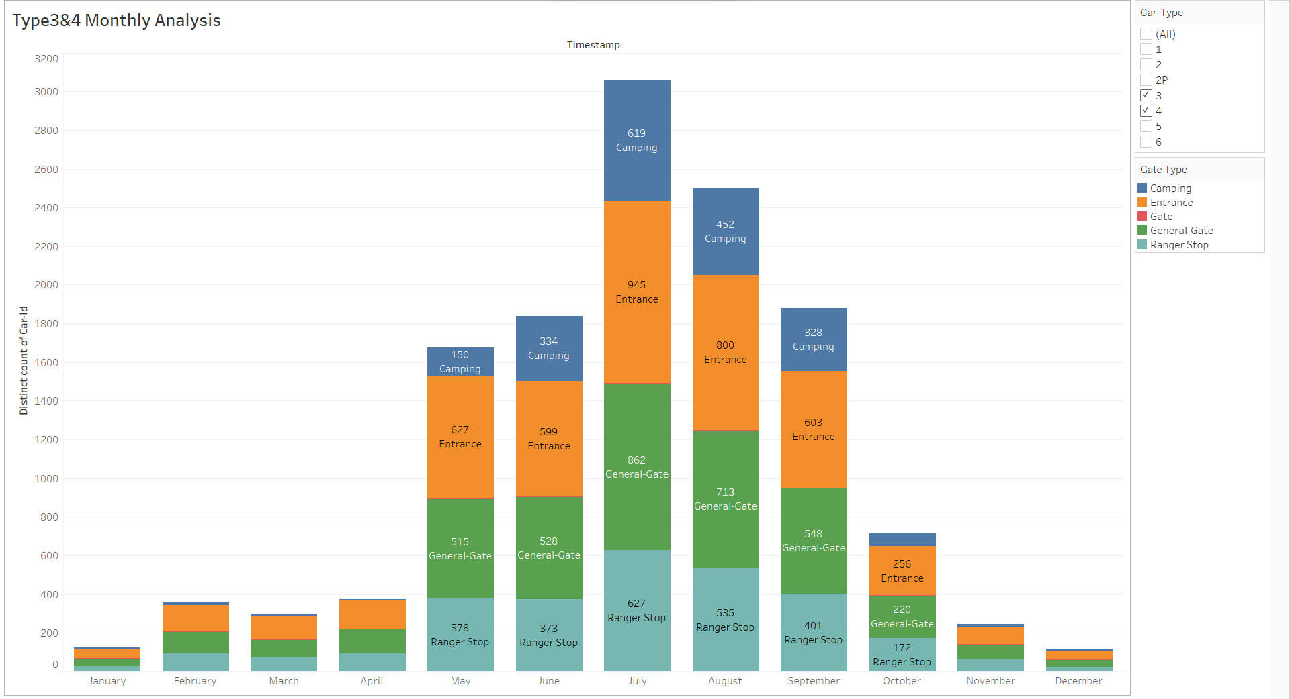
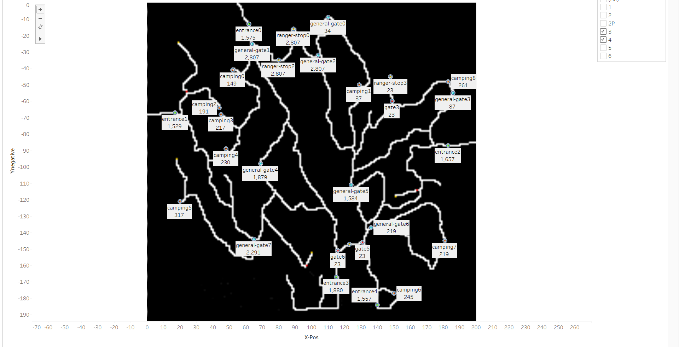

Slide 13
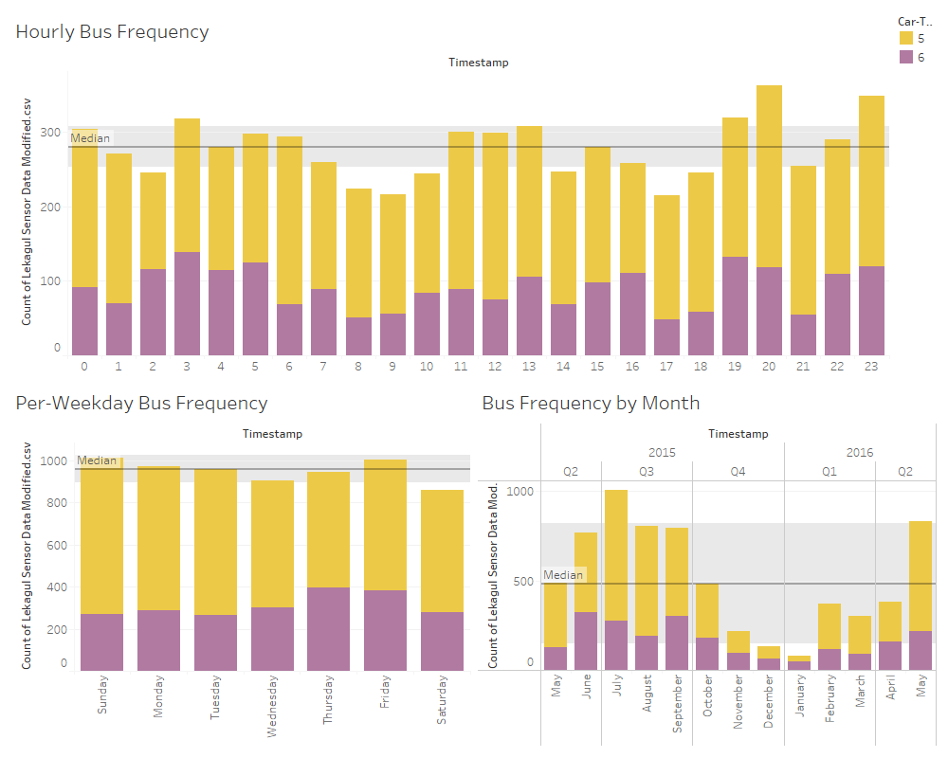
Bus Patterns
Notes:
You can see that buses travel consistently through the park, and there are less on Saturdays.
Buses come at all times of day, even night, through the park. So, the park is probably on several bus routes. There are less around 8am and 5pm, which are rush hour, so traffic might lead to fewer buses. There are also more buses at 8pm and 11pm, which means there may be more scheduled at that time.
Finally, buses are more common in summer and less common in winter. Either the roads are more difficult to travel in winter, or the buses are delivering less people then.

Slide 14
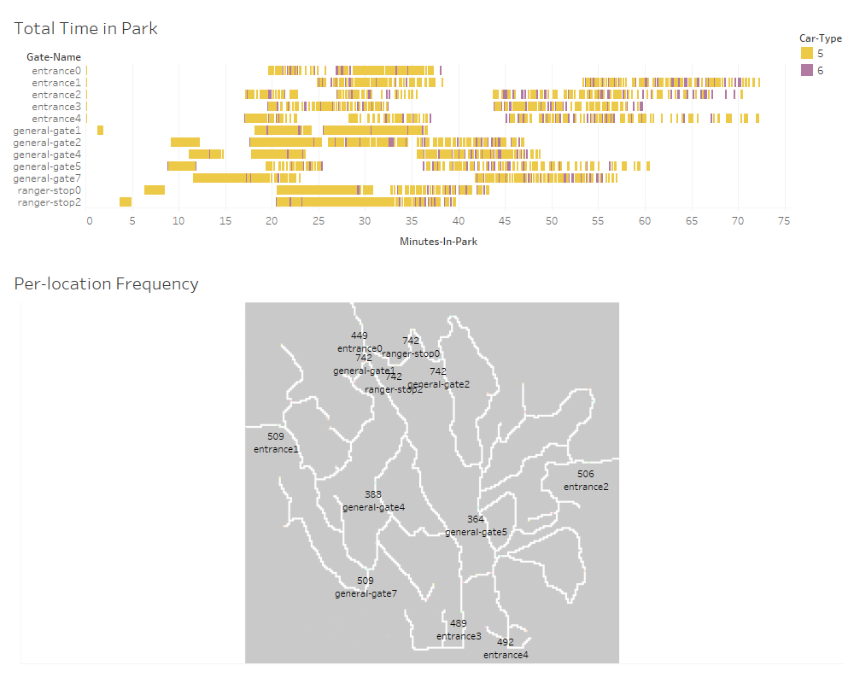
Bus Locations
Notes:
Buses move very consistently through the park. They only visit the locations on this map, and never go out the way they came in. So, they are probably just delivering people to and from the park, or just passing through as part of a route.
Depending on route, they spend different amounts of time in the park. However, timing is very clustered and consistent, meaning they always take the same routes and travel about the same speed. Variance could be because they spend time picking up or dropping off passengers.

