Slide 1
Wine Scoring
Dataminig, Mid Sweden University, VT21
Vlad Iosif, Marcel Transier

Slide 2
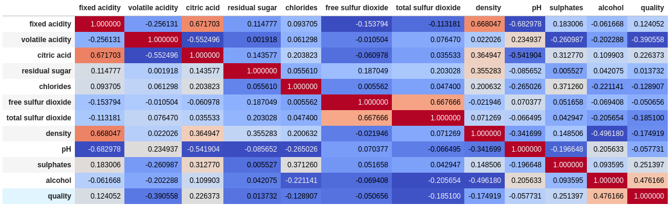
The Data: Red Wine

Slide 3
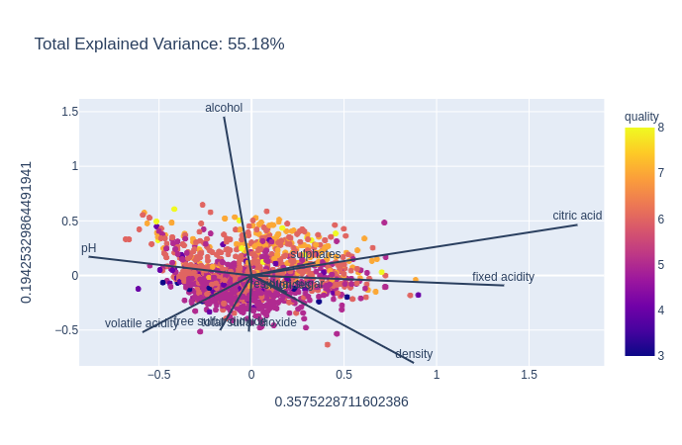
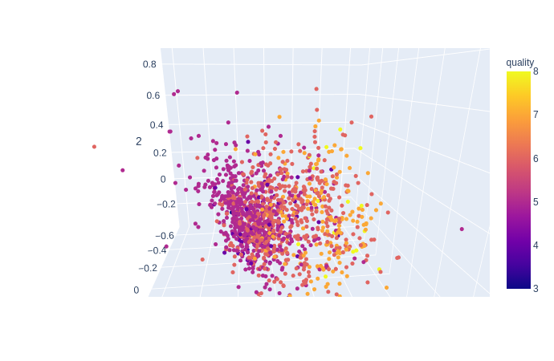
The Data: Red Wine

Slide 4
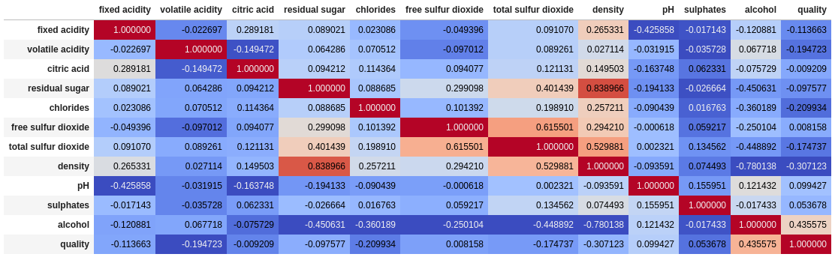
The Data: White Wine

Slide 5
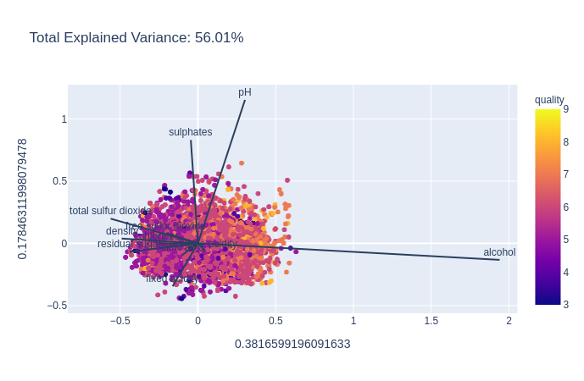
The Data: White Wine

Slide 6
Procedure
python, sklearn;
split in 75% training, 25% test;
grid search: tune hyperparameters:
  5 fold cross validation (20% of training).
fixed seed on all stochastic procedures.

Slide 7
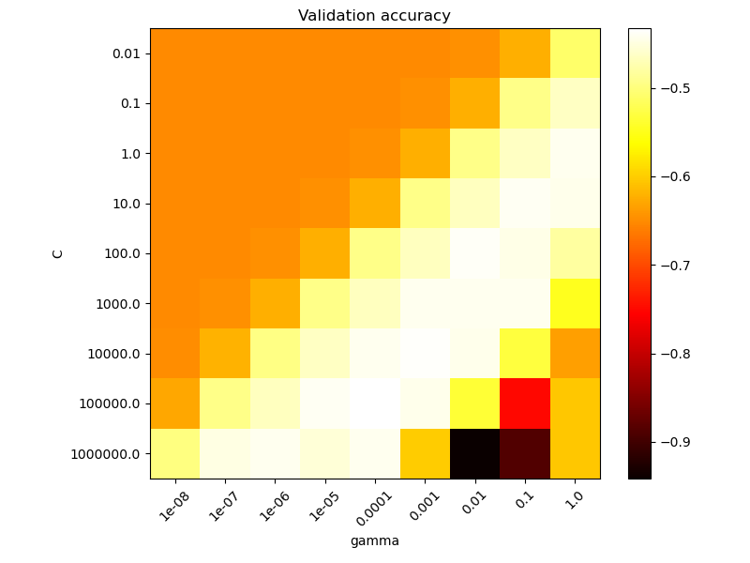
Grid search

Slide 8
SVM: procedure
normalize data (0, 1);
3 different grid parameters;
  1 for each kernel:
    rbf: C, gamma;
    poly: C, gamma, degree, coef0;
    sigmoid: C, gamma, coef0.

Slide 9
NN: procedure
normalize data (-1, 1);
tuning parameters one/two at a time;
parameters tuned and order:
  network structure + activation function (logistic, tanh, relu);
  alpha;
  beta;
  batch size.

Slide 10
evaluation metrics
MAD (medium absolute distance);
accurracy with tollerance;
REC curve.

Slide 11
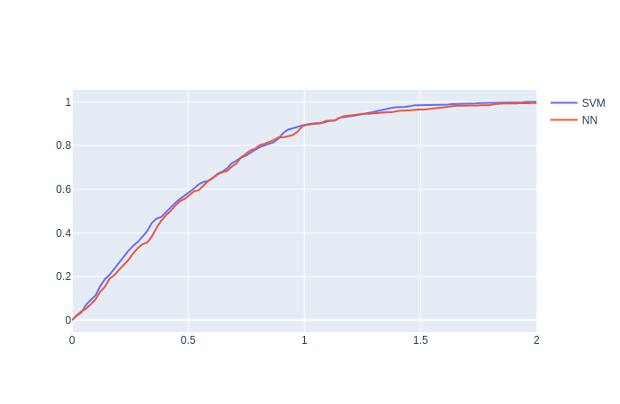
Results: REC red wine
SVM (rbf)
  MAE: 0.501
  ACC(T=1): 0.898
NN (relu)
  MAE: 0.526
  ACC(T=1): 0.892

Slide 12
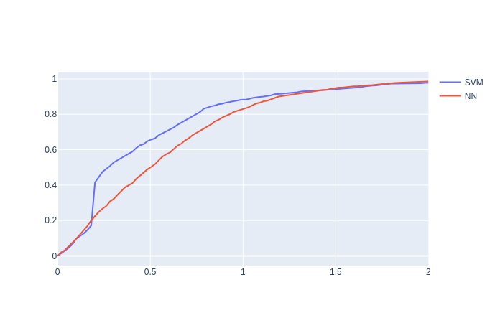
Results: REC white wine
SVM (rbf)
  MAE: 0.491
  ACC(T=1): 0.882
NN (relu)
  MAE: 0.599
  ACC(T=1): 0.827

Slide 13
Final considerations
target quality score is subjective;
results archieved are comparable or better than the available literature based on the dataset;
with more computational power: bigger grid search can increase the NN performance.

