Slide 1
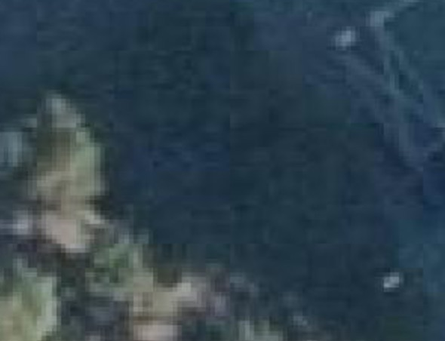
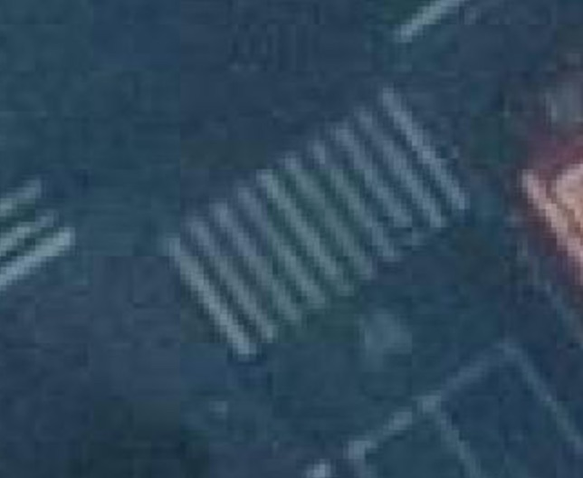
y=-1
(“No Crossing”)
y=1
(“Crossing”)

