Slide 1
Three Components of Machine Learning
Alexander Jung
Assistant Professor
Department of Computer Science
Aalto University

Slide 2
Data
Loss
Hypothesis
Space

Slide 3
Data

Slide 4
Data = (Large) Set of “Data Points”
data points are different objects but which are of similar “type”

Slide 5
Data Point = Atomic Unit of Information
highly abstract concept
data points can represent persons
data points can represent realizations of random variables
data points can represent sets of data points
ML methods require sufficient amount of data points

Slide 6
Features and Labels
data points often have many different properties
features=properties that can be measured/computed easily
labels=properties that are “difficult” to determine
labels are higher-level facts or quantities of interest
labels can often be determined only in hindsight
determining labels might require human (domain) experts

Slide 7

Data Point = “Some Photo”
features could include:
red, green, blue intensities of pixels
timestamp of photo
location of photo shot
identity of photographer
label:
hiking duration for the photographer
to reach mountain peak

Slide 8
Data Point = “Some Person”
features:
name
healthcare records
credit card transactions
social media posts
genetic fingerprint
fingerprint
travel history
label:
how likely will person need intensive care next week?

Slide 9
Data Point = “Some Dataset”
features:
number of data points
what type of features are used for data points
what label is used for data points
label:
can label value be predicted well from features?

Slide 10
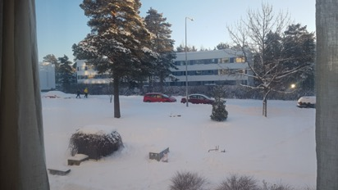
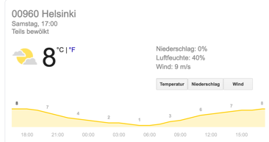


Data Point = “Some Ski-Day Ahead”
features:
snapshot in the morning
morning temperature
weather forecast
label:
maximum daytime temperature (important for ski waxing)

Slide 11
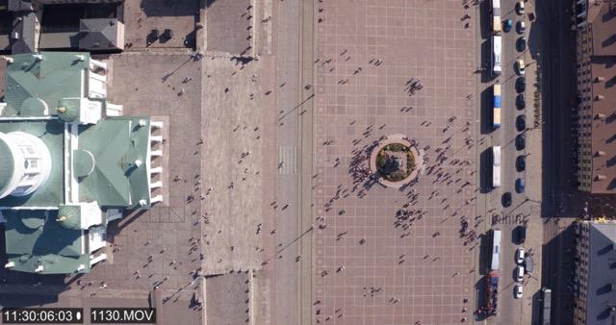
Data Point = “Somewhere in Helsinki”
features:
coordinates of place
city building maps
current traffic statistics
CET time
drone video
label:
how many people are currently at this place ?

Slide 12
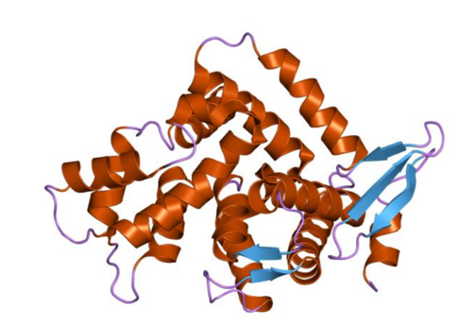
Data Point = “Some Protein”
features:
protein structure
physical measurements
scientific papers about this protein
label:
is the protein toxic?

Slide 13

Data Point = “Some Plant”
features:
plant species
RGB image
multi-spectral image
ambient temperature
label:
does the plant need more water?

Slide 14
Hypothesis Space

Slide 15
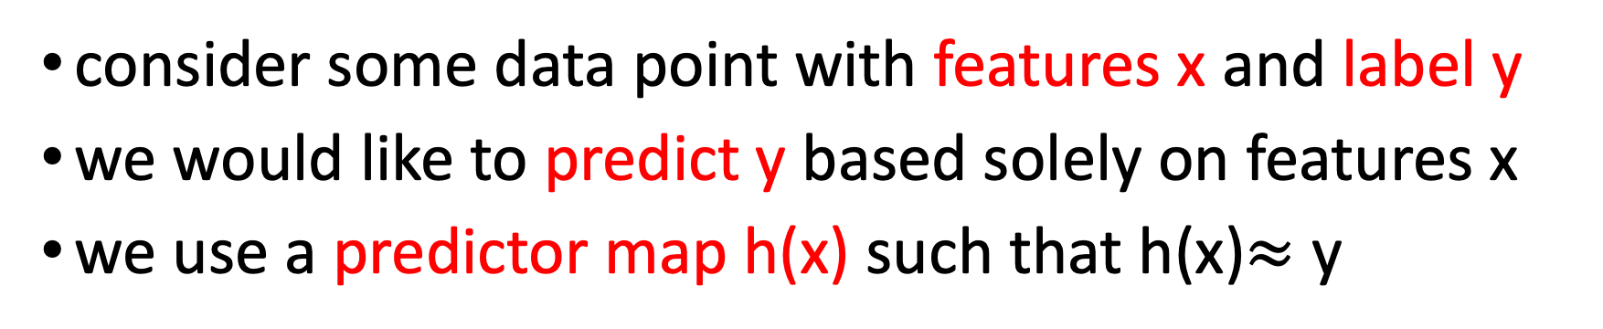
Predictors
consider some data point with features x and label y
we would like to predict y based solely on features x
we use a predictor map h(x) such that h(x)$≈$ y
h(x)
label value
feature x

Slide 16
Hypothesis Space of Predictor Maps
ML is about finding or learning a good predictor
we do not have time to search over all possible maps
there are simply too many of them
restrict to a subset of predictor maps (“hypothesis space”)
h(x)
hypothesis space consisting
of two predictor maps
h(x) and h’(x)
label value
h’(x)
feature x

Slide 17
Hypothesis Space of Linear Predictors
data points with numeric features
numeric label
linear predictor maps
each predictor defined by weights

Slide 18
Hypothesis Space of Linear Predictors
label value
each linear predictor is
defined by the weights !
feature x

Slide 19
Hypothesis Space of Decision Trees
represent predictor map by flow chart (“decision tree”)
input feature x
yes
no

Slide 20
Hypothesis Space of Decision Trees
label value
feature x

Slide 21
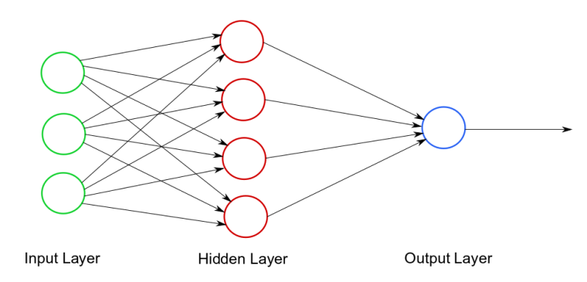
Hypothesis Space of Artificial Neural Networks
weights w

Slide 22
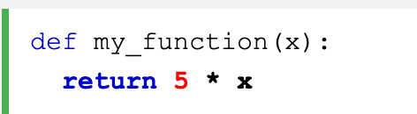
Hypothesis Space of Python Functions
2 *
6 *

Slide 23
Loss

Slide 24
How Good is a Predictor?
use h(x) to predict (estimate) label y based on feature x
in general, prediction error h(x)-y is not zero
loss function measures the “size” of prediction error
h(x’)
prediction error h(x) –y
label value
data point with feature x, label y
x
feature value x’

Slide 25
Measuring Error Size via Loss Functions
loss function $ℒ(\hat{y},y$)
loss function is design choice !
prediction error $\hat{y}−y$

Slide 26
The Squared Error Loss
prediction error h(x) -y

Slide 27
The Absolute Error Loss
prediction error h(x) -y

Slide 28
Putting Together the Pieces

Slide 29
Design Choices
what features and labels to use is a design choice
what hypothesis space to use is a design choice
what loss function to use is a design choice
must meet statistical and computational requirements

Slide 30
Statistical and Computational Aspects
squared loss function can be minimized easily
absolute error loss more difficult to minimize
squared error loss sensitive to outliers
absolute error loss robust to outliers

Slide 31
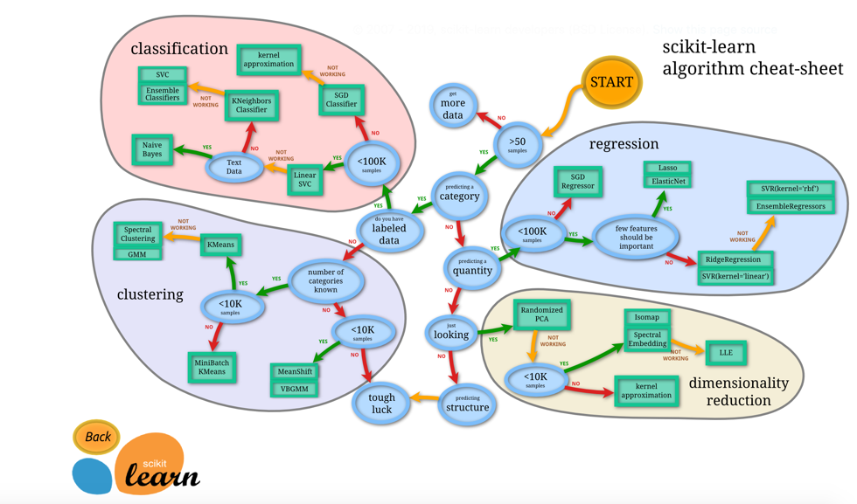
Some Guidance for Design Choices

Slide 32
ID-Card of Linear Least Square Regression
features: real numbers
labels: real number
hypothesis space: linear predictor maps
loss: squared error loss

Slide 33
ID-Card of Deep Learning
features: real numbers
labels: real number
hypothesis space: artificial neural networks
loss: squared error loss

Slide 34
ID-Card of Logistic Regression
features: real numbers
labels: finite number of different classes or categories
hypothesis space: linear predictor maps
loss: logistic loss

Slide 35
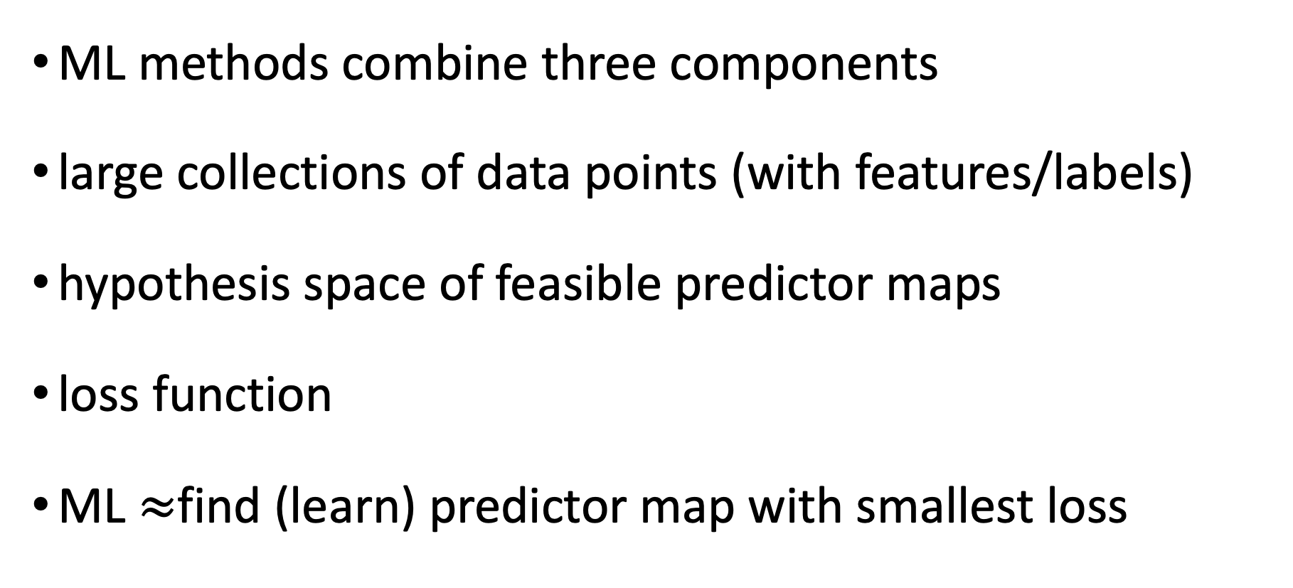
So What ?
ML methods combine three components
large collections of data points (with features/labels)
hypothesis space of feasible predictor maps
loss function
ML $≈$find (learn) predictor map with smallest loss

Slide 36


ML = Optimization Problem
ML methods are loss minimization techniques
complexity depends on hypo. space and loss function
lin. predictors + sq. error loss -> convex problem
non-lin. pred. + sq. err loss -> non-convex problem
lin. predictors + 0/1 loss -> non-convex problem

Slide 37
