Slide 1
Advanced Certificate Program in Generative AI - December 2023 Vu Tuan Anh
1

Slide 2
Requirements of the topic: Build Mr.HelpMate
2

Slide 3
Requirements of the topic: Build Mr.HelpMate
Build Mr.HelpMate AI with:
The Embedding Layer: The PDF document needs to be effectively processed, cleaned, and chunked for the embeddings. Here, the choice of the chunking strategy will have a large impact on the final quality of the retrieved results. So, make sure that you try out various stratgies and compare their performances. Another important aspect in the embedding layer is the choice of the embedding model. You can choose to embed your chunks using the OpenAI embedding model or any model from the SentenceTransformers library on HuggingFace.
The Search Layer: Here, you first need to design at least 3 queries against which you will test your system. You need to understand and skim through the document, and accordingly come up with some queries, the answers to which can be found in the policy document. Next, you need to embed the queries and search your ChromaDB vector database against each of these queries. Implementing a cache mechanism is also mandatory. Finally, you need to implement the re-ranking block, and for this you can choose from a range of cross-encoding models on HuggingFace.
The Generation Layer: In the generation layer, the final prompt that you design is the major component. Make sure that the prompt is exhaustive in its instructions, and the relevant information is correctly passed to the prompt. You may also choose to provide some few-shot examples in an attempt to improve the LLM output.
3

Slide 4
Objectives of Build Mr.HelpMate
4

Slide 5
Objectives
Project Goals: HelpMate AI Search System
Developing a Semantic Search System:
Employ the INS process encompassing three layers: Embedding Layer, Search and Rank Layer, and Generation Layer to enhance document retrieval efficiency.
Extracting Information from PDF Documents:
Extract data from PDF documents and store it in a structured format. Subsequently, generate vector representations using the SentenceTransformerEmbedding all-MiniLM-L6-v2 model to facilitate search and analysis.
Implementing a Cache Layer to Improve System Performance:
Integrate a cache layer to enhance system performance by storing and retrieving previous queries along with their results. Consequently, minimize processing time for recurring similar queries.
3

Slide 6
Architectural Design of Build Mr.HelpMate
4

Slide 7
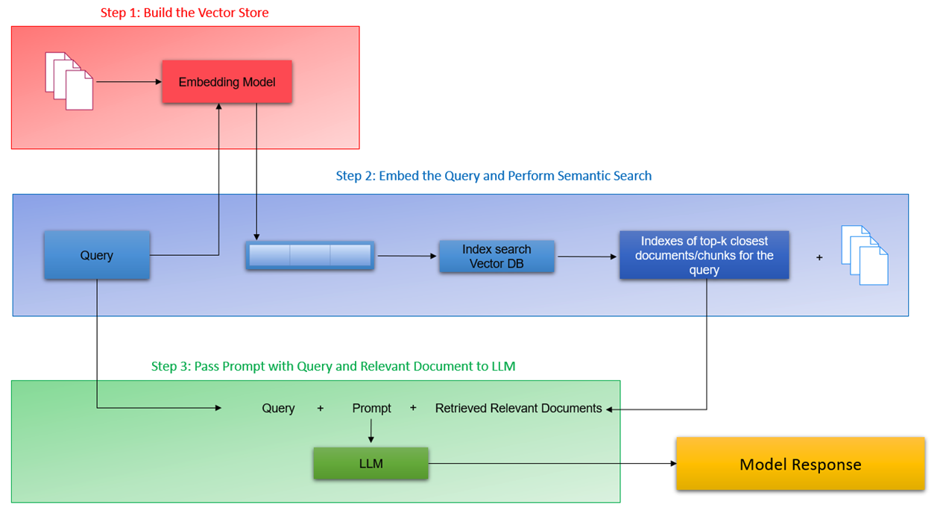
Architectural Design
4

Slide 8
Architectural Design
The INS pipeline is a system designed to process user queries and provide informative answers by leveraging a knowledge base and a large language model (LLM). Here's a breakdown of its three key layers:
1. Building the Vector Store (Embedding Layer):
- This is the foundation of the pipeline, where the system processes textual information from documents.
- Documents are first broken down into smaller chunks.
- Each chunk is then fed into an embedding model, which transforms the text into a numerical representation (vector).
- This vector captures the semantic meaning of the text, allowing for efficient comparisons later.
- Embedding Model: Choose between OpenAI's embedding model and SentenceTransformers from HuggingFace. Assess the impact of the selected model on the quality of vector representations.
2. Search and Rank Layer:
- This layer acts like a search engine for the knowledge base.
- When a user enters a query, the system searches the vector store (created in Layer 1) for documents or chunks that are semantically similar to the query.
- Essentially, it finds the information in the knowledge base that best matches the user's question.
- The output of this layer is a list containing the top K most relevant documents or chunks (along with their locations within the knowledge base) based on their semantic similarity to the query.
3. Generation Layer:
- This layer takes the user's original query, the top retrieved results from the search layer (containing relevant information), and a well-crafted prompt as inputs for the LLM.
- The LLM, a powerful language model trained on massive amounts of text data, then uses this information to generate a response.
- With the context provided by the query, retrieved information, and the prompt, the LLM can create a comprehensive and coherent answer that directly addresses the user's question while incorporating relevant details from the knowledge base.
- In summary, the INS pipeline acts as a bridge between user queries and the knowledge base. It efficiently retrieves relevant information and leverages an LLM to generate informative and user-friendly answers.
5

Slide 9
Implement for Build Mr.HelpMate
4

Slide 10
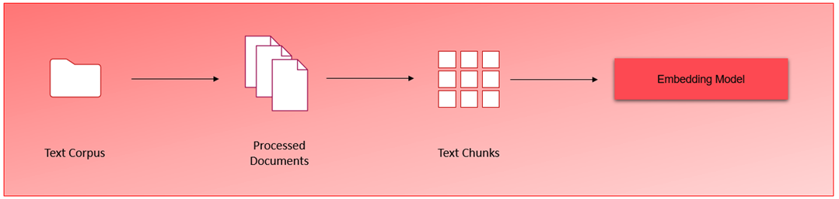
1. Building the Vector Store (Embedding Layer) 1.1. Extensive pre-processing precedes text corpus processing
Build the vector store
The Embedding Layer process is complex and involves several detailed pre-processing steps. Initially, we process the documents, which in this context are related to the insurance sector. This involves extracting text from the documents, dividing it into smaller segments, and subsequently feeding these segments into the embedding model for further processing.
5

Slide 11
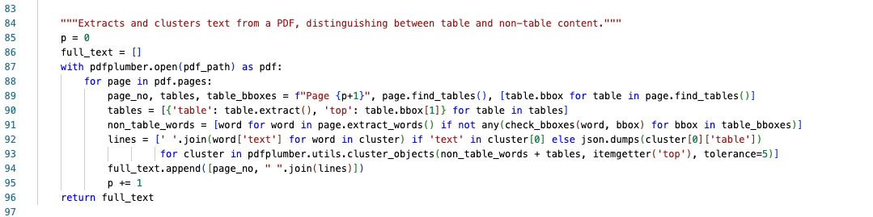
1. Building the Vector Store (Embedding Layer) 1.2. Extracting text from multiple PDFs
# Function to extract text from a PDF file.
# 1. Declare a variable p to store the iteration of the loop that will help us store page numbers alongside the text
# 2. Declare an empty list 'full_text' to store all the text files
# 3. Use pdfplumber to open the pdf pages one by one
# 4. Find the tables and their locations in the page
# 5. Extract the text from the tables in the variable 'tables'
# 6. Extract the regular words by calling the function check_bboxes() and checking whether words are present in the table or not
# 7. Use the cluster_objects utility to cluster non-table and table words together so that they retain the same chronology as in the original PDF
# 8. Declare an empty list 'lines' to store the page text
# 9. If a text element in present in the cluster, append it to 'lines', else if a table element is present, append the table
# 10. Append the page number and all lines to full_text, and increment 'p'
# 11. When the function has iterated over all pages, return the 'full_text' list
5

Slide 12
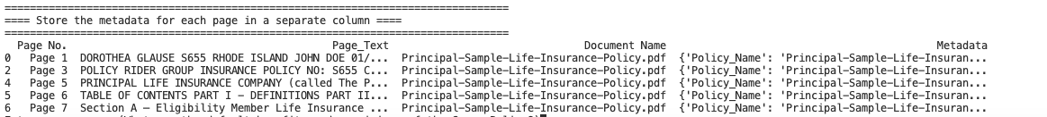
1. Building the Vector Store (Embedding Layer) 1.3. Store the metadata for each page in a separate column
We can now execute the embeddings on individual pages, a strategy that is advantageous for two main reasons:
Insurance documents are typically structured in a way that minimizes irrelevant content on each page, ensuring that all text segments within a page are closely related.
By using larger chunk sizes, we can provide the language model with sufficient context during the generation layer, facilitating more accurate and relevant outputs.
5

Slide 13
1. Building the Vector Store (Embedding Layer) 1.4. Generate and Store Embeddings using OpenAI and ChromaDB
The INS pipeline is a system designed to process user queries and provide informative answers by leveraging a knowledge base and a large language model (LLM). Here's a breakdown of its three key layers:
1. Building the Vector Store (Embedding Layer):
- This is the foundation of the pipeline, where the system processes textual information from documents.
- Documents are first broken down into smaller chunks.
- Each chunk is then fed into an embedding model, which transforms the text into a numerical representation (vector).
- This vector captures the semantic meaning of the text, allowing for efficient comparisons later.
- Embedding Model: Choose between OpenAI's embedding model and SentenceTransformers from HuggingFace. Assess the impact of the selected model on the quality of vector representations.
5

Slide 14
Architectural Design
The INS pipeline is a system designed to process user queries and provide informative answers by leveraging a knowledge base and a large language model (LLM). Here's a breakdown of its three key layers:
1. Building the Vector Store (Embedding Layer):
- This is the foundation of the pipeline, where the system processes textual information from documents.
- Documents are first broken down into smaller chunks.
- Each chunk is then fed into an embedding model, which transforms the text into a numerical representation (vector).
- This vector captures the semantic meaning of the text, allowing for efficient comparisons later.
- Embedding Model: Choose between OpenAI's embedding model and SentenceTransformers from HuggingFace. Assess the impact of the selected model on the quality of vector representations.
2. Search and Rank Layer:
- This layer acts like a search engine for the knowledge base.
- When a user enters a query, the system searches the vector store (created in Layer 1) for documents or chunks that are semantically similar to the query.
- Essentially, it finds the information in the knowledge base that best matches the user's question.
- The output of this layer is a list containing the top K most relevant documents or chunks (along with their locations within the knowledge base) based on their semantic similarity to the query.
3. Generation Layer:
- This layer takes the user's original query, the top retrieved results from the search layer (containing relevant information), and a well-crafted prompt as inputs for the LLM.
- The LLM, a powerful language model trained on massive amounts of text data, then uses this information to generate a response.
- With the context provided by the query, retrieved information, and the prompt, the LLM can create a comprehensive and coherent answer that directly addresses the user's question while incorporating relevant details from the knowledge base.
- In summary, the INS pipeline acts as a bridge between user queries and the knowledge base. It efficiently retrieves relevant information and leverages an LLM to generate informative and user-friendly answers.
5

Slide 15
Architectural Design
The INS pipeline is a system designed to process user queries and provide informative answers by leveraging a knowledge base and a large language model (LLM). Here's a breakdown of its three key layers:
1. Building the Vector Store (Embedding Layer):
- This is the foundation of the pipeline, where the system processes textual information from documents.
- Documents are first broken down into smaller chunks.
- Each chunk is then fed into an embedding model, which transforms the text into a numerical representation (vector).
- This vector captures the semantic meaning of the text, allowing for efficient comparisons later.
- Embedding Model: Choose between OpenAI's embedding model and SentenceTransformers from HuggingFace. Assess the impact of the selected model on the quality of vector representations.
2. Search and Rank Layer:
- This layer acts like a search engine for the knowledge base.
- When a user enters a query, the system searches the vector store (created in Layer 1) for documents or chunks that are semantically similar to the query.
- Essentially, it finds the information in the knowledge base that best matches the user's question.
- The output of this layer is a list containing the top K most relevant documents or chunks (along with their locations within the knowledge base) based on their semantic similarity to the query.
3. Generation Layer:
- This layer takes the user's original query, the top retrieved results from the search layer (containing relevant information), and a well-crafted prompt as inputs for the LLM.
- The LLM, a powerful language model trained on massive amounts of text data, then uses this information to generate a response.
- With the context provided by the query, retrieved information, and the prompt, the LLM can create a comprehensive and coherent answer that directly addresses the user's question while incorporating relevant details from the knowledge base.
- In summary, the INS pipeline acts as a bridge between user queries and the knowledge base. It efficiently retrieves relevant information and leverages an LLM to generate informative and user-friendly answers.
5

Slide 16
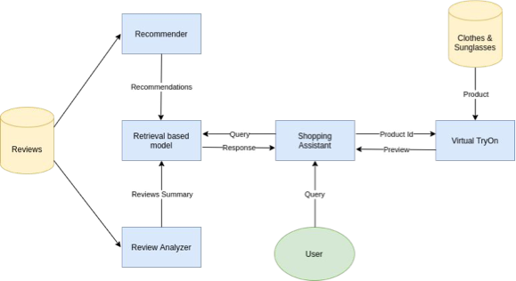
WORKFLOW
4

Slide 17
METHODOLOGY
5

Slide 18
CHATBOT
Retrieval-Based Model for Efficient Responses
The Shopping Assistant utilizes a retrieval-based model to efficiently deliver responses to user queries. This model employs a technique called weighted TF-IDF in conjunction with cosine similarity. Weighted TF-IDF helps identify the most relevant keywords within product descriptions and reviews, while cosine similarity measures the similarity between a user's query and these keywords. This combined approach allows the Shopping Assistant to quickly retrieve the closest pre-defined response that best addresses the user's needs.
Pre-defined Response Categories
The Shopping Assistant's pre-defined responses fall into four main categories:
Product Recommendations: Suggesting relevant products based on user preferences.
Review Summaries: Providing concise summaries of product reviews to aid informed decisions.
Virtual Try-On Experience: Offering real-time virtual try-on functionality for specific fashion items like T-shirts and sunglasses.
General Conversation: Handling greetings, thanks, and other general conversational interactions.
6

Slide 19
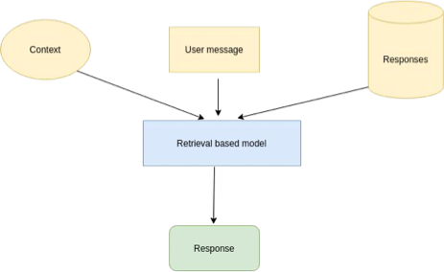
RETRIEVAL BASED MODEL
7

Slide 20
VIRTUAL TRY-ON
8

Slide 21
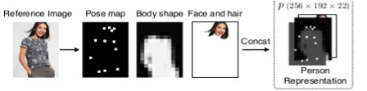
DATA PREPROCESSING
Clothing-Agnostic Person Representation
The GMM (Geometric Matching Module) utilizes a clothing-agnostic person representation to understand the user's body shape and pose. This representation combines three key components:
Pose Heatmap: This is a heatmap generated using the "OpenPose" library. It captures the location and intensity of 18 key body joints, providing information about the user's posture.
Body Mask: This is a single-channel binary mask that identifies different body parts. It essentially acts as a segmentation map, separating the body from the background.
Reserved Regions: This is a three-channel RGB image that preserves the user's face and hair. This information is crucial to maintain a realistic appearance in the final try-on image.
9

Slide 22
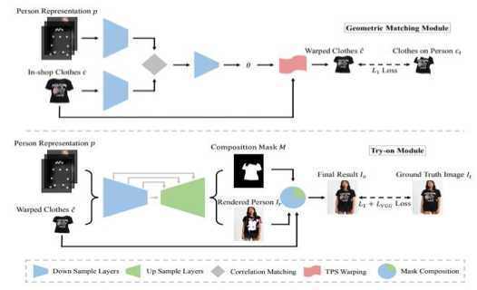
VIRTUAL TRY-ON ARCHITECTURE
10

Slide 23
VIRTUAL TRY-ON ARCHITECTURE
The architecture consists of two main components:
Geometric Matching Module (GMM): This module transforms the target garment into a warped form that aligns with the person's body shape and pose.
Try-On Module (TOM): This module integrates the warped garment with the image of the target person and synthesizes the final try-on image:
- Mainly consists of changed to consists of for a more concise structure.
- Cloth changed to garment for a more specific term in clothing.
- Warped cloth changed to warped form for improved readability.
- Try-on result changed to try-on image for a more specific output.
11

Slide 24
GEOMETRIC MATCHING MODULE (GMM)
12

Slide 25
GEOMETRIC MATCHING MODULE (GMM)
GMM is used to transform the target clothing c into a warped version ĉ that is roughly aligned with the input person representation p. GMM consists of four main components:
Feature Extraction Networks: Two separate neural networks are used to extract high-level features from the target clothing c and the person representation p. These networks utilize downsampling convolutional layers to achieve this.
Correlation Layer: The extracted features from both networks are combined into a single tensor using a correlation layer. This combined tensor is then fed into the regressor network.
Regressor Network: This network predicts the spatial transformation parameters, denoted by θ. These parameters define how the target clothing needs to be warped.
Thin-Plate Spline (TPS) Transformation Module: This module utilizes the predicted parameters θ to warp the target clothing c into the final output ĉ. The transformation is achieved using the Thin-Plate Spline (TPS) method.
13

Slide 26
Try-On Module (TOM)
14

Slide 27

Try-On Module (TOM)
The Try-On Module (TOM) acts as a synthesizer, not a generator, to create the final output image. This image represents the desired clothing virtually "tried on" by the input person.
- Architecture: TOM utilizes an encoder-decoder architecture similar to U-Net. This architecture takes a concatenated input of the person representation p and the warped clothing ĉ.
- Image Rendering and Mask Prediction: The network simultaneously renders a person image and predicts a segmentation mask denoted by M. This mask defines the regions where the warped clothing and the person image should be combined.
- Image Synthesis: Finally, the rendered person image. and the warped clothing ĉ are fused together using the segmentation mask M to synthesize the final try-on image . This is achieved using the following formula:
15

Slide 28
DATASET
16

Slide 29
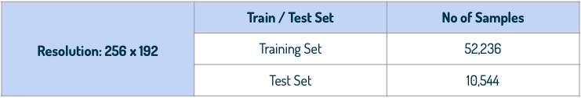
DATASET
The dataset used for training the model is MPV (Multi-Pose Virtual Try-on).
It contains 37,723 images of people in various poses, along with 14,360 corresponding clothing images. All images have a resolution of 256x192 pixels.
17

Slide 30
TRAINING
18

Slide 31

TRAINING
The GMM module was trained using the pixel-wise L1 loss between the warped result ĉ and ground truth (ct).
TOM is trained adversarially in competition with a discriminator. This discriminator receives three inputs: the TOM result image (Io), the input clothing image (c), and the person representation (p). The discriminator's task is to distinguish whether the resulting image (Io) is a realistic try-on image or a fake one generated by TOM.
- Optimizer used : Adam
- Final loss of generator on validation : 3.62001
- Final loss of discriminator on validation: 0.003821
19

Slide 32
VISUALISATION
20

Slide 33

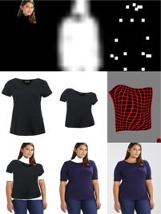
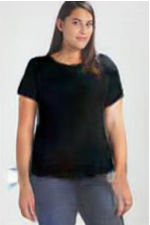



VISUALISATION
Person
GMM result
TOM result
Cloth
21

Slide 34
VIRTUAL TRY-ON OF SUNGLASSES
22

Slide 35
VIRTUAL TRY-ON OF SUNGLASSES
Leverages the Jeeliz library: This library enables real-time face detection and placement of virtual glasses frames onto the user's face, creating an augmented reality (AR) experience.
Minimal Latency: The system operates with very low latency, delivering near real-time performance for a smooth user experience.
Versatile Functionality: The underlying technology can be easily adapted to support virtual try-on for other facial wearables such as masks, jewelry, and caps.
23

Slide 36
REVIEW ANALYSIS
24

Slide 37
REVIEW ANALYSIS
The system employs a multi-step process to generate concise and informative review summaries:
Data Preprocessing: We leverage the NLTK library to pre-process the raw review data obtained from an online shopping website. This preprocessing step involves removing unnecessary words such as articles (a, an, the) and prepositions (in, on, at, etc.) to focus on the core content of the reviews.
Noun Phrase Extraction: An inbuilt tokenizer is utilized to identify relevant nouns and noun phrases within the preprocessed reviews. These phrases typically describe the consumer's experience with the product.
Sentence Scoring: The system assigns a score to each sentence based on the frequency of these relevant nouns and noun phrases within the sentence. Sentences containing more frequently occurring product-related words receive higher scores.
Summary Generation: Finally, the system ranks the sentences based on their calculated scores. The sentences with the highest scores are then compiled to form the final review summary. This approach ensures that the summary captures the most important aspects of the user reviews.
25

Slide 38
RECOMMENDER SYSTEM
26

Slide 39
RECOMMENDER SYSTEM
Product Recommendation System
This module utilizes a collaborative filtering approach to recommend products to users. The system relies on a dataset containing user ratings for various products.
Here's how it works:
Similarity Calculation: The system employs the Pearson Correlation Coefficient (PCC) to measure the similarity between users based on their past product ratings. Users with high PCC scores are considered to have similar preferences.
Recommendation Generation: For a specific user, the system identifies users with high PCC scores, essentially finding users with similar tastes. Products that these similar users have highly rated are then recommended to the target user. This approach leverages the idea that users with similar preferences are likely to find similar products appealing.
27

Slide 40
WORKING PROTOTYPE
28

Slide 41
WORKING PROTOTYPE
See it in action!
Demo Video: https://www.youtube.com/watch?v=o7hb1808GUE
Code and Setup Instructions: https://github.com/MrVuTuanAnh/GEN_AI
29

Slide 42
SCREENSHOTS
30

Slide 43
SCREENSHOTS
Available at:
https://github.com/MrVuTuanAnh/GEN_AI/tree/main/screenshots
31

Slide 44
TECH STACK
32

Slide 45
TECH STACK
Frontend: React.js - Leverages a virtual DOM for efficient rendering and simplifies complex UI creation.
Backend: FastAPI - This high-performance Python framework streamlines web server development and facilitates seamless Machine Learning model integration.
Virtual Try-On: PyTorch - Chosen for its dynamic computational graph, ideal for this application.
Natural Language Processing (NLP): NLTK - Provides pre-trained models and extensive data corpora, enabling swift and effortless text processing and analysis.
Deployment: Docker & Docker Compose - Ensure application portability by containerizing both the web application and server.
33

Slide 46
API DOCUMENT
34

Slide 47
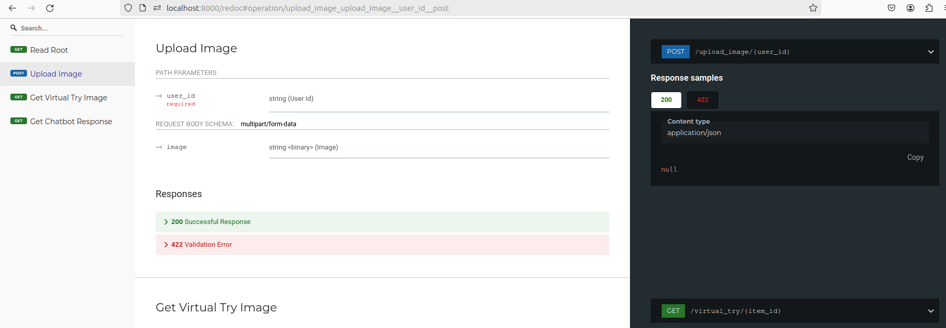
API DOCUMENT
Upload Image API: http://localhost:8000/redoc#operation/upload_image_upload_image__user_id_post
35

Slide 48
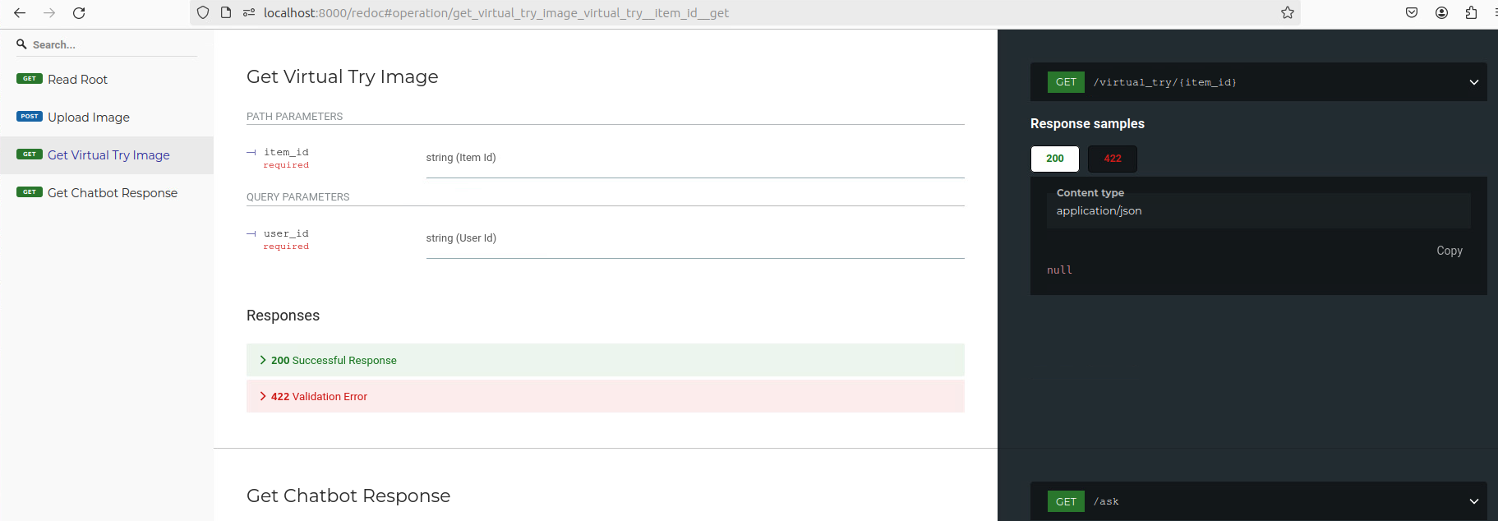
API DOCUMENT
Get Virtual Try Image API: http://localhost:8000/redoc#operation/get_virtual_try_item_id_get
36

Slide 49
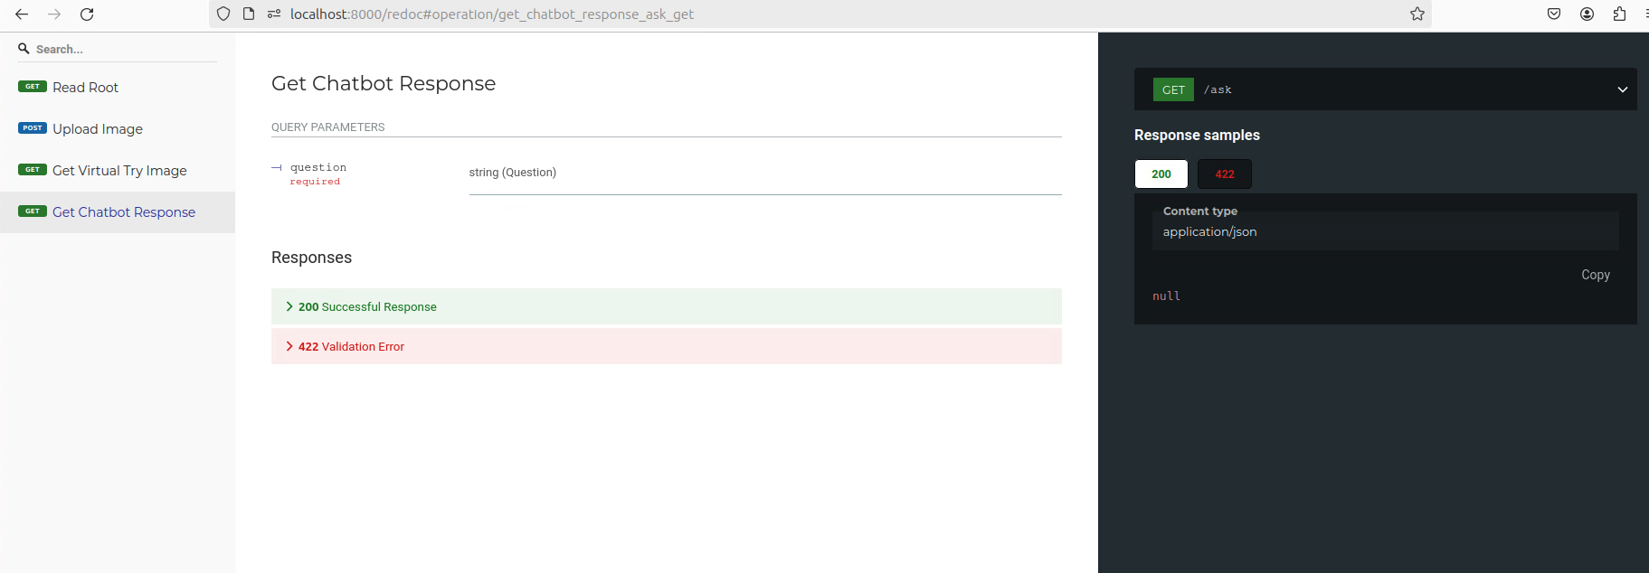
API DOCUMENT
Get Chatbot Response API: http://localhost:8000/redoc#operation/get_chatbot_response_ask_get
37

Slide 50
EXTENT OF SCALABILITY
38

Slide 51
EXTENT OF SCALABILITY
Our application leverages Docker containers for easy scaling. Spinning up new containers to handle increased service capacity takes mere seconds. Additionally, Kubernetes can be integrated for automatic scaling of these Docker containers across multiple hosts, providing horizontal scaling for the application.
Furthermore, our initial use of JSON data files allows for a smooth transition to a NoSQL database like MongoDB. By creating multiple replicas of the database, we can achieve horizontal scaling, ensuring the system can accommodate a growing user base.
39

Slide 52
IMPACT
40

Slide 53
IMPACT
The shopping assistant offers a multitude of benefits for both users and retailers:
Enhanced Shopping Experience: Users can enjoy a more convenient and personalized shopping experience.
Increased Safety: By enabling virtual try-on and reducing the need for physical store visits, the platform promotes safety during pandemics or for those seeking a contactless shopping experience.
Boosted Platform Engagement: The interactive features of the shopping assistant can lead to increased user engagement on the platform.
Reduced Costs: Both retailers and customers can save money by minimizing returns and exchanges facilitated by the virtual try-on functionality.
Eliminated Infrastructure Expenses: Retailers can avoid the significant costs associated with setting up physical trial rooms or showrooms.
Time-Saving Efficiency: The shopping assistant allows users to shop efficiently, saving valuable time.
Increased Sales: By streamlining the shopping experience and offering a more engaging platform, the shopping assistant can contribute to increased sales for retailers.
41

Slide 54
Future Enhancements
42

Slide 55
Future Enhancements
The shopping assistant has the potential for further development in several areas:
Improved Chatbot Responses: Integration of generative models can enhance the chatbot's ability to provide more precise and informative responses.
Natural Language Interaction: Speech-to-text and voice synthesis functionalities can be incorporated to create a more natural and interactive user experience.
Mobile App Development: Expanding accessibility through a mobile application that communicates with the existing server.
Automated Review Summarization: Utilizing web workers to run the product review summarization script at regular intervals, ensuring up-to-date summaries.
Multilingual Support: Catering to a wider audience by enabling the chatbot to interact in multiple languages.
Reduced Latency in Virtual Try-On: Leveraging GPUs can potentially reduce the processing time for virtual try-on, leading to a smoother user experience.
43

Slide 56
THANH YOU !!!
44

