Slide 1

An Inventory management system
By Morgan Lewis Walsh

Slide 2

Project scope
The IMS project aims for:
Version Control integration, using Agile and the Feature-Branch model.
Kanban board with user stories and task completed throughout the project.
A relational SQL database for persistent data storage, with at least three tables, and their relationships modelled via an Entity Relation Diagram (ERD).
A functional ‘back-end’ to the application that follows best practice and design principles in OOP, meeting the Kanban board requirements.
A functional application build, with dependencies included, produced via an integrated build tool.
Unit tests to validate the application, with an aim of 80% test coverage.

Slide 3

Tech Requirements
Technology Type | Technology Name
Version Control System (VCS) | Git
Source Code Management | GitHub
Kanban Board | Jira
Database Management System | GCP MySQL instance
Back-end Language | Java
Build Tool | Maven
Unit Testing | JUnit

Slide 4
Where did I start… sprint 1
Deciding where to start is tricky!
After forking the IMS starting point repository from Nick Johnsons GitHub, I decided to follow the laid out milestones, and with this I created my Jira board and added the milestones as tasks and user stories.
At this stage, I created my Risk Assessment and ERD, then placed them within my project repositories root.
Afterwards, I created my GCP SQL instance in preparation for the future.
My first Sprint

Slide 5
Risk assessment
RISK | RISK STATEMENT | RESPONSE STRATEGY | OBJECTIVES | LIKELIHOOD | IMPACT | RISK LEVEL
Autism/Social communicative factors | As I am on the autistic spectrum, this can affect my ability to accurately report how I am doing which can slow progression. | Telling my tutors about this and look into having regular self-mediated progress checks into my projects progression via Jira. | Reduce the impact autism spectrum disorder may have on my work. | High | Medium | Medium
GitHub | Documentation and code will be publicly available, I should ensure no hard-coded sensitive data remains and no documentation containing sensitive data is available for access. | Double, even triple, checking work before uploading and using stronger usernames and password. | Reduce the likelihood of data theft. Increase layers of protection. | Low | High | High
Hardware Failure | Failure of home-computing equipment could cause me to lose access to data/work produced or corrupt local files. | Ensure backups exist on the cloud. A spare computing machine would also be viable for continuing work. | Reduce the likelihood of losing data. Improve data integrity. | Low | High | Medium
Loss of Internet Connectivity | Losing access to the internet would prevent access to any cloud hosted data/work, thus decreasing productivity. | A mobile router running on a SIM contract could be used for short-term internet access. A mobile phone can be used as a tether to connect to the internet, if mobile data allows. Daily router resets to reset the routers connection to the ISP. | Reduce the impact of losing internet connectivity. | Low | High | High
Cloud Service Provider failure | Just like local storage, cloud storage can suffer from data loss, breaches, etc… This could hugely impact a project if only one backup exists. | Research the cloud storage provider to ensure they use the strong data security systems, and have multiple Availability Zones to maintain zone redundancy. Using multiple providers will also offer multiple backups of work. | Reduce chance of data loss/theft. Ensure redundancy and resilience. | Low | High | High

Slide 6
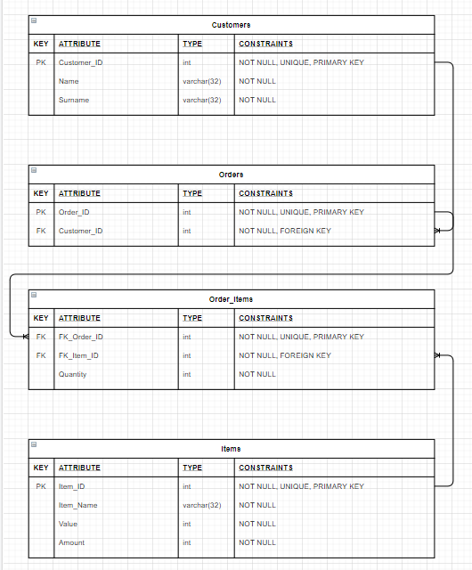
erd

Slide 7
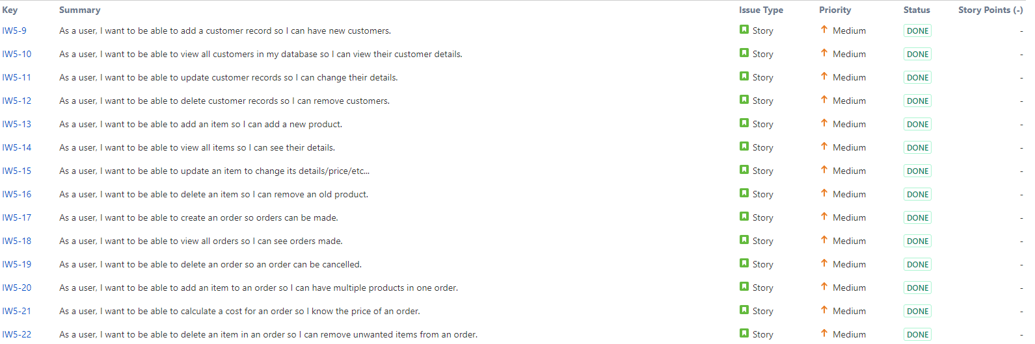
What did I do next… sprint 2
After completing my first Sprint, I created my next Sprint to hard-code my SQL statements in preparation for my system.
This gave me practice with Jira, as I learned to add concise User Stories, and practice with SQL as I wrote my statements.

Slide 8
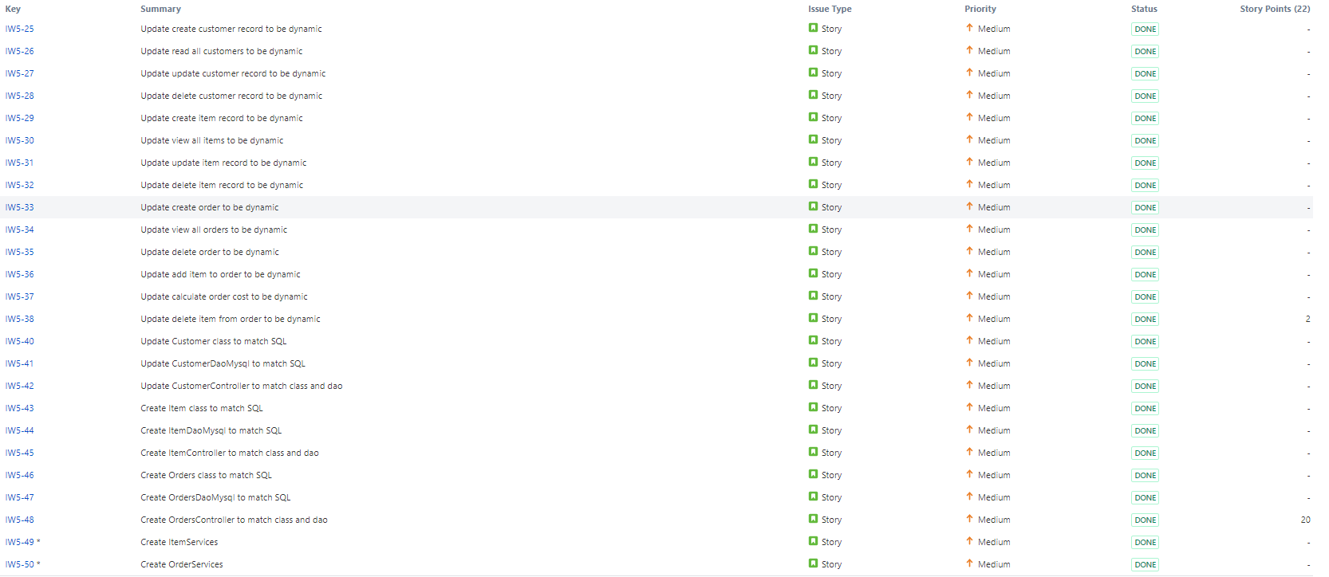
Onto my third sprint, sprint 3
My third Sprint required me to make my SQL statements dynamic, have a Java application using JDBC to communicate with a database, and to take in user input for selecting the right method to query the database.
I ran into many errors here, it took the realisation that I was breaking the single responsibility principle to rectify my mistakes in my Order Controller.

Slide 9
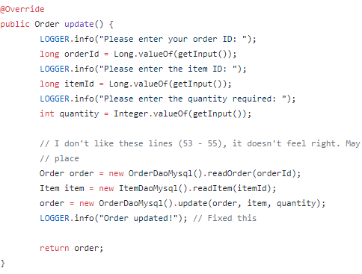
My mistake in my order controller
COMMIT: 88bf01b372 | FILE: ims-starting-point/src/main/java/com/qa/ims/controller/OrderController.java/
Notes:
Disobeying single responsibility, fixed this by placing an Item class instance variable to each instance of Order.

Slide 10
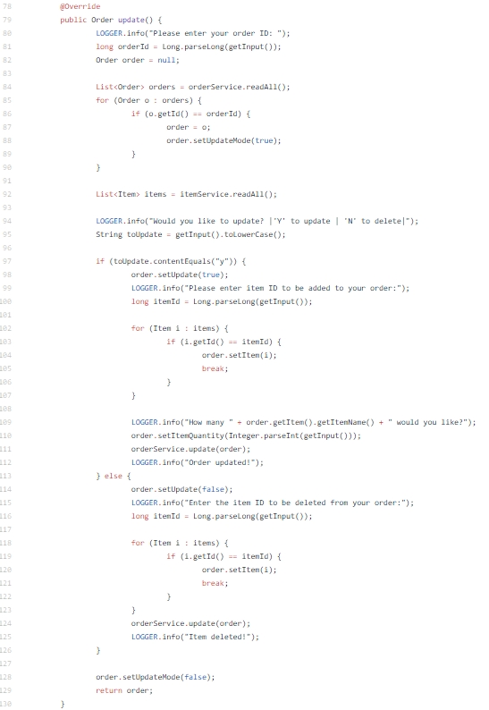
How I fixed my mistake
Luckily, this was a simple fix :D
All it took was obeying the principle of single responsibility, therefore encapsulating relevant services within a single class.
I did this by adding an Item class instance variable to my Order class.

Slide 11
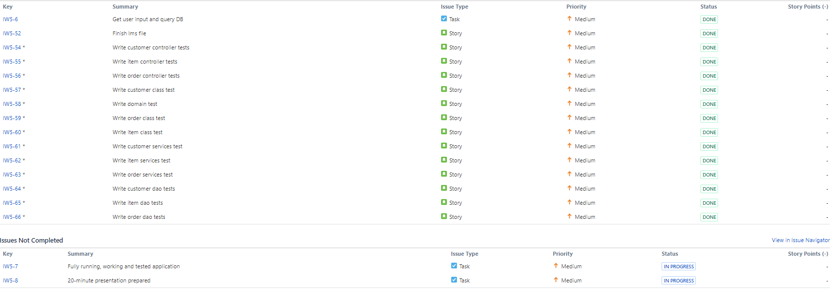
The final sprint, sprint 4
The final leg of the journey, my final sprint. Here, I had to make sure my application functioned correctly via unit testing; thus ensuring correct, and working CRUD functionality.
I used Maven & Surefire to package my application into a JAR file and receive reports in my ‘target’ directory.
Once my unit tests passed, at a coverage of 74.5% (Originally ≈ 81.0%), I started my presentation building.

Slide 12
Time for a project demonstration
I will demonstrate to you:
How my Inventory Management System works (A high-level overview)
My tests running, and a Surefire report.
A quick look at my readme.

Slide 13
What could I have done better
My calculateCost() method did not function as intended, instead returning 0 rather then iterating over the ItemSet as intended. This requires me to improve my debugging abilities, although I quickly managed to solve the problem 30 minutes before the due time :D
At times, I felt like I was not ‘standing on my own two feet’, in the proverbial sense. At other times, I felt like it flew by. I feel this is likely due to not poor, but not great planning and failure to get Planning Poker to function; thus reducing my ability to gauge a tasks difficulty prior to starting.
Testing was a rough process at first, as I struggled to get Mockito functioning.

Slide 14
What went well
I feel my first attempt at a Enterprise style Java Inventory Management System went very well, in the grand scheme of things. The knowledge gained from making mistakes has been very valuable in my learning process.
Although testing was rough at first, upon the discovery that Junit could be used with a test database, I set to work at an astonishing pace; achieving a test coverage of 74.5%.
Even though the I failed to achieve the 80% coverage and calculate cost criteria successfully, I achieved the concept of a Minimal Viable Product (MVP) meeting all other functionality specified in the criteria.

Slide 15

Any Questions?

Slide 16

Thank You for listening
Morgan.walsh@acadamytrainee.com
Trainee digital/software consultant

