Slide 1
SundayCloud
— 前端界面解说

Slide 2
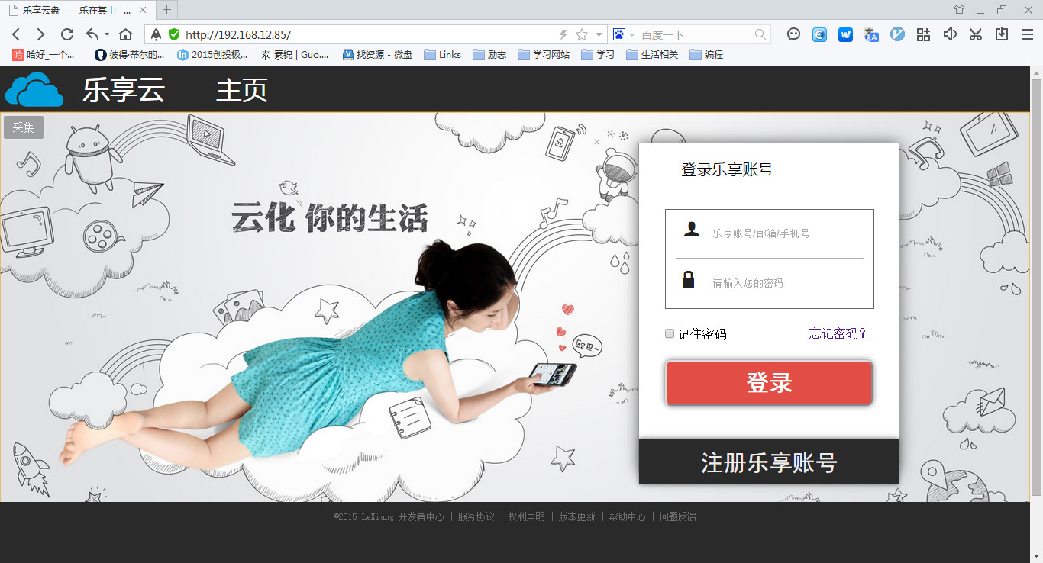
Login.html

Slide 3
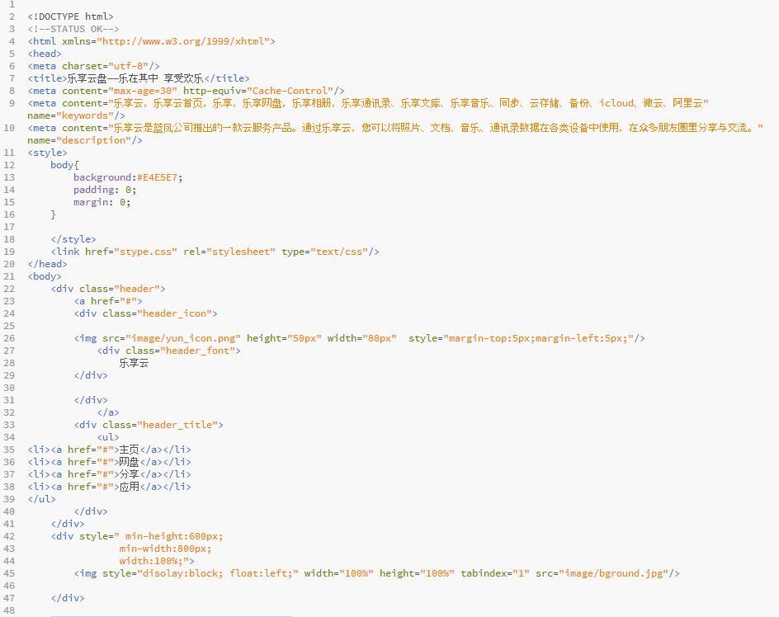
Login.html :

Slide 4
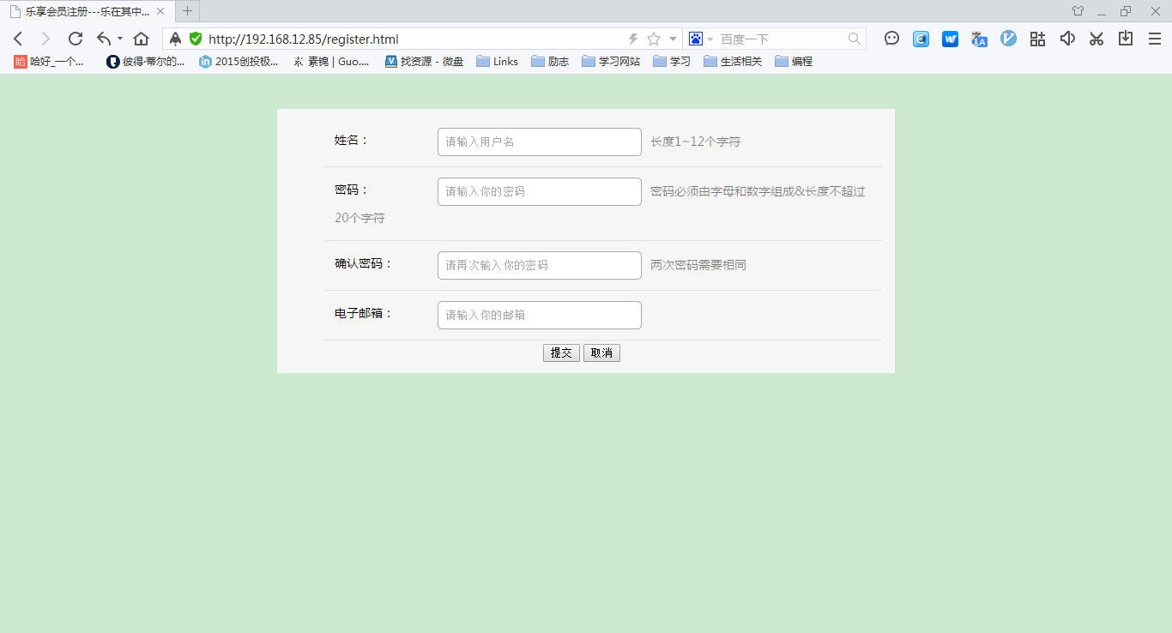
register.html

Slide 5
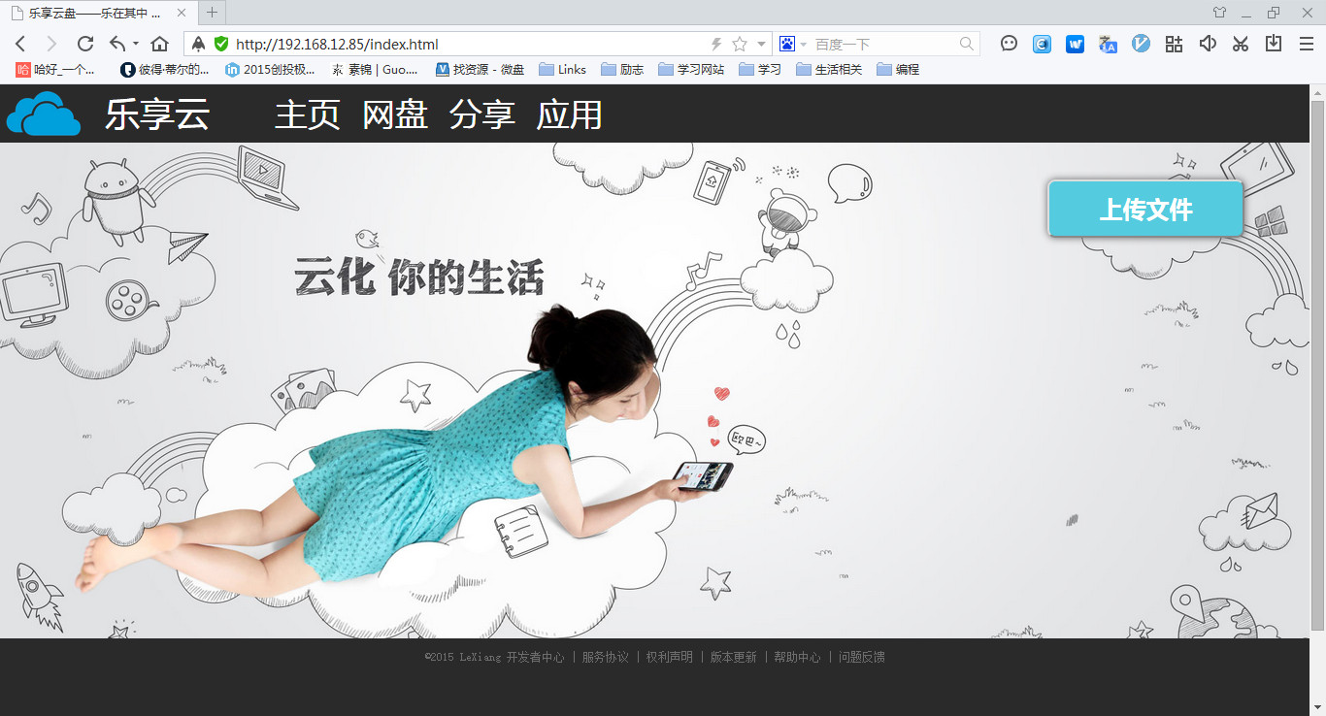
Index.html

Slide 6
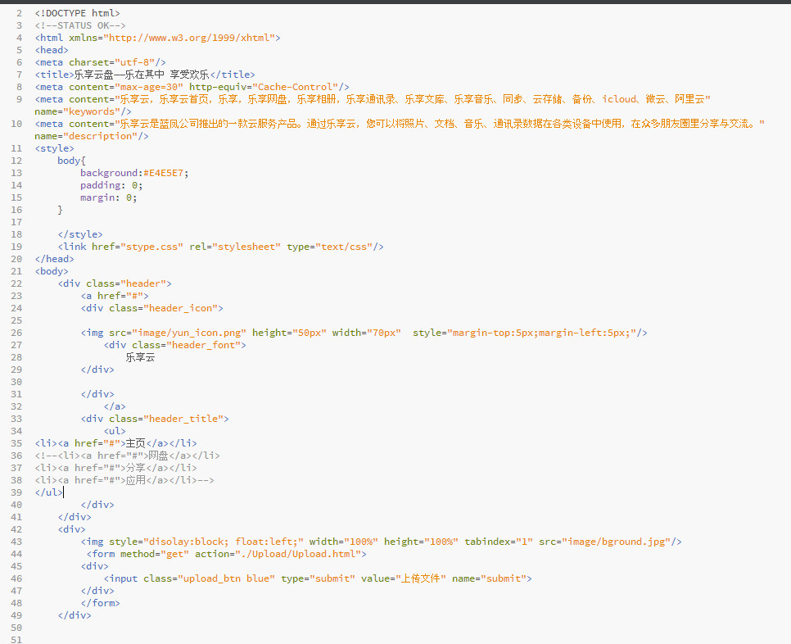
Index.html

Slide 7
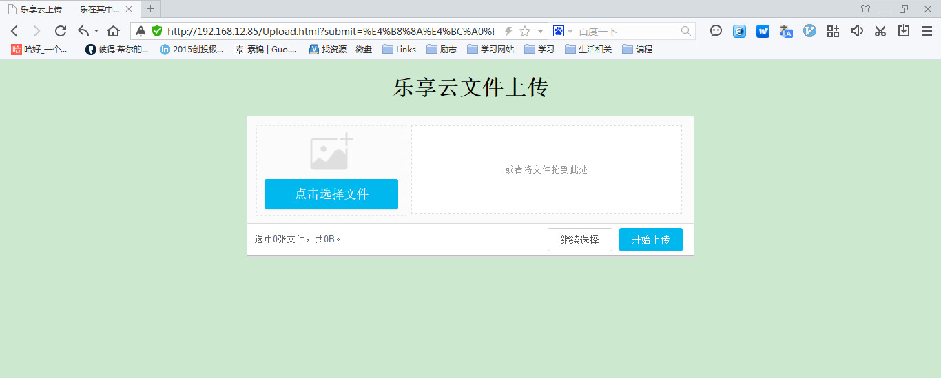
upload.html

Slide 8
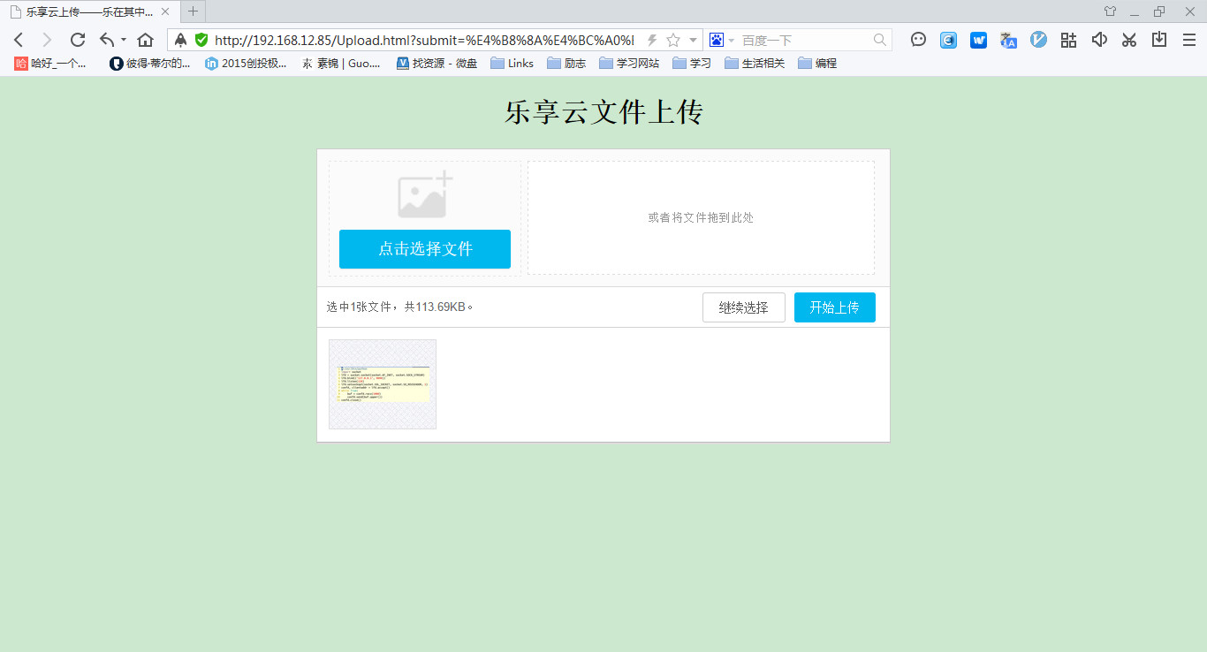
upload.html

Slide 9
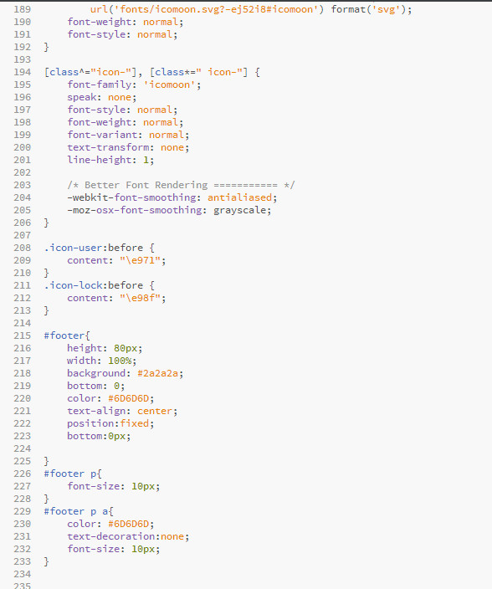
stype.css

Slide 10




数据库：MySQL

Slide 11
谢谢观赏！！

