Slide 1

L&D Recommendations for Ericsson Engineers
Data-Driven Personalization for Workforce Development

Slide 2

AGENDA
> Business CHALLENGE
> DATA FOUNDATION
> KEY INSIGHTS
> solution WALKTHROUGH
> IMPACT & NEXT STEPS
Notes:
5/26/20252011-11-17
2
Ericsson Group Presentation
2011-05-05
LME-11:001143 Uen, Rev B
2
March 2009
2

Slide 3
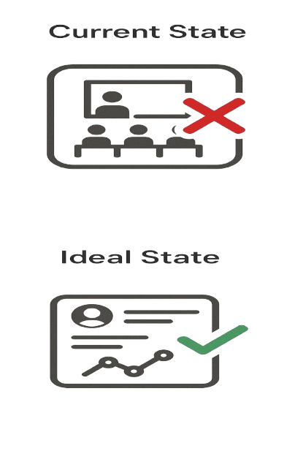
The Problem: One-Size-Fits-All L&D Fails Engineers
Problem 1:
Mid-career engineers (35-44) show 27% lower training completion vs. peers
Problem 2:
62% of skill gaps in cybersecurity go unaddressed for 6+ months
Problem 3:
HR spends 73% of L&D time on manual matching
Notes:
5/26/20252011-11-17
3
Ericsson Group Presentation
2011-05-05
LME-11:001143 Uen, Rev B
3
March 2009
3

Slide 4
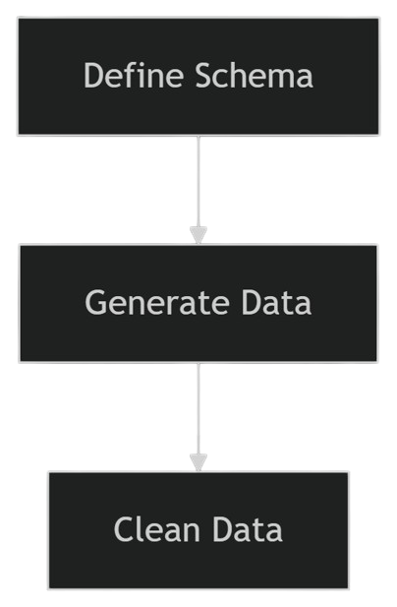
Synthetic Data Creation with Python
Why Python?
Rapid Prototyping
Control over data
Easy CSV export
# Define the fields and data types
data = {
'Employee_ID': range(1, 6001), # 6000 employees
'Age': np.random.randint(18, 60, 6000), # Random ages between 18 and 60
'Career_Stage': np.random.choice(['Entry-Level', 'Mid-Career', 'Senior'], 6000),
'Skills': np.random.choice(['5G', 'AI/ML', 'Cybersecurity', 'Leadership'], 6000),
'Training_Participation': np.random.randint(0, 600, 6000), # Random training participation
'Certifications': np.random.randint(0, 5, 6000), # Random certifications
'Performance_Metrics': np.random.uniform(0, 1, 6000), # Random performance scores
'Skill_Gaps': np.random.choice(['5G', 'AI/ML', 'Cybersecurity', 'Leadership'], 6000)
}

Slide 5
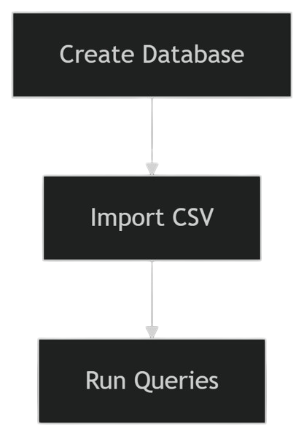
Structured Analysis with SQL
Why SQL?
Fast Aggregations
Handles future data growth
Clear relationships
# Step 2: Create the Engineers table
cursor.execute('''
CREATE TABLE IF NOT EXISTS Engineers (
Employee_ID INTEGER PRIMARY KEY,
Age INTEGER,
Career_Stage TEXT,
Skills TEXT,
Training_Participation INTEGER,
Certifications INTEGER,
Performance_Metrics REAL,
Skill_Gaps TEXT
)
''')
conn.commit()
# Step 3: Import data from CSV df = pd.read_csv('ericsson_engineers.csv') df.to_sql('Engineers', conn, if_exists='replace', index=False)
Career Stage | Avg. Training Hours
Entry | 295.3
Mid | 301.5
Senior | 290

Slide 6
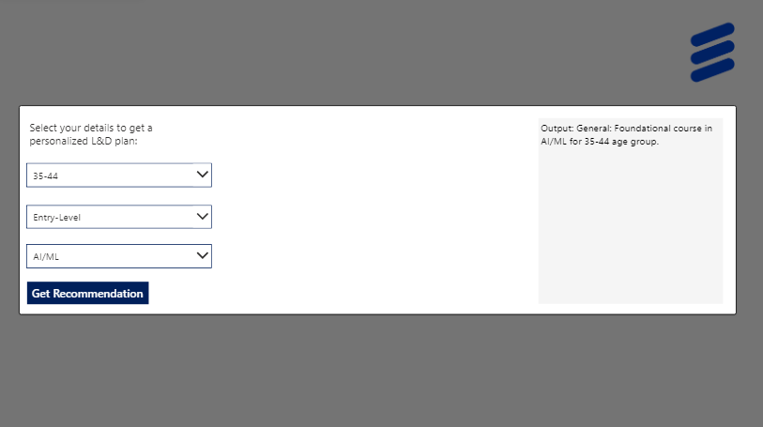
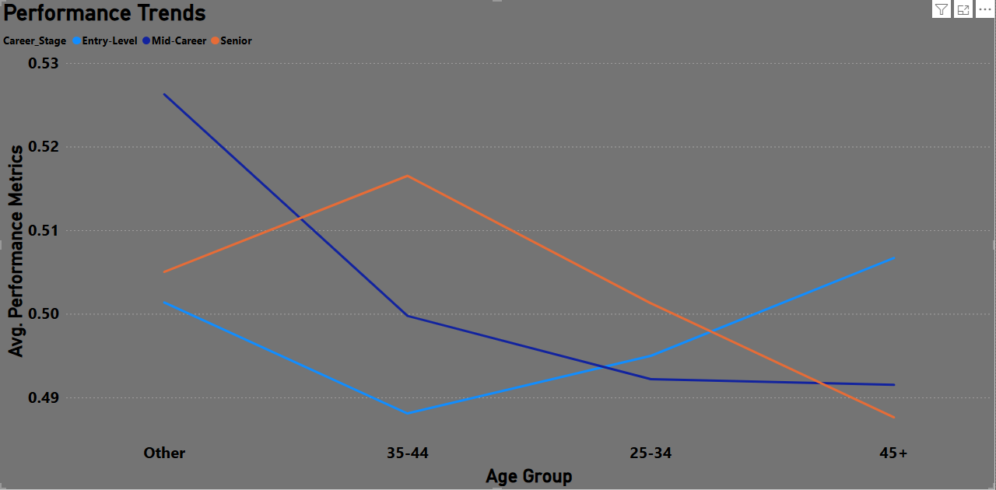
End-to-end Solution: From Data to Decisions
Engineer Inputs
Real-Time Filtering
Power BI Analytics
Personalized Output
Entry-Level Performance is Below Average
Dashboard Insight | Entry-Level Employees Receive Most Training | Leadership Gaps Peak Among 45+ EE
Buisness Action | Ensure training aligns with role-specific skills | Launch leadership programs for 45+

Slide 7

Live demo: Power bi dashboard
Notes:
5/26/20252011-11-17
7
Ericsson Group Presentation
2011-05-05
LME-11:001143 Uen, Rev B
7
March 2009
7

Slide 8

Live demo: Power apps
Notes:
5/26/20252011-11-17
8
Ericsson Group Presentation
2011-05-05
LME-11:001143 Uen, Rev B
8
March 2009
8

Slide 9
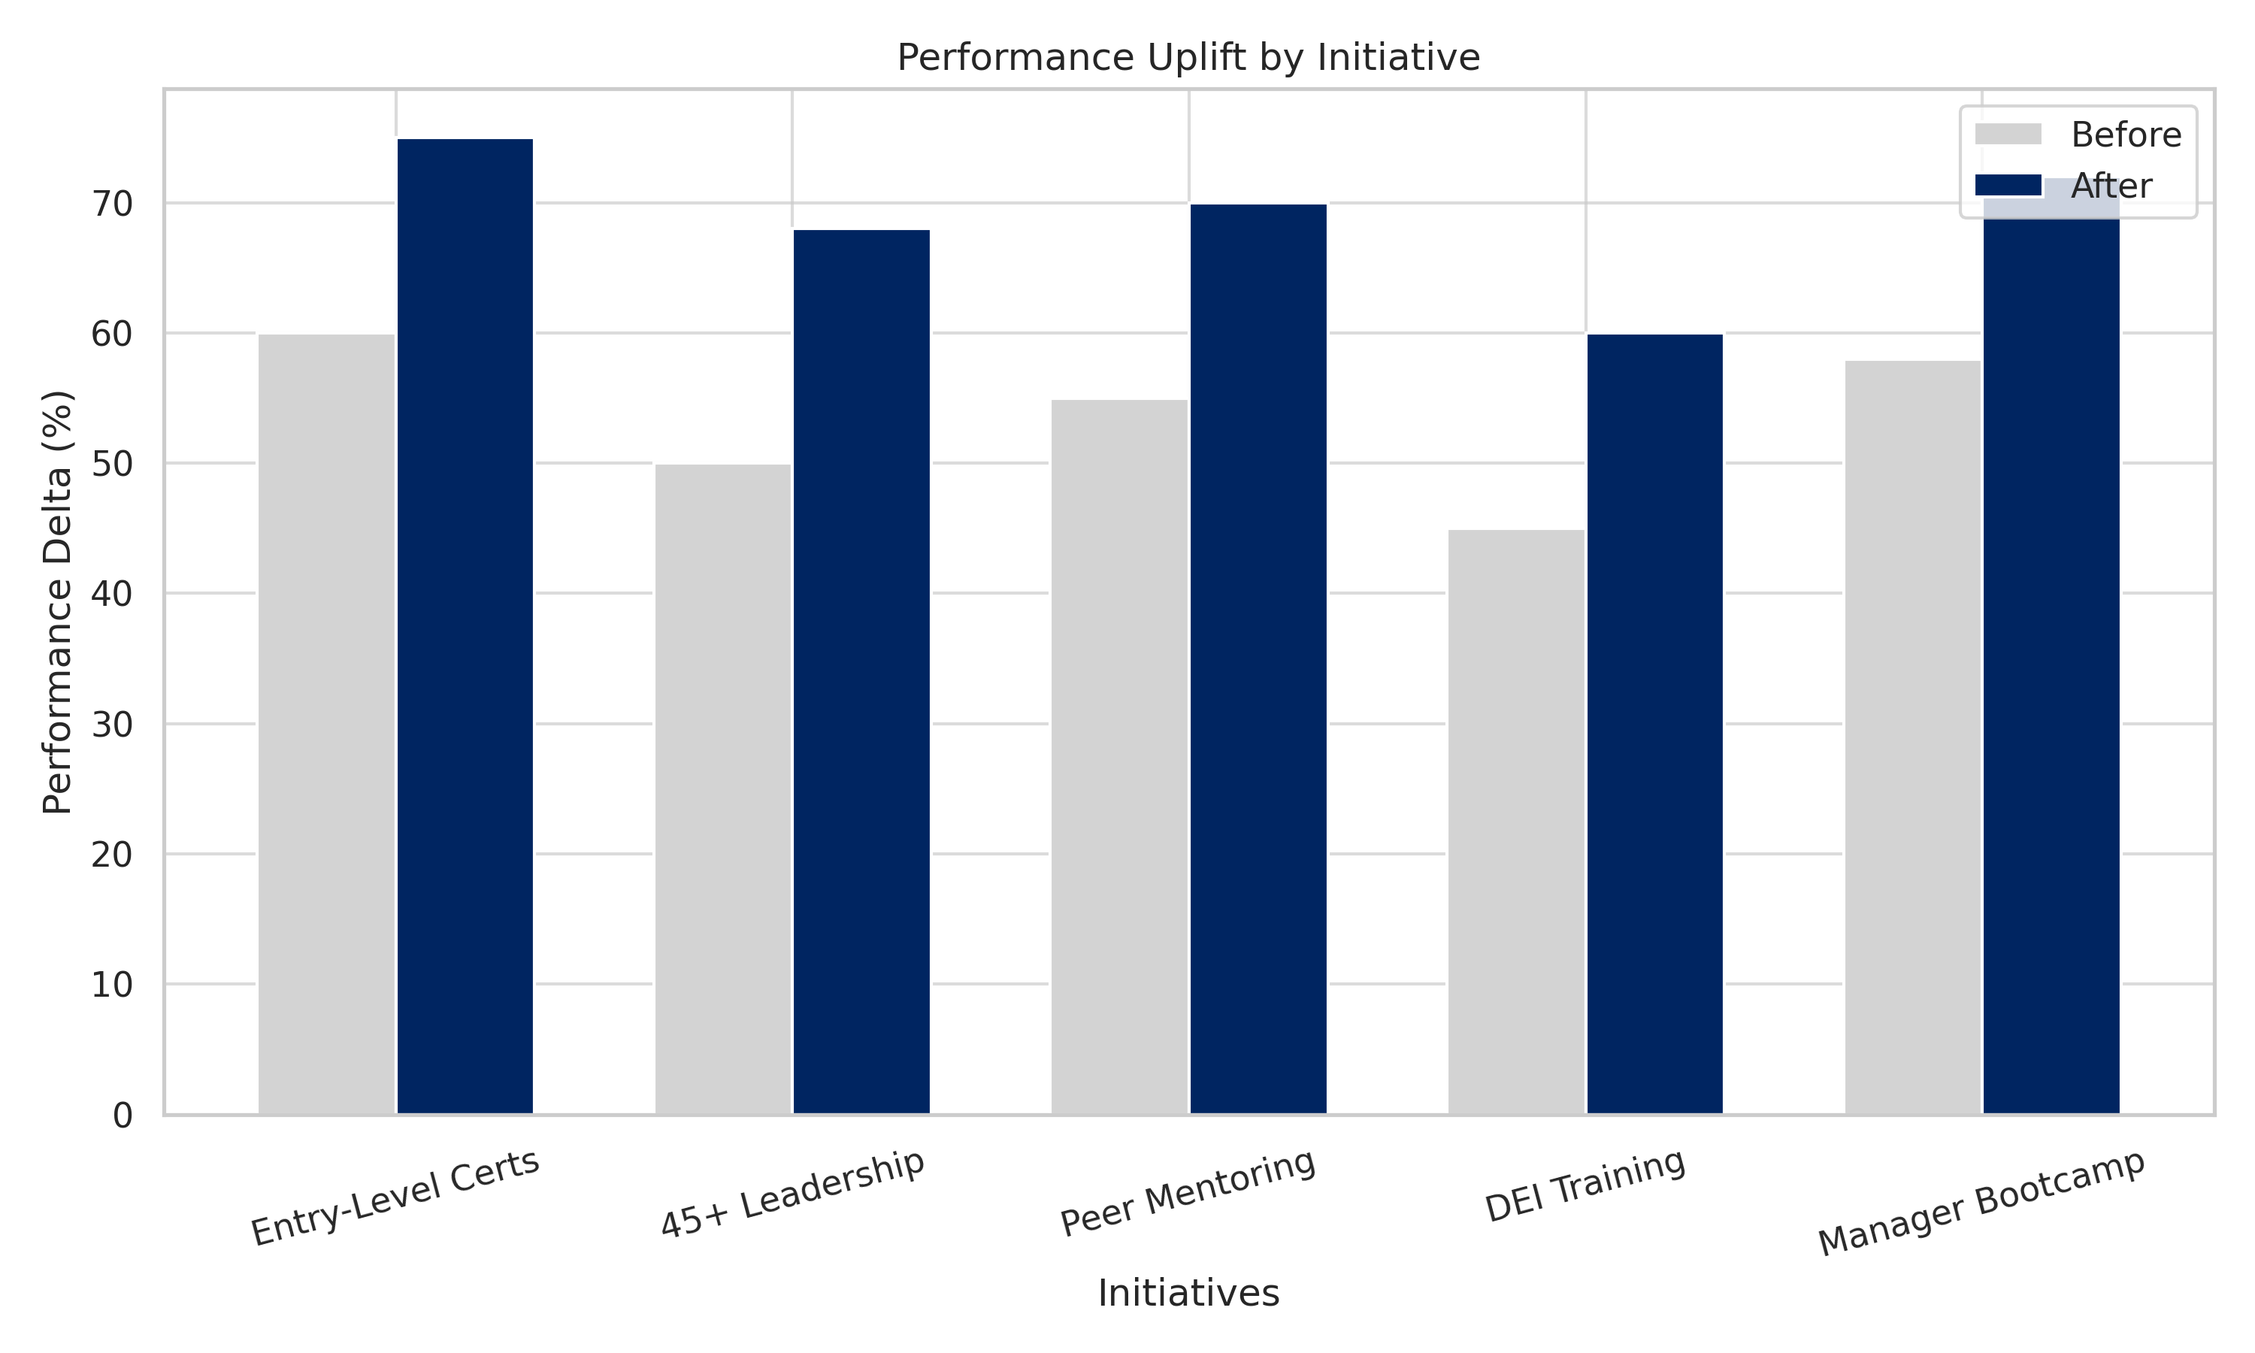
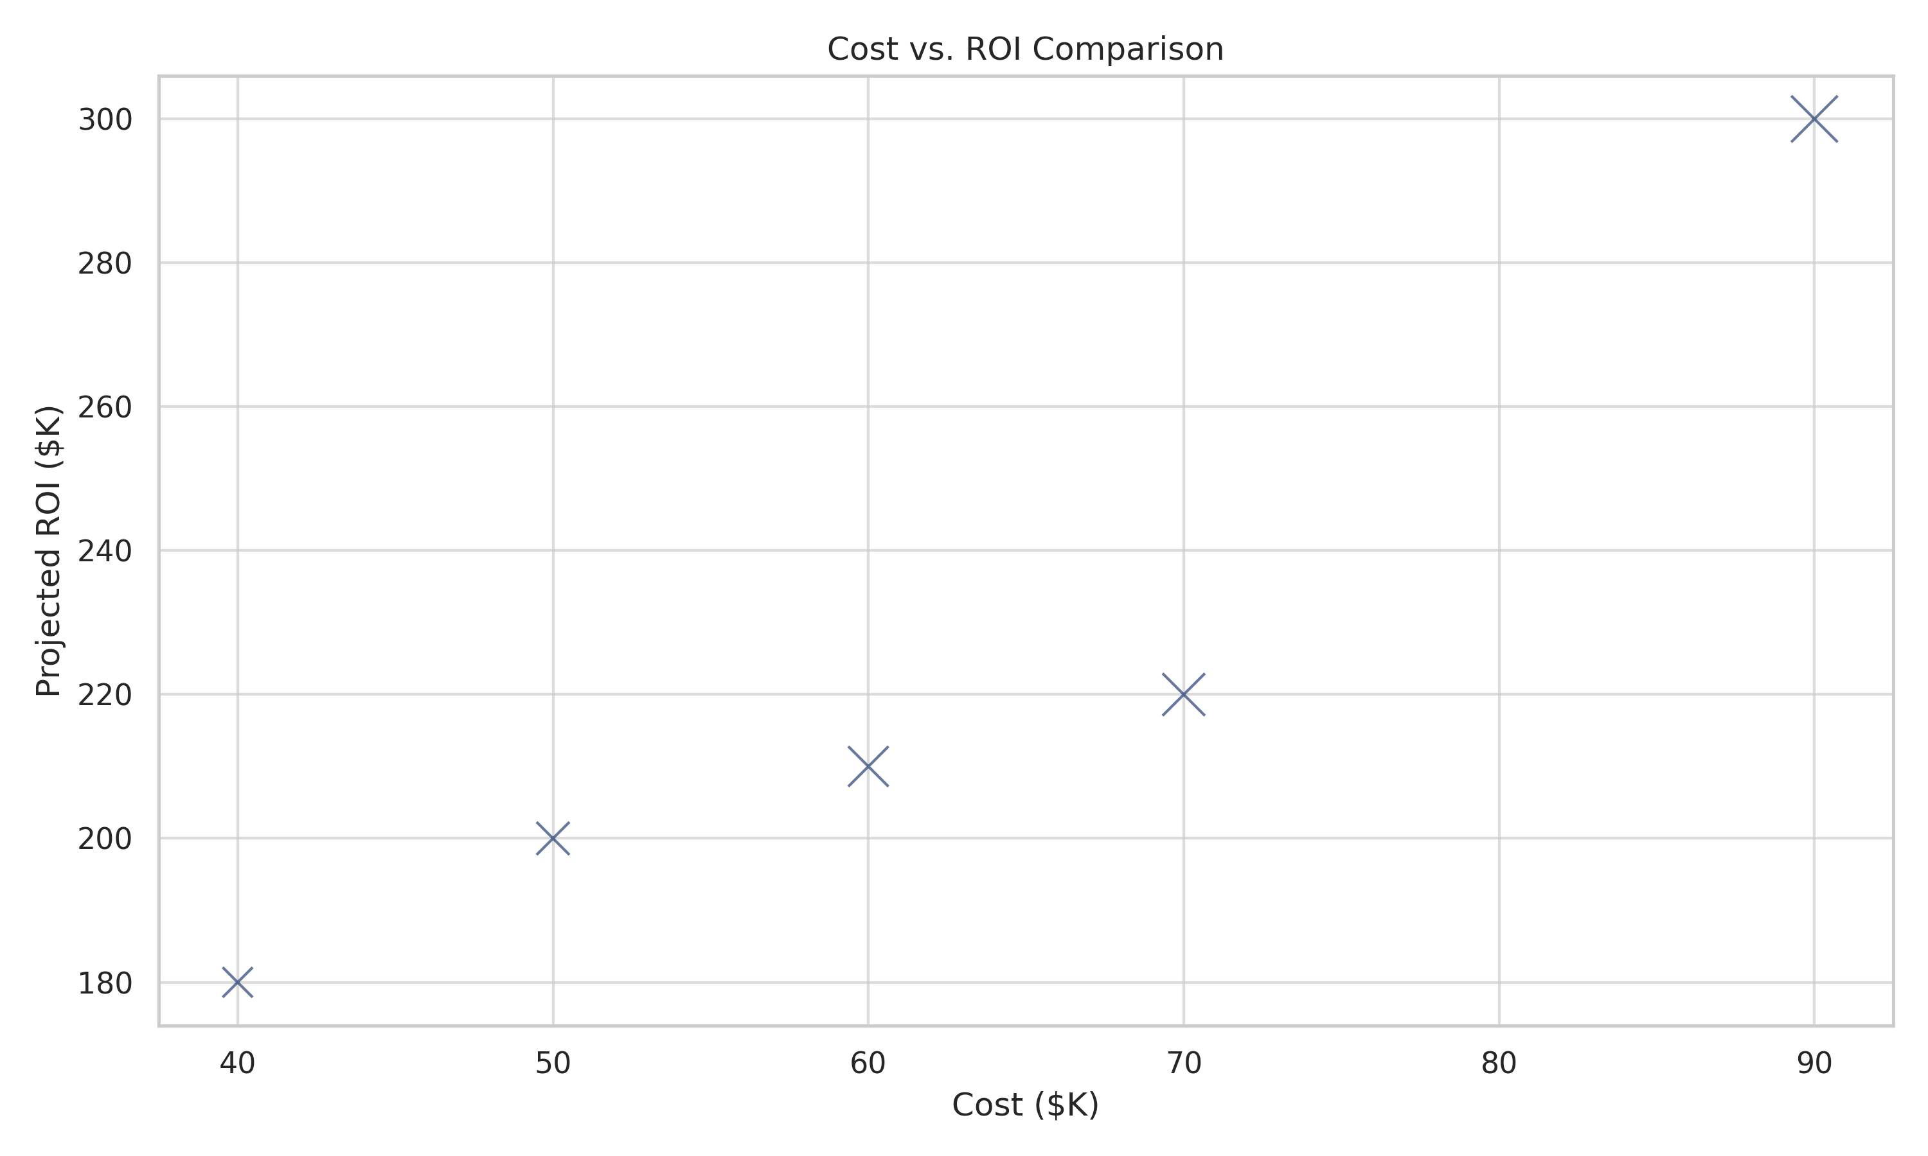
ROI Projection: Performance upskill & Cost Efficiency
Metric | Before (Current State) | After (Projected) | Delta (+/-)
Entry-Level Performance | 0.457 (No cert) | 0.504 (Certified) | +10.2%
45+ Leadership Score | 0.484 | 0.518 (Training) | +7.0%
5G Skill Gaps Closed | 902 EE (45+/25-34) | 450 (50% reduction) | -50%
AI/ML Performance (25-34) | 0.490 | 0.515 (Mentoring) | +5.1%
Cybersecurity Score (35-44) | 0.481 | 0.496 (Drills) | +3.1%

Slide 10
Ericsson upskilling roadmap
Pilot Phase (Q3)
Scale Phase (Q4)
Global Rollout (Q1)
Optimization (Q2)
R&D Team Pilot
Entry-Level Certs (10.2% performance lift)
45+ Leadership Bootcamp (559 gaps closed)
Target: 20% skill reduction by Dec. 2026
5G/IoT Expansion
5G Labs for 45+
AI/ML Training for 35-44 (0.49→0.51 scores)
Coverage: 5 regions
Company-Wide Mandates
Entry-Level Certifications required
Cybersecurity Drills (25-34 focus)
Partner: Cisco simulators deployed
AI-Driven Automation
Dynamic skill gap forecasting
Cert-linked promotions

Slide 11





Thank you
Driving Growth Through Data
Let’s Connect
github.com/MrWhiteTree
linkedin.com/in/shayburns
shayrburns@gmail.com
(682) 367-2903
Notes:
5/26/20252011-11-17
11
Ericsson Group Presentation
2011-05-05
LME-11:001143 Uen, Rev B
11

Slide 12
Notes:
5/26/20252011-11-17
12
Ericsson Group Presentation
2011-05-05
LME-11:001143 Uen, Rev B
12

