Slide 1
ITRON INDIA HACKATHON 2K18

Slide 2
TEAM NAME- ”KEEP IT SIMPLE”

Slide 3
TEAM MEMBERS-
DEEKSHITH PATIL
SAI SREERAM
VISHAL G YADAV
JAHNAVI P

Slide 4
OBJECTIVE-
SMART WATER
SMART IRRIGATION SYSTEM FOR PADDY FIELDS

Slide 5
CONTENTS-
OVERVIEW
LOOP HOLES
SOLUTION
OUR IDEA
COMPONENTS USED
IMPLEMENTATION

Slide 6
OVERVIEW
India has the largest paddy output in the world and is also the fourth largest exporter of rice in the world. Paddy is cultivated at least twice a year in most parts of India.
But, paddy fields also require a lot of water for its production. Although, drip irrigation has been a sensation, it cannot be used for paddy fields.
Generally, water coming from either canals or check dams are stored in a temporary storage called water reservoir tanks. Then distributed to segments of paddy fields by smaller canals from it. Conventionally, the opening from which the water is let into the fragments of paddy fields have to be manually opened and closed which is not only hectic but also leads to water wastage if not closed in time.
Hence an accurate and smart irrigation system would be of great help for the Indian farmers.

Slide 7
CURRENT LOOPHOLES IN PADDY IRRIGATION.
Unequal distribution of water along the canal
Over irrigation
To reduce the wastage of water
Improper time management of crop harvest
No prior caution of natural disaster

Slide 8
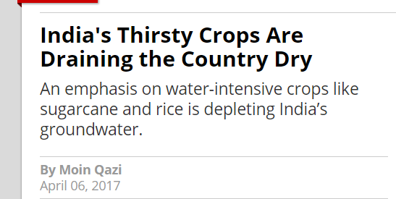
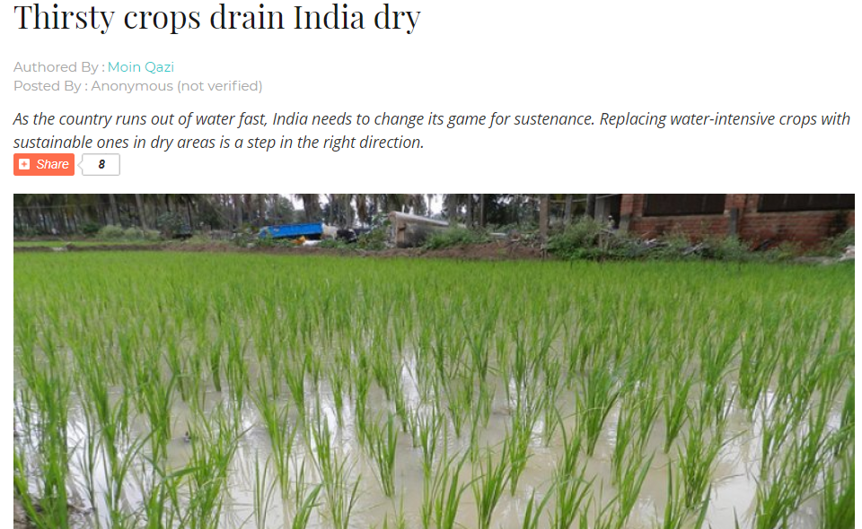
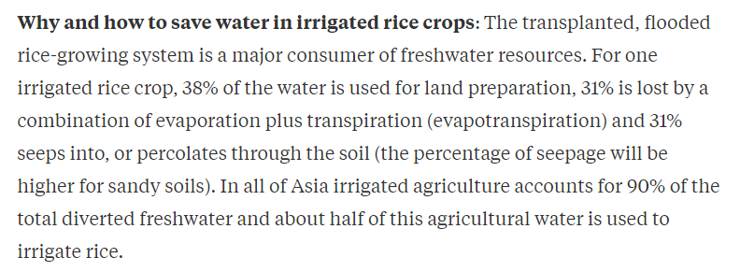
Research papers and Statistics:

Slide 9
OUR IDEA
We, team “keep it simple”, aim at achieving smart and sufficient distribution of water to paddy fields using IOT. From the irrigation pond, where the water is stored temporarily, PVC pipes run to each and every fragment. These pipes avoid water loss due to seepage from the soil. The opening of the PVC pipes at each fragment is controlled using a custom designed mobile application.
The app is designed in order to control the opening and closing of each and every nozzle at the fragment, through which the water enters the paddy field in a controlled manner. Also, the speed at which the water is let out can be controlled.
Additionally, a soil moisture sensor is placed at the end of each segment. Once the water reaches the end of that fragment, the sensor readings go high following which a notification is pushed in the mobile application indicating that the segment has received sufficient water and the water supply to this segment can be cut off using the app, if required. Similarly, the entire field can be irrigated without much wastage of water.
The availability of internet signals poses a challenge to the solution mentioned above. As, it becomes difficult to automate in the absence of internet. But, with improving coverage range of signal day by day, by the service providers, this shouldn’t be a major issue.
This automated system of irrigation ensures minimum wastage of water, reduces human intervention, without compromising on the amount of water needed by the crop, for its sustained development.

Slide 10
SOLUTION
The above mentioned problem’s can be solved by using the concept of smart water irrigation,
As it aims at providing appropriate amount of water at the appropriate time in such a way that it always favours the ideal condition for the crop in any season of the year.

Slide 11
COMPONENT’S USED
RIVA DEV LE
MOISTURE SENSOR
RELAY BOARD
SOLENOID VALVE
PVC PIPES
MICROSOFT AZURE

Slide 12
IMPLEMENTATION

Slide 13
THANK YOU

