Slide 1


M.Tech/MCA Program
Advanced Industry Integrated Programs
Jointly offered by University and LTIMindTree
Review II
Retail Shop Assistant
ROHAN SINGH (T8632)
Knowledge partner | Implementation partner

Slide 2
Project Title – Retail Shop Assistant
Addresses Profit Challenges:
Tackles competition from online & 10-min delivery services.
AI Insights:
Uncovers hidden sales patterns for smarter decisions.
Accurate Forecasting:
Predicts daily, weekly, and monthly sales by category & item.
Performance Tracking:
Identifies best-selling products and categories.
Introduction

Slide 3
Project Title - Retail Shop Assistant
Introduction
Actionable Suggestions:
Reduces waste, avoids stockouts, and boosts profitability.
Gen AI Recommendations:
Provides easy-to-understand, personalized suggestions.
User-Friendly Interface:
Operate with a simple Streamlit dashboard—no technical skills needed.

Slide 4
Project Title - Retail Shop Assistant
Objective
AI powered quantity prediction of items or item category
AI forecasts optimal item/category quantities to stock.
Graph based daily , weekly or monthly sales .
Graphs show daily, weekly, and monthly sales trends.
Gen AI based model to give additional advices for marketing .
Personalized marketing advice to boost sales .
User friendly architecture .
Easy-to-use Streamlit dashboard for non-technical users.

Slide 5
Project Title - Retail Shop Assistant
Modules
( Module – 1 ) -> Dashboard User Interface .
( Module – 2 ) -> Sales Tracking Module .
( Module – 3 ) -> Inventory Management Module .
( Module – 4 ) -> Marketing Strategy Module .

Slide 6
Project Title - Retail Shop Assistant
Methodology
Dashboard User Interface –
-> Simple, intuitive UI built with Streamlit for easy operation .
Sales Tracking Module –
-> Visualizes sales data using Matplotlib for clear daily, weekly,
and monthly trends .
Inventory Management Module –
-> Predicts optimal stock levels with advanced algorithms like
Gradient Boosting Regressor .
Marketing Strategy Module –
-> Uses Google Gemini for marketing strategy .

Slide 7
Project Title - Retail Shop Assistant
Exploratory Data Analysis
Dataset Overview: ->2,000+ rows with features like Item Name, Category, Price, Date, Quantity,
and seasonal flags.
Key Insights:
-> Quantity distribution shows right-skewed sales patterns.
-> Category-wise trends reveal peak demand in Grocery and Dairy.
-> Monthly revenue trends highlight seasonal spikes (e.g., Diwali, Holi).
-> Correlation matrix shows strong link between Price, Quantity, and
Revenue.

Slide 8
Project Title - Retail Shop Assistant
Data Preprocessing
Date Features Extracted: Day, Month, DayOfWeek, IsMonsoon, IsHoliday, Festival
Flags
Categorical Encoding: Category, MRPBand encoded using OneHotEncoder
Missing Value Handling: Filled or dropped based on context (e.g., IsStockout)
Feature Engineering: Created Revenue, MRPBand, and festival season indicators

Slide 9
Project Title - Retail Shop Assistant
Approach/Algorithms/Tools
Streamlit –
-> Streamlit enables a clean, user-friendly interface for shop owners.
-> Automatically refreshes data and predictions with minimal delay.
-> Designed for ease of use—no coding knowledge required.
Google Gemini –
-> Google Gemini is a family of advanced AI models developed by
Google.
-> Creates tailored promotions and product recommendations based
on customer behavior.

Slide 10
Project Title - Retail Shop Assistant
Approach/Algorithms/Tools
Gradient Boosting Regressor –
Accurate Forecasting:
-> GBR learns complex patterns in sales data to predict item
demand precisely .
Handles Non – Linear Trends:
-> Captures seasonal , promotional , and trend-based variations in
inventory needs.

Slide 11
Project Title - Retail Shop Assistant
Approach/Algorithms/Tools
Gradient Boosting Regressor –
Feature Importance:
-> Highlights which factors (e.g., day , category , past sales)
influence demand most.
Improves Profitability:
-> Helps avoid overstocking and stockouts, optimizing inventory
costs.

Slide 12
Project Title - Retail Shop Assistant
Project plan/Milestone Progress
Module – 1 = Dashboard and User Interface
Module – 2 = Sales Tracking
Module – 3 = Inventory Management Module
Module – 4 = Marketing Strategy Module

Slide 13
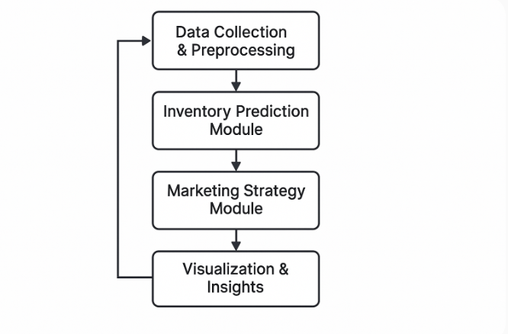
Project Title - Retail Shop Assistant
Pipeline structure
.

