Slide 1


M.Tech Program
Advanced Industry Integrated Programs
Jointly offered by University and LTIMindTree
Project Title:
Retail Shop Assistant
Team Member
Name: Rohan Singh (24MAI0093)
TID: T8632

Slide 2
Retail Shop Assistant
Introduction
With the rise of online and 10 min delivery services retail shop owners often struggles to get profit .
Deep learning based model the helps the retail shop owners in checking the daily , weekly and monthly sales based on both category and item .
Provide easy to operate interface using streamlit and gen ai models for better suggestions .

Slide 3
Introduction
Retail Shop Assistant
Deep Learning can uncover hidden patterns in sales data.
Enables accurate forecasting of daily, weekly, and monthly sales.
Helps retailers understand which products and categories perform best.
Provides actionable insights to reduce waste, avoid stockouts, and improve profitability.
When combined with an easy-to-use interface (like Streamlit) and Gen AI suggestions, it empowers shop owners without requiring technical expertise

Slide 4
Retail Shop Assistant
Objective – Easy & Efficient Interface
User-Friendly Design: Simple, intuitive interface built with Streamlit for quick navigation.
Fast Data Entry & Viewing: Ensures real-time access to sales data without complexity.
Flexible Analysis: View sales data by category or individual item for better insights.
Seamless Experience: Designed for non-technical users, making operations smooth and efficient.

Slide 5
Objective – AI and Gen AI Interface
Retail Shop Assistant
AI-Powered Predictions:
Trained models forecast which items or categories to restock and in what quantity.
Actionable Insights:
Identify high-performing products and avoid overstocking low-demand items.
Gen AI Suggestions:
Personalized recommendations for marketing strategies, inventory optimization, and sales improvement.
Data-Driven Decisions:
Empower shop owners to increase profitability and reduce waste using intelligent insights.

Slide 6
Retail Shop Assistant
Scope
Sales Analysis
Provides a detailed view of sales trends on a daily, weekly, and monthly basis.
Allows filtering by item name or product category for deeper insights.
Inventory Management
Uses AI-driven predictions to suggest optimal stock levels.
Helps avoid overstocking and stockouts, improving cash flow and reducing waste.

Slide 7
Retail Shop Assistant
Scope
Marketing Recommendations
Gen AI-powered insights based on historical sales data.
Suggests promotions, discounts, and campaigns to boost sales.
Business Optimization
Combines sales analysis, inventory planning, and marketing
strategies .
Empowers retailers to make data-driven decisions for higher
profitability
.

Slide 8
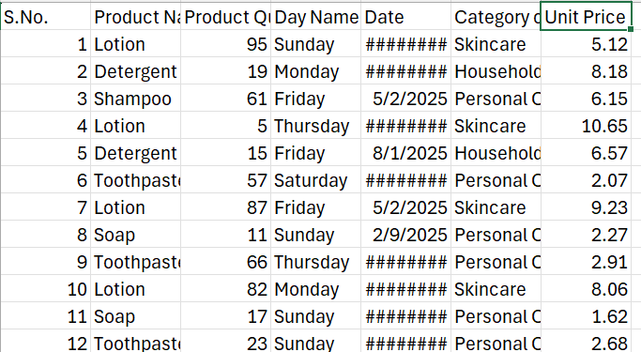
Retail Shop Assistant
Sample of dataset
Data Set

Slide 9
Retail Shop Assistant
Literature Review
Zoho inventory – Interface can be complex for non tech users . Not affordable for small scale retail shop owners .
Brightpearl – Not affordable for many people , good for big and mid scale uses , majorly trained for western datasets and users .
Katana cloud inventory - Dashboards and analytics are not comprehensive enough for strategic decisions.

Slide 10
Retail Shop Assistant
Summary of Literature
Uses Streamlit for user-friendly interface .
AI model is trained on data based on Indian retail shop sales .
Uses ai model trained on deep learning algorithms for inventory management .
Uses gen ai model (Gemini) for further assistance on decisions like marketing , inventory management .
Uses algorithms like matplotlib.pyplot to easily understanding the sales data to take individual decisions by user .

Slide 11
Retail Shop Assistant
Modules to cover
Module | Description
Sales tracking module | Daily/weekly/monthly sales overview Graphical representation using Matplotlib
Inventory Management | Uses algorithms like lstm , XGBoost for inventory management
Marketing Strategy module | Uses gen ai models like google Gemini for marketing suggestions
Dashboard Interface | Uses Streamlit for simple UI

Slide 12
Retail Shop Assistant
Module – 1 : Sales Tracking Module
Purpose: Monitor and analyze sales trends Features:
Daily, weekly, and monthly sales overview
Visualizations using Matplotlib
Helps identify peak sales periods and slow-moving items

Slide 13
Retail Shop Assistant
Module – 2 : Inventory Management
Purpose: Help shop owners manage stock efficiently Features:
Predicts which items to restock and which to avoid
Supports multiple algorithms (e.g., LSTM, XGBoost, or others based on data suitability)
Adapts to different shop sizes and inventory patterns
Focuses on reducing waste and improving profitability

Slide 14
Retail Shop Assistant
Module – 3 : Marketing Strategy Module
Purpose: Enhance customer engagement and boost sales Features:
Uses Generative AI models (e.g., Google Gemini)
Provides personalized marketing suggestions
Helps design campaigns based on customer behavior

Slide 15
Retail Shop Assistant
Module – 4 : Dashboard Interface
Purpose: Provide a user-friendly control panel Features:
Built with Streamlit
Simple and intuitive UI for navigating modules
Real-time updates and interactive elements

Slide 16
THANK YOU

