Slide 1
Final Project Presentation
FAN, Lok Wai 1155194671
WU, Chun Hei 1155194804

Slide 2
Basic functions
Streaming ASR
Google Cloud Speech
Press “Start Recording” to start recording
Show interim => Streaming
LLM
DeepSeek is used
Chat History is available
Stream unit: sentence
Streaming TTS
Google Cloud Text To Speech
Streaming unit: sentence
Generate audio files (.mp3)
Stored the files locally
UI
PyGame
Size Scaling
Chatlog Scrolling

Slide 3


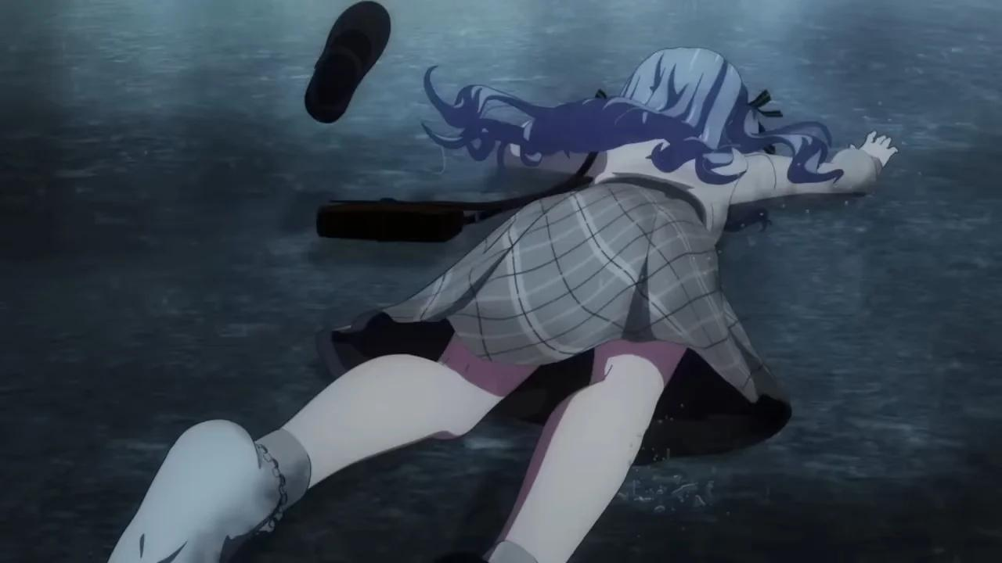
Advanced function
- Tsundere （傲嬌） personality
- Prompt Engineering
- Output Formatting
- Returning Ave Mujica and MyGO!!!!! stickers
- Web Scraping
- Vector Database w/ Embedding
- Embedding Matching
- Image showing in UI

Slide 4
THANK YOU!!!!!

