Slide 1

TensorFlow 2.0
Simple Neural Network
Deep Learning in Earth Science v2 Lecture 2
By Xiao Zhuowei
10.15.2019

Slide 2
OUTLINES
OUTLINES
1
TensorFlow 2.0 Installation
2
Build Simple NN with Low-level APIs
3
Build Simple NN with High-level APIs
4
Discussion

Slide 3

Installation
conda create –n tf2 python=3.6
conda activate tf2
pip install tensorflow
or
pip install tensorflow-gpu
conda install cudatoolkit cudnn

Slide 4
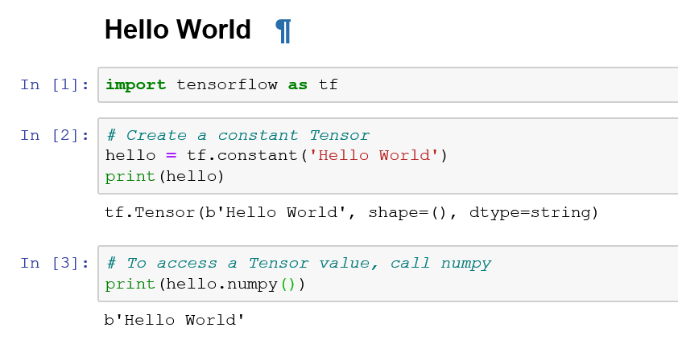
Hello World
https://github.com/aymericdamien/TensorFlow-Examples

Slide 5
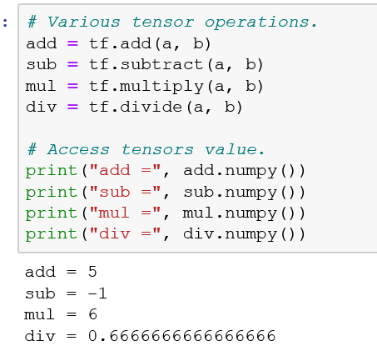
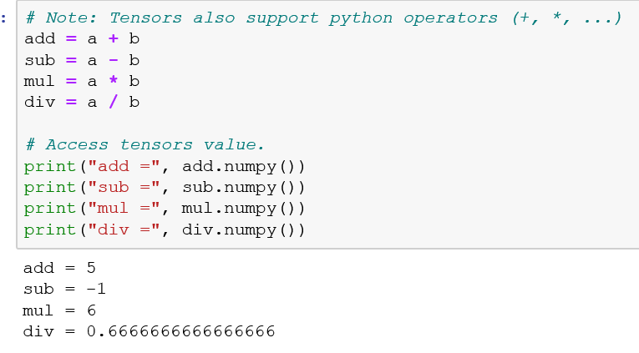
Basic Operation
https://github.com/aymericdamien/TensorFlow-Examples

Slide 6
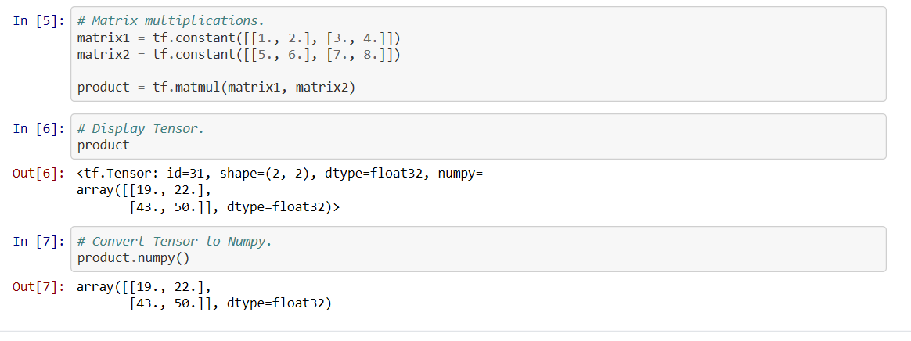
Basic Operation
https://github.com/aymericdamien/TensorFlow-Examples

Slide 7
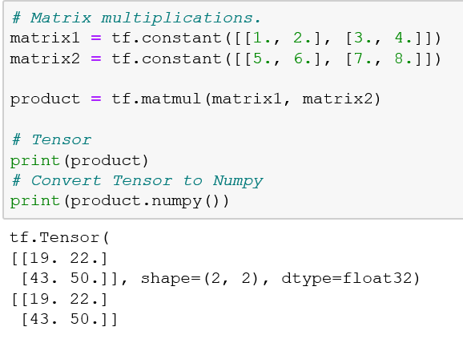
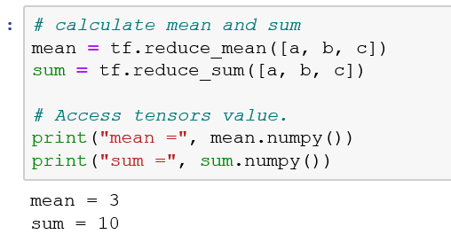
Basic Operation
https://github.com/aymericdamien/TensorFlow-Examples

Slide 8
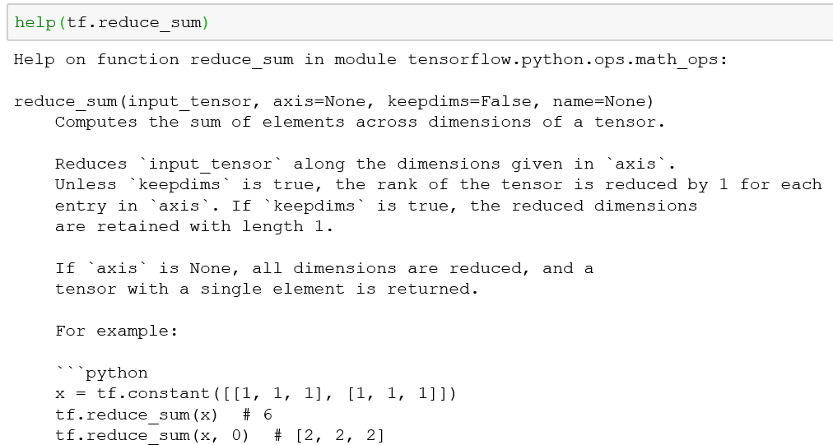
Basic Operation

Slide 9
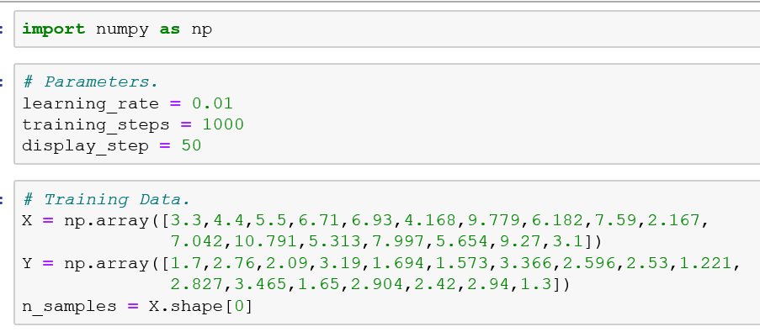
Simple Linear Regression
https://github.com/aymericdamien/TensorFlow-Examples

Slide 10
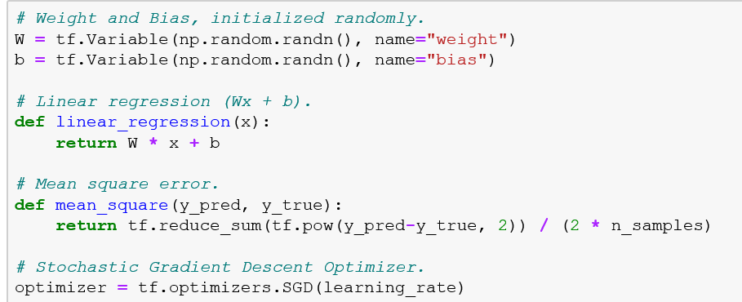
Simple Linear Regression
https://github.com/aymericdamien/TensorFlow-Examples

Slide 11
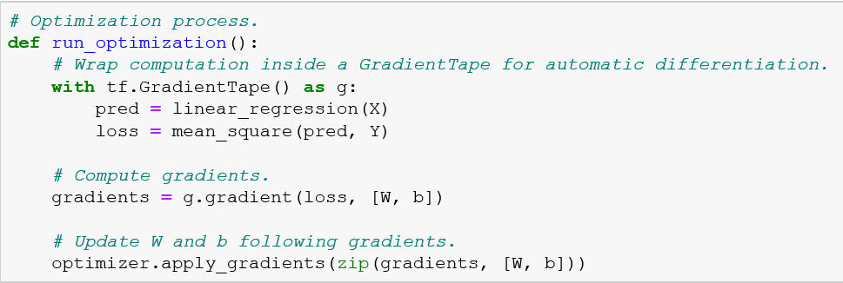
Simple Linear Regression
https://github.com/aymericdamien/TensorFlow-Examples

Slide 12
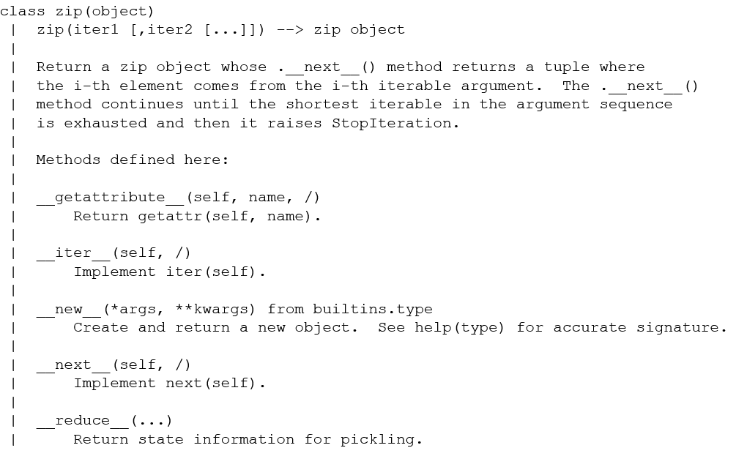
Simple Linear Regression

Slide 13
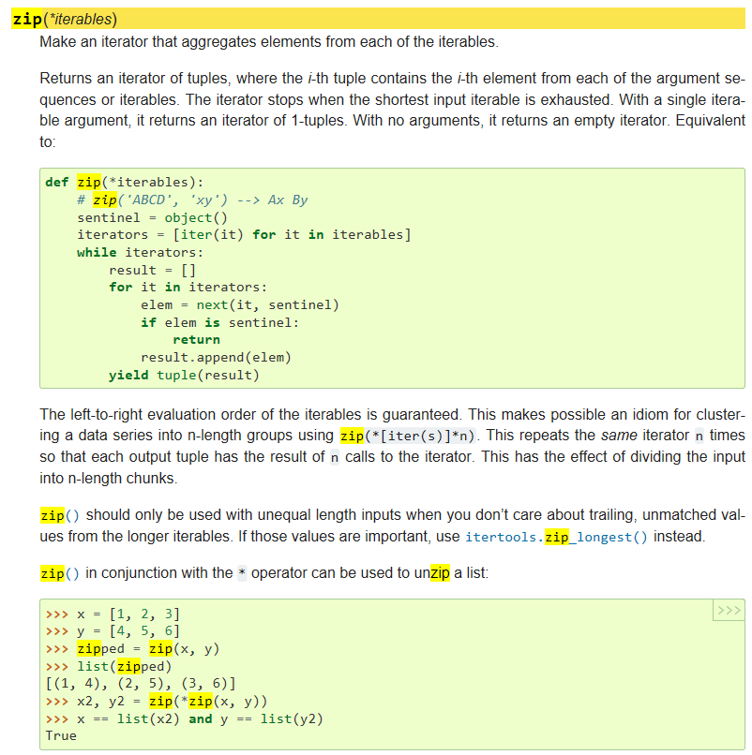
Simple Linear Regression
When a yield statement is executed, the state of the generator is frozen and the value of expression list is returned to next()'s caller. By frozen we mean that all local state is retained, including the current bindings of local variables, the instruction pointer, and the internal evaluation stack: enough information is saved so that the next time next() is invoked, the function can proceed exactly as if the yield statement were just another external call.

Slide 14
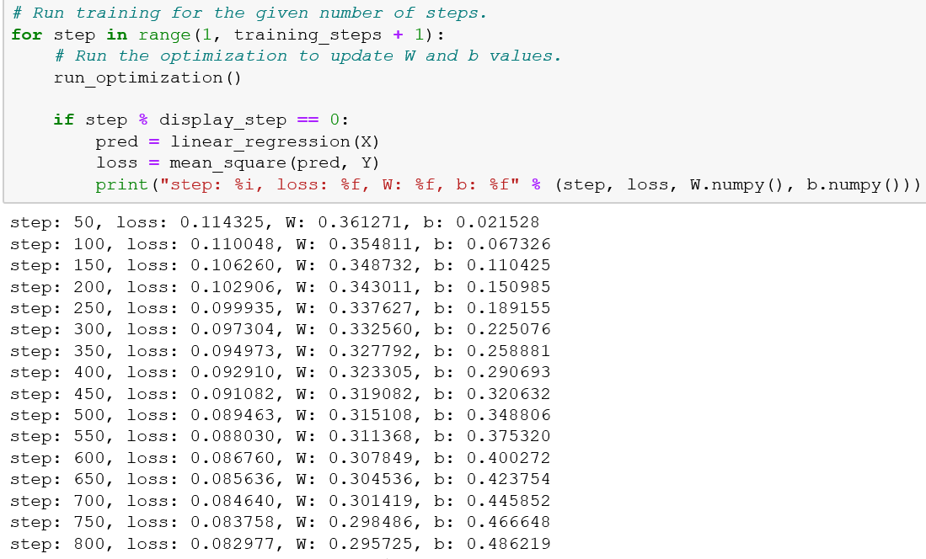
Simple Linear Regression
https://github.com/aymericdamien/TensorFlow-Examples

Slide 15
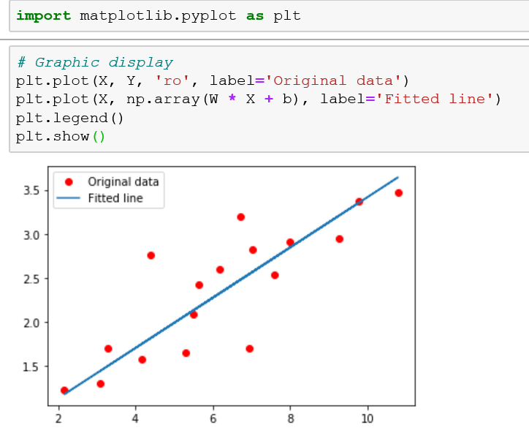
Simple Linear Regression
https://github.com/aymericdamien/TensorFlow-Examples

Slide 16
OUTLINES
OUTLINES
1
TensorFlow 2.0 Installation
2
Build Simple NN with Low-level APIs
3
Build Simple NN with High-level APIs
4
Discussion

Slide 17
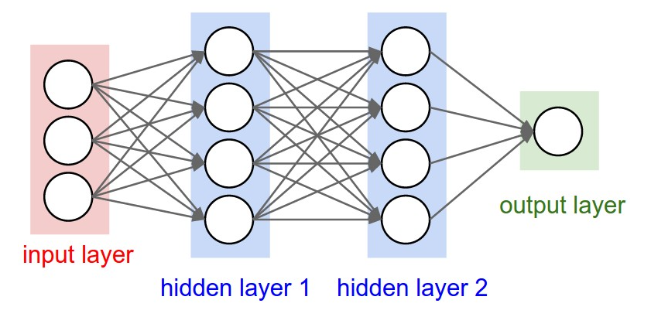
Simple NN with Low-level APIs
Fully Connected Neural Network
https://github.com/aymericdamien/TensorFlow-Examples

Slide 18
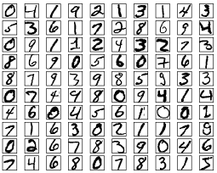
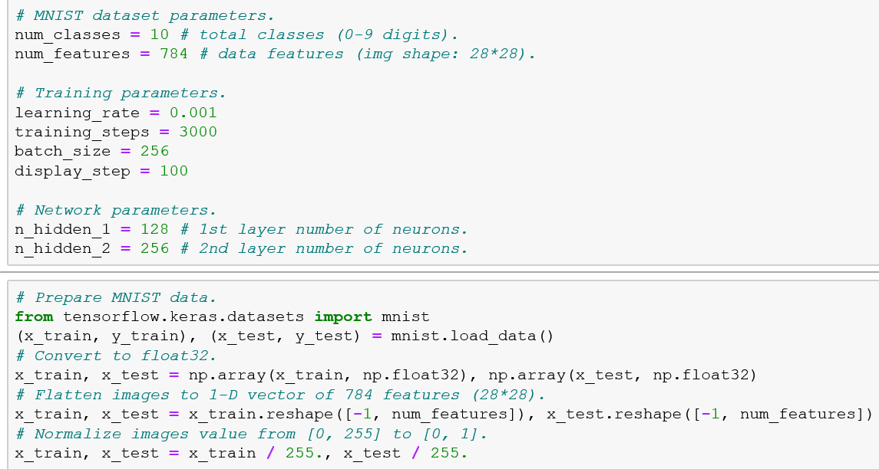
Simple NN with Low-level APIs
https://github.com/aymericdamien/TensorFlow-Examples

Slide 19
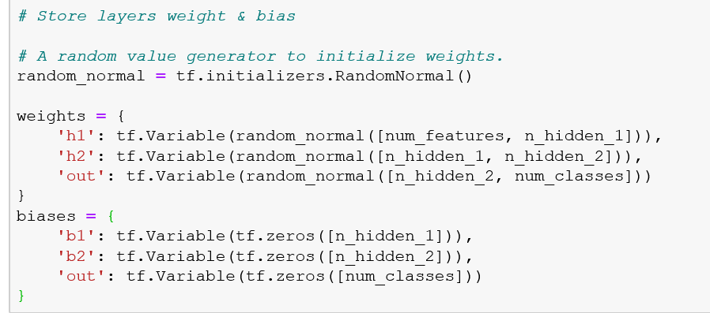
Simple NN with Low-level APIs
https://github.com/aymericdamien/TensorFlow-Examples

Slide 20
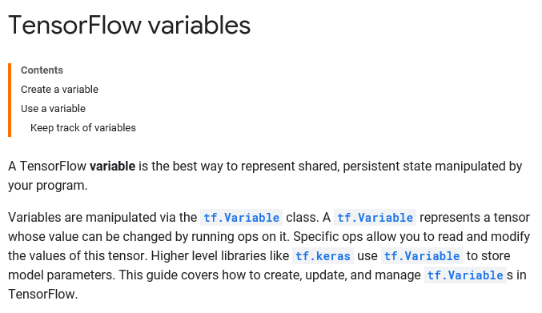
Simple NN with Low-level APIs
https://www.tensorflow.org/guide/variable

Slide 21
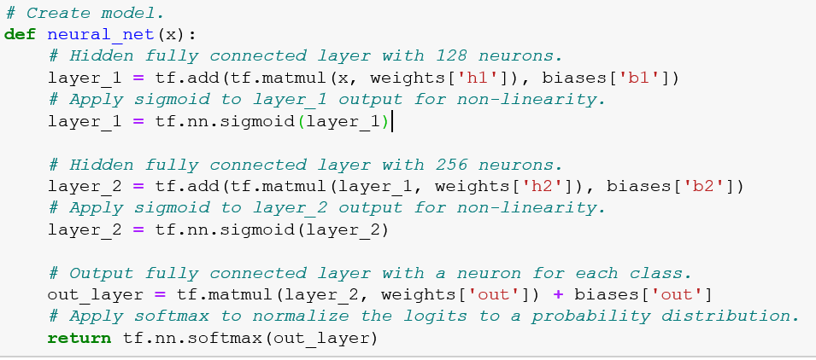
Simple NN with Low-level APIs
https://github.com/aymericdamien/TensorFlow-Examples

Slide 22

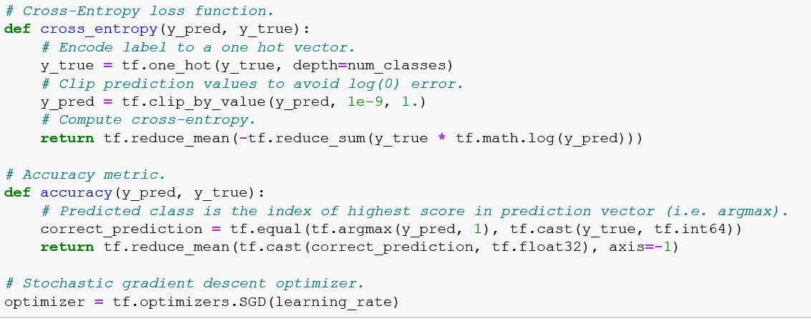
Simple NN with Low-level APIs
https://github.com/aymericdamien/TensorFlow-Examples

Slide 23
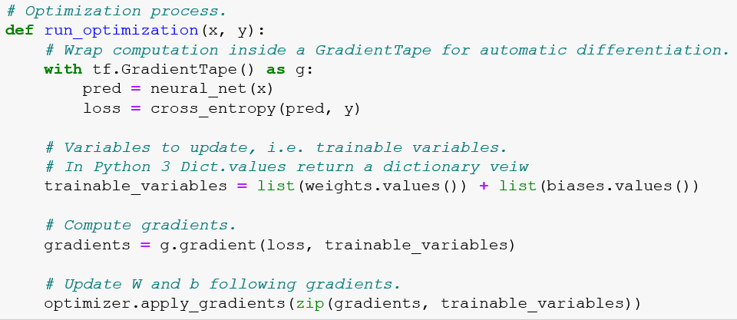
Simple NN with Low-level APIs
https://github.com/aymericdamien/TensorFlow-Examples

Slide 24
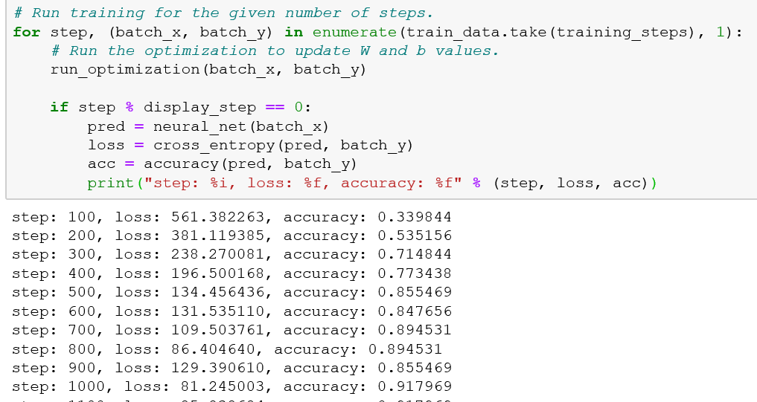
Simple NN with Low-level APIs
https://github.com/aymericdamien/TensorFlow-Examples

Slide 25
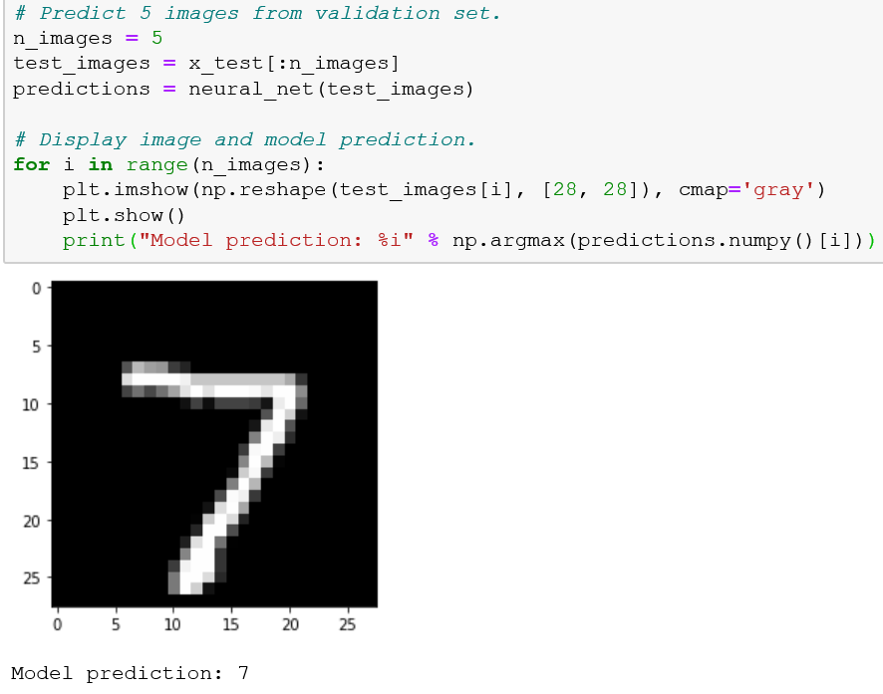
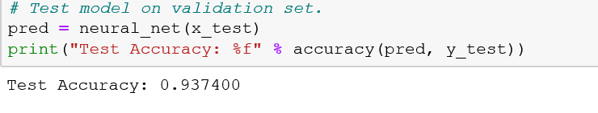
Simple NN with Low-level APIs
https://github.com/aymericdamien/TensorFlow-Examples

Slide 26
OUTLINES
OUTLINES
1
TensorFlow 2.0 Installation
2
Build Simple NN with Low-level APIs
3
Build Simple NN with High-level APIs
4
Discussion

Slide 27
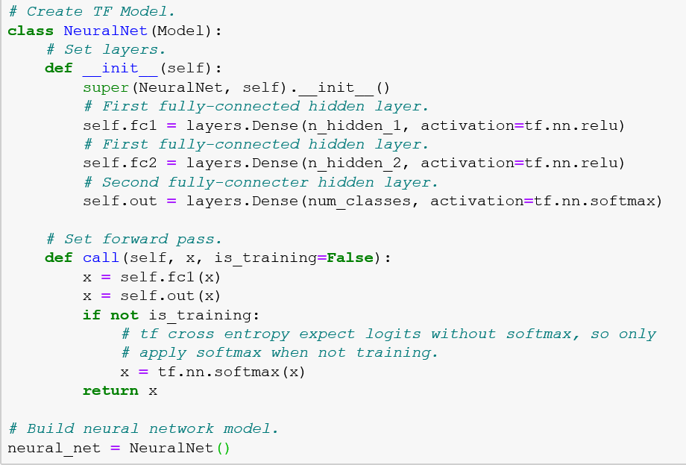
Simple NN with High-level APIs
https://github.com/aymericdamien/TensorFlow-Examples

Slide 28
Simple NN with High-level APIs
There are two ways to instantiate a `Model`:
1 - With the "functional API", where you start from `Input`, you chain layer calls to specify the model's forward pass, and finally you create your model from inputs and outputs:
import tensorflow as tf
inputs = tf.keras.Input(shape=(3,))
x = tf.keras.layers.Dense(4, activation=tf.nn.relu)(inputs)
outputs = tf.keras.layers.Dense(5, activation=tf.nn.softmax)(x)
model = tf.keras.Model(inputs=inputs, outputs=outputs)

Slide 29
2 - By subclassing the `Model` class: in that case, you should define your layers in `__init__` and you should implement the model's forward pass in `call`.
import tensorflow as tf
class MyModel(tf.keras.Model):
def __init__(self):
super(MyModel, self).__init__()
self.dense1 = tf.keras.layers.Dense(4, activation=tf.nn.relu)
self.dense2 = tf.keras.layers.Dense(5, activation=tf.nn.softmax)
def call(self, inputs):
x = self.dense1(inputs)
return self.dense2(x)
model = MyModel()
If you subclass `Model`, you can optionally have | a `training` argument (boolean) in `call`, which you can use to specify | a different behavior in training and inference:

Slide 30
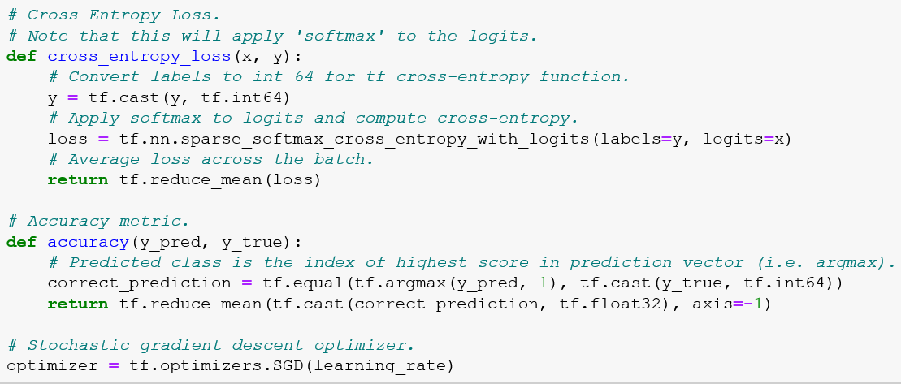
Simple NN with High-level APIs
https://github.com/aymericdamien/TensorFlow-Examples

Slide 31
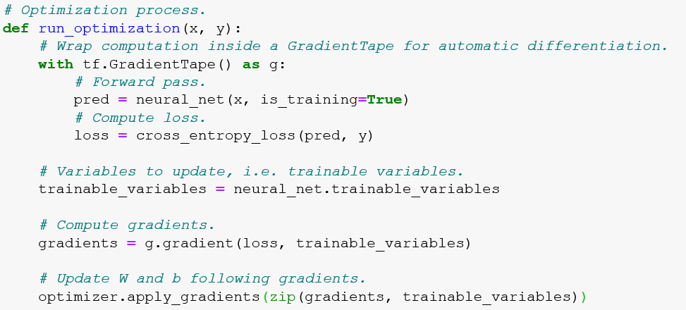
Simple NN with High-level APIs
https://github.com/aymericdamien/TensorFlow-Examples

Slide 32
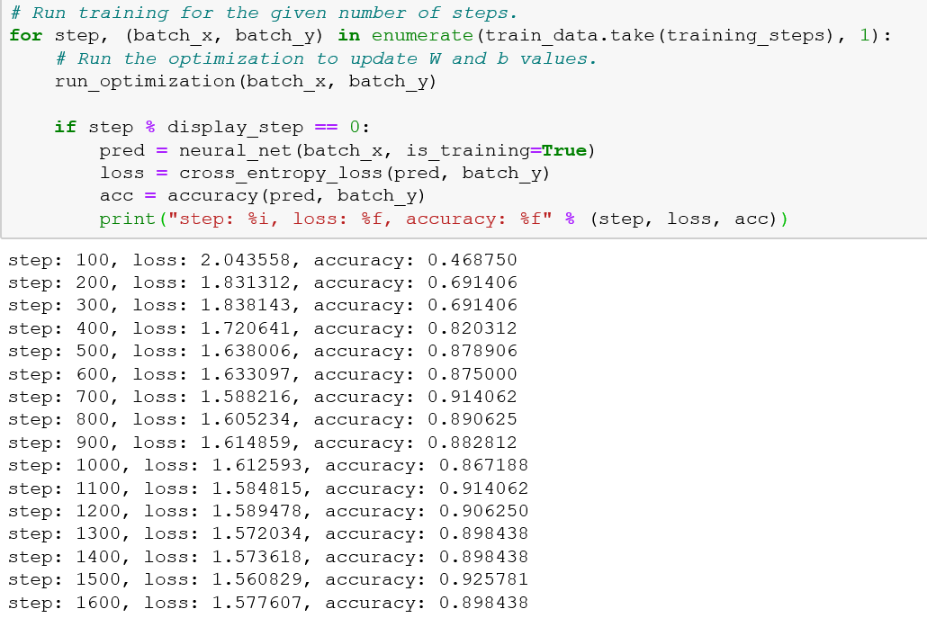
Simple NN with High-level APIs
https://github.com/aymericdamien/TensorFlow-Examples

Slide 33
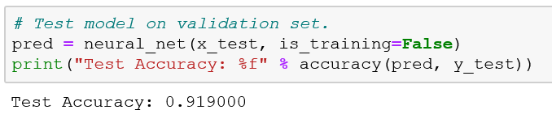
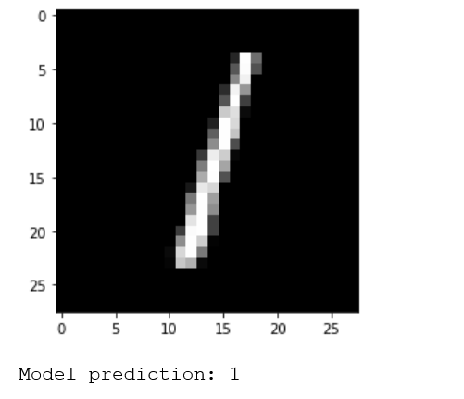
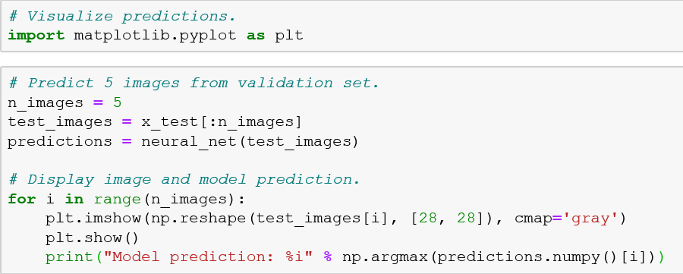
Simple NN with High-level APIs
https://github.com/aymericdamien/TensorFlow-Examples

Slide 34
OUTLINES
OUTLINES
1
TensorFlow 2.0 Installation
2
Build Simple NN with Low-level APIs
3
Build Simple NN with High-level APIs
4
Discussion

Slide 35

Discussion

