Slide 1

TensorFlow 2.0
Simple CNN and RNN
Deep Learning in Earth Science v2 Lecture 4
By Xiao Zhuowei
10.23.2019

Slide 2
OUTLINES
OUTLINES
1
CNN with Low-level APIs
2
CNN with High-level APIs
3
RNN with High-level APIs
4
Discussion

Slide 3
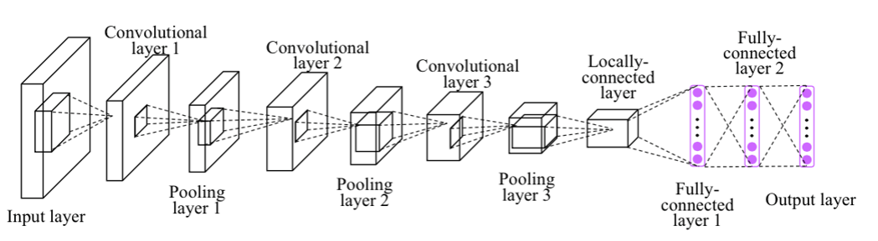
CNN with Low-level APIs
Simple CNN Overview
https://github.com/aymericdamien/TensorFlow-Examples/

Slide 4
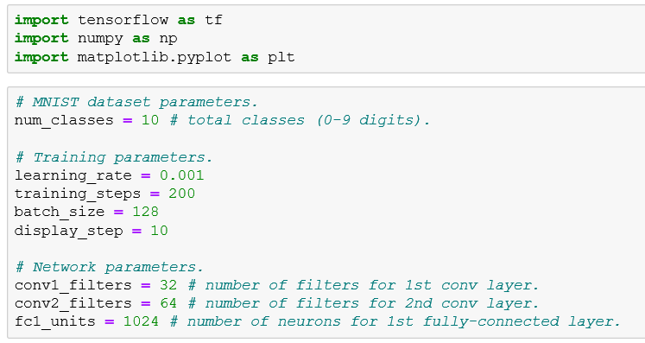
CNN with Low-level APIs
https://github.com/aymericdamien/TensorFlow-Examples

Slide 5
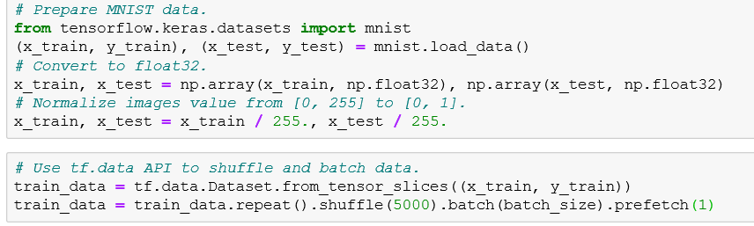
CNN with Low-level APIs
https://github.com/aymericdamien/TensorFlow-Examples

Slide 6
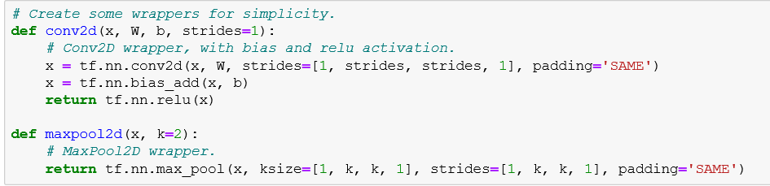
CNN with Low-level APIs
https://github.com/aymericdamien/TensorFlow-Examples

Slide 7
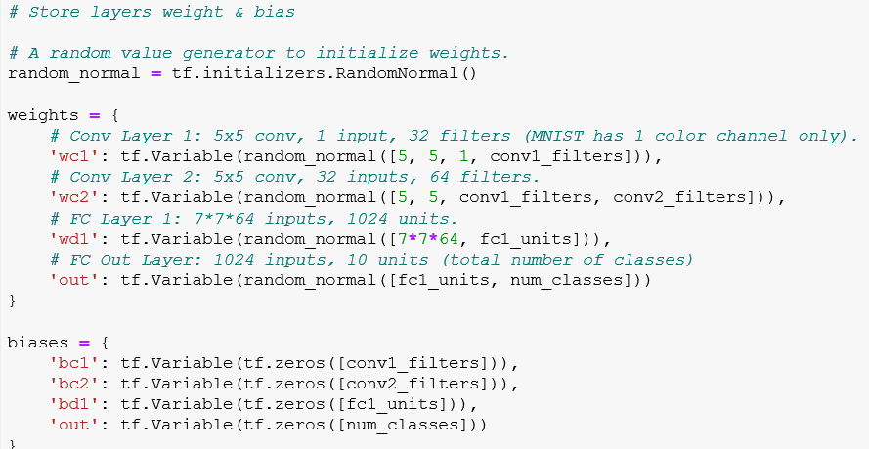
CNN with Low-level APIs
https://github.com/aymericdamien/TensorFlow-Examples

Slide 8
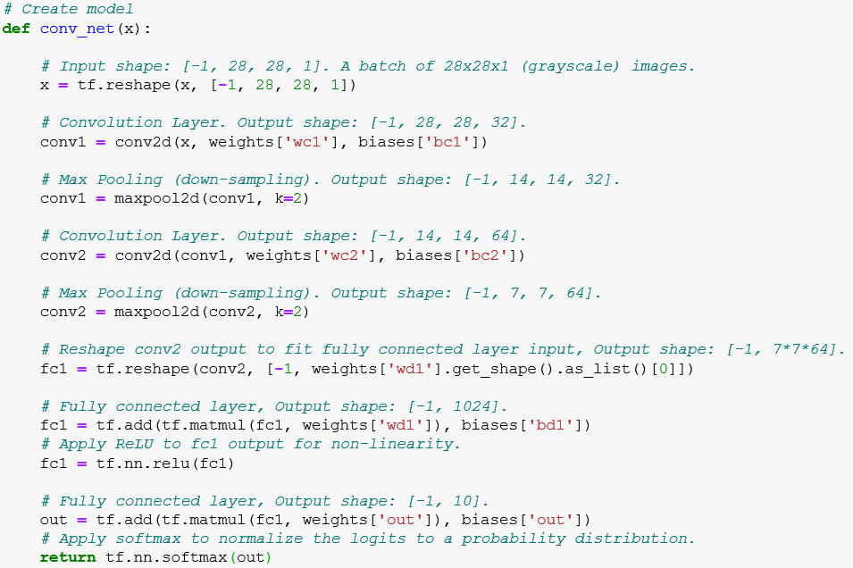
CNN with Low-level APIs
https://github.com/aymericdamien/TensorFlow-Examples

Slide 9
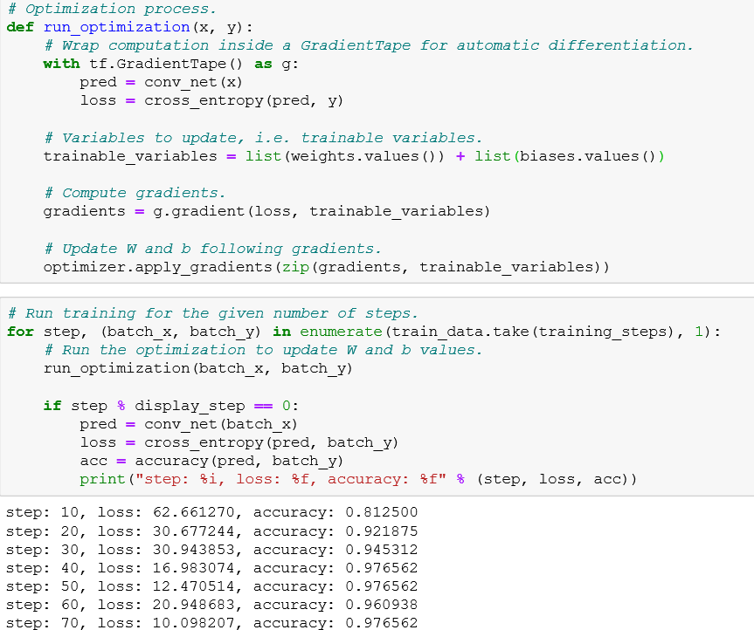
CNN with Low-level APIs
https://github.com/aymericdamien/TensorFlow-Examples

Slide 10
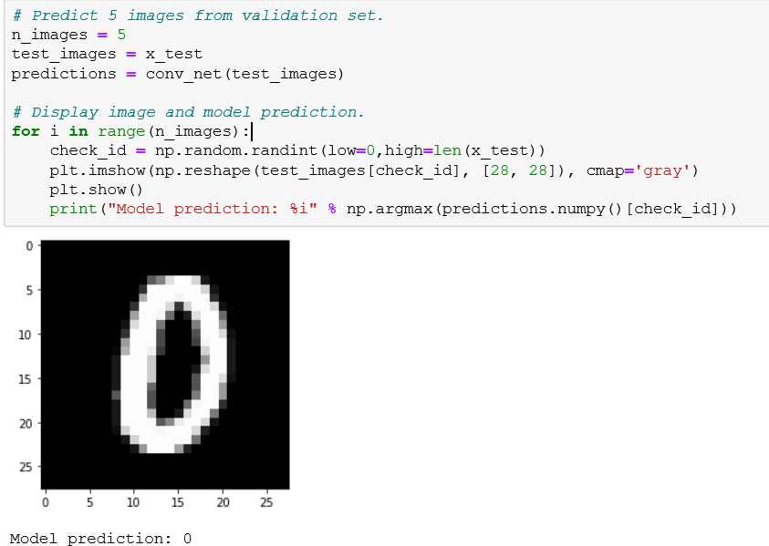
CNN with Low-level APIs
https://github.com/aymericdamien/TensorFlow-Examples

Slide 11
OUTLINES
OUTLINES
1
CNN with Low-level APIs
2
CNN with High-level APIs
3
RNN with High-level APIs
4
Discussion

Slide 12
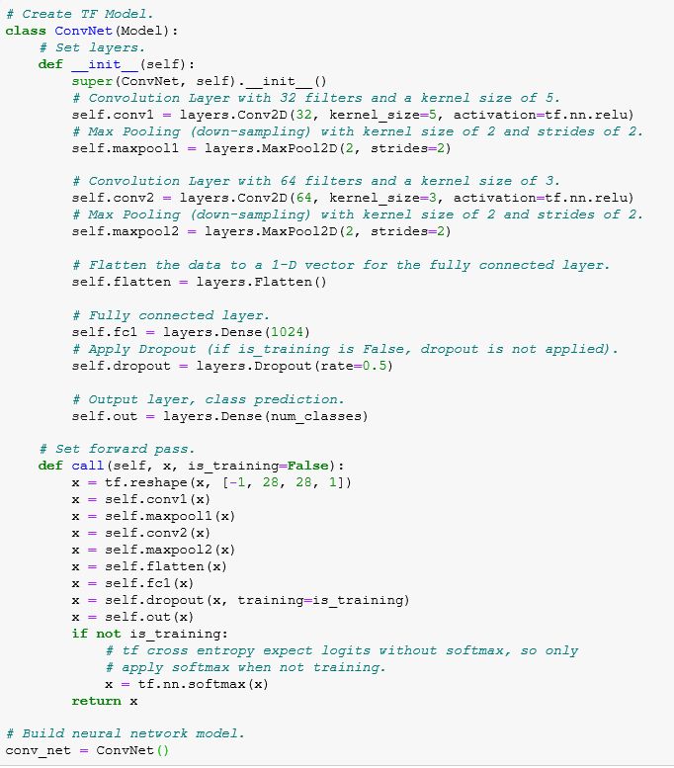
CNN with High-level APIs
https://github.com/aymericdamien/TensorFlow-Examples

Slide 13
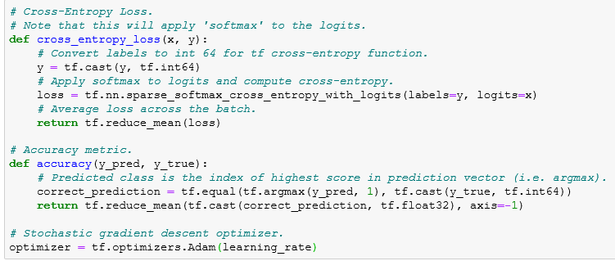
CNN with High-level APIs
https://github.com/aymericdamien/TensorFlow-Examples

Slide 14
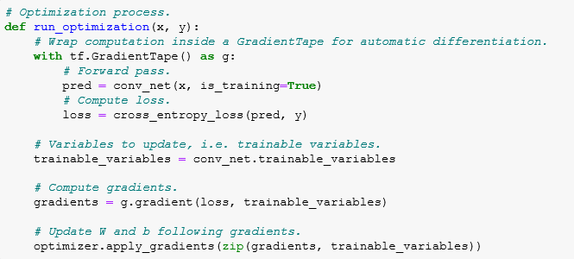
CNN with High-level APIs
https://github.com/aymericdamien/TensorFlow-Examples

Slide 15
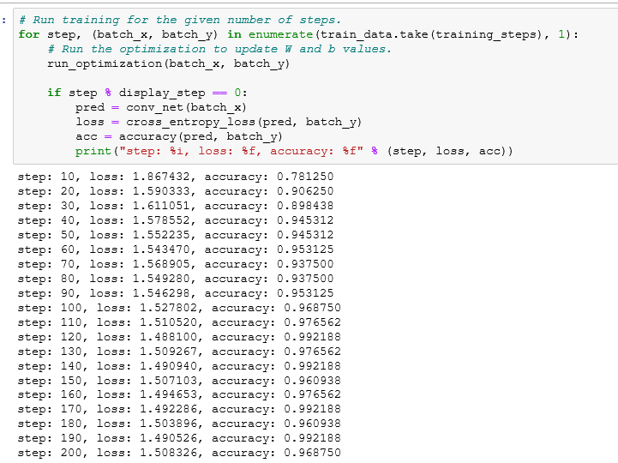
CNN with High-level APIs
https://github.com/aymericdamien/TensorFlow-Examples

Slide 16
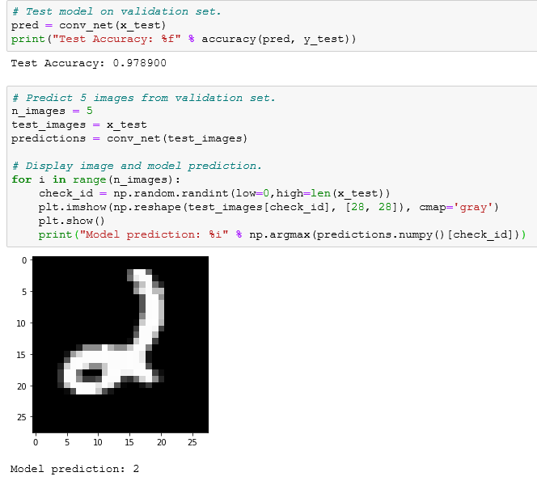
CNN with High-level APIs
https://github.com/aymericdamien/TensorFlow-Examples

Slide 17
OUTLINES
OUTLINES
1
CNN with Low-level APIs
2
CNN with High-level APIs
3
RNN with High-level APIs
4
Discussion

Slide 18
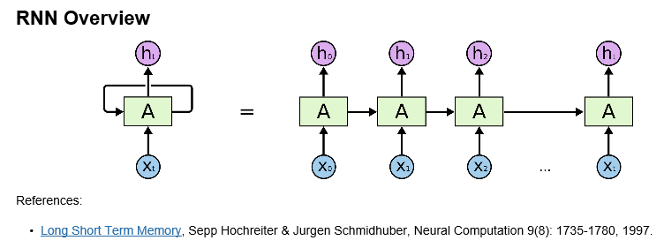
RNN with High-level APIs
https://github.com/aymericdamien/TensorFlow-Examples

Slide 19
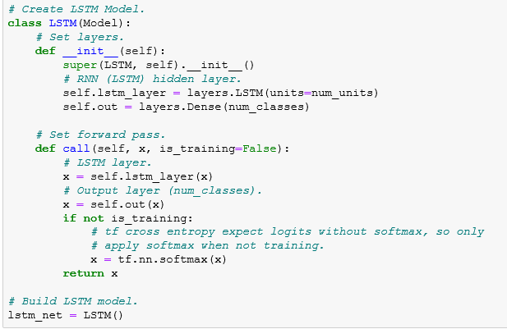
RNN with High-level APIs
https://github.com/aymericdamien/TensorFlow-Examples

Slide 20
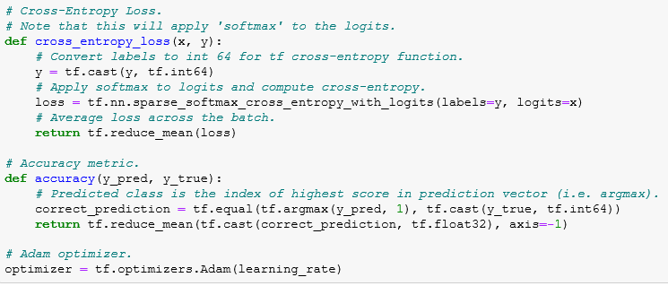
RNN with High-level APIs
https://github.com/aymericdamien/TensorFlow-Examples

Slide 21
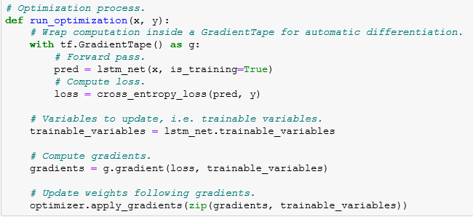
RNN with High-level APIs
https://github.com/aymericdamien/TensorFlow-Examples

Slide 22
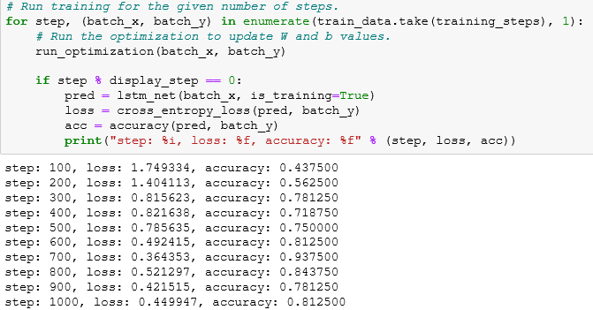
RNN with High-level APIs
https://github.com/aymericdamien/TensorFlow-Examples

Slide 23
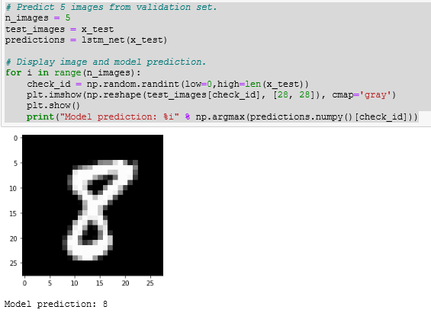
RNN with High-level APIs
https://github.com/aymericdamien/TensorFlow-Examples

Slide 24
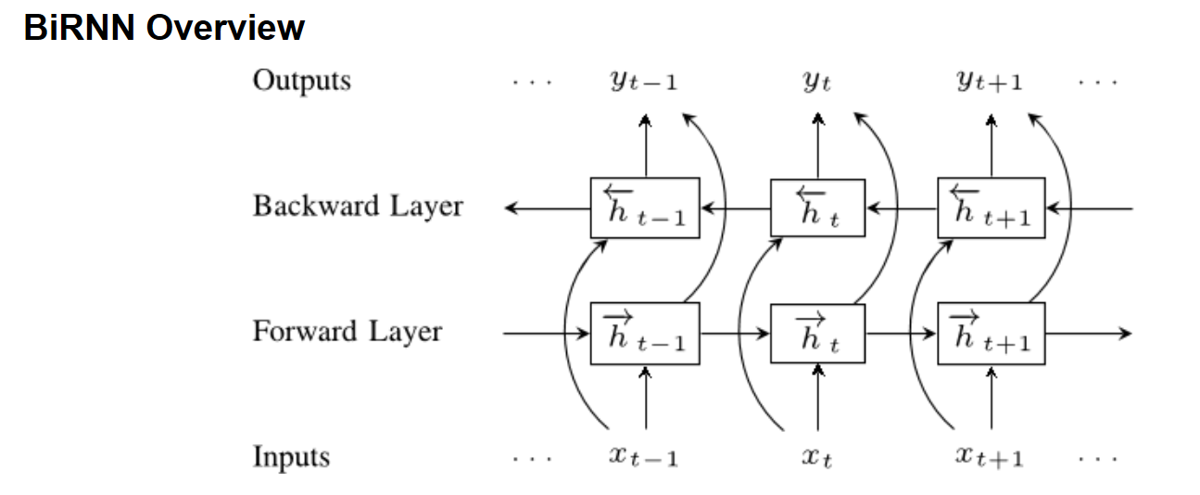
RNN with High-level APIs
https://github.com/aymericdamien/TensorFlow-Examples

Slide 25
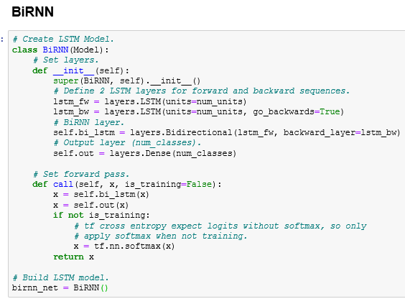
RNN with High-level APIs
https://github.com/aymericdamien/TensorFlow-Examples

Slide 26
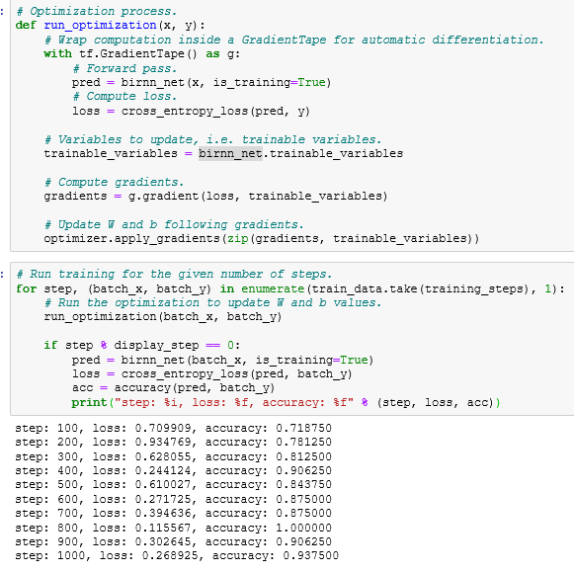
RNN with High-level APIs
https://github.com/aymericdamien/TensorFlow-Examples

Slide 27
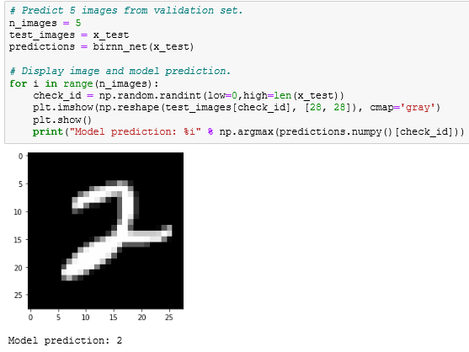
RNN with High-level APIs
https://github.com/aymericdamien/TensorFlow-Examples

Slide 28
OUTLINES
OUTLINES
1
CNN with Low-level APIs
2
CNN with High-level APIs
3
RNN with High-level APIs
4
Discussion

Slide 29

Discussion

