Slide 1

TensorFlow 2.0
Simple GANs
Deep Learning in Earth Science v2 Lecture 6
By Xiao Zhuowei
10.31.2019

Slide 2
OUTLINES
1
Deep Convolutional GAN
2
Wasserstein GAN
3
Conditional GAN
4
Discussion

Slide 3
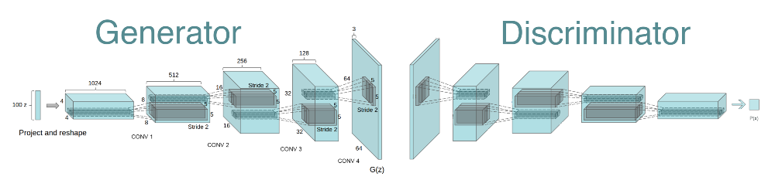
Deep Convolutional GAN
DCGAN Overview
https://github.com/aymericdamien/TensorFlow-Examples/

Slide 4
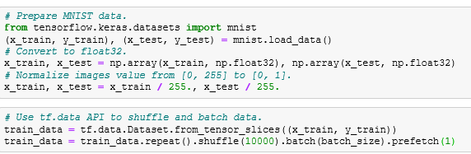
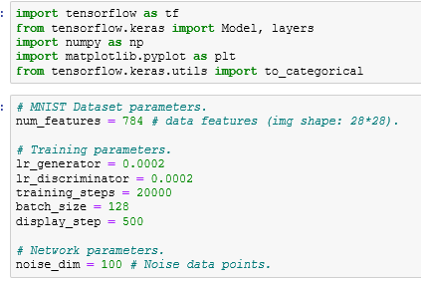
Deep Convolutional GAN
Prepare Dataset
Import Packages
Set GPU
https://github.com/aymericdamien/TensorFlow-Examples/

Slide 5
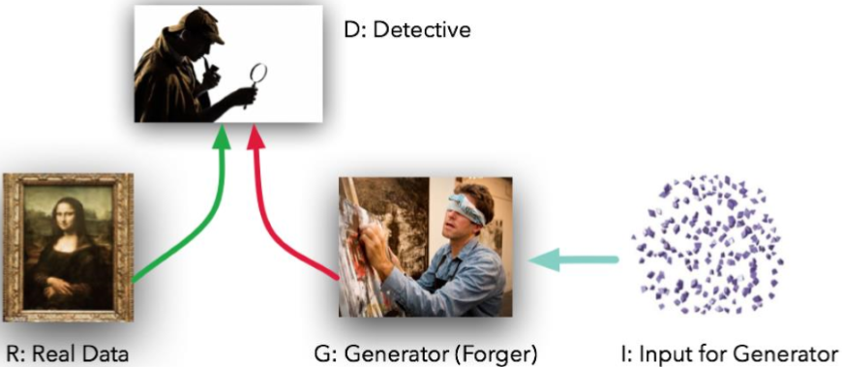
Deep Convolutional GAN
The first net Generate Net G generates fake data G(z) from the input random vector z.
The second net Discriminator Net D tries to tell the difference between the real data x and the fake data G(z).

Slide 6
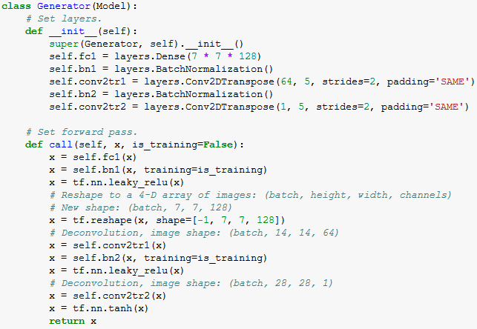
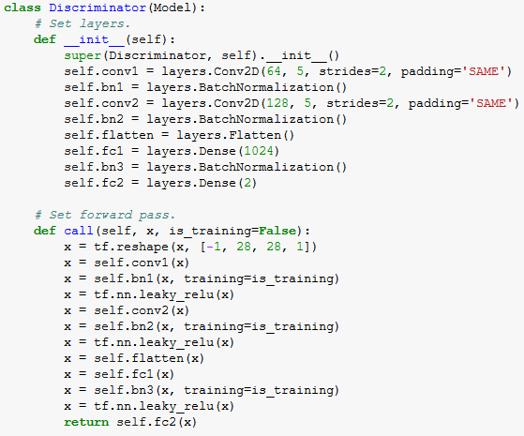

Deep Convolutional GAN
Generator
Discriminator
https://github.com/aymericdamien/TensorFlow-Examples/

Slide 7
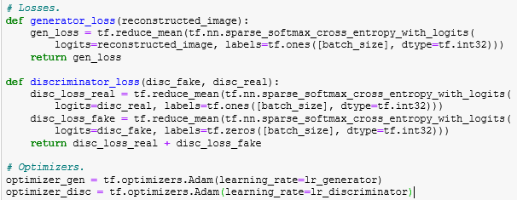
Deep Convolutional GAN
Loss function
https://github.com/aymericdamien/TensorFlow-Examples/

Slide 8
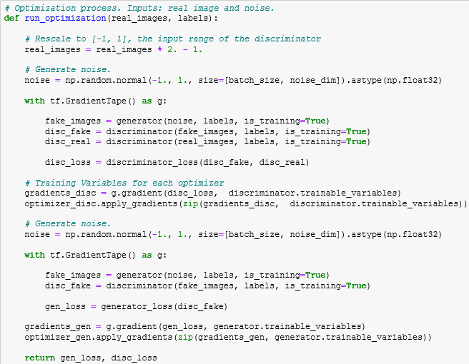
Deep Convolutional GAN
Optimization
https://github.com/aymericdamien/TensorFlow-Examples/

Slide 9
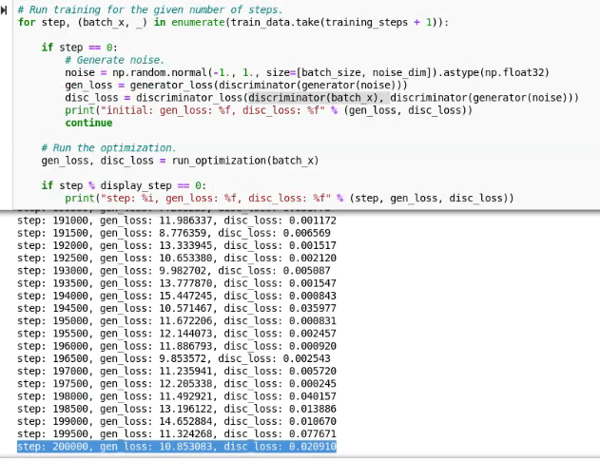
Deep Convolutional GAN
Train
https://github.com/aymericdamien/TensorFlow-Examples/

Slide 10
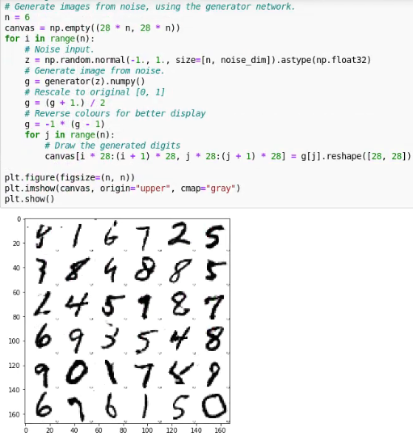
Deep Convolutional GAN
Test
https://github.com/aymericdamien/TensorFlow-Examples/

Slide 11
OUTLINES
1
Deep Convolutional GAN
2
Wasserstein GAN
3
Conditional GAN
4
Discussion

Slide 12
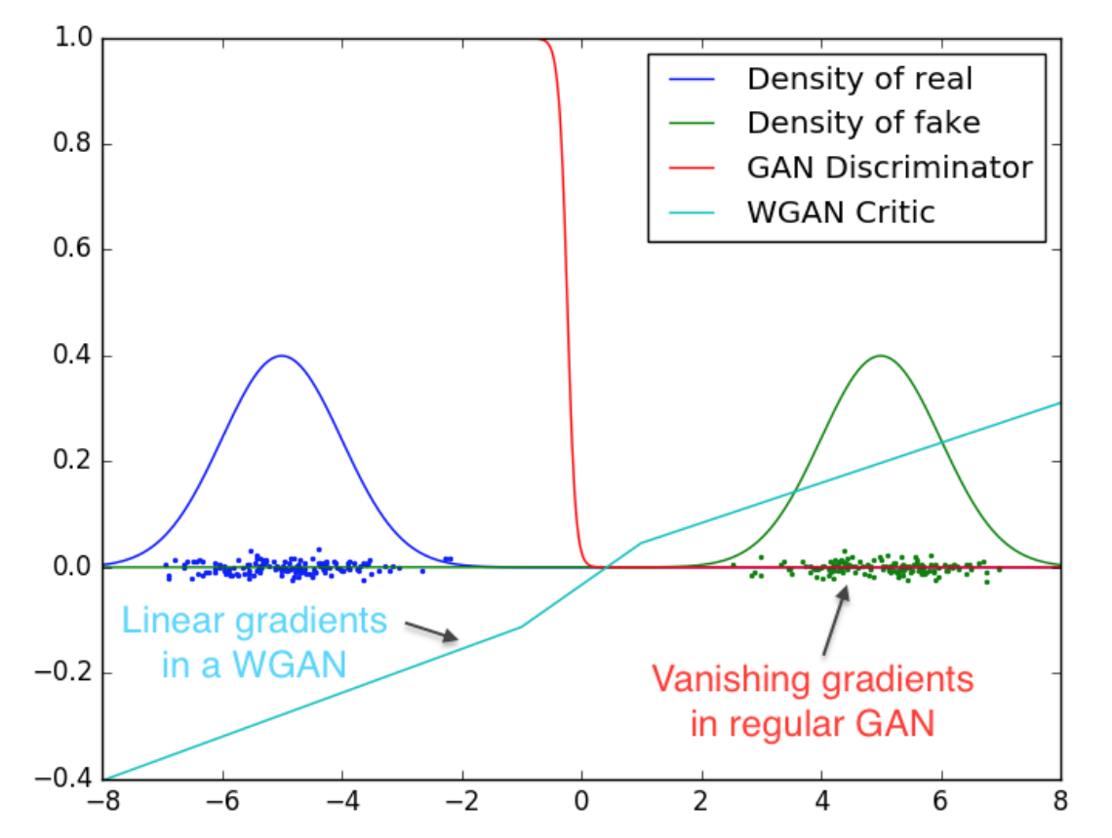
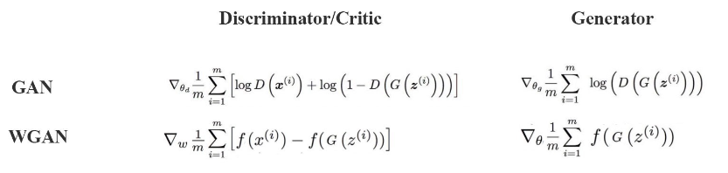
Wasserstein GAN
WGAN Overview
https://medium.com/@jonathan_hui/gan-wasserstein-gan-wgan-gp-6a1a2aa1b490

Slide 13
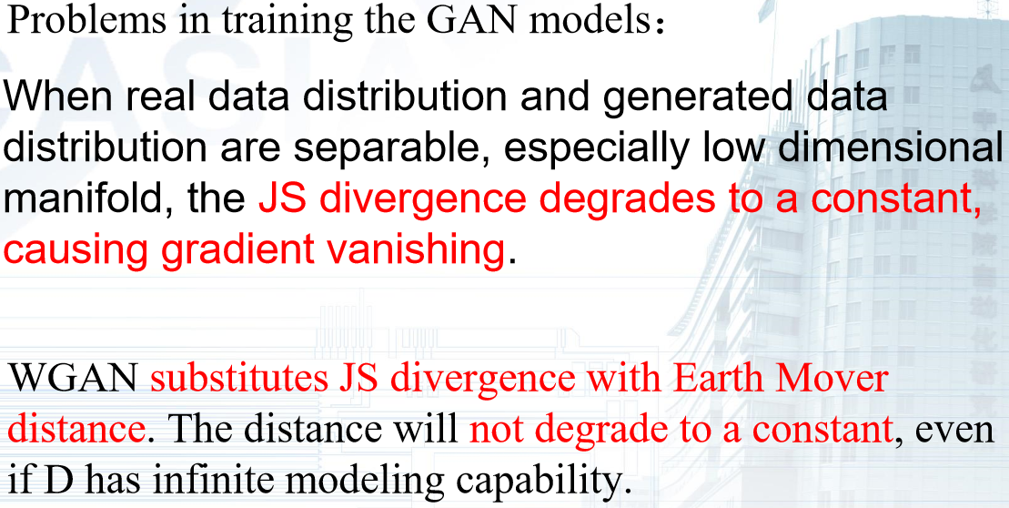
Wasserstein GAN

Slide 14
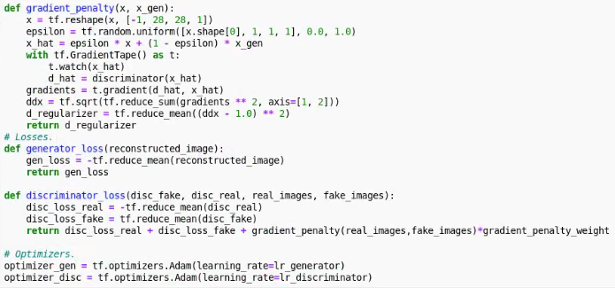
Wasserstein GAN

Slide 15
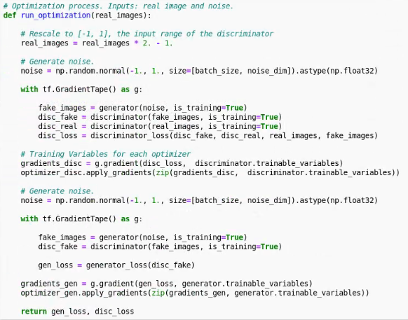
Wasserstein GAN

Slide 16
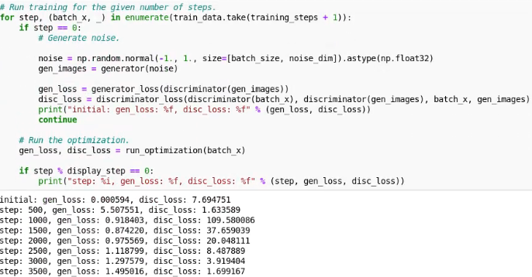
Wasserstein GAN

Slide 17
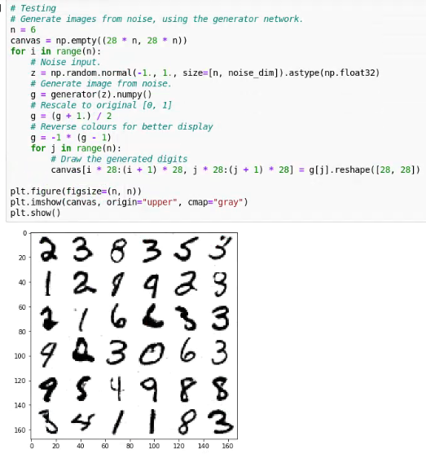
Wasserstein GAN

Slide 18
OUTLINES
1
Deep Convolutional GAN
2
Wasserstein GAN
3
Conditional GAN
4
Discussion

Slide 19
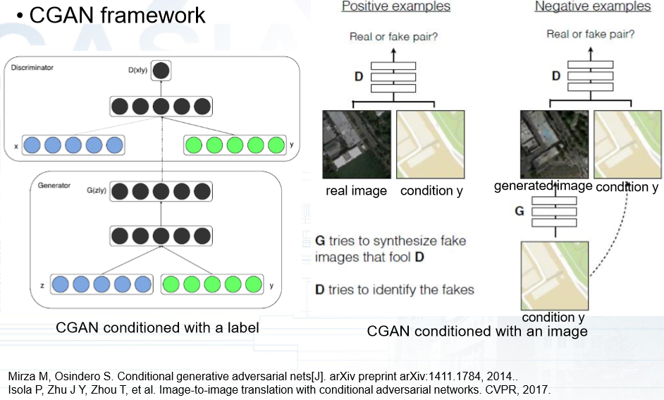
Conditional GAN
CGAN Overview

Slide 20
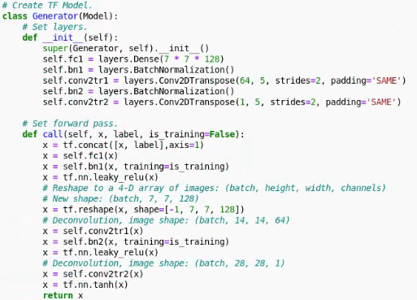
Conditional GAN

Slide 21
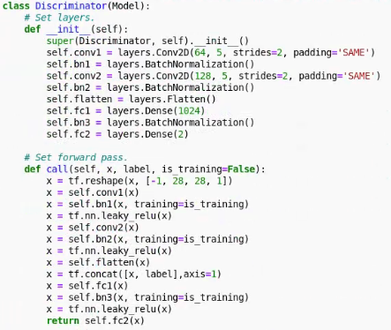
Conditional GAN

Slide 22
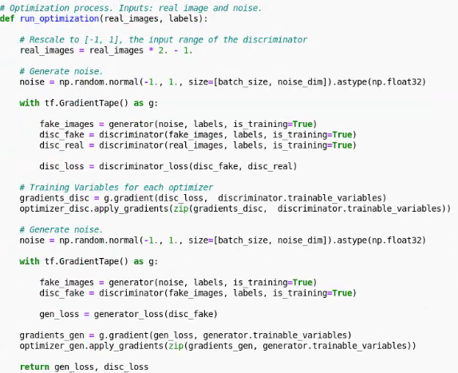
Conditional GAN

Slide 23
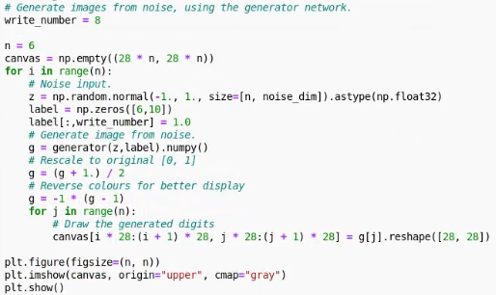
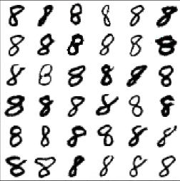
Conditional GAN

Slide 24
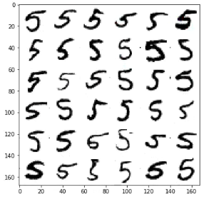
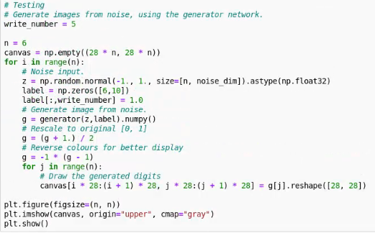
Conditional GAN

Slide 25
OUTLINES
1
Deep Convolutional GAN
2
Wasserstein GAN
3
Conditional GAN
4
Discussion

Slide 26

Discussion

