Slide 1

Measure Of
Information
Deep Learning in Earth Science v2 Lecture 3
By Xiao Zhuowei
10.18.2019

Slide 2
OUTLINES
OUTLINES
1
Maximum Likelihood Estimation
2
Information Entropy
3
Common Loss Functions
4
Discussion

Slide 3


Maximum Likelihood Estimation
From a statistical standpoint, a given set of observations are a random sample from an unknown population. The goal of maximum likelihood estimation is to make inferences about the population that is most likely to have generated the sample.
$$X=\left\{x_{1},x_{2},…,x_{m}\right\}$$
drawn independently from
$$p\left(x\right)$$

Slide 4

Maximum Likelihood Estimation
Model the true distribution by parametric model q(x;𝜃) with 𝜃 as the parameter.
$$θ_{DL}=\underset{θ}{argmax}{ q\left(X;θ\right)}$$

Slide 5
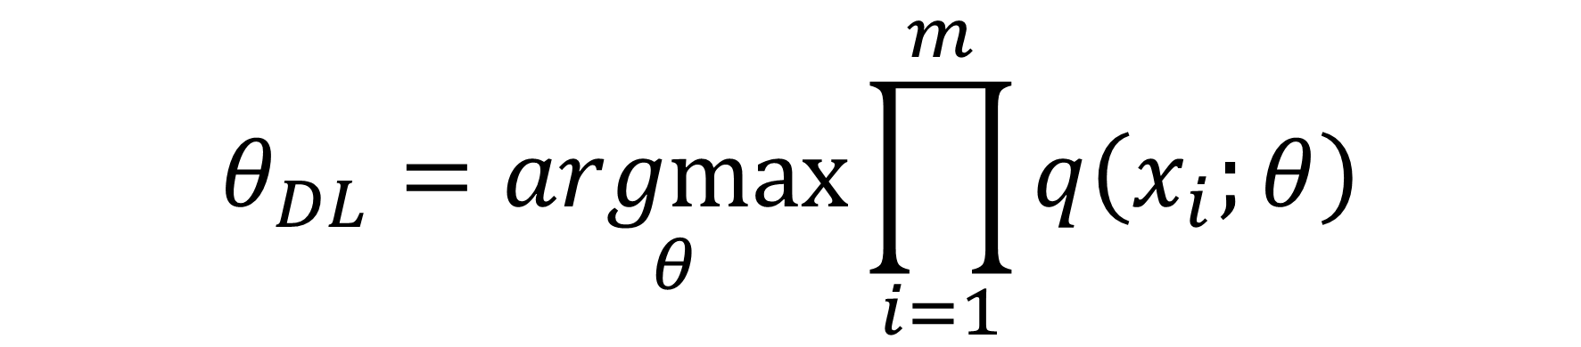
Maximum Likelihood Estimation
Since each example x_{i} in X are independent of each other, then we can write 𝜃_{DL} as
$$θ_{DL}=\underset{θ}{argmax}{\prod_{i=1}^{m}{q\left(x_{i};θ\right)}}$$

Slide 6
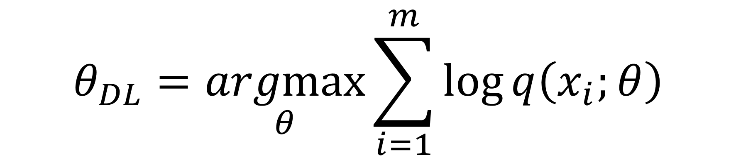
Maximum Likelihood Estimation
To avoid underflow to the computer, we can write 𝜃_{DL} as
$$θ_{DL}=\underset{θ}{argmax}{\sum_{i=1}^{m}{\log{q\left(x_{i};θ\right)}}}$$

Slide 7


Maximum Likelihood Estimation
$$θ_{DL}=\underset{θ}{argmax}{\sum_{i=1}^{m}{\log{q\left(x_{i};θ\right)}}}$$
$$=\underset{θ}{argmax}{\sum_{i=1}^{m}{\frac{1}{m}log{q\left(x_{i};θ\right)}}}$$
$$=\underset{θ}{argmax}{E_{p}\left[\log{q\left(x;θ\right)}\right]}$$
$$=\underset{θ}{argmin}{{−E}_{p}\left[\log{q\left(x;θ\right)}\right]}$$

Slide 8

Maximum Likelihood Estimation
Minimizing the cross-entropy loss can lead model to maximum likelihood estimator.

Slide 9
OUTLINES
OUTLINES
1
Maximum Likelihood Estimation
2
Information Entropy
3
Common Loss Functions
4
Discussion

Slide 10
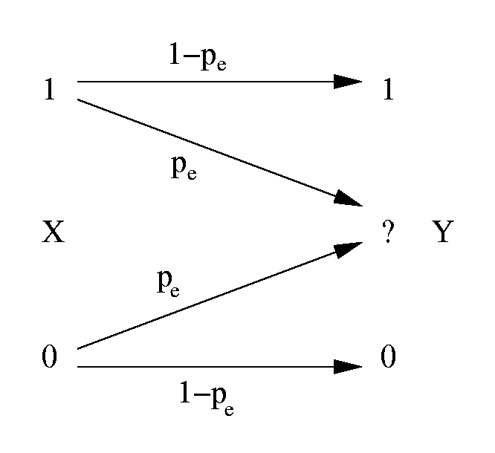
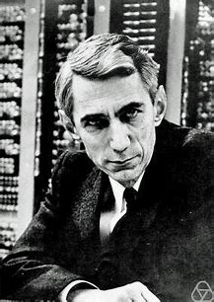
Information Entropy
Shannon (1948): “The fundamental problem of communication is that of reproducing at one point exactly or approximately a message selected at another point”.
https://en.wikipedia.org/wiki/Claude_Shannon

Slide 11

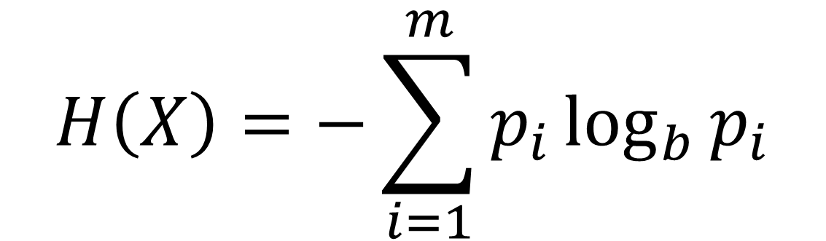
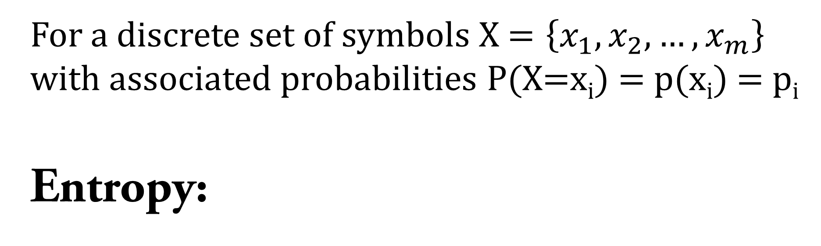
Information Entropy
For a discrete set of symbols X $=\left\{x_{1},x_{2},…,x_{m}\right\}$ with associated probabilities P(X=x_{i}) = p(x_{i}) = p_{i}
Entropy:
$$H\left(X\right)=−\sum_{i=1}^{m}{p_{i}\log_{b}{p_{i}}}$$

Slide 12

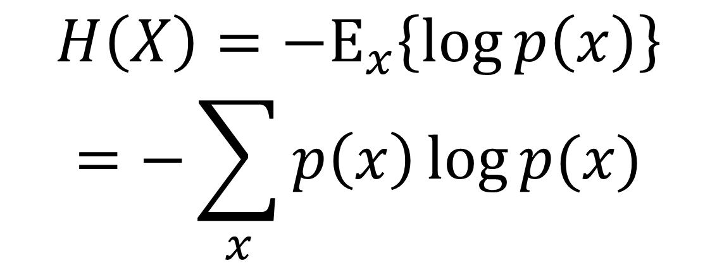
Information Entropy
Entropy (Expectation form):
$$H\left(X\right)={−E}_{x}\left\{\log{p\left(x\right)}\right\}$$
$$=−\sum_{x}{p\left(x\right)\log{p(x)}}$$

Slide 13
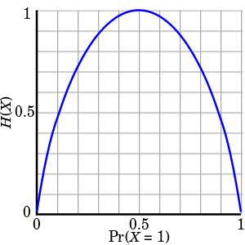
Information Entropy
Binary Entropy Function:
$$H\left(X\right)=−p\log_{2}{p}−(1−p)\log_{2}{(1−p)}$$
https://en.wikipedia.org/wiki/Entropy_(information_theory)

Slide 14
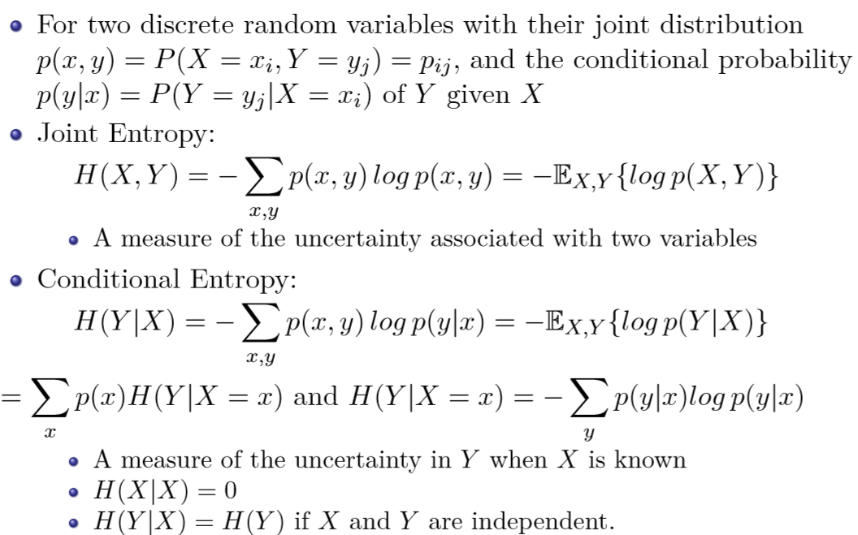
Information Entropy
(B.-G. Hu, 2018, Basics of Information Theory, UCAS Lecture)

Slide 15
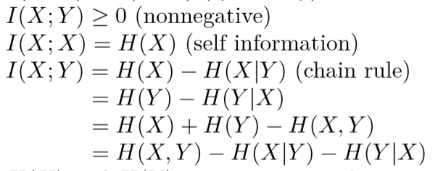
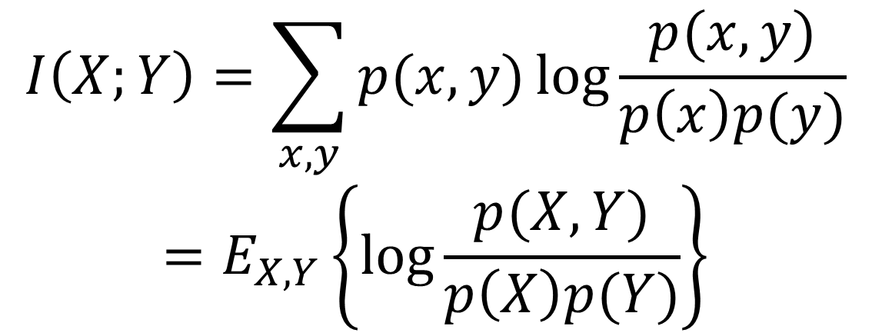
Information Entropy
Mutual Information:
A measure of mutual dependence between the two variables
$$I\left(X;Y\right)=\sum_{x,y}{p(x,y)\log{\frac{p(x,y)}{p\left(x\right)p(y)}}}$$
$$=E_{X,Y}\left\{\log{\frac{p(X,Y)}{p\left(X\right)p(Y)}}\right\}$$

Slide 16
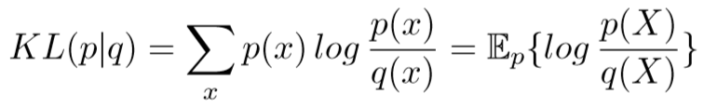
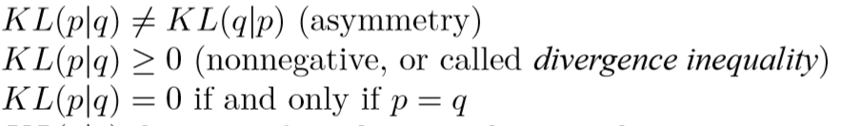
Information Entropy
Kullback-Leibler divergence (Relative Entropy):
A measure of the ‘distance’ between p and q
$$I\left(X;Y\right)=KL(p(x,y)|p\left(x\right)q\left(y\right))$$

Slide 17
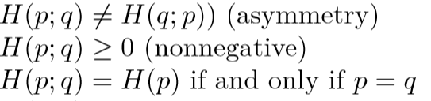
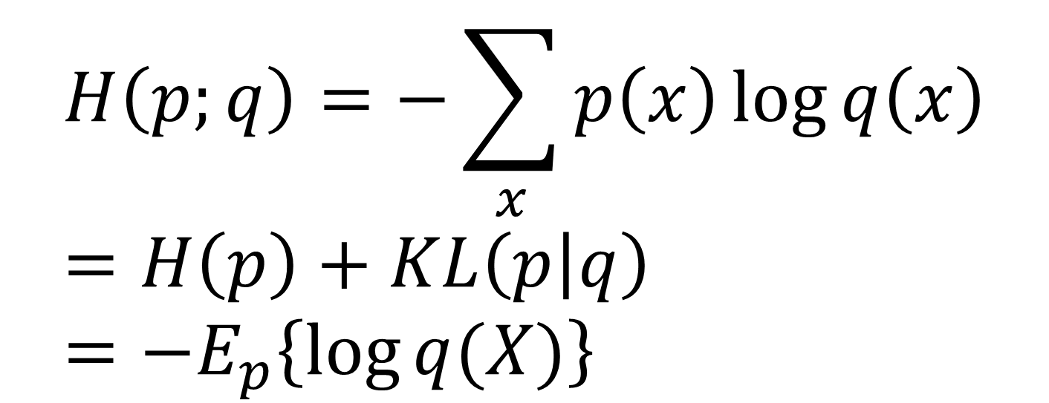
Information Entropy
Cross Entropy:
$$H\left(p;q\right)=−\sum_{x}{p\left(x\right)\log{q\left(x\right)}}=H\left(p\right)+KL\left(p | q\right)={−E}_{p}\left\{\log{q(X)}\right\}$$

Slide 18
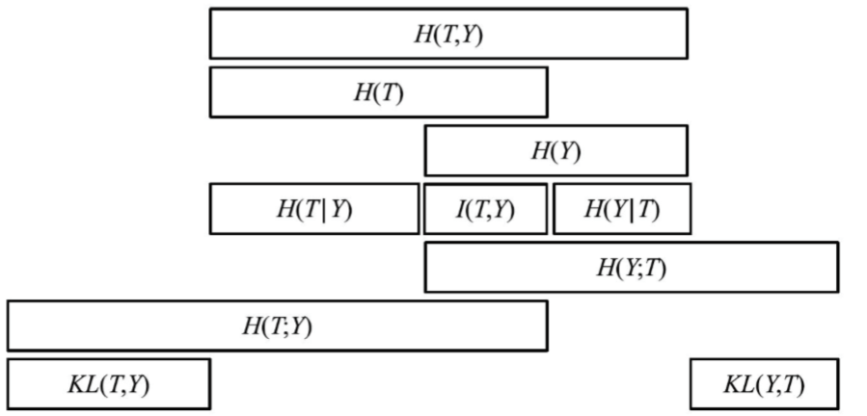
Information Entropy
Graphical interpretations of loss functions in supervised learning (Mackay, 2003, Hu 2015)

Slide 19
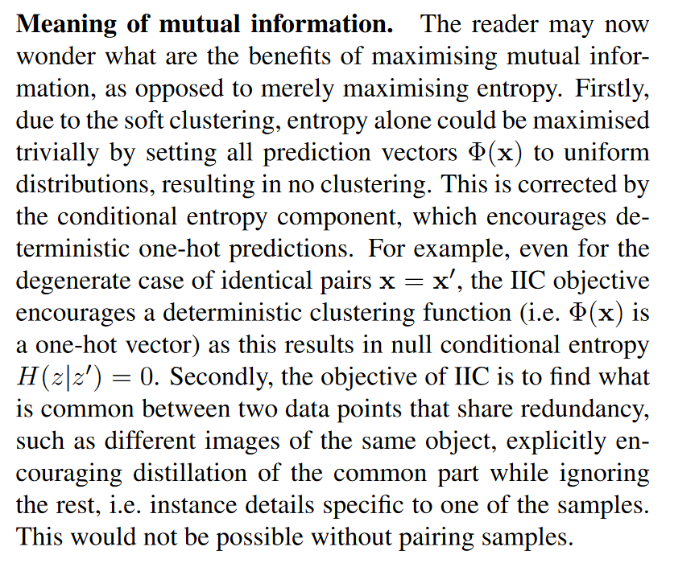
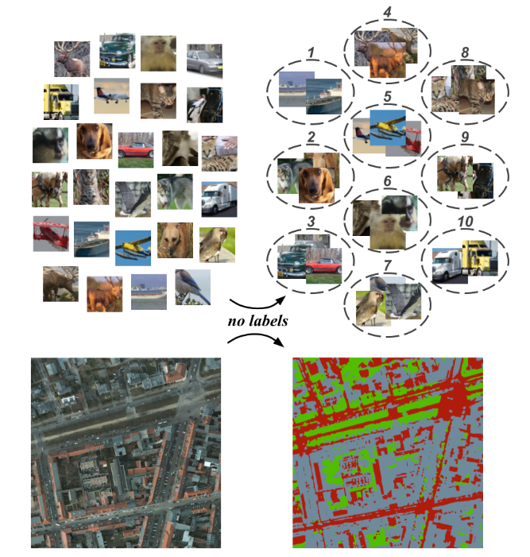
Information Entropy
(Ji et al., 2019, ICCV)

Slide 20
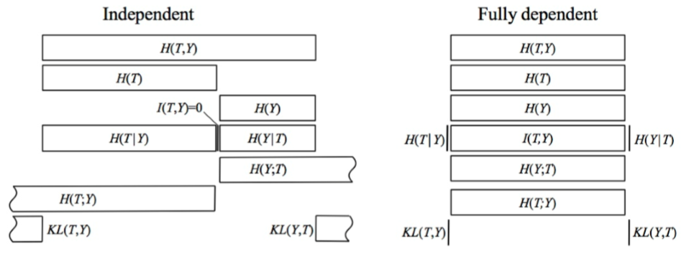
Information Entropy
Graphical interpretations of loss functions in supervised learning (Mackay, 2003, Hu 2015)

Slide 21
OUTLINES
OUTLINES
1
Maximum Likelihood Estimation
2
Information Entropy
3
Common Loss Functions
4
Discussion

Slide 22
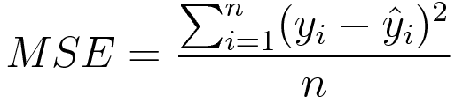
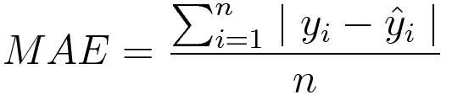
Common Loss Functions
Regression Losses
Mean Square Error/L2 Loss
Mean Absolute Error/L1 Loss

Slide 23
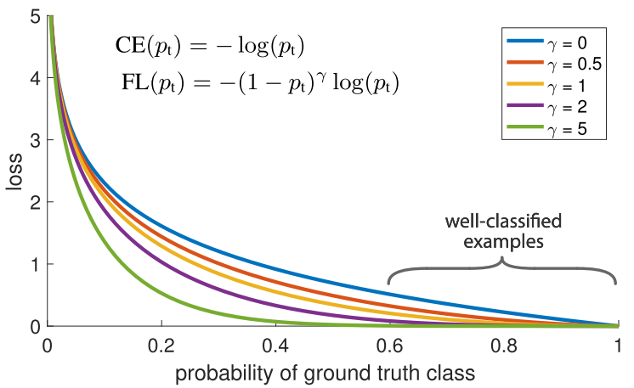


Common Loss Functions
Classification Losses
Cross Entropy Loss:
$$CE\left(p_{t}\right)=−\log\left(p_{t}\right)$$
Balanced Cross Entropy Loss:
$$CE\left(p_{t}\right)=−α_{t}log\left(p_{t}\right)$$
Focal Loss:
$$FL\left(p_{t}\right)=−{(1−p_{t})}^{γ}\log\left(p_{t}\right)$$
(Lin et al., 2018)

Slide 24
OUTLINES
OUTLINES
1
Maximum Likelihood Estimation
2
Information Entropy
3
Common Loss Functions
4
Discussion

Slide 25

Discussion

