Slide 1
Data management lab1
Team members :
Yassine TAHA
Saad Saber
Hafsa SAHNOUN2
Achraf RHANNAM

Slide 2
Part 1 — People and Laboratories
PE1–PE6 and LA1–LA4

Slide 3
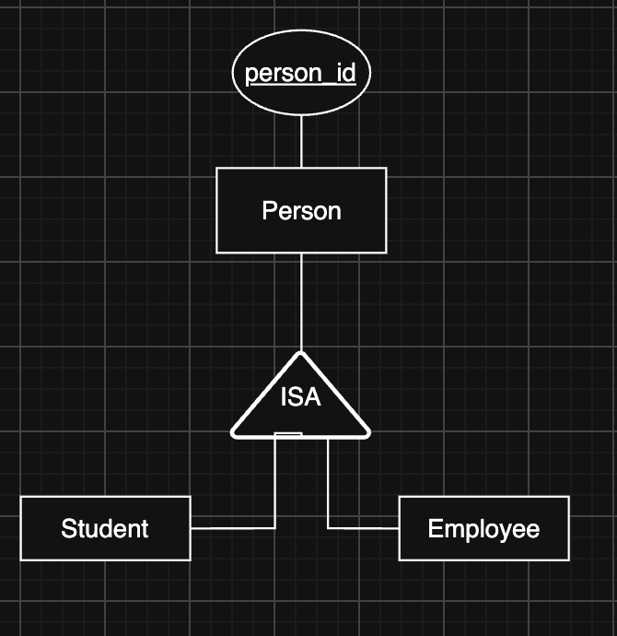
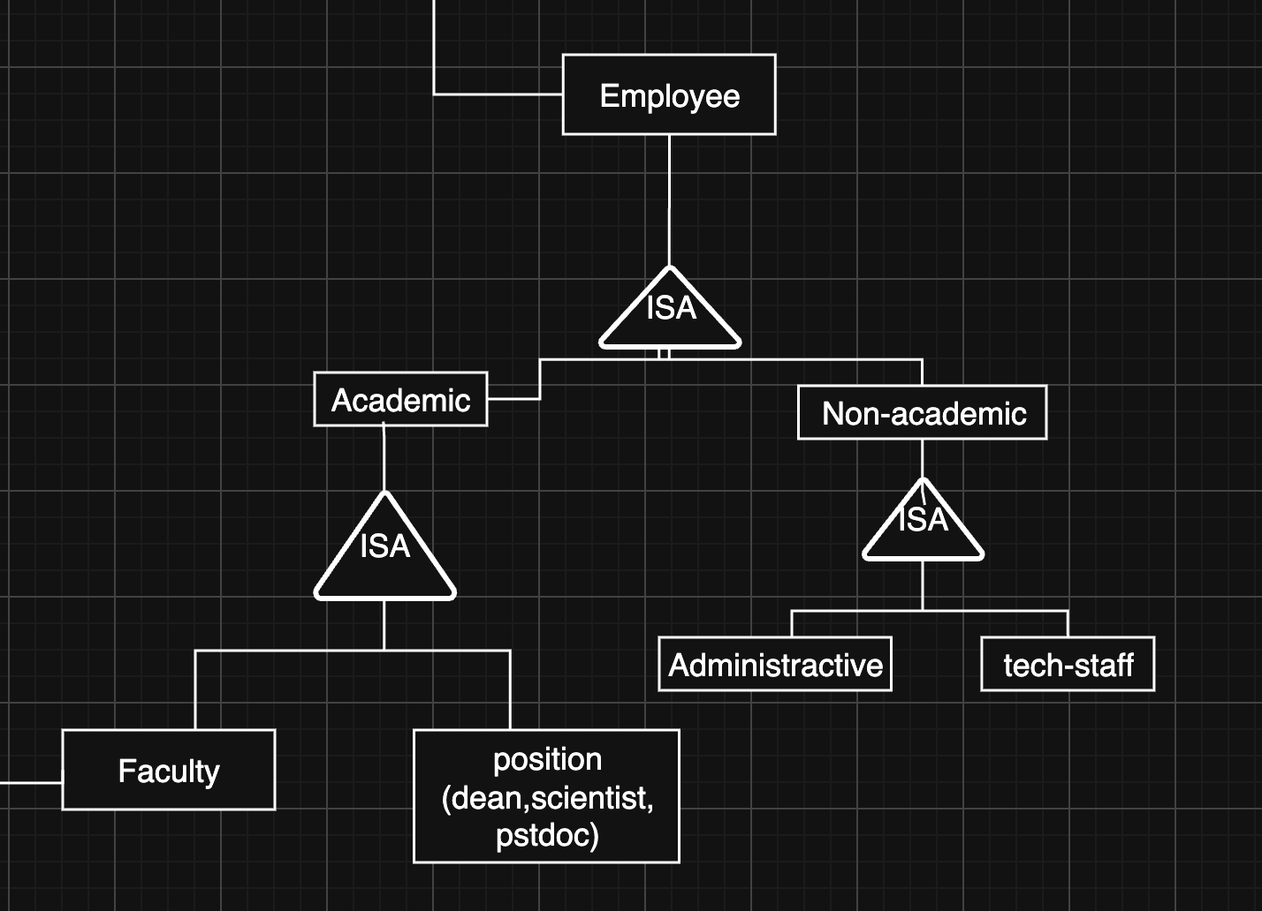
People hierarchy
Employee

Slide 4
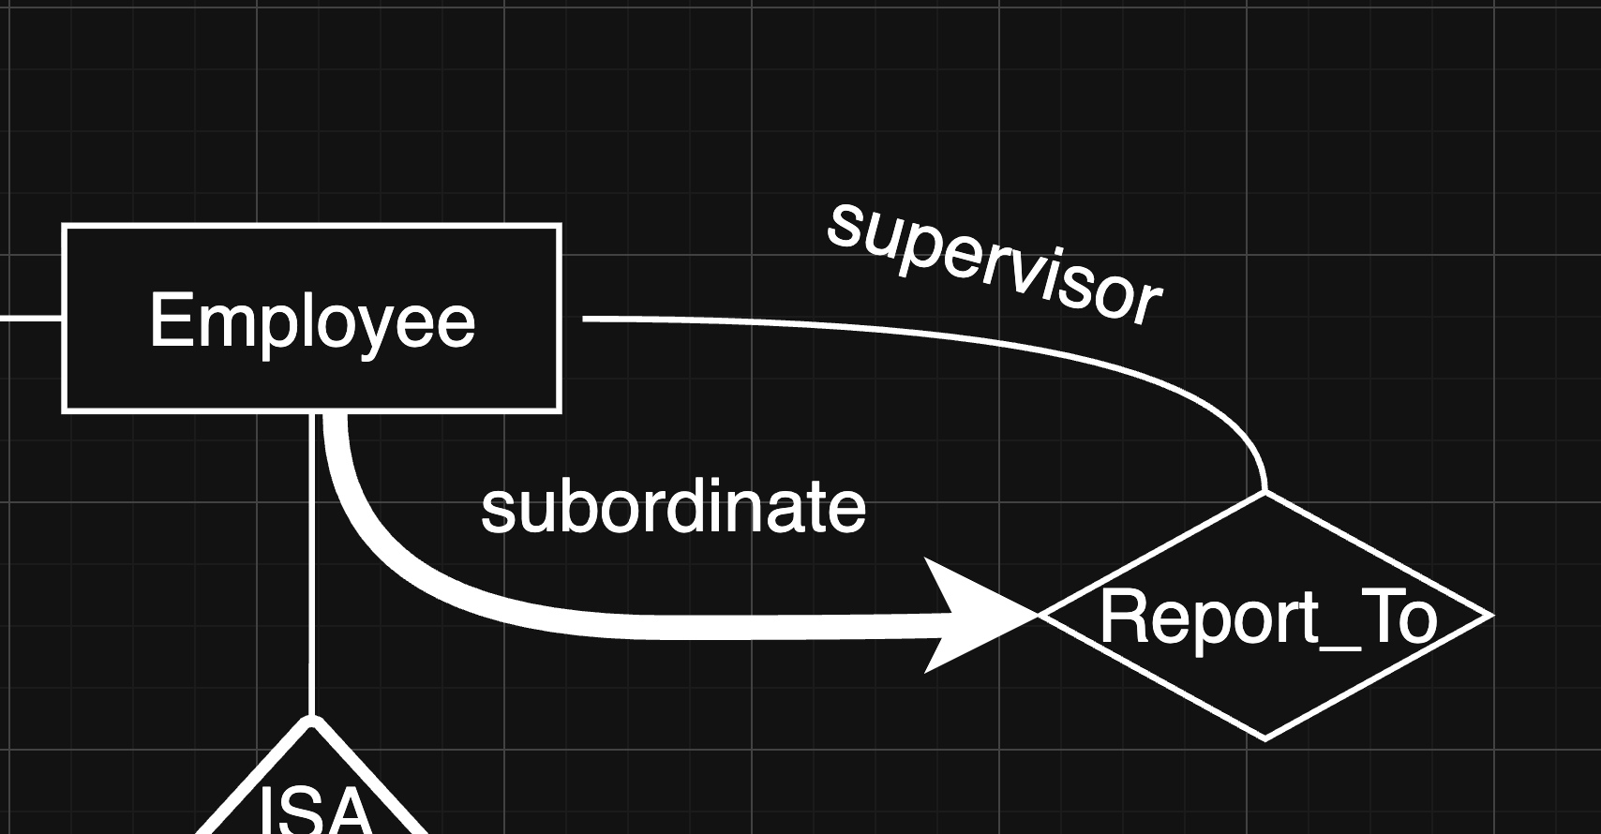
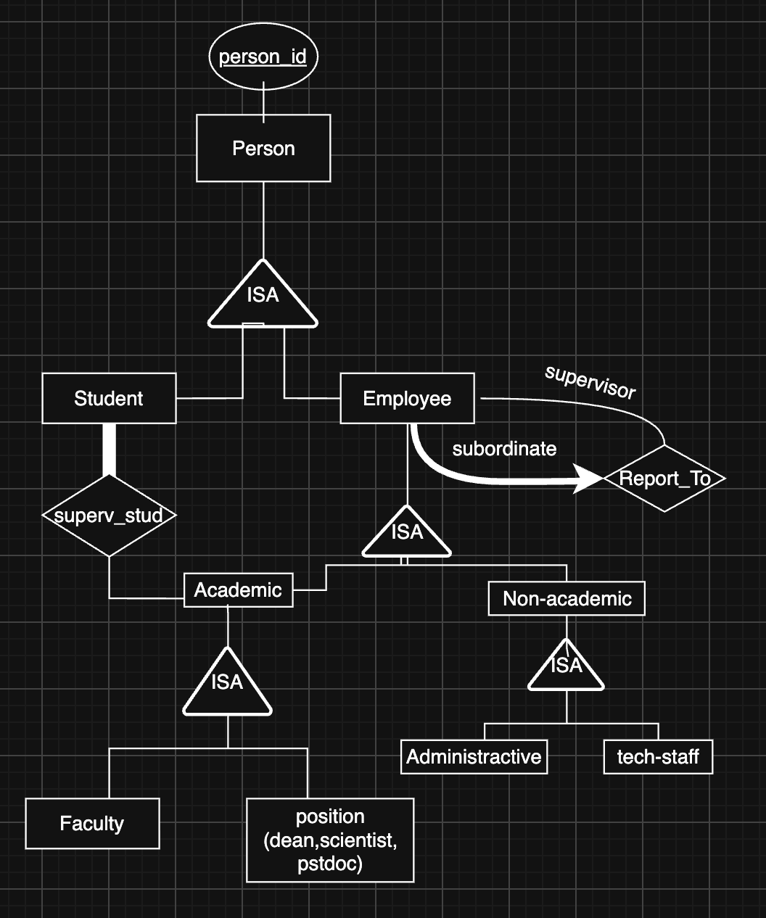
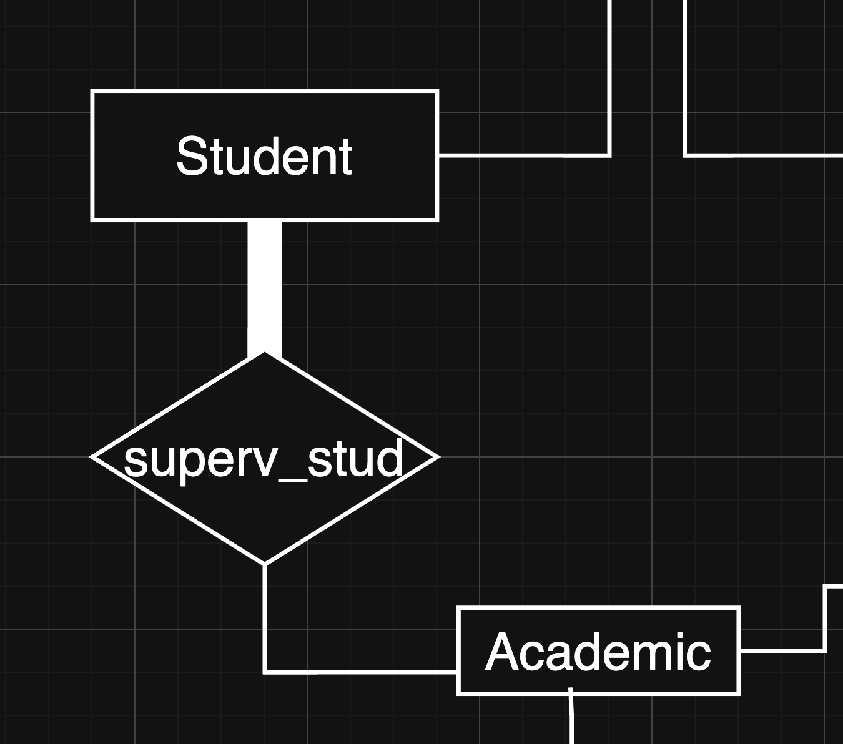
Recursive relationship :
Supervision relationship :

Slide 5
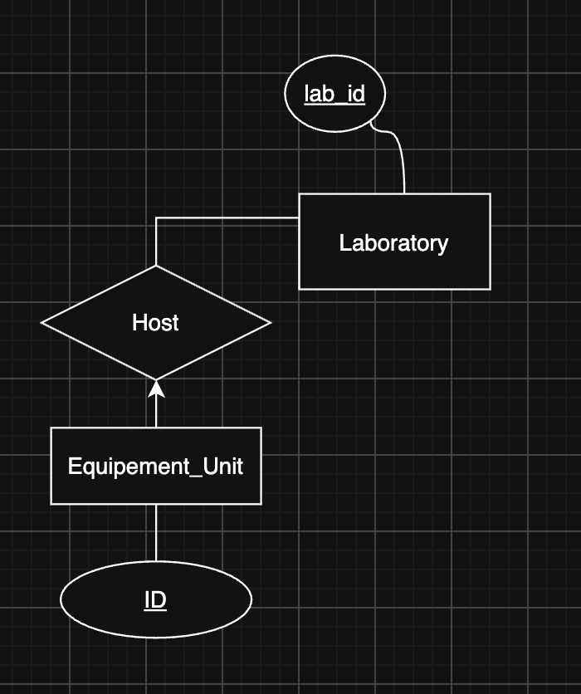
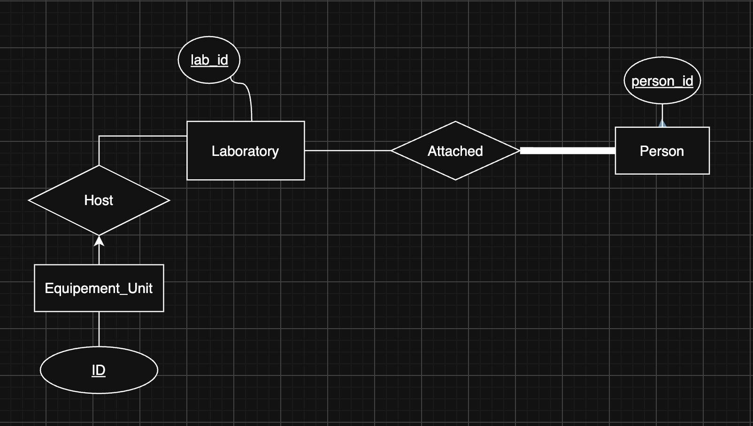
Host relationship:
Attached relationship :

Slide 6
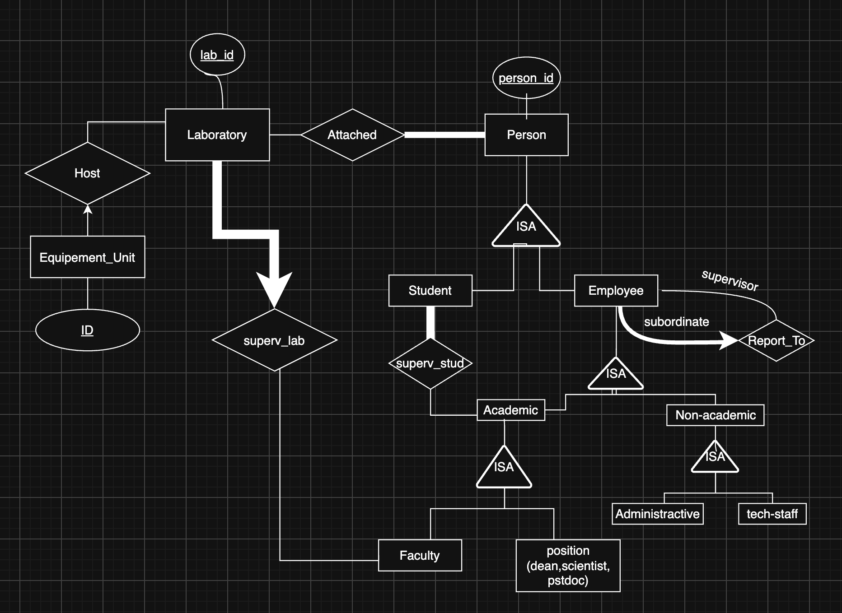
M1 ER Model
• People (PE1–PE6)
• ISA hierarchies
• Laboratories (LA1–LA4)

Slide 7
Part 2 — Reaserch Projects and Budgets
PR1-PR4, BD1-BD3, RE1-RE3

Slide 8
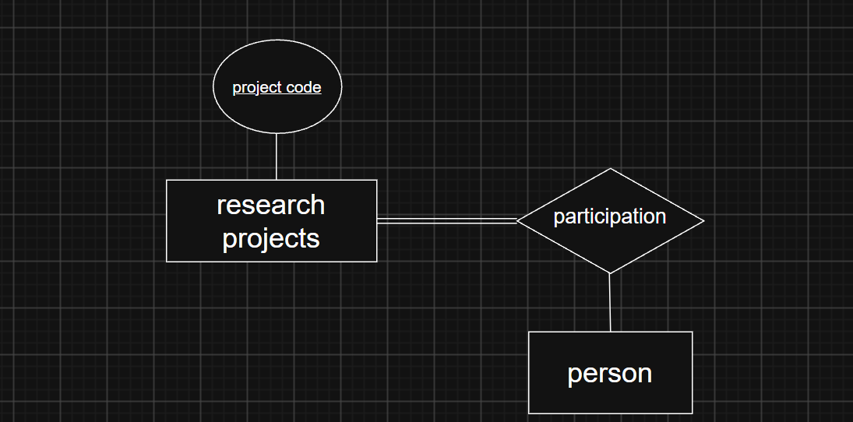
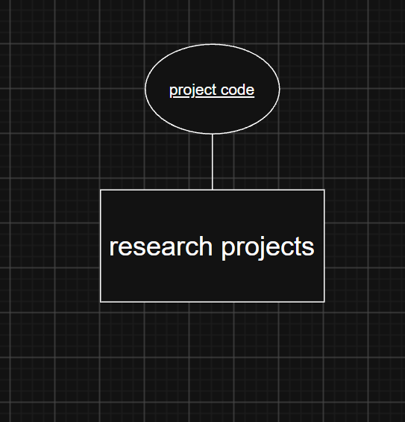
Reaserch project entity :
Involves relationship :

Slide 9
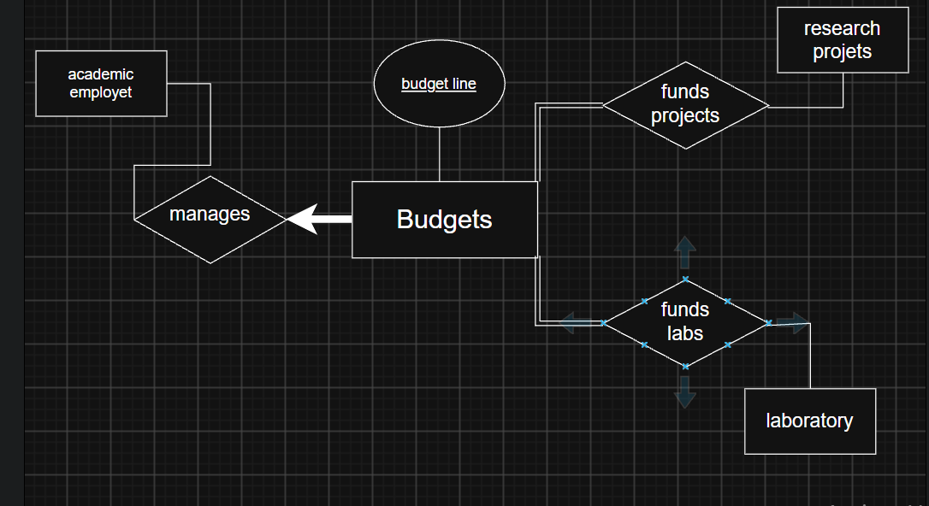
Badget entity and manage relationship :

Slide 10
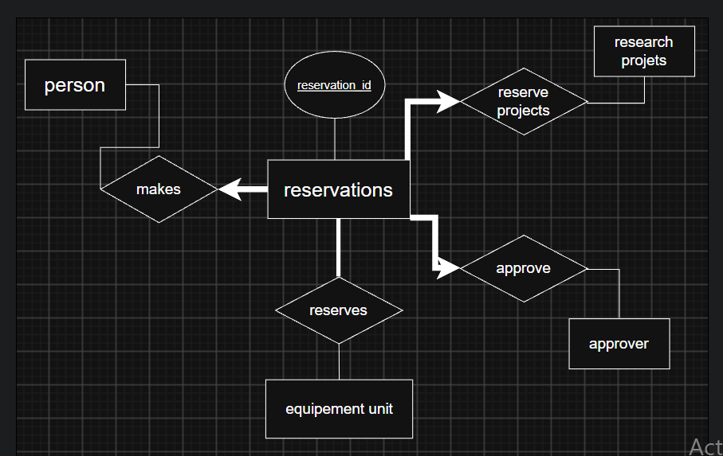
Reservation entity and relation ships :

Slide 11
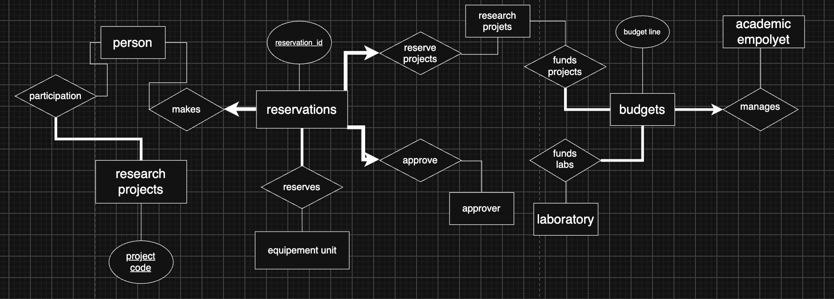
M2 ER Model
PR1-PR4, BD1-BD3, RE1-RE3

Slide 12
Part 3 — Equipment and Operations
EQ1–EQ7, CE1–CE7, MA1–MA3 and CA1–CA4

Slide 13
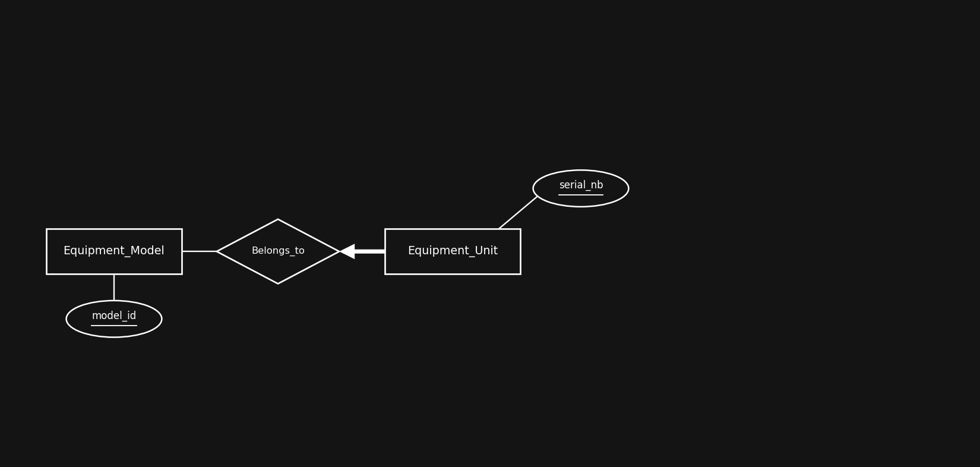
Equipment model and equipment unit
EQ1 · EQ2 · EQ5
Notes:
EQ1 asks us to separate the catalogue entry from the physical object. Keeping one entity set would repeat the manufacturer and the category on every serial number, and would turn the certification rule of CE6 into a rule written once per unit.
Belongs_to has a thick arrow from Equipment_Unit. The arrow means at most one model, the thick line means at least one, so together they give the exactly one of EQ5. Equipment_Model is thin because a model can exist with no unit yet.

Slide 14
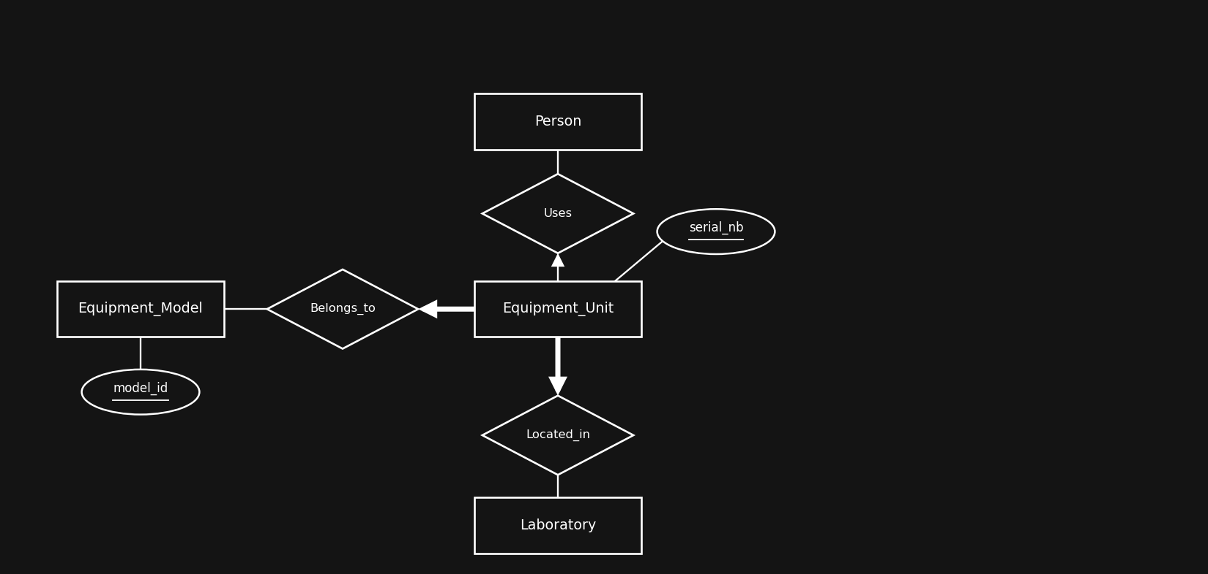
Who is using a unit
EQ7
Notes:
EQ7 gives an asymmetric cardinality: at most one person per unit at a time, but one person can hold several units. That is an arrow on the Equipment_Unit side only. Both lines are thin, a unit can sit idle and a person can be using nothing. The word eligible in EQ7 comes from CE7 and cannot be drawn.

Slide 15
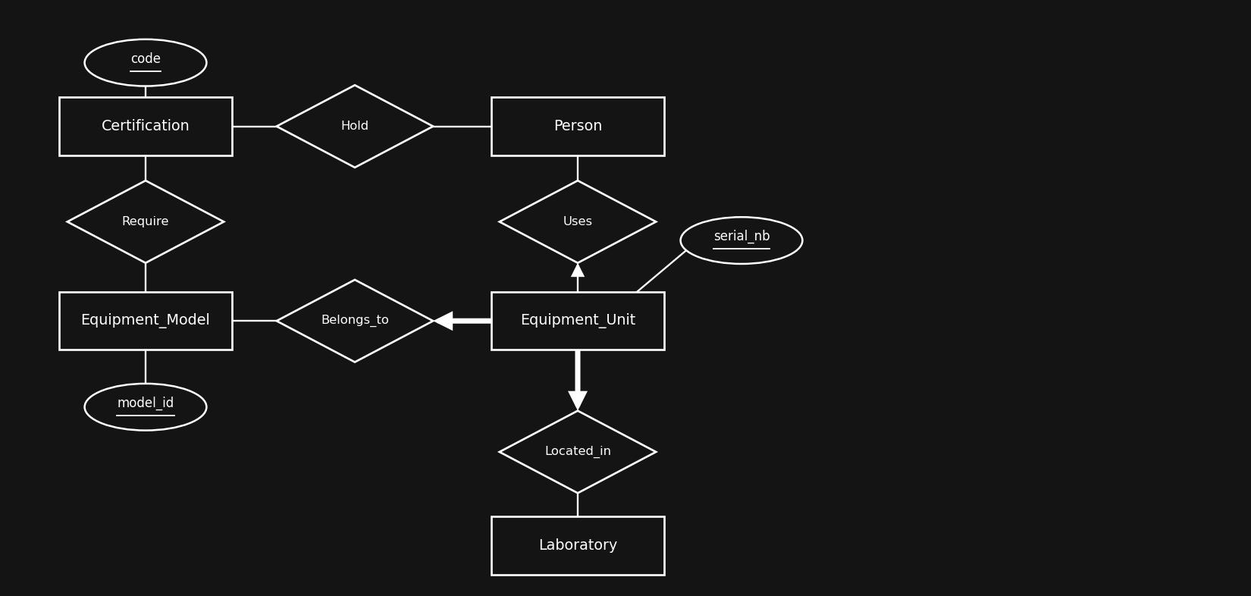
Certifications and authorizations
CE1–CE6
Notes:
Require is many to many (CE6) and is attached to Equipment_Model, not to the unit, because a certification authorises a make and model. Both sides are thin since CE1 says only certain equipment needs certification.
Hold is many to many too (CE3). The issue date, expiration date and grade of CE4 sit on the relationship because they describe the award. CE5 needs nothing extra: a relationship set holds one instance per pair, so a new award replaces the old one.

Slide 16
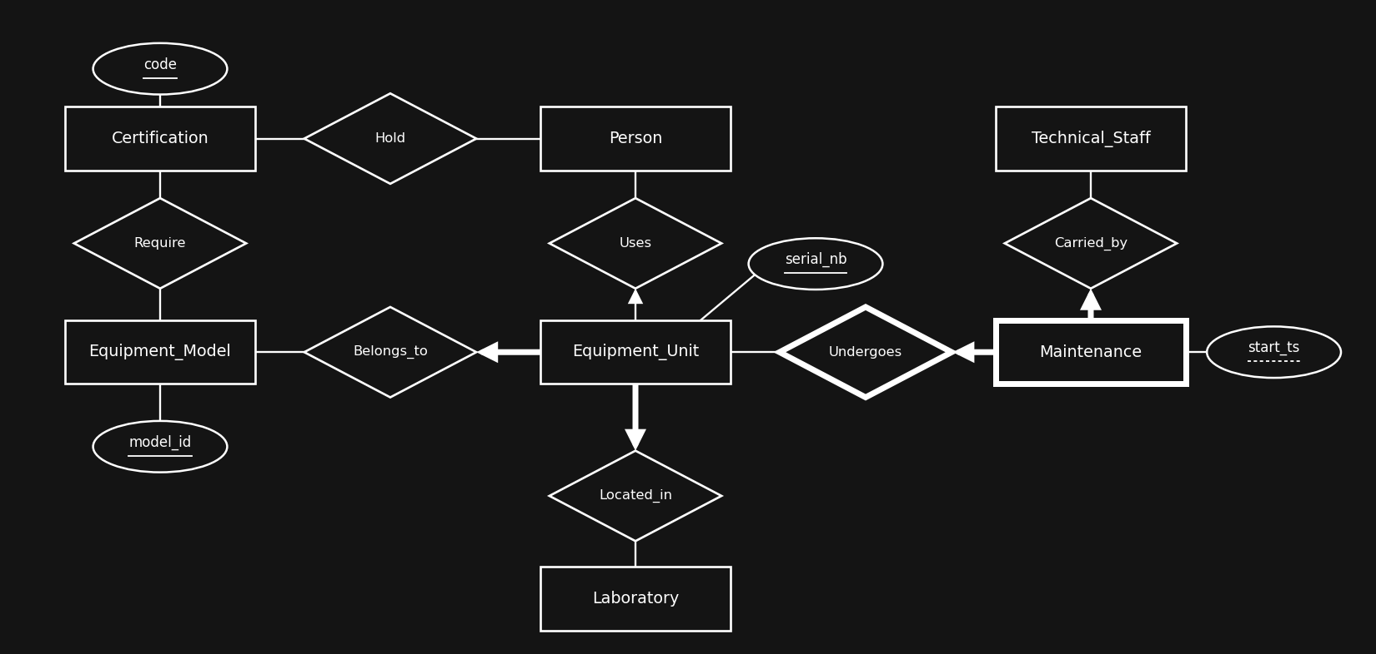
Maintenance
MA1 · MA2 · MA3
Notes:
MA2 identifies a maintenance by the serial number plus the start timestamp, so start_ts is a partial key and Maintenance is a weak entity set. Undergoes is its identifying relationship and carries a thick arrow from Maintenance.
Carried_by points at Technical_Staff and not at Person. That is what enforces the technical staff member of MA3, and it is the link back to the ISA hierarchy of part 1.

Slide 17
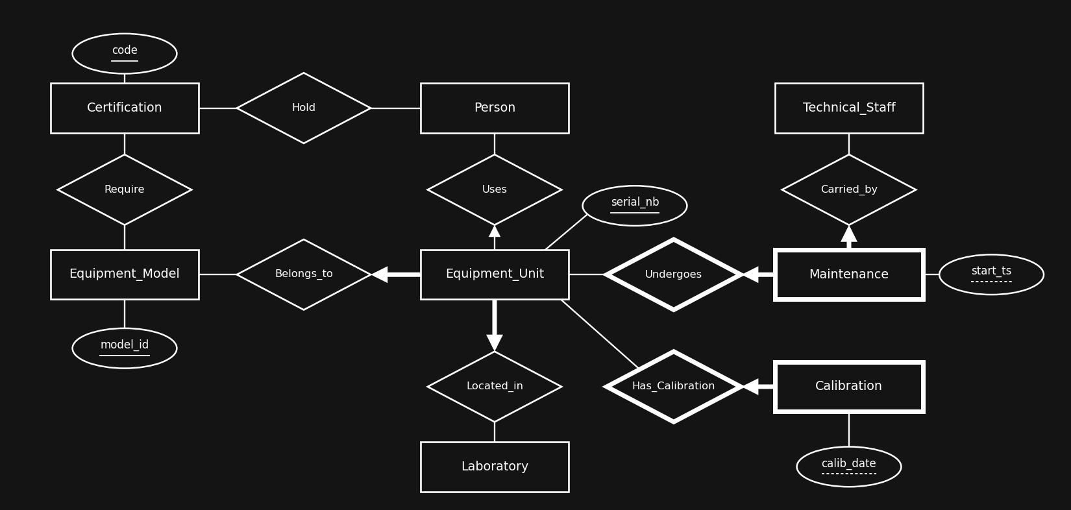
Calibration records
CA1–CA4
Notes:
Same pattern as maintenance: CA4 identifies a record by the unit plus the calibration date and CA3 makes Has_Calibration the identifying relationship.
The difference is on purpose. CA1 says calibration is routine and we do not need to know who did it, so Calibration has no Carried_by. Putting maintenance and calibration in one entity set would have lost that. Equipment_Unit is thin because only some units need calibration.

Slide 18
Part3 –
ER MODEL
EQ · CE · MA · CA
Notes:
Person, Laboratory and Technical_Staff come from part 1. Everything else belongs to this part.

Slide 19
Part 4— Laboratory Consumables and Supply Chain
CO1-CO10

Slide 20
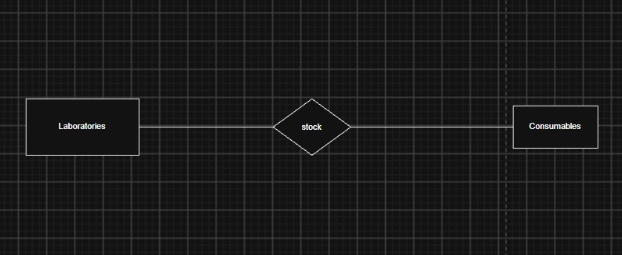
Making the consumable Entity and its relationship with Laboratory

Slide 21
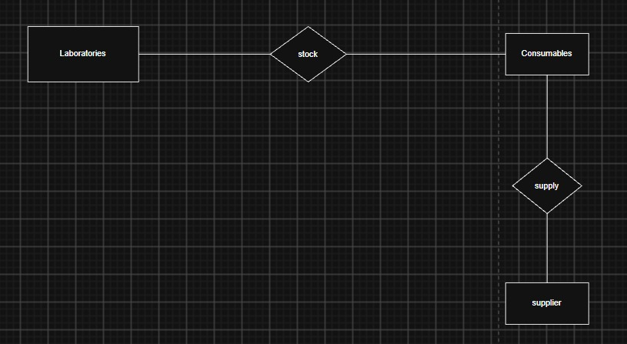
Creating the supplier entity :

Slide 22
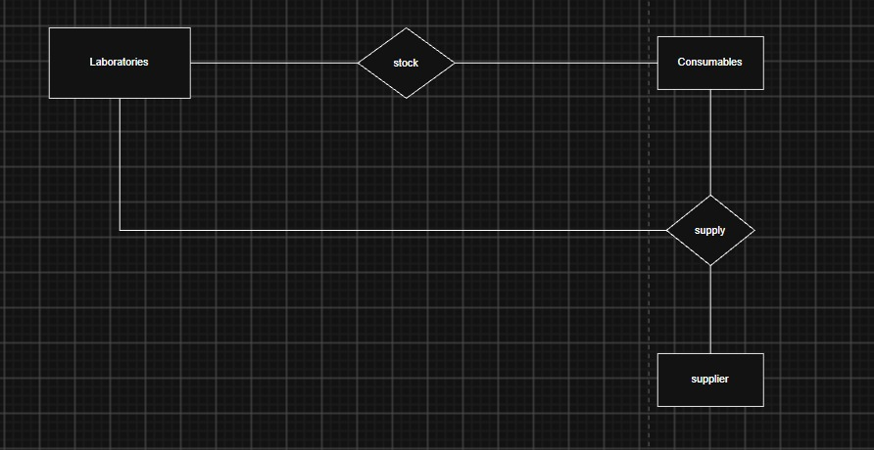
Making the ternary relationship

Slide 23
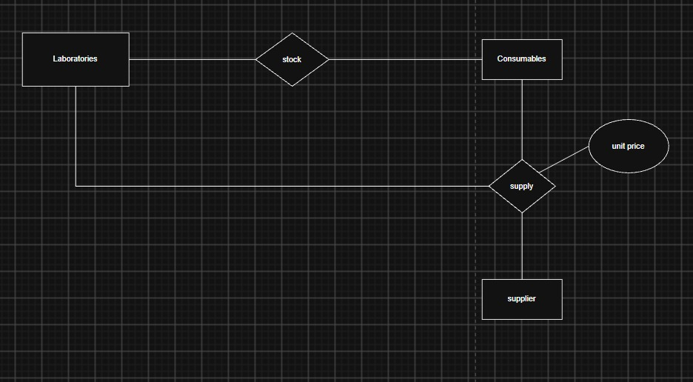
Making the negotiated unit price as an attribute to supplies

Slide 24
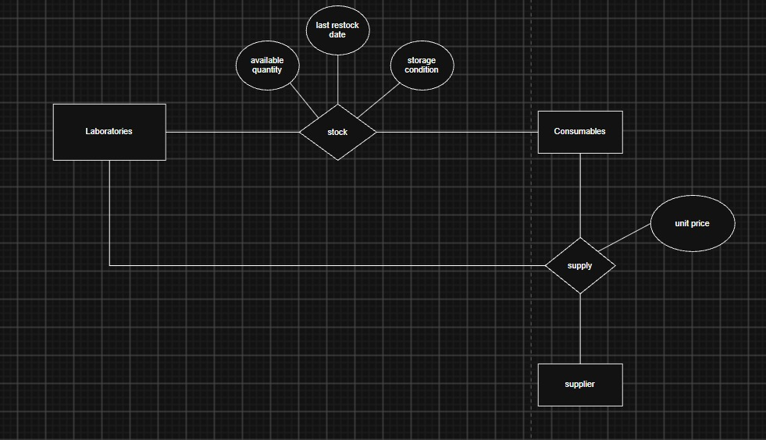
Making attributes associated with Stock

Slide 25
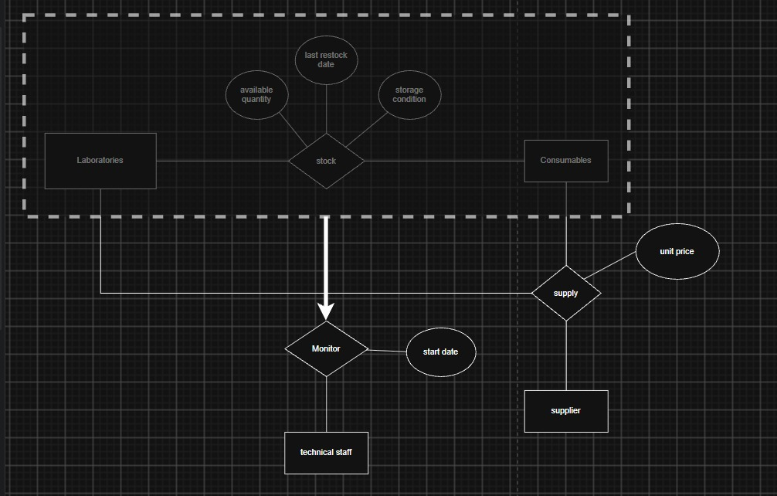
Aggregation so that Technical Staff can monitor the aggregated stock entity

Slide 26
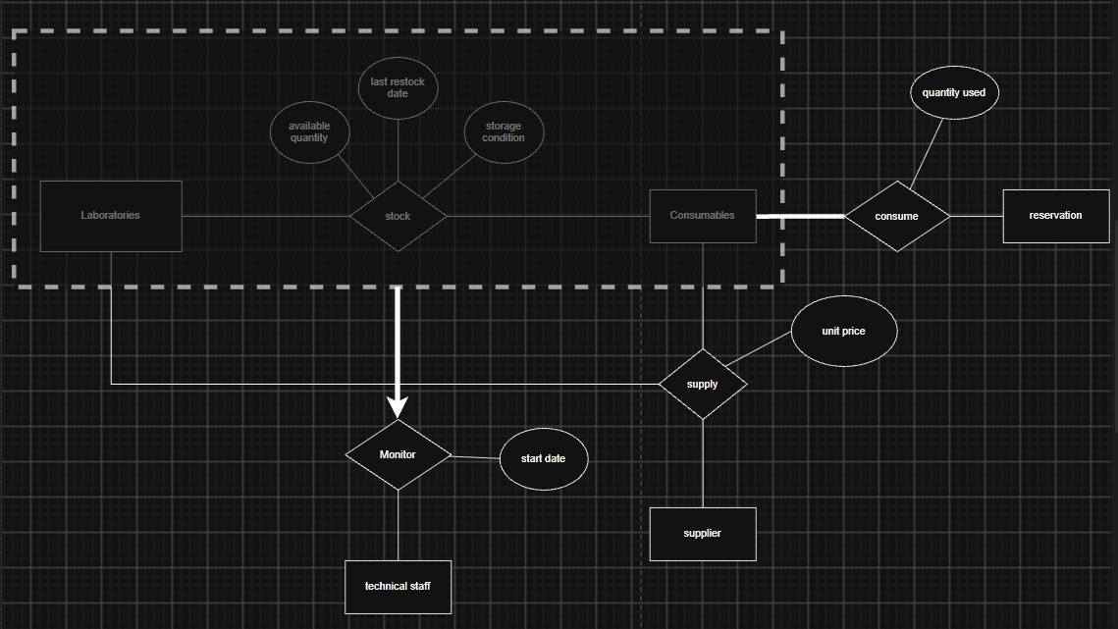
Creating the relationship Consume between reservation and consumable and its attribute

Slide 27
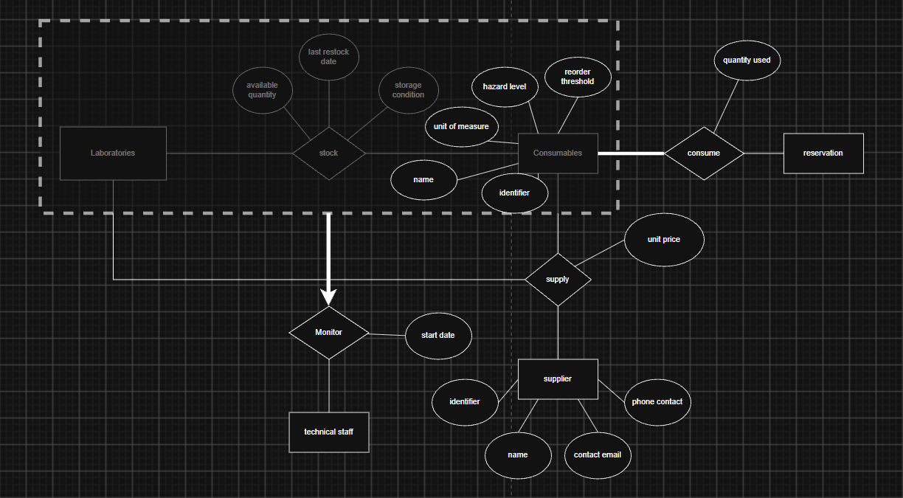
Part4 : ER MODEL
CO1-CO11

Slide 28
Part 5 — Attributes
Entities with their attributes

Slide 29
Attributes — Person and Laboratory
Person
person_id | identifier, key
first_name | text
last_name | text
email | text
affiliation | text
start_date | date
end_date | date, optional
Laboratory
lab_id | identifier, key
name | text
building | text
room_nb | text
discipline | research area
Subclasses: Student adds program (BSc, BEng, MSc, PhD) from PE3, Employee adds phone and office_space from PE4. The leaf subclasses add nothing of their own, they only say which position the employee holds. None of the four relationship sets of part 1 has attributes.

Slide 30
Attributes — Research Project and Participation
Research_Project
project_code | identifier, key
title | text
start_date | date
end_date | date
status | Proposed, Active, Suspended, Completed, Cancelled
Participates_in (Research_Project – Person)
role | PI, Co-PI, Collaborator
Subclasses: Academic_Staff, from part 1, supplies the PI and the Co-PI and adds nothing of its own. Participates_in is the only relationship set of this part with an attribute, and a person plays exactly one role in each project.

Slide 31
Attributes — Budget and Reservation
Budget
budgetary_line | identifier, key
granted_amount | money amount
disbursed_amount | money amount
start_date | date
end_date | date
Reservation
reservation_id | identifier, key
submission_ts | timestamp
planned_start_ts | timestamp
planned_end_ts | timestamp
purpose | text
status | Pending, Approved, Rejected, Cancelled, Completed
Subclasses: Approver, a person designated by the dean, adds nothing of its own. None of the relationship sets of these two parts (Manages, Funds_Project, Funds_Lab, and the reservation links to person, project, equipment unit and approver) has attributes.

Slide 32
Attributes — Equipment
Equipment_Model
model_id | identifier, key
commercial_name | text
manufacturer | text
category | text
required_environment | fume hood, 4 °C, ...
training_mandatory | boolean
Equipment_Unit
serial_nb | identifier, key
acquisition_date | date
purchase_cost | decimal
op_status | InService / UnderMaintenance / OutOfService / Retired
is_portable | Portable / Fixed (EQ6)
Why is_portable is an attribute and not an ISA: portable and fixed units have no attributes of their own and take part in exactly the same relationships, so the two subclasses would have been empty.

Slide 33
Attributes — Certification and Hold
Certification
code | identifier, key
title | text
issuing_authority | text
validity_period | duration in months
safety_level | ordinal
Hold (relationship set)
issue_date | date
expiration_date | date
grade | text, optional (CE4)
 | one instance per (Person, Certification) pair
Why these three sit on Hold: they describe the moment the certification was awarded, not the person and not the certificate type. CE5 then follows on its own, a relationship set cannot hold two instances for the same pair. Require, Belongs_to, Located_in and Uses have no attributes.

Slide 34
Attributes — Maintenance and Calibration
Maintenance (weak)
start_ts | partial key (MA2)
end_ts | timestamp
type | Preventive / Corrective
description | text
cost | decimal
outcome | Resolved / FollowUpRequired
Calibration (weak)
calib_date | partial key (CA4)
calib_type | text
result | Pass / Fail / Adjusted
next_due_date | date
remarks | text, optional
Full identifiers: serial_nb + start_ts for a maintenance, serial_nb + calib_date for a calibration. Neither partial key is unique on its own, which is why both are drawn with a dashed underline.

Slide 35
Attributes — Consumable and Supplier
Consumable
consumable_id | identifier, key
name | text
unit_of_measure | text
hazard_level | level
reorder_threshold | quantity, one value per consumable
Supplier
supplier_id | identifier, key
name | text
contact_email | text
phone_nb | text
Note: hazard_level and reorder_threshold hold one value per consumable and apply in every laboratory. The attributes that depend on a laboratory, a supplier or a reservation belong to the relationship sets on the next slide.

Slide 36
Attributes — Stock, Supply, Monitor and Consume
Stock (Laboratory – Consumable)
available_quantity | quantity
last_restock_date | date
storage_condition | text, optional
Supply (Supplier – Consumable – Laboratory)
unit_price | money amount, per combination
Monitor (Technical_Staff – Stock)
start_date | date
Consume (Reservation – Consumable)
quantity_used | quantity
Relationship sets: Stock links Laboratory and Consumable. Supply links Supplier, Consumable and Laboratory and may exist without stock. Monitor links one Technical_Staff member to each Stock pair, and Consume links Reservation and Consumable.

