Slide 1

PIZZA WORLD
WELCOME

Slide 2
INTRODUCTION/ABOUT PIZZA PRESENTATION
<numéro>

Slide 3

PIZZA
BASED IN ANGERS, PIZZA WORLD MAKES THE BEST PIZZAS IN THE WORLD
<numéro>

Slide 4
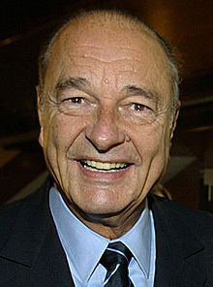


TEAM MEMBERS
DOMINIQUE DELAROCHE
Back office
SQL
JEROME
VINET
Back office
Javascript
He’s strong
TOM
BRUN
Front
Javascript
<numéro>

Slide 5
The Process
CONCEPT
Modeling of DATA
DESIGN
CODE
PUBLISH
5 steps to succeed
<numéro>

Slide 6
CONCEPT
<numéro>

Slide 7
THE CONCEPT
ONLINE PIZZA SITE
web interface with restricted access
Admin interface
Products list
Application developed in PHP and mysql
Customer order tracking
<numéro>

Slide 8
Modeling of Data
<numéro>

Slide 9
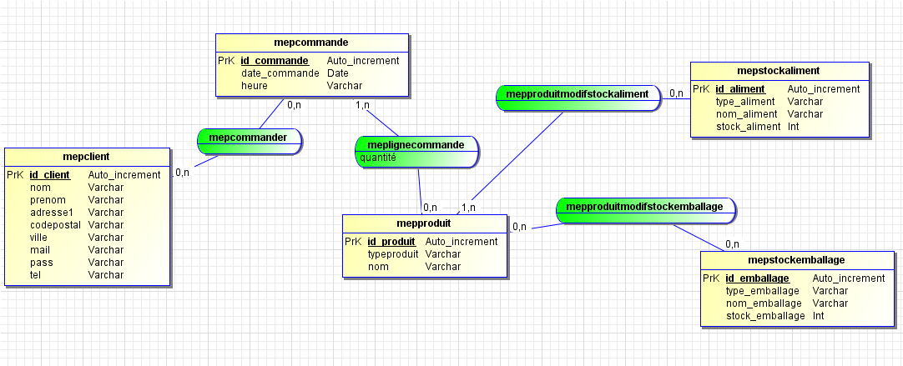
MCD
<numéro>

Slide 10
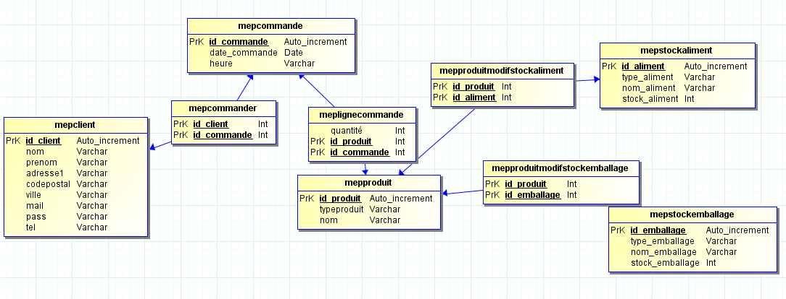
MLD
<numéro>

Slide 11
DESIGN
<numéro>

Slide 12

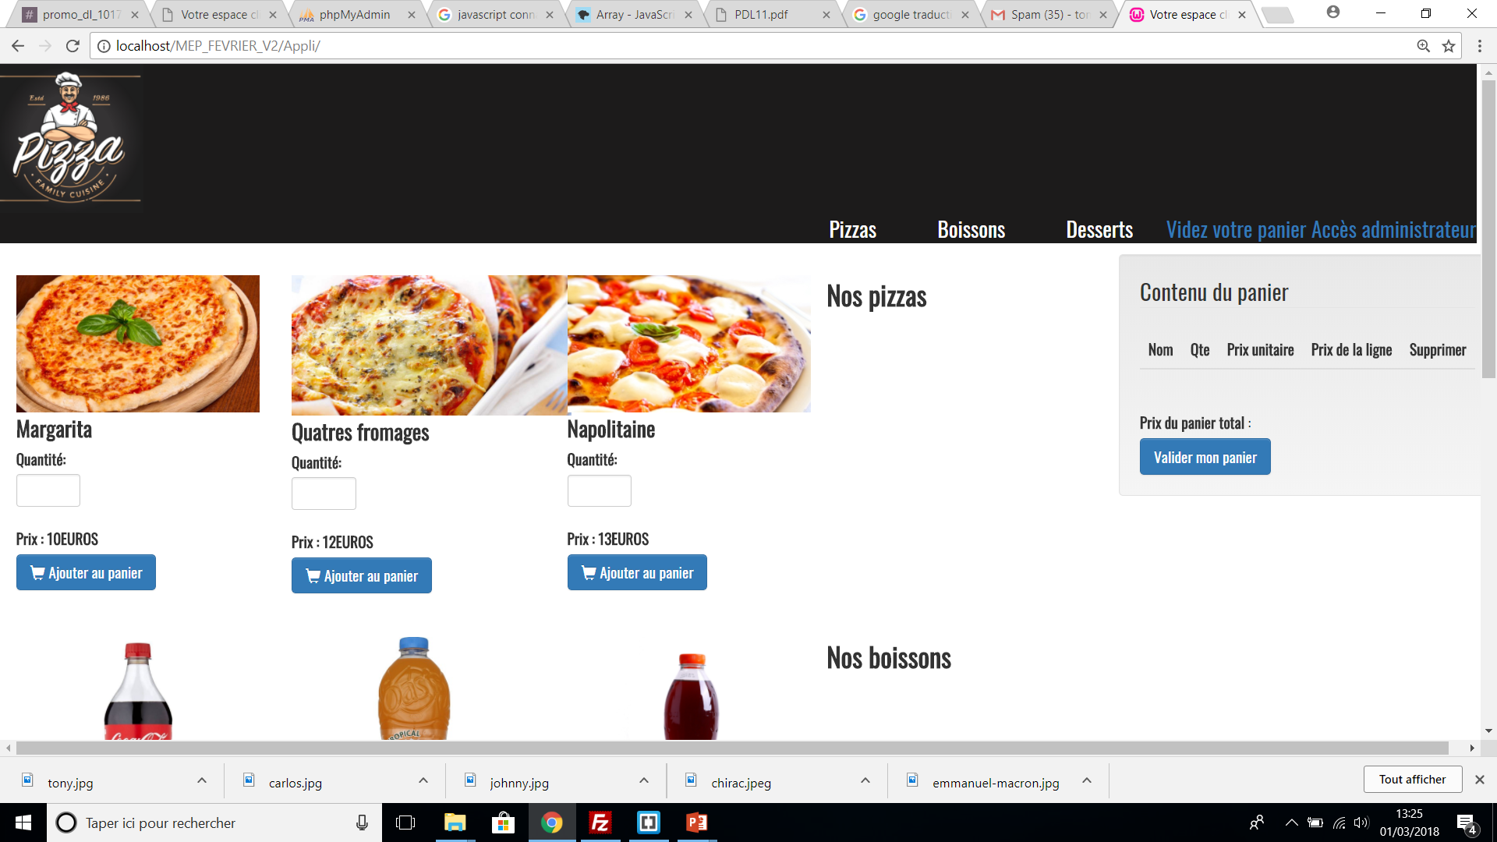
CLIENT
List of products
Pizzas-Drink-Dessert
Order Basket
Products-order amount
Fact sheet
Name-description-photo-price-amount
<numéro>

Slide 13

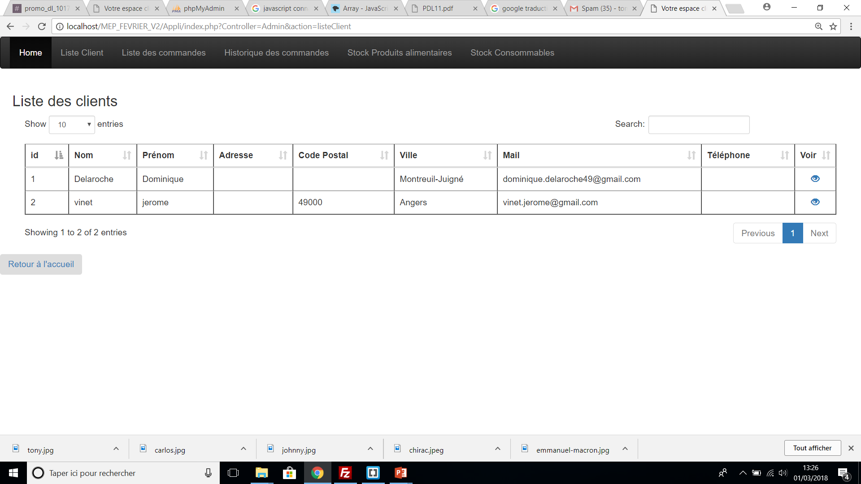
ADMIN
Customer management
View history order – Pending order – status order
Product management
View article reference
Stock management
Stock information
<numéro>

Slide 14
CODE
<numéro>

Slide 15
Pizza WORLD
GO TO BRACKETS
PHP
MySQL
JSON
JAVASCRIPT

Slide 16
PUBLISH
<numéro>

Slide 17
GO TO OUR WEBSITE

